Slide 1

Survival Analysis
Heart Disease-Stroke Prediction
By,
Team: Smart Learners
S. Sri Leha
T. Udaya Lakshmi
N. Sushma
S. Preethi
M. Eswari

Slide 2
Objectives
Use case: Heart Diseases
Symptoms
Causes & Prevention
About dataset- heart.csv
Steps for building model
Visualization
Choosing the Predictive Model
KNN Classification Model
Node Red Flow

Slide 3
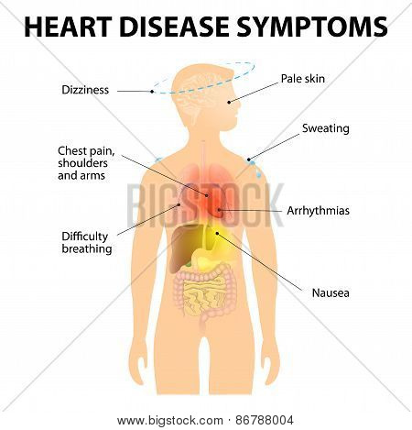
Symptoms of Heart Disease
Heart disease means that the heart is not working normally.
It generally refers to conditions that involve narrowed or blocked blood vessels that can lead to a heart attack, chest pain or stroke.

Slide 4
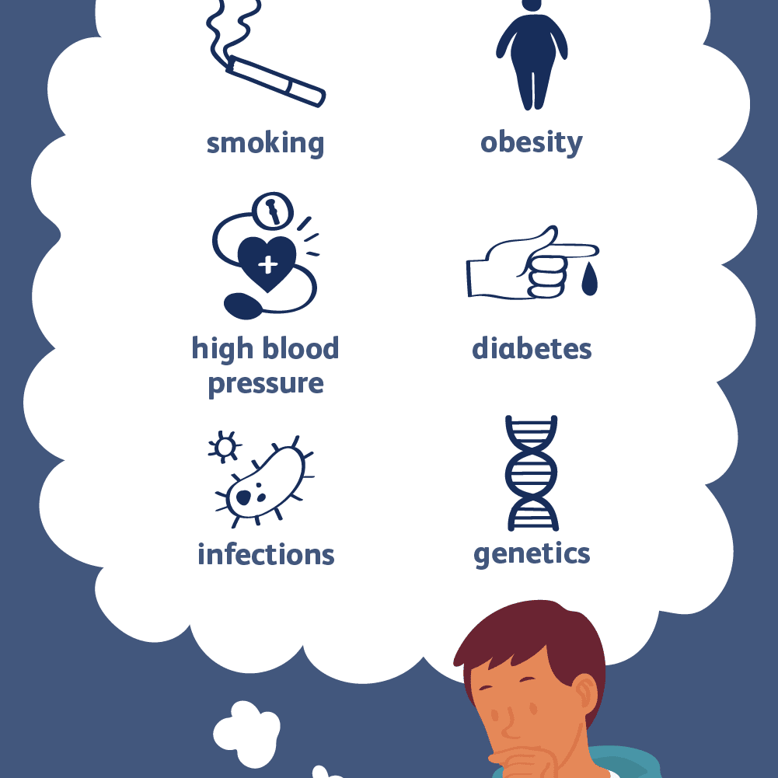

Causes & Prevention of Heart Disease

Slide 5
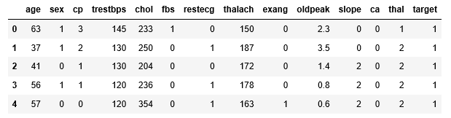
About the dataset
Data set – heart.csv (Heart Disease and Stroke Prediction)
Total Attributes – 14
Number of Instances – 303
Independent variable(X labels) - Age, Sex, CP, chol,fbs, thalach, exang, slope, thal
Dependent variable(Y label) - Target
Target:-diagnosis of heart disease (angiographic disease status) - Value 0: < 50% diameter narrowing - Value 1: > 50% diameter narrowing

Slide 6
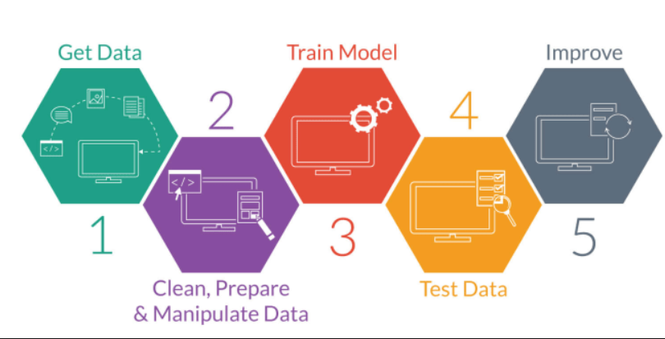
Steps for building model
Importing the libraries
Loading the Dataset
Removing the noisy data
Splitting the dataset into Training and Test sets
Feature Scaling
Fitting the model to the Training set
Predicting the test set results
Visualization of results

Slide 7
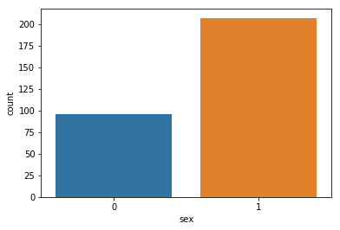
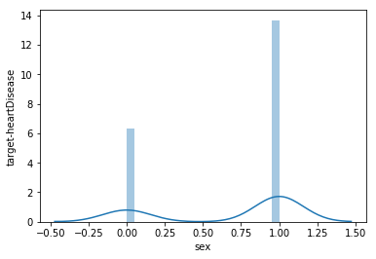
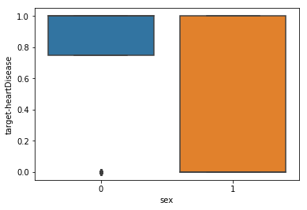
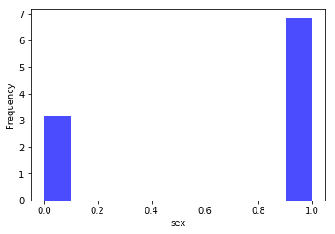
Visualization techniques
Attribute –Sex
distplot
countplot
boxplot
histogram

Slide 8
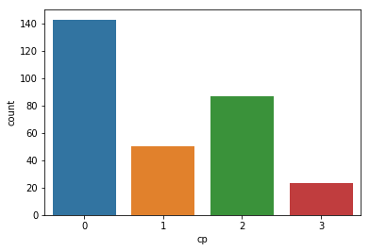
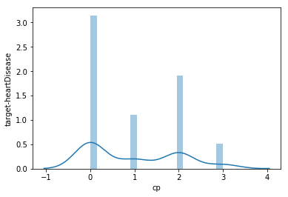
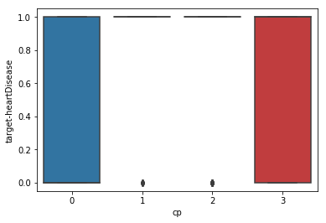
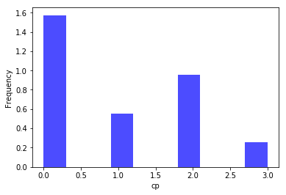
Visualization techniques
Attribute – Chest Pain
distplot
countplot
boxplot
histogram

Slide 9
Choosing the Predictive Model
Sno | Methods | Precision | Recall | F!_score | Support | Accuracy
1 | Navie Bayes | 0.71 | 0.71 | 0.71 | 76 | 0.71
2 | Decision Tree | 0.71 | 0.71 | 0.71 | 76 | 0.71
3 | KNN | 0.82 | 0.82 | 0.82 | 76 | 0.81
4 | Support Vector Machine | 0.76 | 0.76 | 0.76 | 76 | 0.76
5 | Support Vector Machine Kernel | 0.75 | 0.75 | 0.75 | 76 | 0.75
6 | Logistic Regression | 0.76 | 0.76 | 0.76 | 76 | 0.76
7 | Random Forest | 0.77 | 0.76 | 0.76 | 76 | 0.76

Slide 10
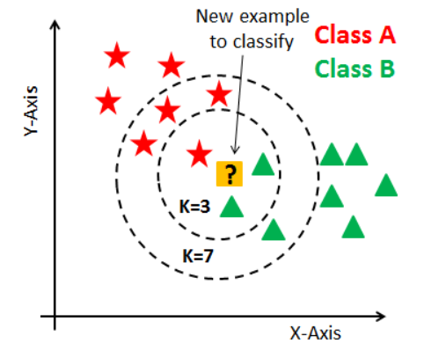
KNN – K Nearest Neighbours
Step 1: Choose k value of neighbors
Step 2: Take k nearest neighbors of new data point, according to Euclidean distance
Step 3: Among k neighbors, count the no. of data points in each category
Step 4: Assign new data point to the category where you counted most neighbors
Step 5: Model is ready

Slide 11
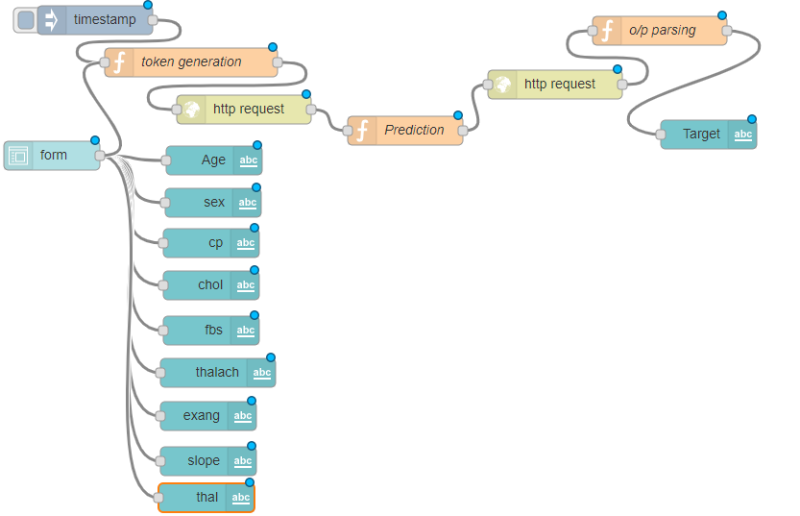
Node Red Flow
Node-RED is a programming tool for writing together hardware devices, APIs and online services in new and interesting ways.
Flow_url
UI_url

Slide 12
Thank You

