Slide 1
BANK CHURN MODELLING
Team Name:
Unique coders
Team Members:
Piniganti Krishna Vamsi
Sai Rahul Dodda
Prathipati Sai Naveen

Slide 2
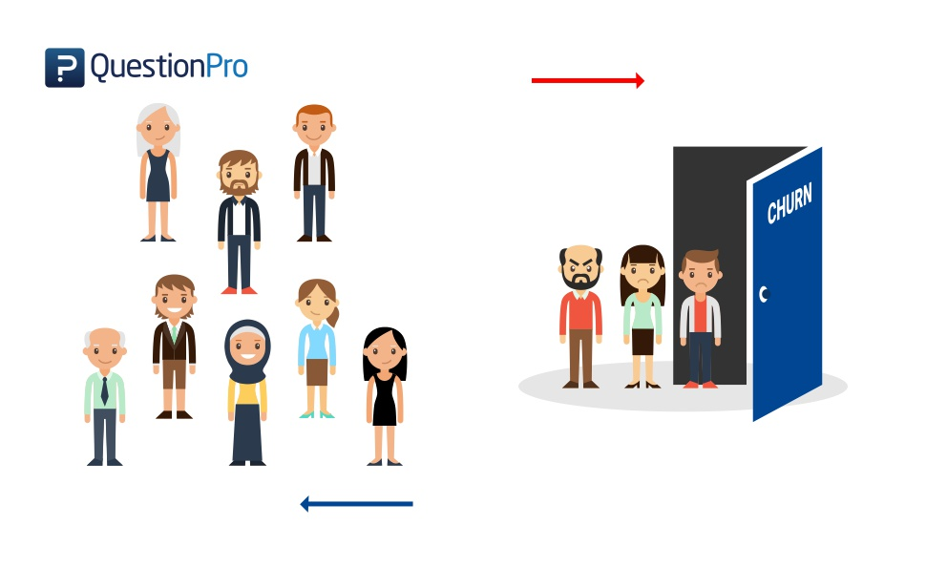
Churn occurs when a customer or user stops using a particular service. It is simply refered as loss of customers or clients.

Slide 3
What do we need to predict ?
We need to predict whether a customer exits or stays and uses the services of the bank
Why do we need to predict ?
We need to predict to know the status of the relationship between the customer and the bank

Slide 4
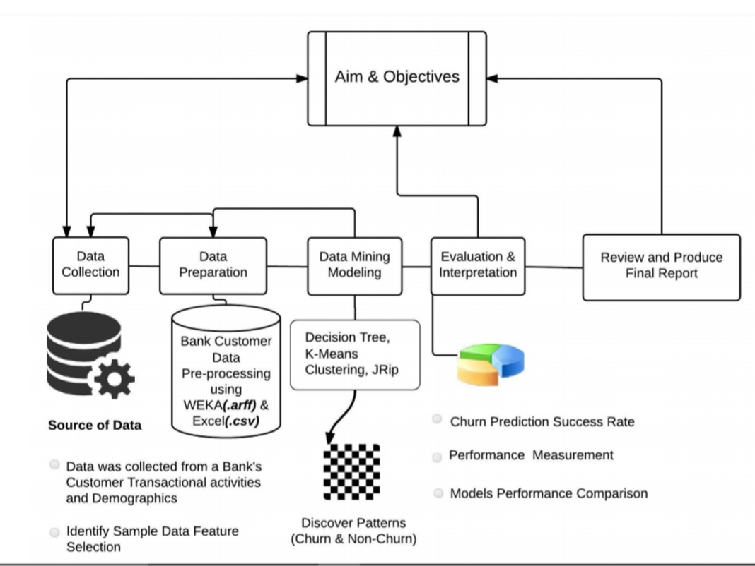

Slide 5
Exploratory Data Analysis
Our Dataset contains the following Attributes
RowNumber
CustomerId
Surname
CreditScore
Geography
Gender
Age
Tenure
Balance
NumOfProducts
HasCrCard
IsActiveMember
EstimatedSalary
Exited

Slide 6
Data pre-processing
Checking the null values
RowNumber 0
CustomerId 0
Surname 0
CreditScore 0
Geography 0
Gender 0
Age 0
Tenure 0
Balance 0
NumOfProducts 0
HasCrCard 0
IsActiveMember 0
EstimatedSalary 0
Exited 0
Drop the columns which doesn’t show any impact on our Target variable. i.e Row number , customerid, surname
Since this is a classification kind of problem everything needs to be in numerical values
→converting the Gender into 0 or 1 By using label encoder
→Geography which is a categorical variable can be converted by using one hot encoder

Slide 7
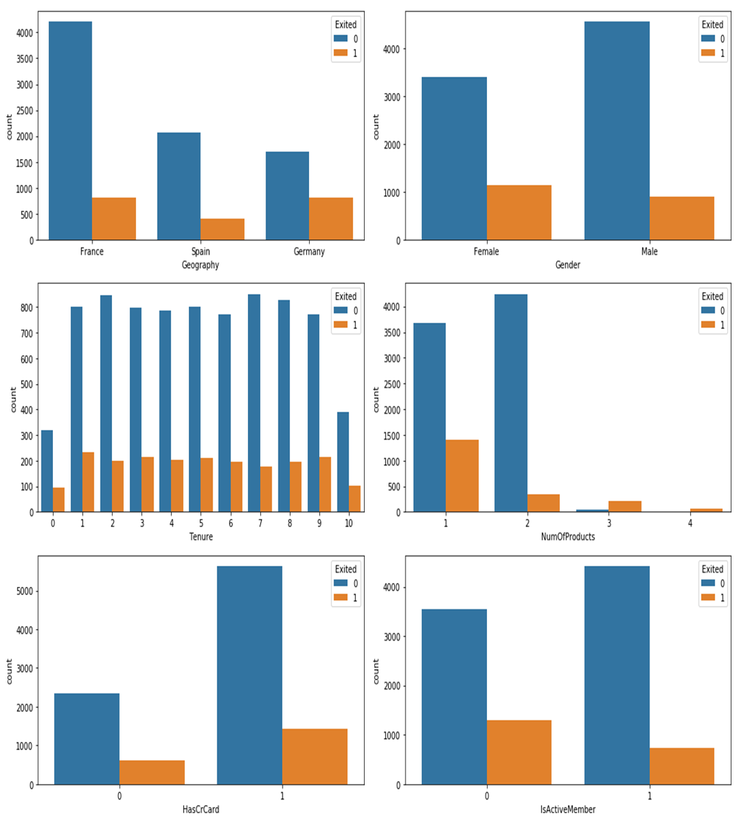
Data visualization

Slide 8
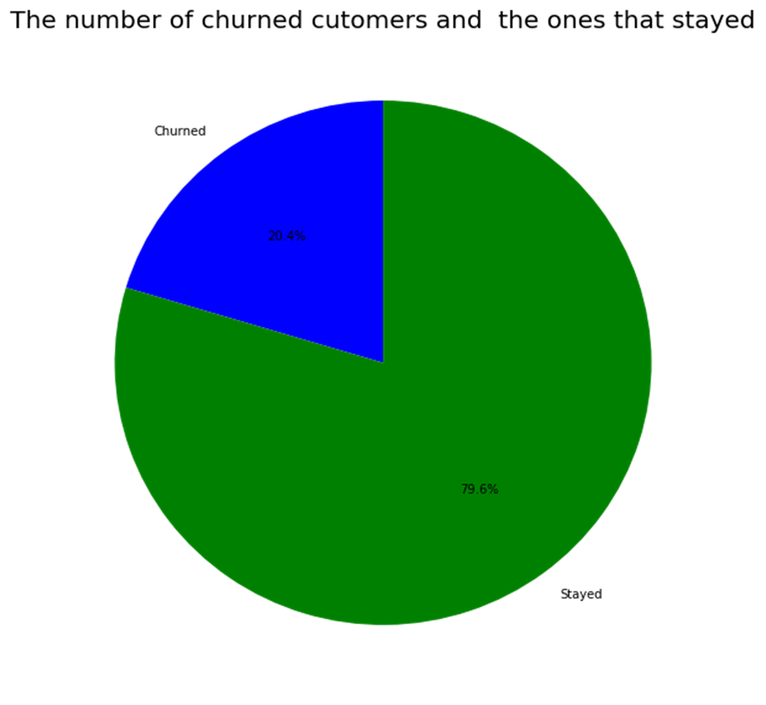
Churned
20.4%
Stayed
79.6%

Slide 9
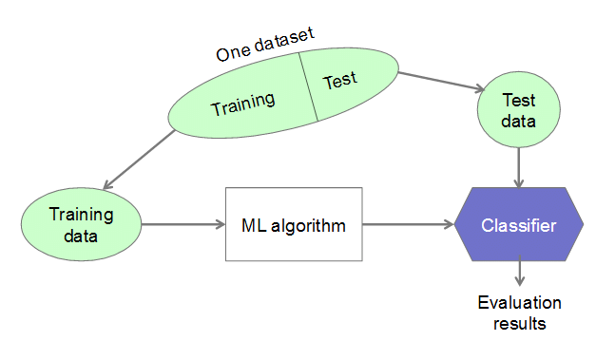
Training and Testing

Slide 10
Selecting the best algorithm
→We have applied different kind of the classification on our data and selected the one which gave us the best accuracy
Gaussian Naive bayes : 80.56 %
K-nearest neighbors : 76.84 %
Support vector classifier : 81.36 %
Decision tree classifier : 79.67999999999999 % Random Forest : 85.11999999999999 %
Logistic Regression : 80.56 %
→Here Random Forest is the one which Gave the best accuracy. Having an accuracy of 85% means that our model is good enough to predict whether the customer would like to churn or stays.

Slide 11
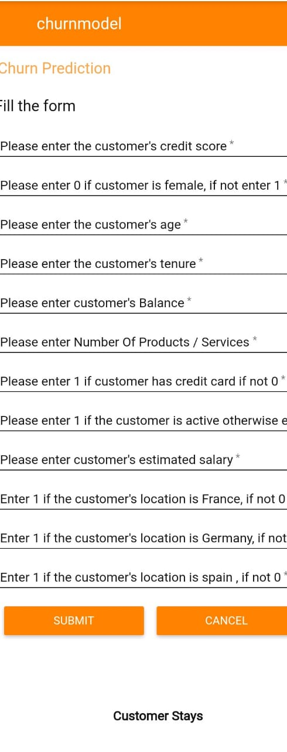
Final Phase after deployment
Creating the Dashboard UI using node-red

