Slide 1
PREDICTING TAXI FARES

Slide 2



Percentage of online cab booking system has been increasing rapidly from past 3 years

Slide 3
Aim:
The goal of this challenge is to predict the fare of a taxi trip by given information about the pickup and drop off locations, the pickup date time and number of passengers travelling.
In any analytics project ,80% of the time and effort is spent on data cleaning, exploratory analysis and deriving new features.
The data set given contains longitudes and latitudes as its pickup& dropoff-locations. Since,it is difficult to find distance in that format. So,we convert the distance into normal form by using the Haversine’s formula .

Slide 4
Data given:
Pickup longitude
Pickup latitude
Dropoff-longitude
Dropoff-latitude
Number of passengers
Pickup date&time
Previous fare amounts recorded.
The main target is to predict the fare_amount
So, It is taken as Target variable(Y) & input variables are taken in (X).

Slide 5
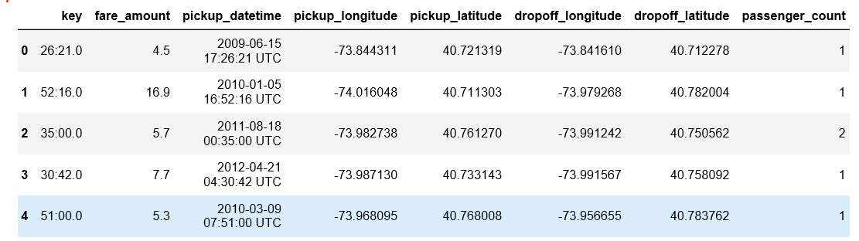
DATA:

Slide 6
Haversine Formula for Distance
This formula determines the great-circle distance between two points on a sphere given their longitudes and latitudes.
a = sin²(Δφ/2) + cos φ1 ⋅ cos φ2 ⋅ sin²(Δλ/2)
c = 2 ⋅ atan2( √a, √(1−a) )
d = R ⋅ c
#R = Radius of the earth

Slide 7
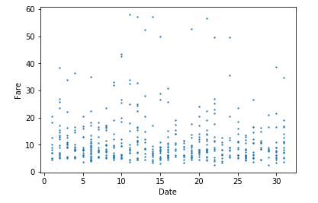
Pickup-dates VS Fare

Slide 8
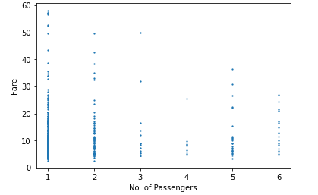
Number of passengers VS Fare

Slide 9
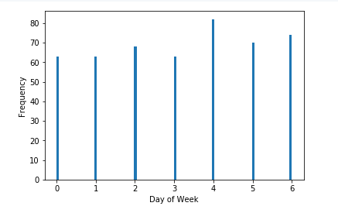
Day of the Week and Frequency of passengers

Slide 10
Choosing best ML Algorithm:
As it is a regression problem, we have three algorithms over here :
Multi-linear
Polynomial
Random Forest Regressor
The algorithm which gives the best r2_score value is chosen and used.

Slide 11
Reason to choose Random Forest Regression
Random Forest is a flexible, easy to use machine learning algorithm that produces, even without hyper-parameter tuning, a great result most of the time. It is also one of the most used algorithms, because it’s simplicity and the fact that it can be used for both classification and regression tasks. In this post, you are going to learn, how the random forest algorithm works and several other important things about it

Slide 12
Accuracy check
We used Random Forest Regression to check the accuracy . Random Forest Regressor is one of the regression model algorithm.
It has some advantages , It will be used in both the classification and regression.
In our project , It shows the accuracy of 84.3 %

Slide 13
Conclusion
Overall, our models for predicting taxi pickups in New York City performed well. The Random forest regression model performed best, likely due to its unique ability to capture complex feature dependencies. The decision tree regression model achieved a value of and 0.82 for r2_score. Our results and error analysis for the most part supported our. A model could be useful to city planners and taxi dispatchers in determining where to position taxicabs and studying patterns in ridership.

Slide 14
Thank you!!!!

