Slide 1
Project plan: the Riverside Community Kitchen
Project plan

Slide 2
This plan authorises the Riverside Community Kitchen.
The paper carries the charter, scope, work breakdown, schedule, cost, assignments and risks.
Notes:
This plan authorises the Riverside Community Kitchen. Its objective: Open a community kitchen that serves 200 meals a week. The sponsor is Riverside Trust. The declared budget is USD 48,000.00. The critical path runs 40 periods, with 3 critical activities. The plan carries the charter, scope, work breakdown, schedule, cost, assignments and risks; a record that is missing is named rather than guessed.

Slide 3
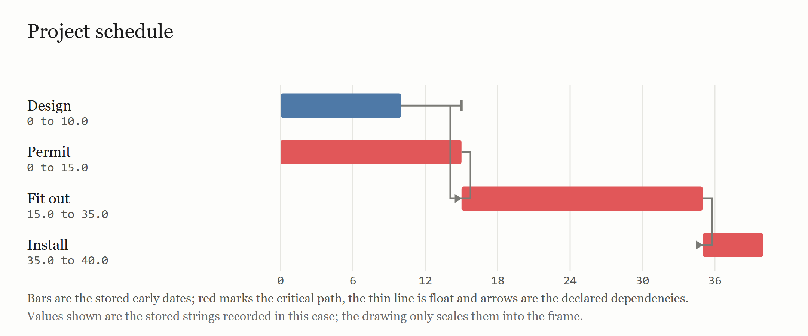
The critical path runs 40 periods over 4 activities.
Bars are the frozen schedule's stored early start and finish.
Notes:
The schedule carries 4 activities. The critical path runs 40 periods and carries 3 critical activities. Early and late dates and float are the frozen method's own values; an activity with float is not on the critical path.

Slide 4
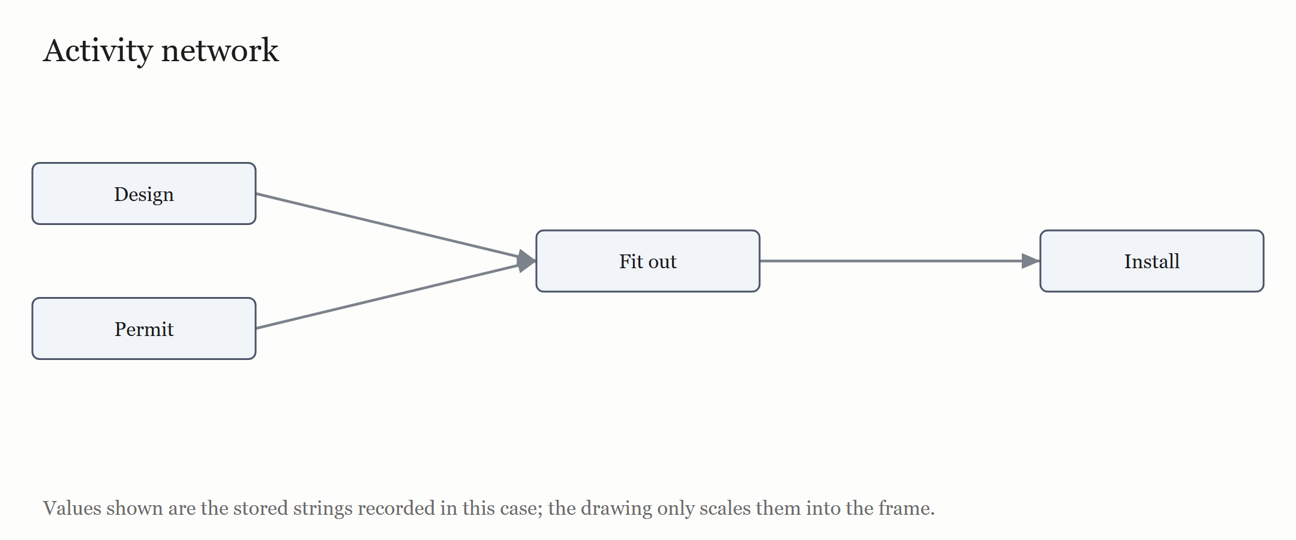
Activity network: the record declares 3 dependencies among 4 activities.
Boxes are the activities; arrows are the declared dependencies.

Slide 5
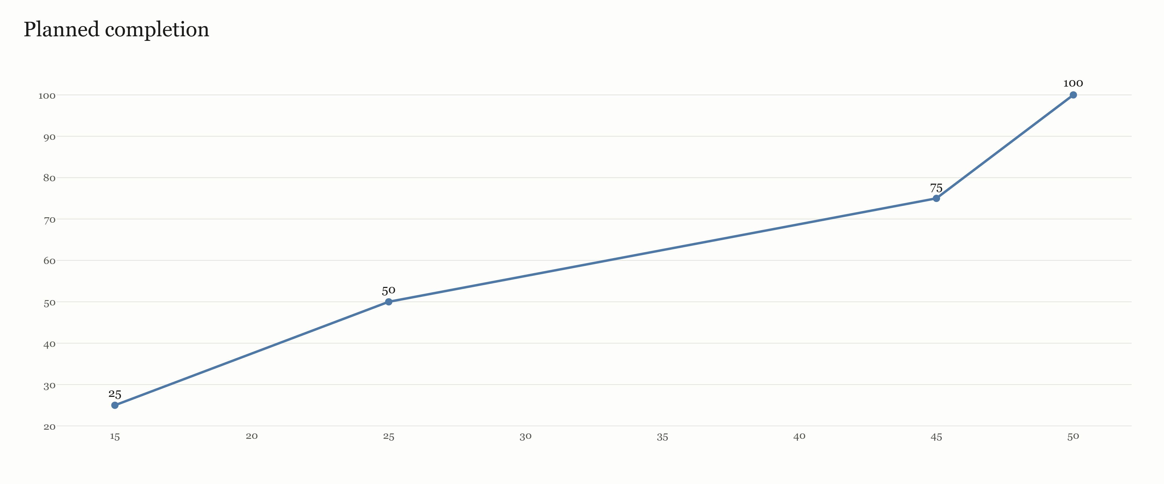
Planned completion: the stored finishes place 4 activities over 50 periods.
The curve is the cumulative per cent of activities finished: it is progress, not cost.

Slide 6
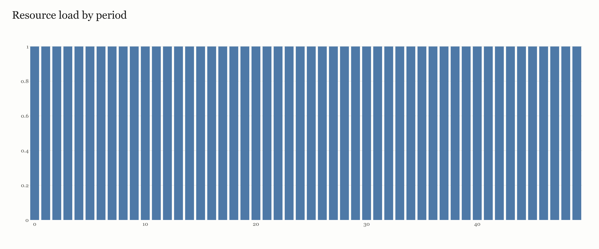
Resource load: declared demand sums to 1 in the busiest period after levelling.
Bars are the declared demand per period after levelling; capacities stay per resource.

Slide 7
The WBS carries 4 nodes and 4 work packages.
ID | Work package | Owner | Cost | Acceptance
A1 | Design the kitchen | Architect | USD 6,000.00 | Drawings signed
A2 | Apply for the permit | Project manager | USD 2,000.00 | Permit issued
A3 | Fit out the kitchen | Builder | USD 30,000.00 | Handover signed
A4 | Install equipment | Supplier | USD 10,000.00 | Equipment commissioned
Notes:
The WBS carries 4 nodes and 4 work packages. Each work package states an owner, a cost and the test that shows it is complete; the parent nodes carry the roll-up.

Slide 8
The schedule carries 4 activities.
ID | Activity | Duration | ES | EF | LS | LF | Float | Critical
A1 | Design | 10.0 | 0 | 10.0 | 5.0 | 15.0 | 5.0 | no
A2 | Permit | 15.0 | 0 | 15.0 | 0.0 | 15.0 | 0.0 | yes
A3 | Fit out | 20.0 | 15.0 | 35.0 | 15.0 | 35.0 | 0.0 | yes
A4 | Install | 5.0 | 35.0 | 40.0 | 35.0 | 40.0 | 0.0 | yes
Notes:
The schedule carries 4 activities. The critical path runs 40 periods and carries 3 critical activities. Early and late dates and float are the frozen method's own values; an activity with float is not on the critical path.

Slide 9
Dates count one declared period as one working day, Monday to Friday, from the declared start date of 2026-01-05.
ID | Activity | Start | Finish | Working days
A1 | Design | 2026-01-05 | 2026-01-16 | 12
A2 | Permit | 2026-01-05 | 2026-01-23 | 19
A3 | Fit out | 2026-01-26 | 2026-02-20 | 26
A4 | Install | 2026-02-23 | 2026-02-27 | 5
Notes:
Dates count one declared period as one working day, Monday to Friday, from the declared start date of 2026-01-05. A finish is the last working day of the activity; weekends are a gap and no holiday is inferred.

Slide 10
The frozen resource-levelling method orders activities by early start, then longest duration, then id, and delays an activity until its declared resource has capacity.
ID | Activity | Levelled start | Levelled finish | Delay
A1 | Design | 15 | 25 | 15
A2 | Permit | 0 | 15 | 0
A3 | Fit out | 25 | 45 | 10
A4 | Install | 45 | 50 | 10
Notes:
The frozen resource-levelling method orders activities by early start, then longest duration, then id, and delays an activity until its declared resource has capacity. It adds 10 periods, so the plan finishes in 50 periods against 40 without resource limits. 10 periods were over capacity before levelling and 0 after; the peak demand was 2 before and 1 after.

Slide 11
The WBS rolls 4 nodes up to a total of USD 48,000.00.
ID | Item | Cost
A1 | Design the kitchen | USD 6,000.00
A2 | Apply for the permit | USD 2,000.00
A3 | Fit out the kitchen | USD 30,000.00
A4 | Install equipment | USD 10,000.00
 | Total | USD 48,000.00
Notes:
The WBS rolls 4 nodes up to a total of USD 48,000.00. The declared budget is USD 48,000.00; the variance is USD 0.00. Cost is carried by the work package, not by the activity; no estimate is added where the record declares none.

Slide 12
The matrix names, for every activity, the roles the record declares as responsible and accountable, and the consulted or informed roles it states.
Activity | Name | Design | Management | Build | Equipment
A1 | Design | R | A
A2 | Permit |  | A
A3 | Fit out |  | A | R
A4 | Install |  | A |  | R
Notes:
The matrix names, for every activity, the roles the record declares as responsible and accountable, and the consulted or informed roles it states.

Slide 13
The register carries 1 risk.
ID | Risk | Likelihood | Impact | Response | Owner
R1 | Permit delay | Medium | High | Apply early | Project manager
Notes:
The register carries 1 risk. Likelihood and impact are labels, not probabilities, and each risk states a response and an owner. No risk score or expected loss is computed.

Slide 14
City Health Department (2025). Community Kitchen Guidelines.
Ministry of Health (2024). Food Safety Code.
The last 2 sources above were declared in the brief; the product neither fetched nor verified them.
The references the paper lists, in the paper's citation style.

