Slide 1
Project plan: the Riverside Community Kitchen
Project plan

Slide 2
This plan authorises the Riverside Community Kitchen.
The paper carries the charter, scope, work breakdown, schedule, cost, assignments and risks.

Slide 3
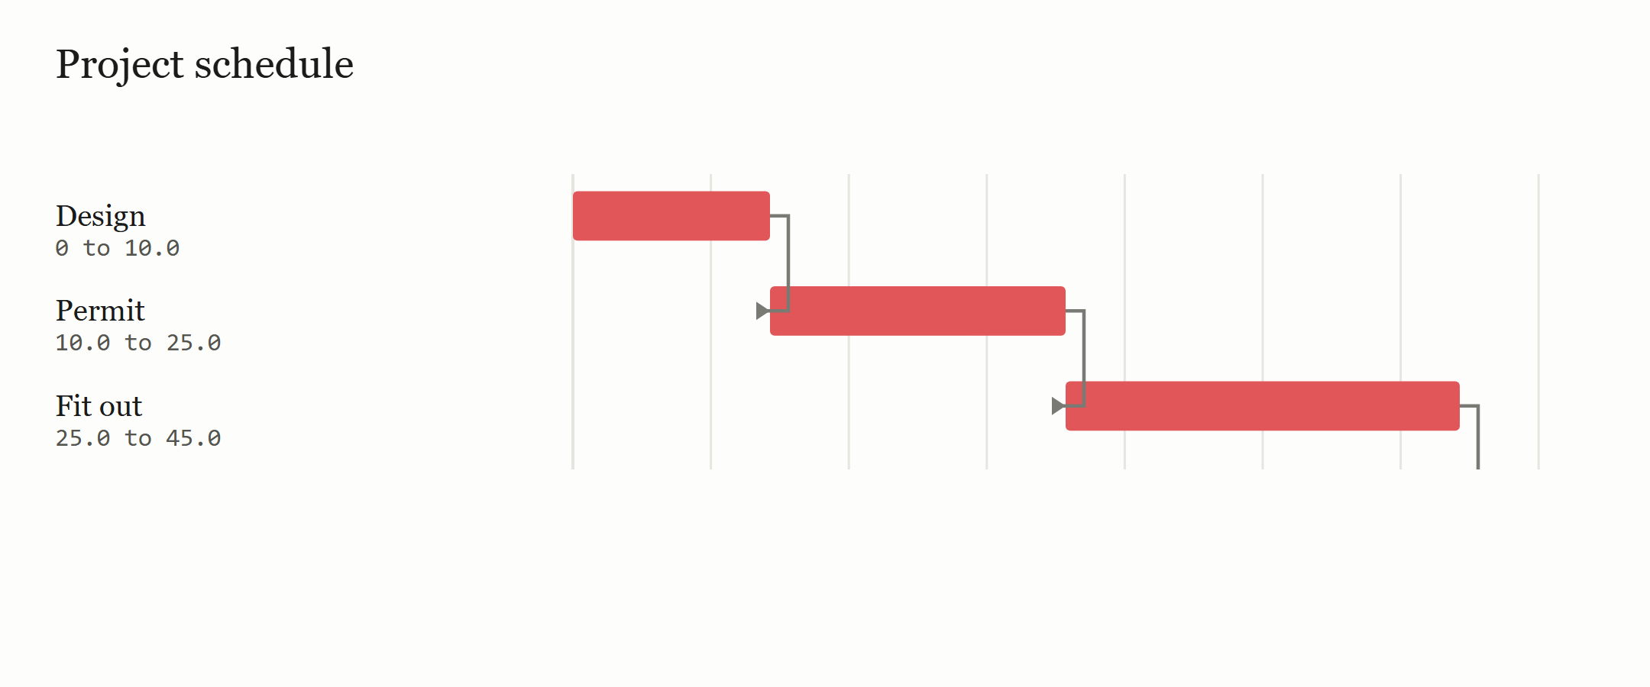
The critical path runs 50 periods over 4 activities.
Bars are the frozen schedule's stored early start and finish.

Slide 4
The WBS carries 4 nodes and 4 work packages.
ID | Work package | Owner | Cost | Acceptance
A1 | Design the kitchen | Architect | USD 6,000.00 | Drawings signed
A2 | Apply for the permit | Project manager | USD 2,000.00 | Permit issued
A3 | Fit out the kitchen | Builder | USD 30,000.00 | Handover signed
A4 | Install equipment | Supplier | USD 10,000.00 | Equipment commissioned

Slide 5
The schedule carries 4 activities.
ID | Activity | Duration | ES | EF | LS | LF | Float | Critical
A1 | Design | 10.0 | 0 | 10.0 | 0.0 | 10.0 | 0.0 | yes
A2 | Permit | 15.0 | 10.0 | 25.0 | 10.0 | 25.0 | 0.0 | yes
A3 | Fit out | 20.0 | 25.0 | 45.0 | 25.0 | 45.0 | 0.0 | yes
A4 | Install | 5.0 | 45.0 | 50.0 | 45.0 | 50.0 | 0.0 | yes

Slide 6
The WBS rolls 4 nodes up to a total of USD 48,000.00.
ID | Item | Cost
A1 | Design the kitchen | USD 6,000.00
A2 | Apply for the permit | USD 2,000.00
A3 | Fit out the kitchen | USD 30,000.00
A4 | Install equipment | USD 10,000.00
 | Total | USD 48,000.00

Slide 7
The matrix names, for every activity, the roles the record declares as responsible and accountable, and the consulted or informed roles it states.
Activity | Name | Design | Management | Build | Equipment
A1 | Design | R | A
A2 | Permit |  | A
A3 | Fit out |  | A | R
A4 | Install |  | A |  | R

Slide 8
The register carries 1 risk.
ID | Risk | Likelihood | Impact | Response | Owner
R1 | Permit delay | Medium | High | Apply early | Project manager

