Slide 1
Arq .Net Valladolid
Chat con SignalR y
.Net Core
Óscar Vicente Pérez
Github: @smartcodinghub

Slide 2
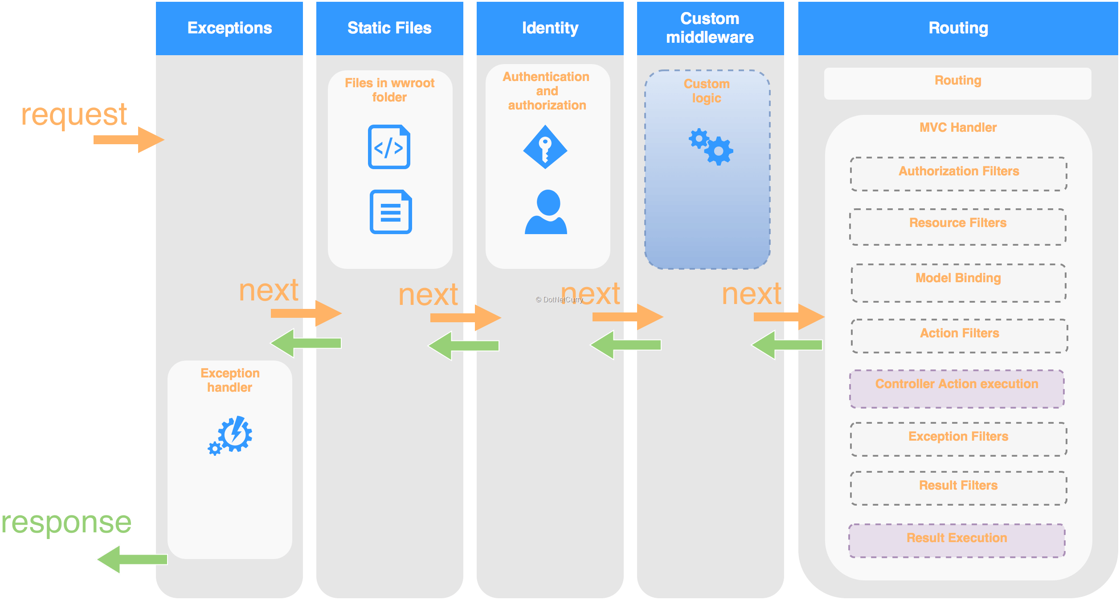
.Net Core: Empezando de cero

Slide 3

SignalR: Funcionamiento
Hub method: Send
Pusblish: Send
Web Client
Hub
Open Connection
Hub
Client
connection.invoke(‘Send’, msg)
Publish: Received
Subscribe: Received
Web Client
Hub
Open Connection
Hub
Client
Clients.Client(connectionId).Send(msg)

