Slide 1

Internet System
Multimedia Networking
P. Bakowski
bako@ieee.org

Slide 2
Multimedia networking applications
streaming stored audio and video
streaming live audio and video
real-time interactive audio and video
delay sensitive
loss-tolerant

Slide 3
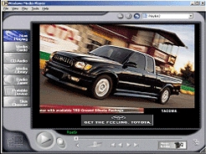
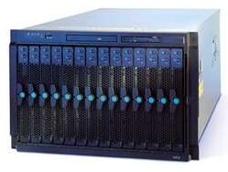
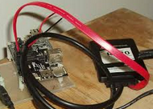
Multimedia networking applications
streaming stored audio and video
stored media
video server rack
streaming
continuous playout

Slide 4
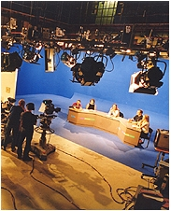
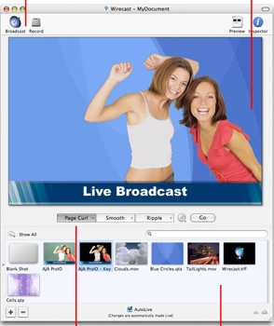
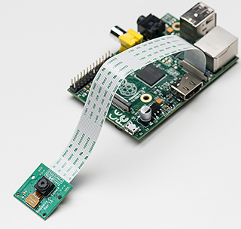
Multimedia networking applications
streaming live audio and video
media not stored
multiple streams
broadcasting

Slide 5
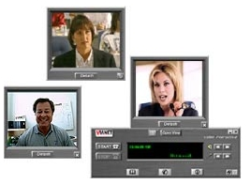
Multimedia networking applications
real-time interactive audio and video
no stored media
strong real-time constraints
multicasting

Slide 6


Internet evolution
more bandwidth and switching capacity
routing
switching

Slide 7
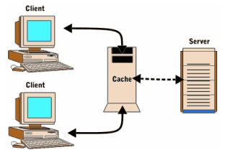
Internet evolution
more bandwidth and switching capacity
content distribution by replication and caching

Slide 8

Internet evolution
more bandwidth and switching capacity
content distribution by replication and caching
multicast overlay networks
multicast routers

Slide 9
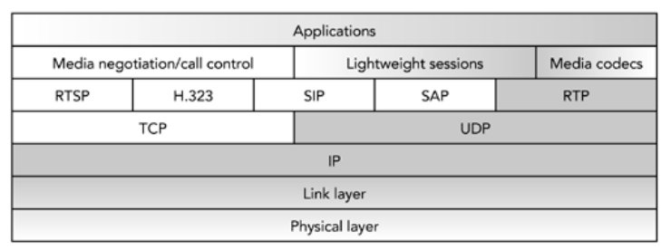
Multimedia protocol stack
RTP and RTCP

Slide 10
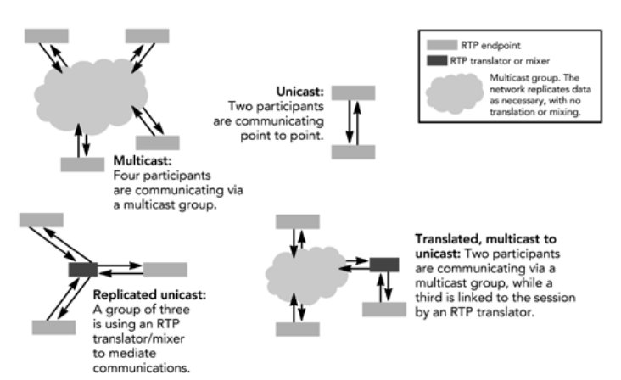
RTP session types
RTP and RTCP

Slide 11
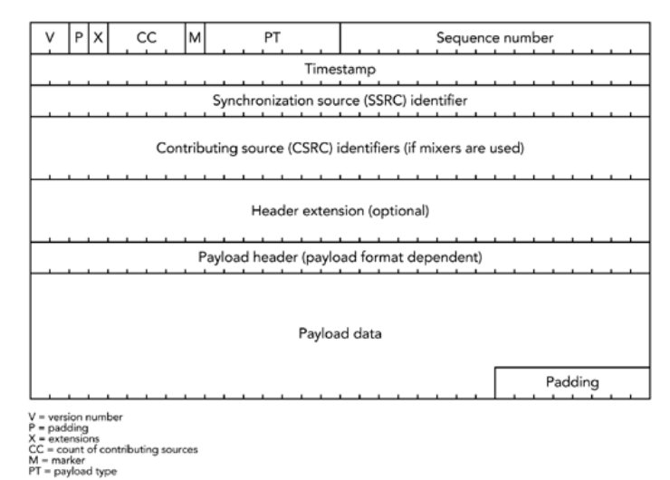
RTP packet

Slide 12
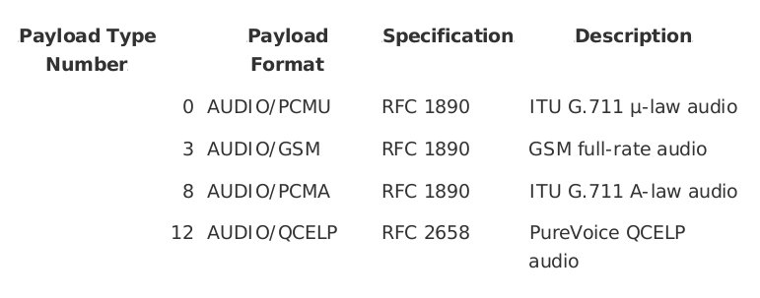
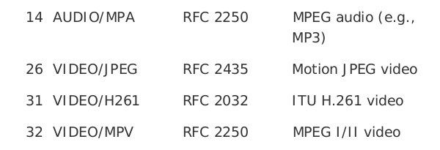
RTP packet : payload type
96 to 127 – dynamic (includes H264)

Slide 13
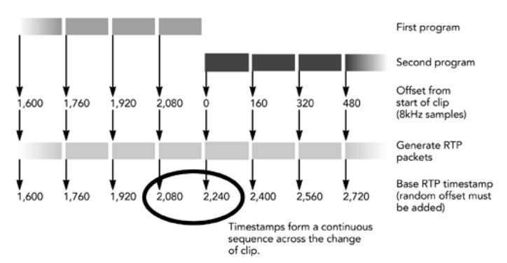
RTP packet : timestamp
audio
20 ms * 8000 1/s => 160 (timestamp distance)
reference – media clock audio (8kHz), video (96KHz)

Slide 14
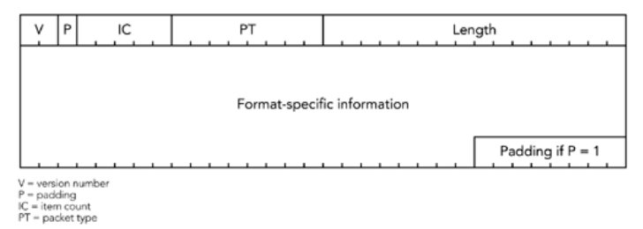
RTCP packet

Slide 15
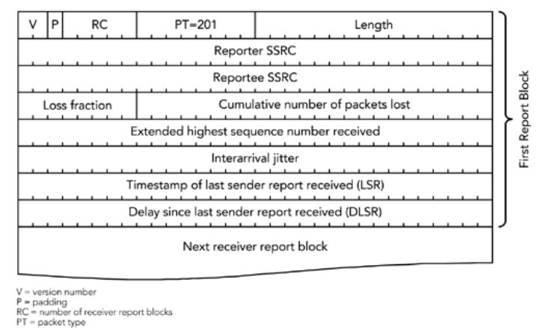
RTCP packet: receiver report

Slide 16
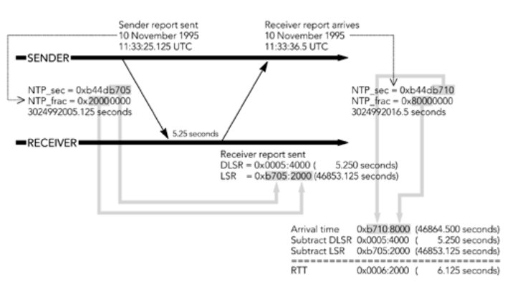
RTT time computation
NTP – Network Time Protocol – data on 64 bits 0xb44db705 - seconds 0x20000000 - fraction of second

Slide 17
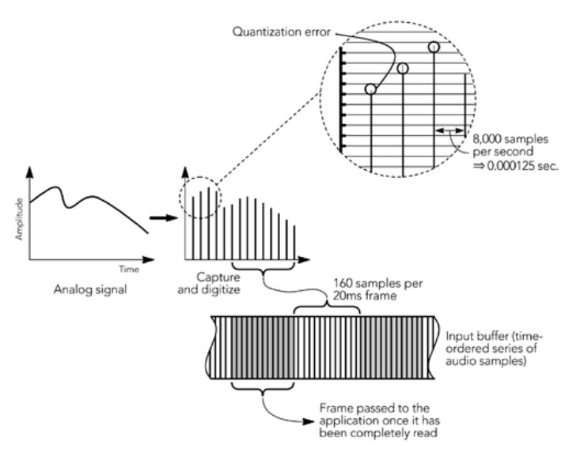
Audio capture
analog signal
time

Slide 18
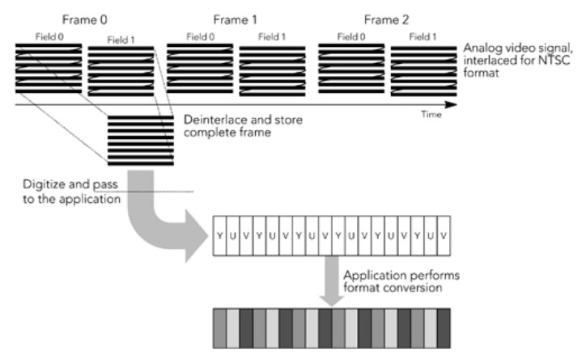
Video capture

Slide 19
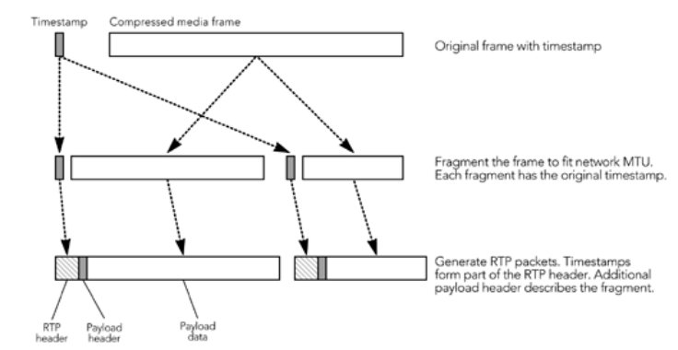
Media frames & packets

Slide 20
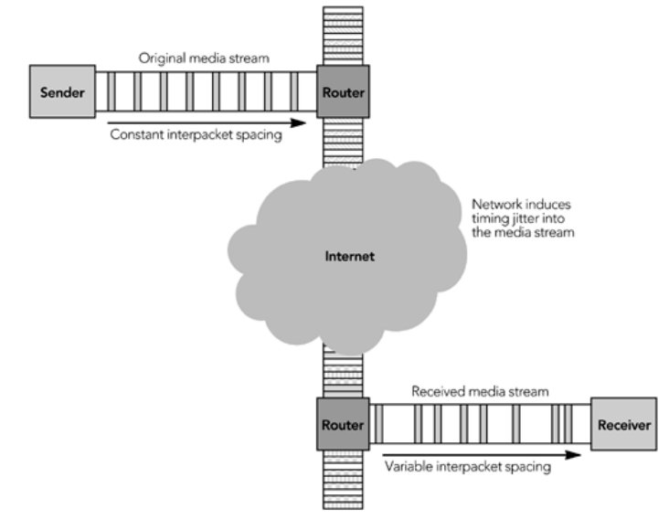
Packet timing - disruption

Slide 21
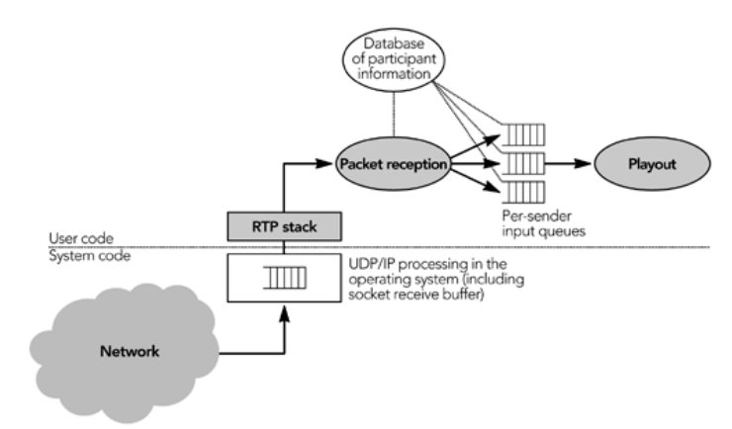
Packet reception & play-out

Slide 22
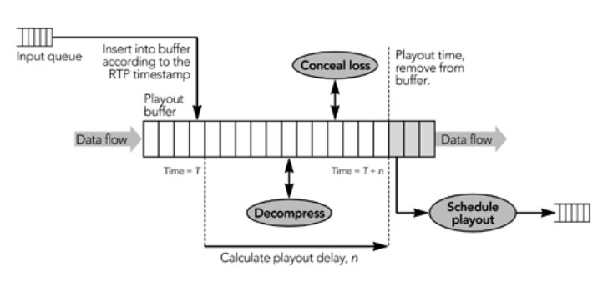
Play-out buffer

Slide 23
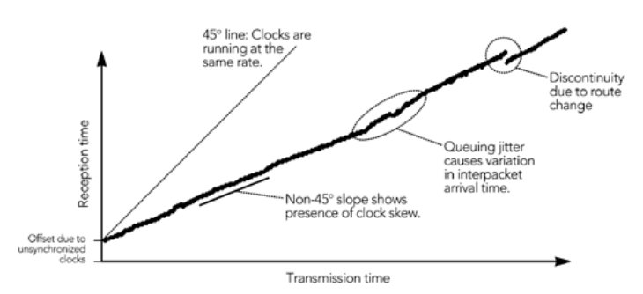
Play-out clock skew

Slide 24
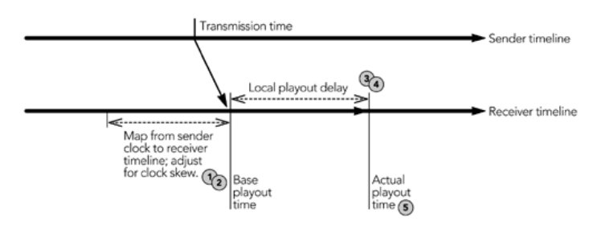
Play-out time calculation

Slide 25
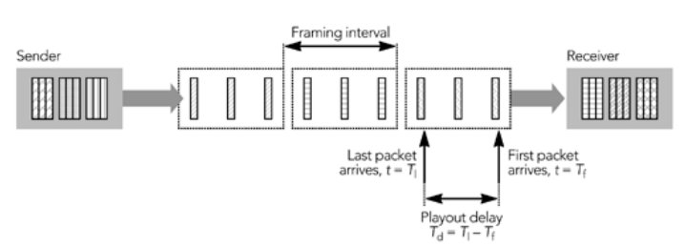
Buffering delay

Slide 26
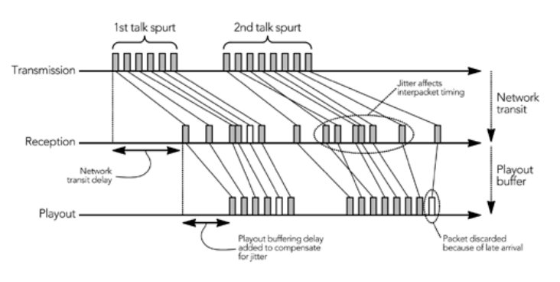
Buffering – network jitter

Slide 27
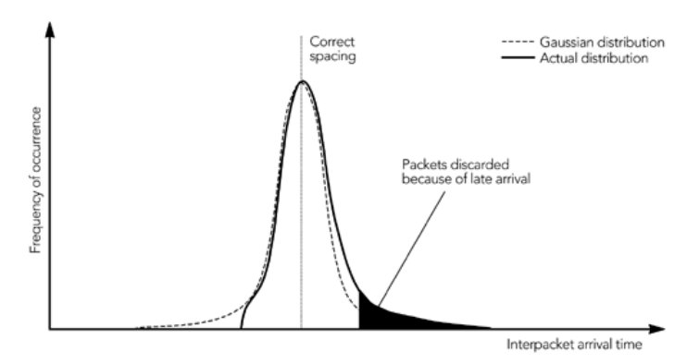
Distribution of network jitter

Slide 28
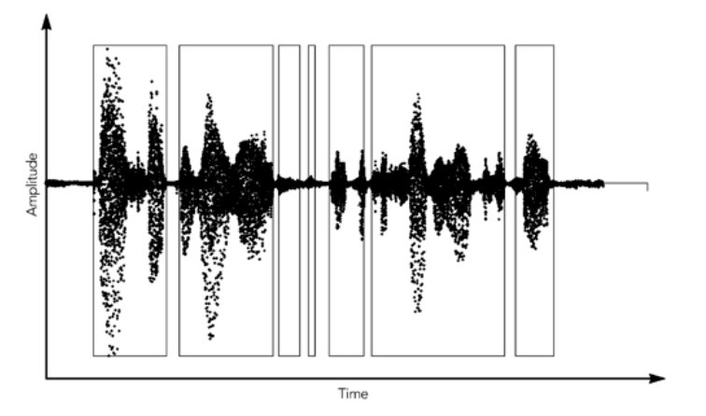
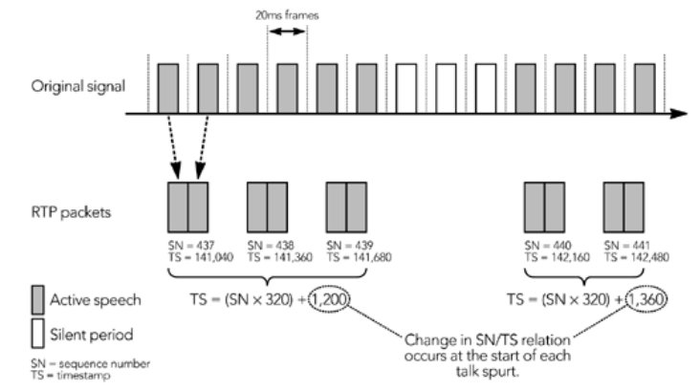
Talk spurts (SN & TS relation)

Slide 29
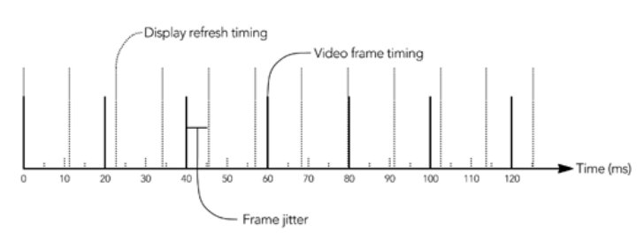
Media frames & Players

Slide 30
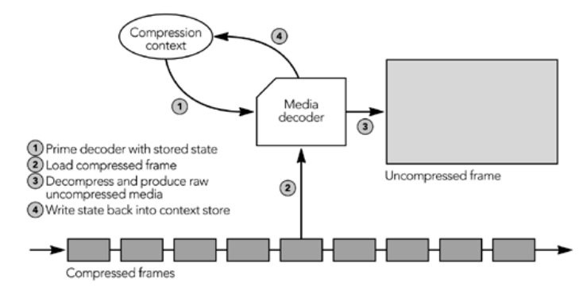
Operation of media decoder

Slide 31
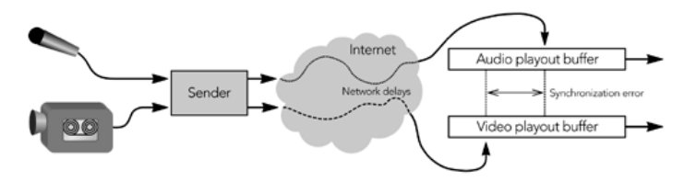
Media multiplexing

Slide 32
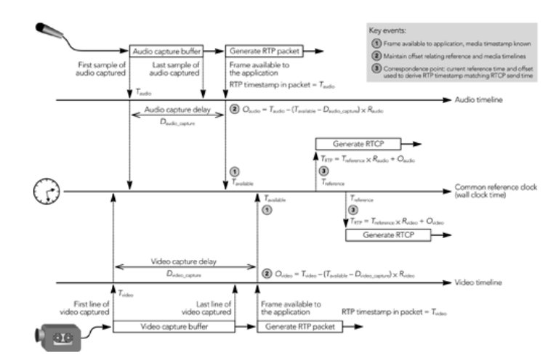
Multiplexing time-line

Slide 33
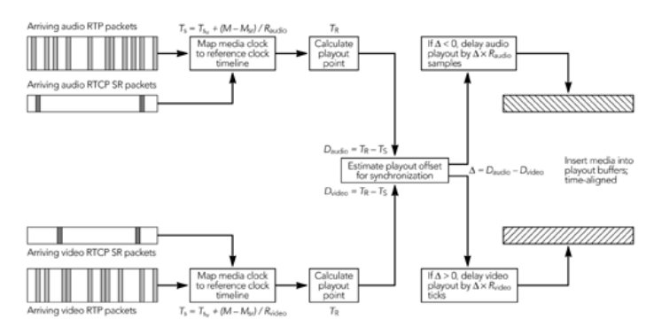
Receiver lip synchronization

Slide 34
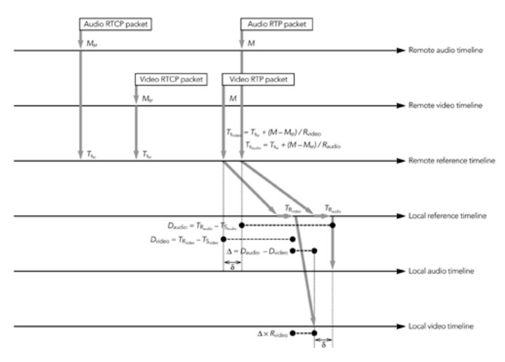
Receiver time lines

Slide 35
Error cancealement and correction

Slide 36
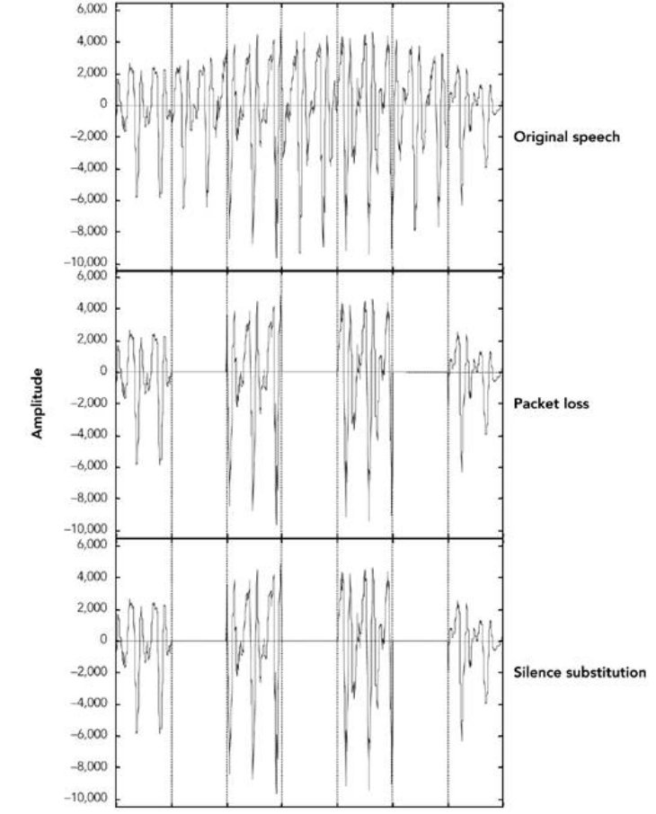
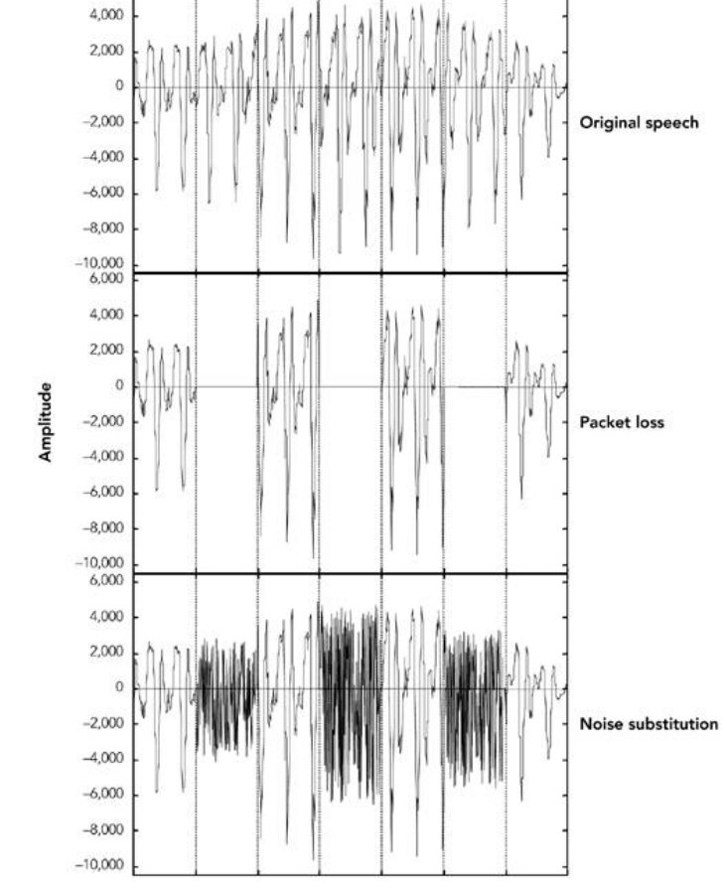
Speach error cancealement (1)

Slide 37
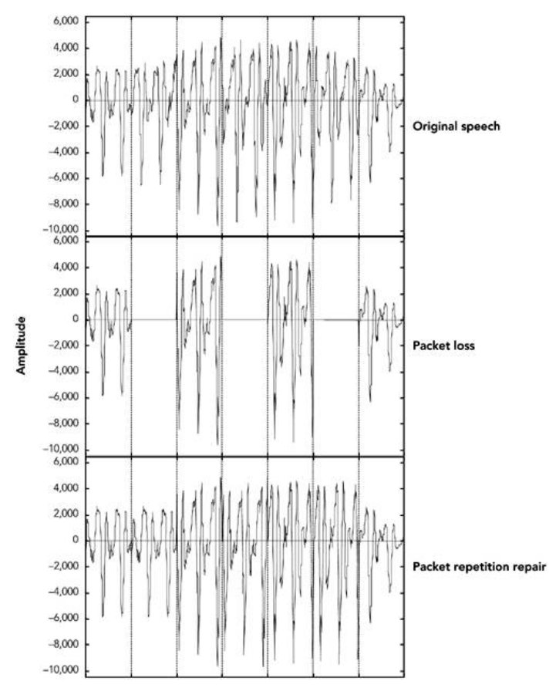
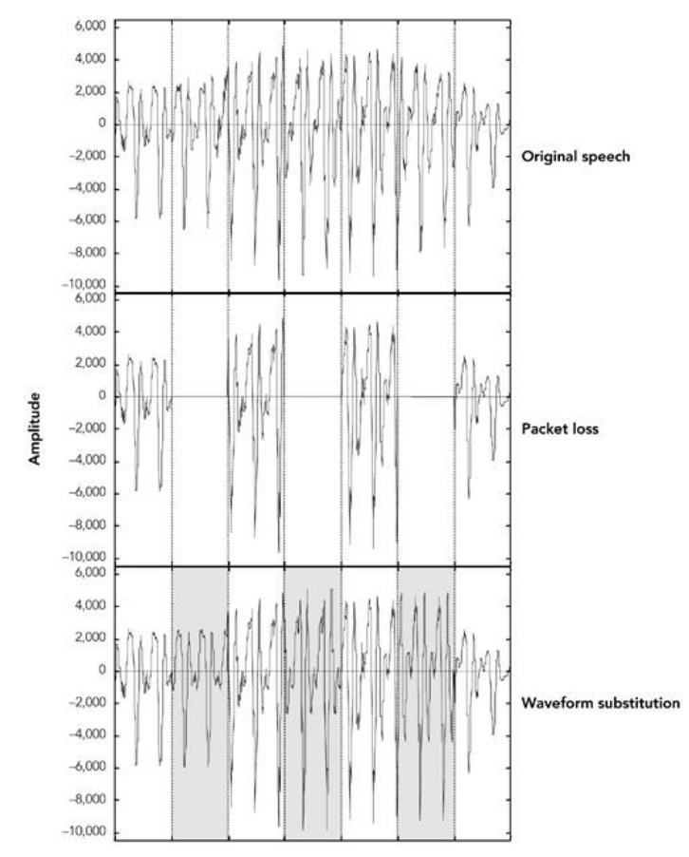
Speach error cancealement (2)

Slide 38
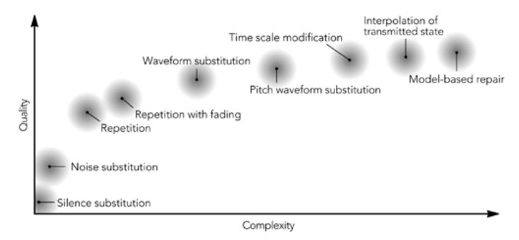
Error cancealement methods

Slide 39
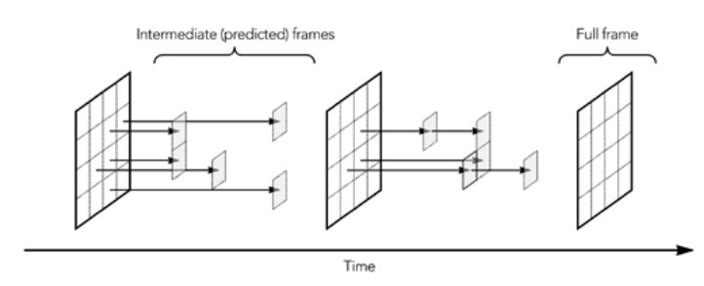
Video codec operation

Slide 40
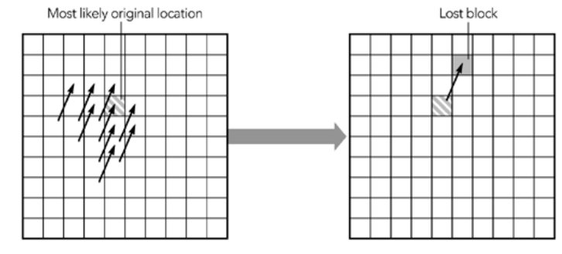
Video motion compensation

Slide 41
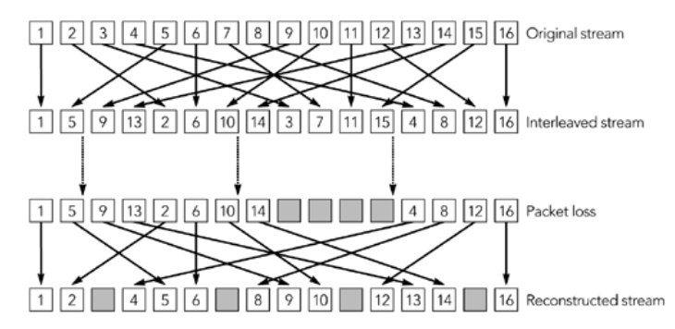
Packet interleaving

Slide 42
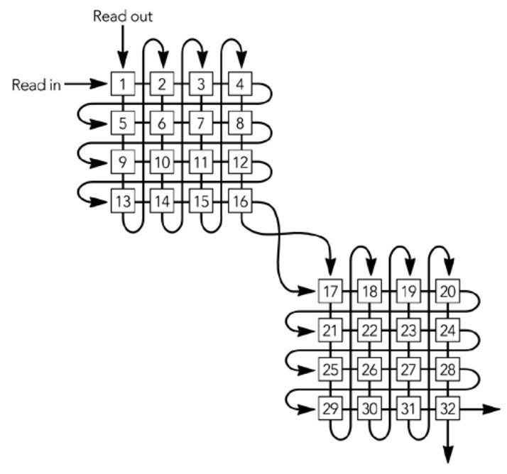
Interleaving matrix

Slide 43
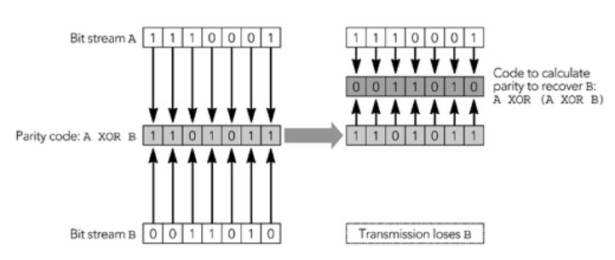
FEC – parity based error correction

Slide 44
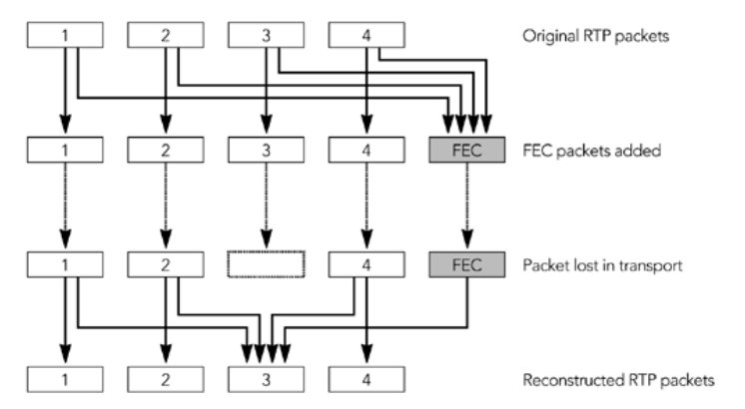
FEC – packet repair

Slide 45
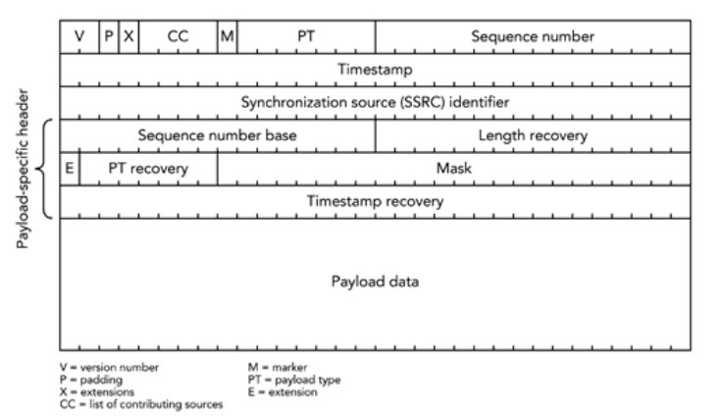
RTP - FEC packet repair

Slide 46
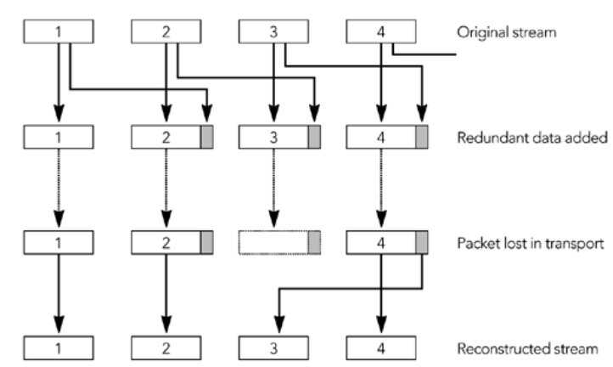
FEC – Redundancy coding

Slide 47
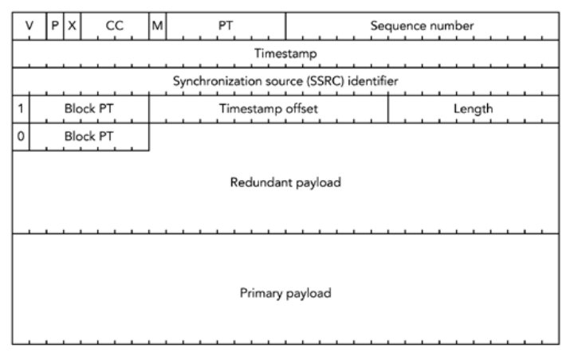
RTP - redundancy packet

Slide 48

RTP – partial checksum

Slide 49


RTCP – transmission feedback

Slide 50

Congestion

Slide 51

Congestion control with TCP

Slide 52

Header compression - principles

Slide 53

Header compression - option

Slide 54

Compressed (header) RTP packet

Slide 55

Summary
Multimedia protocol stack
RTP and RTCP protocols
Audio/video capture
Media frames & packets
Packet reception & play-out
Media synchronization
Error cancealement and repair
Congestion (TCP) and header compression

