Slide 1

Internet & Multimedia
Gstreamer – concepts and examples
P. Bakowski
bako@ieee.org

Slide 2
What is Gstreamer
GStreamer is a pipeline-based multimedia framework written in the C programming language with the type system based on GObject.
GStreamer allows a programmer to create a variety of media-handling components, including simple audio playback, audio and video playback, recording, streaming and editing.
The pipeline design serves as a base to create many types of multimedia applications such as video editors, streaming media broadcasters and media players.

Slide 3
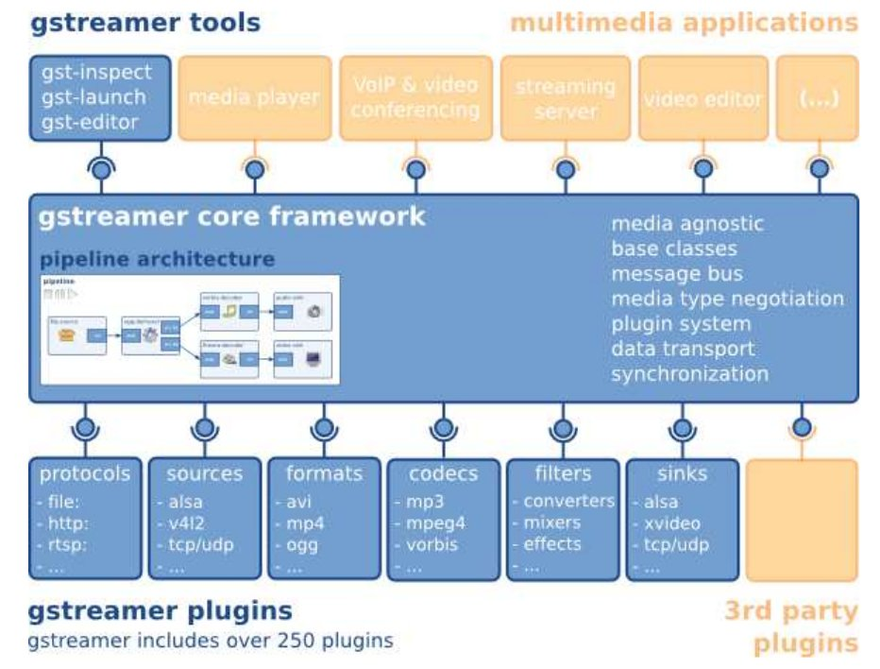
Gstreamer – global overview

Slide 4
Gstreamer – technical overview
GStreamer processes media by connecting a number of processing elements into a pipeline.
Each element is provided by a plug-in. Elements can be grouped into bins, which can be further aggregated, thus forming a hierarchical graph.
Elements communicate by means of pads. A source pad on one element can be connected to a sink pad on another.
When the pipeline is in the playing state, data buffers flow from the source pad to the sink pad. Pads negotiate the kind of data that will be sent using capabilities.

Slide 5
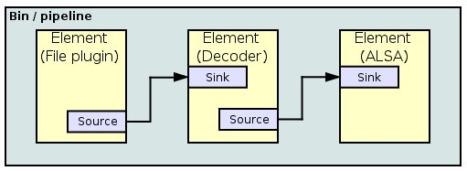
Gstreamer – technical overview
The diagram below could exemplify playing an MP3 file using GStreamer. The file source reads an MP3 file from a computer's hard-drive and sends it to the MP3 decoder. The decoder decodes the file data and converts it into PCM samples which then pass to the ALSA sound-driver. The ALSA sound-driver sends the PCM sound samples to the computer's speakers.

Slide 6

Gstreamer – plugins
GStreamer uses a plug-in architecture which makes the most of GStreamer's functionality implemented as shared libraries. GStreamer's base functionality contains functions for registering and loading plug-ins and for providing the fundamentals of all classes in the form of base classes. Plug-in libraries get dynamically loaded to support a wide spectrum of codecs, container formats, input/output drivers and effects.
Since version 0.10, the plug-ins come grouped into three sets (named after the film The Good, the Bad and the Ugly),There's also a separate GStreamer FFmpeg plug-in, which is a FFmpeg-based plug-in that supports many media formats such as MPEG-1, MPEG-2, MPEG-4, H.261, H.263, H.264, RealVideo, MP3, WMV, FLV, etc.
$ sudo apt-get install libgstreamer0.10-0
gstreamer0.10-ffmpeg gstreamer0.10-alsa gstreamer0.10-plugins-base gstreamer0.10-plugins-good
gstreamer0.10-plugins-bad
gstreamer0.10-plugins-ugly
Clint Eastwood, Lee Van Cleef, and Eli Wallach

Slide 7
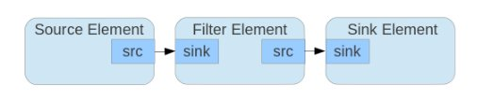
Gstreamer – elements
There are different types of elements such as:
– source element: the source of stream
– sink element: the destination of stream
– filter: the manipulator of streams

Slide 8
Gstreamer – elements
Each element can change state during the execution of application. The states are:
– null: no resource is allocated
– ready: resources are allocated, but the streams are not opened
– pause: streams are opened but no processed
– play: streams are being processed

Slide 9
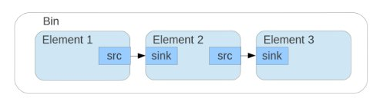
Gstreamer – bin
Bin is an element which contains other elements. Since it is an element it can have the same states as mentioned for element. By changing the state of a bin it automatically changes the states of its elements

Slide 10
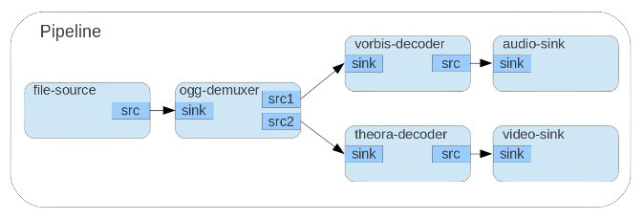
Gstreamer – pipeline
Pipeline is a top level Bin. Each application must have one pipeline.
The following figure demonstrates a pipeline for an ogg player

Slide 11
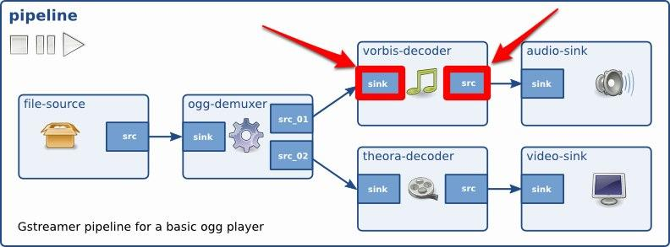
Gstreamer – pads
The pads are element's interface. Streams flow from an element's source pad to another element's sink pad. Pads can be built before execution or during runtime. Pads can have different capabilities, so before connecting two elements together we must make sure that two elements can so to speak talk together.
sink pad
source pad

Slide 12
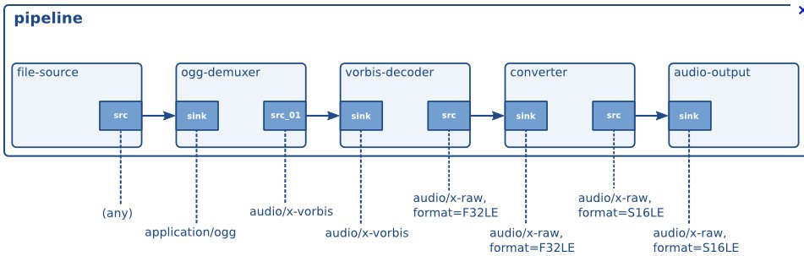
Gstreamer – autoplugging
The audio pipeline with the plugins - a simple media player for Ogg/Vorbis files:

Slide 13
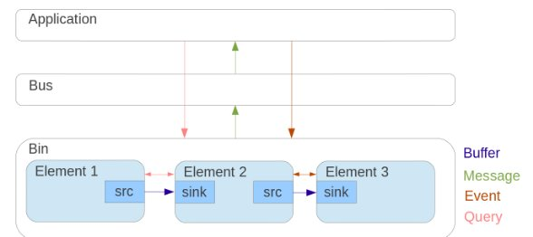
Gstreamer – bus, buffers, ..
Bus : Each element can communicate with other elements via a bus. Bins usually transfer the bus messages of their children to applications.

Slide 14
Gstreamer – bus, buffers, ..
Buffers - They can pass streaming data between elements in the bin. They always travel downstream.
Events - Objects used to notify elements which are waiting for a particular event to occur. They can be sent from application and can travel downstream and upstream.
Message - Objects posted on pipeline bus to notify the application of any particular information such as bugs, state changes, end of streams, etc..
Query - Objects sent from application or between elements to ask a particular information such as duration, positions, etc.. In a bin they can travel downstream and upstream.

Slide 15
Using Gstreamer - launch
After the installation Gstreamer offers several commands :
gst-launch - is a simple script-like commandline application that can be used to build and test pipelines.
For example, the command :
gst-launch audiotestsrc ! audioconvert ! audio/x-raw,channels=2 ! alsasink
will run a pipeline which generates a sine-wave audio stream and plays it to your ALSA audio card.

Slide 16
Using Gstreamer - launch
gst-launch also allows the use of multiple threads.
You can use dots to imply padnames on elements, or even omit the padname to automatically select a pad.
Using all this, the pipeline (note the use of queue element):
gst-launch filesrc location=file.ogg ! oggdemux name=d d. ! queue ! theoradec ! videoconvert ! xvimagesink d. ! queue ! vorbisdec ! audioconvert ! audioresample ! alsasink
will play an Ogg file containing a Theora video-stream and a Vorbis audio-stream.

Slide 17
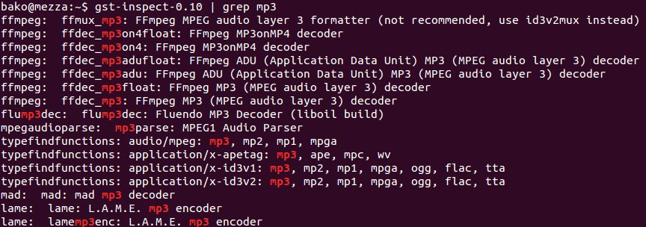
Using Gstreamer - inspect
gst-inspect can be used to inspect all properties, signals, dynamic parameters and the object hierarchy of an element. This can be very useful to see which GObject properties or which signals (and using what arguments) an element supports.

Slide 18
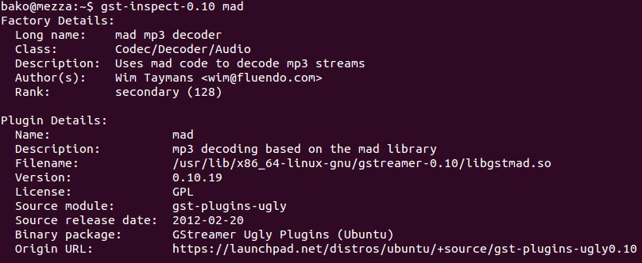
Using Gstreamer - inspect

Slide 19

Gstreamer – streaming
Gstreamer allows us to send the multimedia flows over several Internet protocols :
directly over UDP, TCP as simple data flows or
with RTP/UDP and RTP/RTCP/UDP as controlled multimedia flows
sender pipeline
@IP – port(s)
receiver pipeline
@IP – port(s)

Slide 20
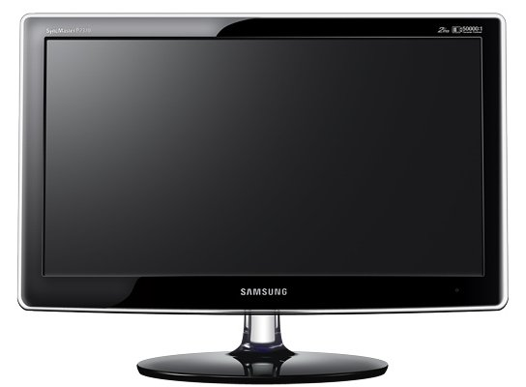

Gstreamer – streaming on UDP
gst-launch -v v4l2src ! 'video/x-raw-yuv, width=320, height=240, framerate=30/1' ! queue ! videorate ! 'video/x-raw-yuv,framerate=30/1' ! jpegenc quality=50 !
udpsink host=172.19.64.141 port=5000
gst-launch udpsrc port=5000 ! jpegdec ! ffmpegcolorspace ! autovideosink
udpsink
sender pipeline
@IP – port
@IP – port
receiver pipeline
udpsrc

Slide 21
Gstreamer – streaming on UDP
gst-launch-1.0 -v v4l2src ! 'video/x-raw, width=320, height=240, framerate=30/1' ! queue ! videorate ! 'video/x-raw,framerate=30/1' ! jpegenc quality=50 ! \
udpsink host=172.19.64.141 port=5000
gst-launch-1.0 udpsrc port=5000 ! jpegdec ! videoconvert ! autovideosink
udpsink
sender pipeline
@IP – port
@IP – port
receiver pipeline
udpsrc

Slide 22
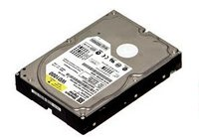
Gstreamer – streaming on TCP
#the client of tcpserver - to be launched first !
echo 'waiting for the connection from server'
gst-launch tcpserversrc host=172.19.64.141 port=5002 ! filesink location=Coffee.mp3
#sending data to the client on host=172.19.69.141 port=5002
gst-launch -v filesrc location=Coffee.mp3 ! tcpclientsink host=172.19.64.141 port=5002
tcpclientsink
sender pipeline
@IP – port
@IP – port
receiver pipeline
tcpserversrc

Slide 23
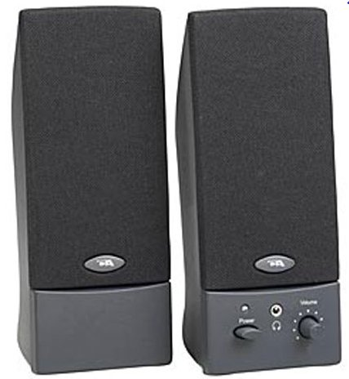

Streaming on RTP/UDP
gst-launch -v alsasrc device=hw:1 ! audioconvert ! audioresample
! 'audio/x-raw-int,rate=16000,width=16,channels=1' ! speexenc ! rtpspeexpay ! udpsink host=172.19.64.141 port=50013
gst-launch udpsrc port=5001 caps="application/x-rtp, media=(string)audio, clock-rate=(int)16000, encoding-name=(string)SPEEX, encoding-params=(string)1, payload=(int)110" ! gstrtpjitterbuffer name=jbuf latency=70 drop-on-latency=True ! rtpspeexdepay ! speexdec ! audioconvert ! audioresample ! volume volume=10 ! autoaudiosink
udpsink
sender pipeline
@IP – port
payload
@IP – port
receiver pipeline
alsasrc device=hw:1
udpsrc

Slide 24
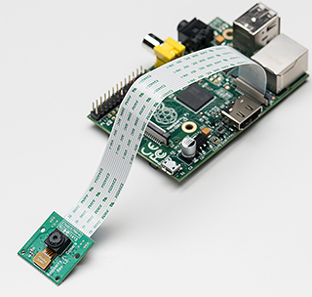
Streaming on RTP/TCP
raspivid -t 0 -w 1280 -h 720 -fps 25 -b 2500000 -p 0,0,640,480 -o - | gst-launch -v fdsrc ! h264parse ! rtph264pay config-interval=1 pt=96 ! gdppay ! tcpserversink host=192.168.0.9 port 5000
gst-launch-1.0 -v tcpclientsrc host=192.168.0.9 port=5000 ! gdpdepay ! rtph264depay ! avdec_h264 ! videoconvert ! autovideosink sync=false
tcpserversink
sender pipeline
@IP – port
payload
tcpclientsrc
@IP – port
receiver pipeline
When using gdp with TCP, the sender can stream data using a tcpserversink, which can be received by multiple clients using tcpclientsrc. You are able to start the sender before the receiver.

Slide 25
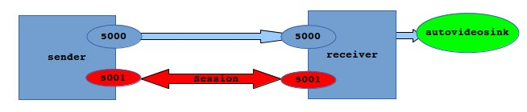
Streaming with RTCP session
gst-launch -tv v4l2src ! videorate ! videoscale method=1 \
! video/x-raw-yuv,width=320,height=240 \
! jpegenc ! rtpjpegpay ! .send_rtp_sink gstrtpsession name=session \
.send_rtp_src ! udpsink port=5000 host=172.19.64.141 \
session.send_rtcp_src ! udpsink port=5001 host=172.19.64.141
gst-launch -tv udpsrc port=5000 \
caps="application/x-rtp, media=(string)video, clock-rate=(int)90000, encoding-name=(string)JPEG, encoding-params=(string)1, payload=(int)26" !\
.recv_rtp_sink gstrtpsession name=session .recv_rtp_src \
! rtpjpegdepay ! jpegdec ! autovideosink \
udpsrc port=5001 caps="application/x-rtcp" ! session.recv_rtcp_sink

Slide 26

Summary
Gstreamer - overview
Gstreamer plugins
Gstreamer: bins, pipelines ..
Gstreamer inspect and launch
Streaming on UDP
Streaming on TCP
Streaming with RTP/UDP and RTP/TCP
Streaming session with RTP and RTCP

