Slide 1

Internet
Internet and Its Protocols
P. Bakowski
bako@ieee.org

Slide 2
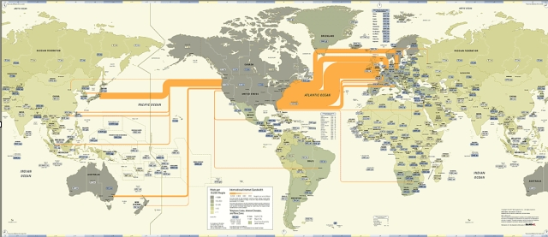
What is the Internet

Slide 3

What is the Internet
global reach – World Wide Web network

Slide 4
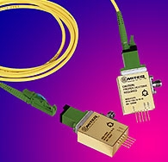
What is the Internet - links
cables
bandwidth – data rate – bits/s

Slide 5
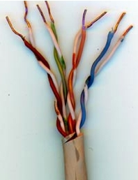
What is the Internet - links
optical fibers
bandwidth – data rate – bits/s

Slide 6
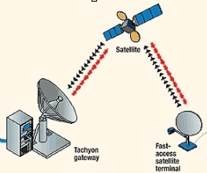
What is the Internet - links
satellite links
bandwidth – data rate – bits/s

Slide 7



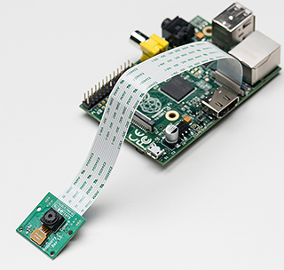
What is the Internet – clients/servers
clients

Slide 8

What is the Internet – clients/servers
servers

Slide 9
What is the Internet – clients/servers
hosts or end systems

Slide 10

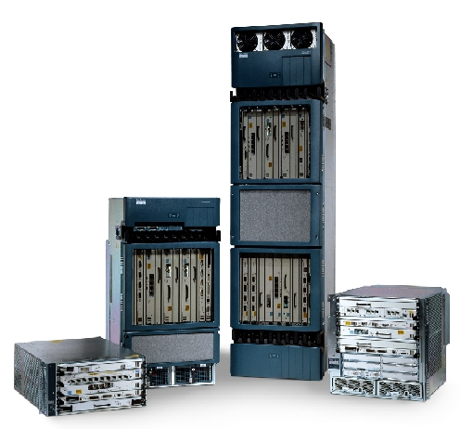
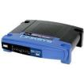
What is the Internet - routers
routers

Slide 11


What is the Internet - routers
switches

Slide 12
What is the Internet - routers
routers

Slide 13
What is the Internet - routers
routes and packets
delays , packet loss

Slide 14
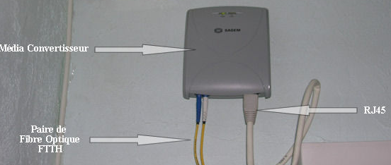
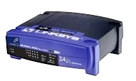
What is the Internet - modems
ADSL and FTTH modems

Slide 15

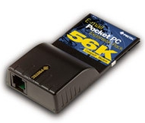
What is the Internet service
electronic mail – ASCII text
reliable, error free,

Slide 16

What is the Internet service
internet telephony – VoIP
low delay, constant delay,

Slide 17
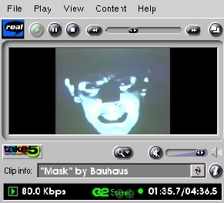
What is the Internet service
video streaming – Video on IP
high data rate, low delay

Slide 18

What is the Internet service
file sharing
data rate, reliability

Slide 19
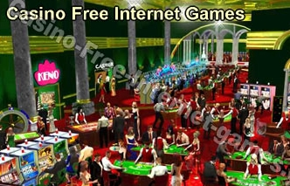
What is the Internet service
games – conferences – interactive multimedia
high data rate, very low delay,

Slide 20
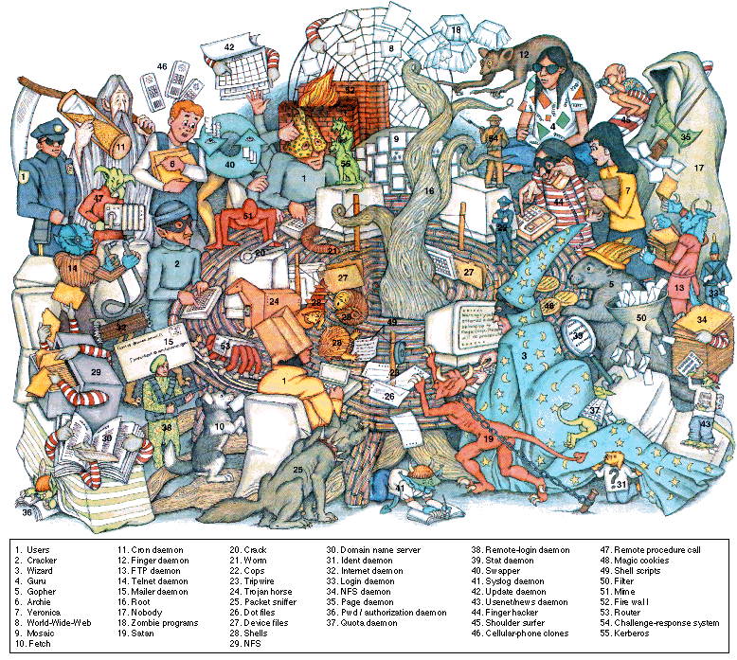
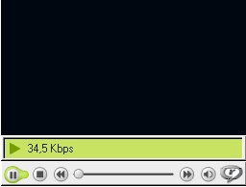
What is the Internet service
connection oriented
reliable service, high delay,

Slide 21
What is the Internet service
connectionless
low reliability, low delay

Slide 22
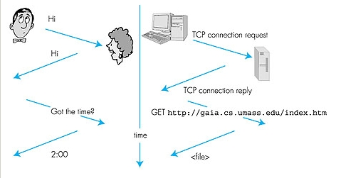
What is a protocol ?
human protocol

Slide 23
What is a protocol
computer network protocol

Slide 24
What is a protocol ?
messages and communication entities

Slide 25
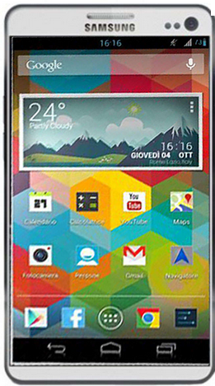
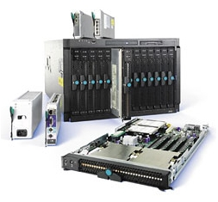
The network edge – end systems
end systems - hosts

Slide 26
The network edge – clients/servers
clients
servers
software - hardware

Slide 27
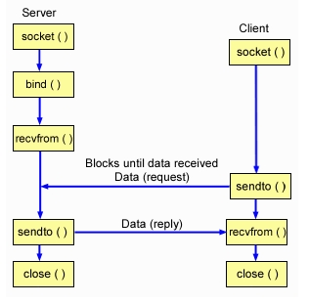
Connectionless Service
packets with destination and source address

Slide 28

Connectionless Service
packets with destination and source address

Slide 29

Connectionless Service
packets with destination and source address

Slide 30
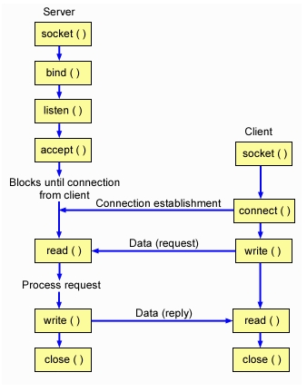
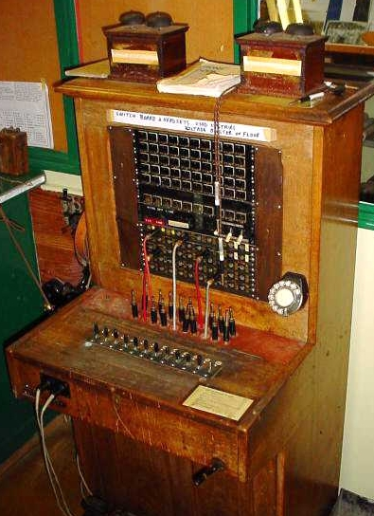
Connection-Oriented Service
packets with destination and source address

Slide 31

Connection-Oriented Service
packets with destination and source address

Slide 32

Connection-Oriented Service
packets with destination and source address

Slide 33


Connection-Oriented Service
packets with destination and source address

Slide 34
Connection-Oriented Service
packets with destination and source address
voice-video on IP

Slide 35
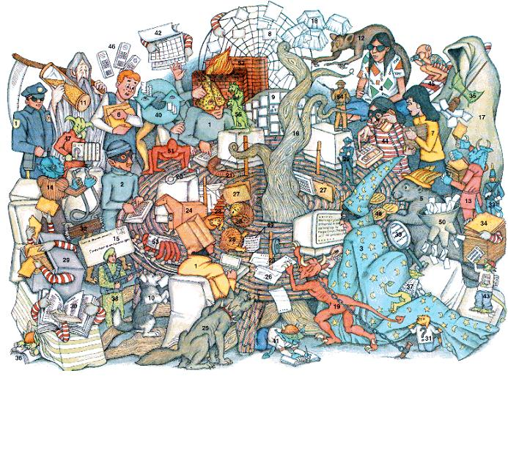
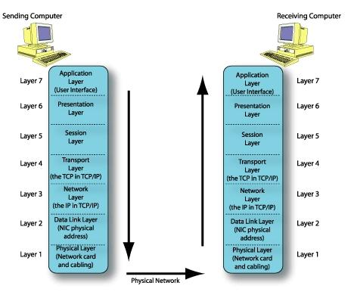
OSI protocol stack
protocols

Slide 36
OSI protocol stack
services/interfaces

Slide 37
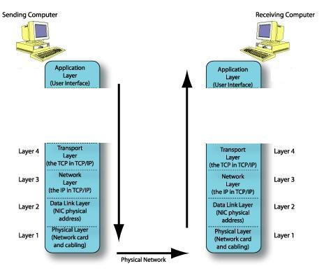
Internet protocol stack
PDUs
bit

Slide 38
Internet protocol stack
PDUs
frame
bit

Slide 39
Internet protocol stack
PDUs
datagram - @
frame
bit

Slide 40

Internet protocol stack
PDUs
segment
datagram
frame
bit

Slide 41
Internet protocol stack
PDUs
segment/packet
datagram
frame
bit

Slide 42

Internet protocol stack
PDUs
message/ media frame
segment/packet
datagram
frame
bit

Slide 43
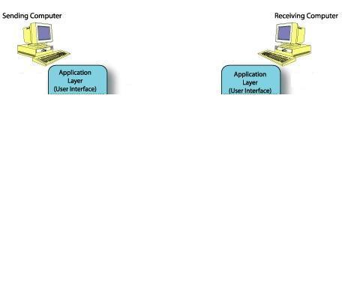
Application layer
HTTP
SMTP
FTP
VoIP
VoD

Slide 44
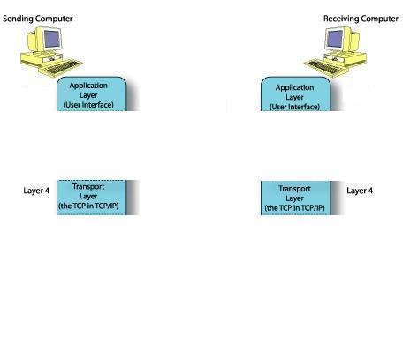


Transport layer
protocols
TCP
programming interface
connection oriented service

Slide 45
Transport layer
protocols
programming interface
UDP
RTP/RTCP
connectionless service

Slide 46
Summary
Various pieces of hardware & software
Systems & applications
Communication modes
Functional layers

