Slide 1
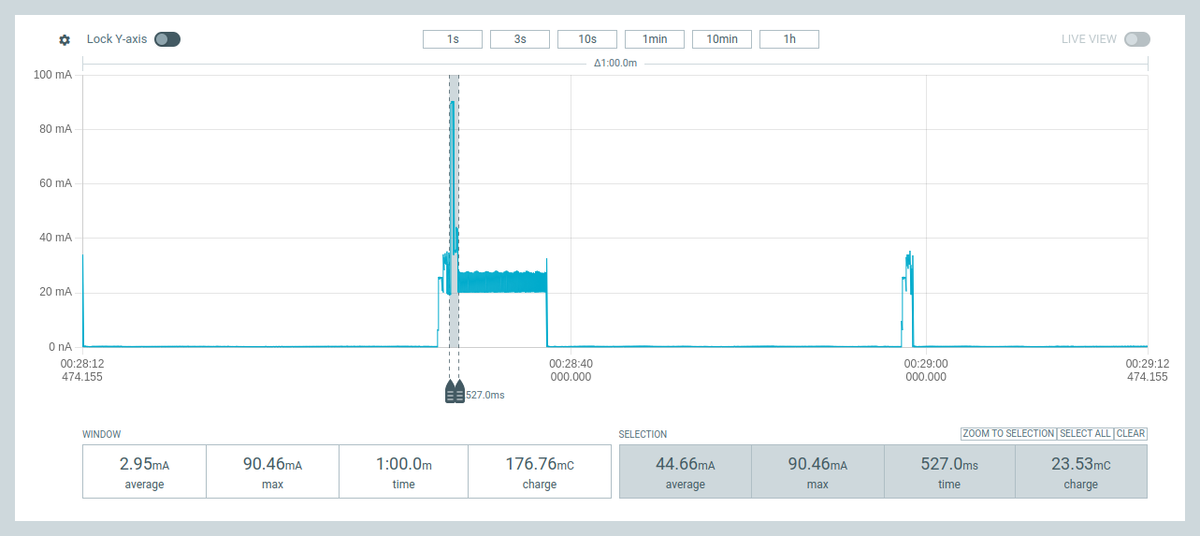
Low Power IoT Architectures
“Mesures et analyse des consommations énergétiques d’une architecture IoT très faible puissance”
P.Bakowski, B.Parrein, A.Bitaillou
IoT Sockets : Direct & Remote Terminals
Low Power
IoT SoC
IoT Board
IoT DevKit
IoT Platform
cycles : stages : phases
IoT data/”power” compression

Slide 2
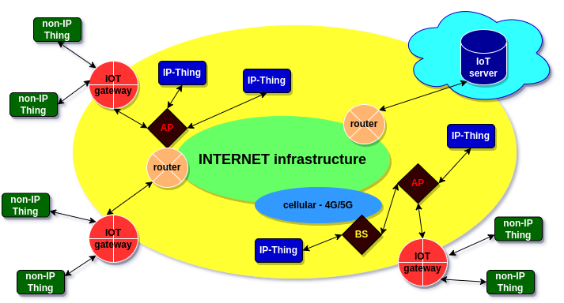
IoT : Direct & Remote Terminals
IP-Thing : Direct Terminal connected to INET via WiFi/4G/5G link
non-IP-Thing : Remote Terminal connected to INET via LoRa link and IoT gateway

Slide 3
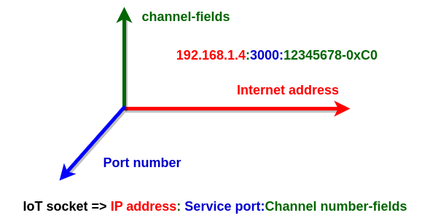
  IoT Sockets : @IP:port:channel
Direct Terminals know: IP address:Service port:Channel number
Gateways know: IP address:Service port
Remote Terminals know only: Channel number (identifier)

Slide 4
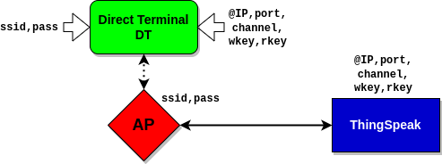
  Direct Terminals and IoT Sockets
IoT Socket
Direct Terminals know: IP address:Service port:Channel number
plus: write and optionally read key
A channel contains fields (max.8) that may be interpreted as IoT data streams to be “compressed”.

Slide 5
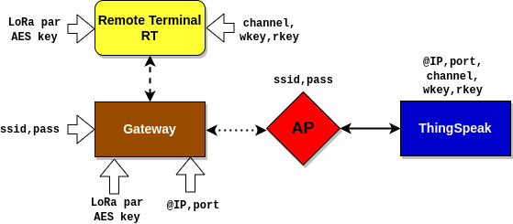
  Remote Terminals and IoT Sockets
IoT Socket
Gateways know IP address : Service port
Remote Terminals know only Channel number (identifier)

Slide 6
  From IoT SoC to IoT Platform
RISC-V,Xtensa: LX6,LX7
ESP32C3
ESP32C6
ESP32S6
WiFi/BLE
Bus I/O,..
PPK II
ARM-M0
SX1262
Bus I/O,..
IoT Platform
Hardware/Firmware/Software
micro-python, C/C++
libraries, packages, modules
IoT Board
SoC
IoT DevKit
CPU
CPU
IoT DevKit
IoT Board
SoC
EEPROM
USB, solar Converters,
Bus I/O, ..
EEPROM
USB, Converters,
Bus I/O, ..
UART,I2C,SPI
sensors/actuators solar panel, battery
supercapacitors, ..
UART,I2C,SPI
sensors/actuators,
modems, solar panel, battery
supercapacitors, ..

Slide 7
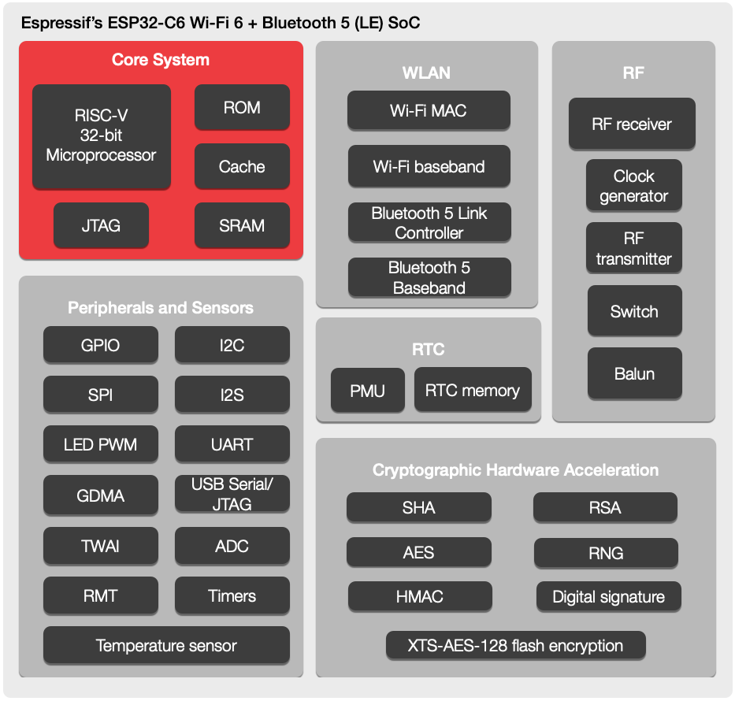
  IoT SoC ESP32C6: low power features
RISC-V: RV32
5 stages pipeline
WiFi6 with TWT - Target Wake Time
Low Power (2mA)
RISC-V: RV32
2 stages pipeline
Buses including
Low Power (I2C,UART)
Crypto and Security

Slide 8
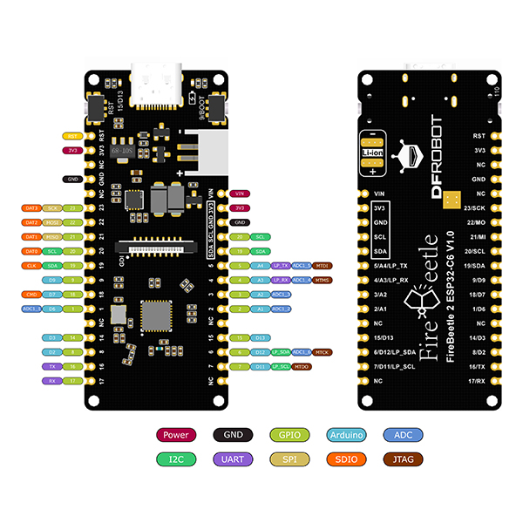
IoT Board (Direct Terminal)
IoT Board: DFRobot FireBeetle2 (ESP32C6) : EEPROM, battery, solar converters, USB bus, I2C, UART,SPI, .. (low/high power)

Slide 9
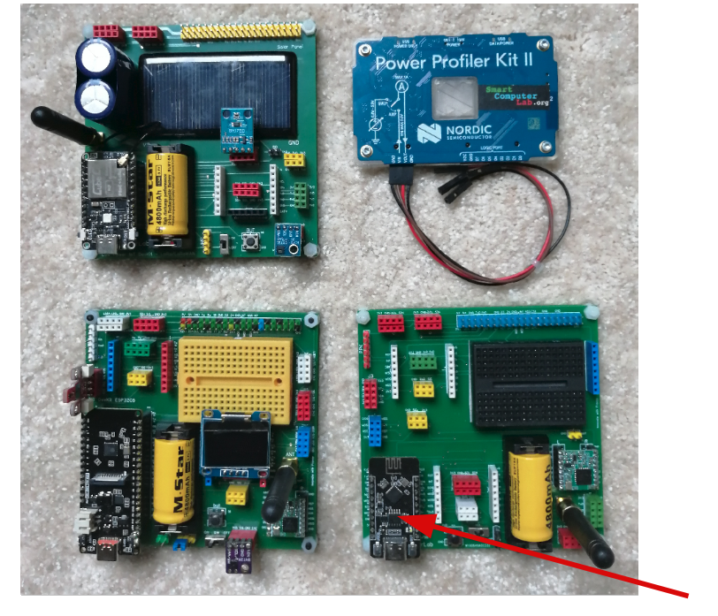
IoT DevKits : RISC-V & ARM boards
Nordic PPK II
CubeCell ( ARM-M0 + SX1262):
Remote Terminal
SX1276 :
Remote Terminal or Gateway
FireBeetle 2 (ESP32C6):
Direct Terminal
Heltec (ESP32C3):
Direct Terminal

Slide 10
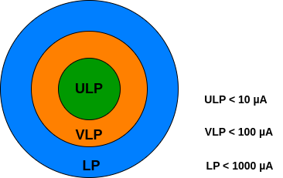
  Low and Very Low Power consumption
Example of average current (power) consumption:
deepsleep mode for low_power stage : 10µA and 100s
normal mode for high_power stage : 40mA and 0.5s
low_power charge + high_power charge= 10µA*100s + 40 000µA*0.5s = 1000µC+20000µC= 21mC
average_current = charge/time = 21mC/100.5s = 0.21mA = 210µA (LP)
Let us calculate the same for low_power stage duration of 600s.
average_current = charge/time = 26mC/600.5s = 0.043mA = 43µA (VLP)

Slide 11
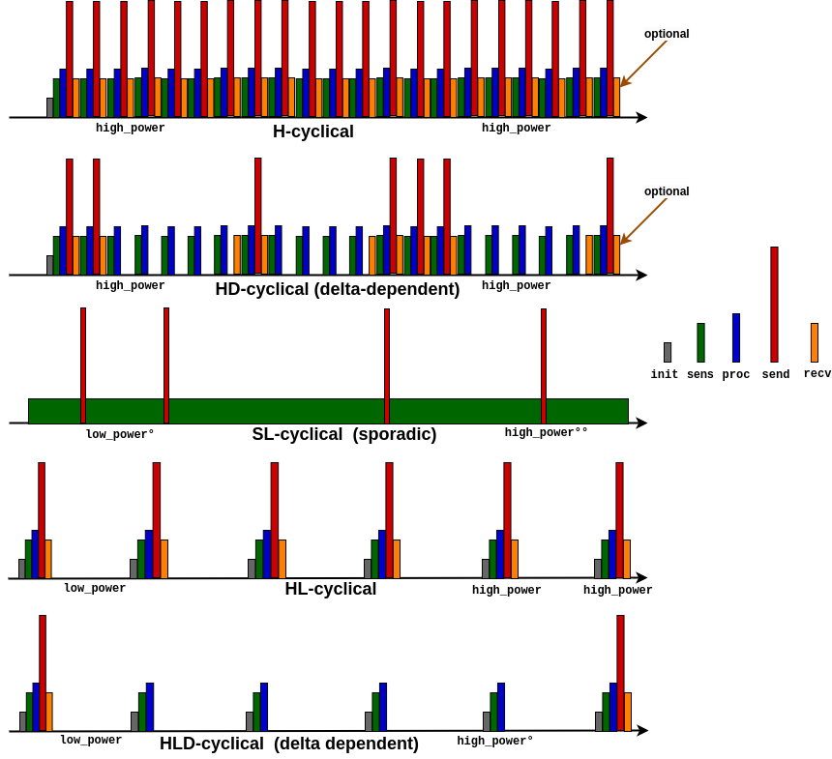
  Terminals: Operational modes
high average current
delta (δ) parameter defines required precision-difference
“sporadic cycle” – activated by an interruption (level change) signal
low average current

Slide 12
  high_power stage - phases
transmission phase
processing phase
sensing phase
reception phase
low_power stage
high_power stage
time
init-stop phases

Slide 13
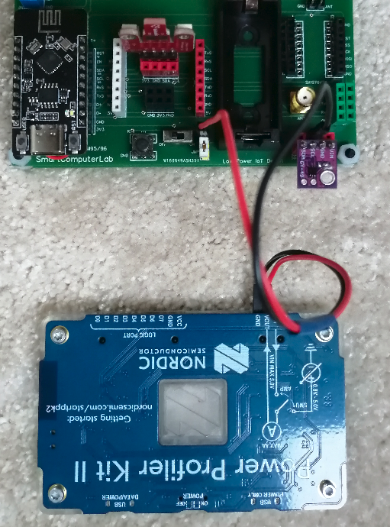
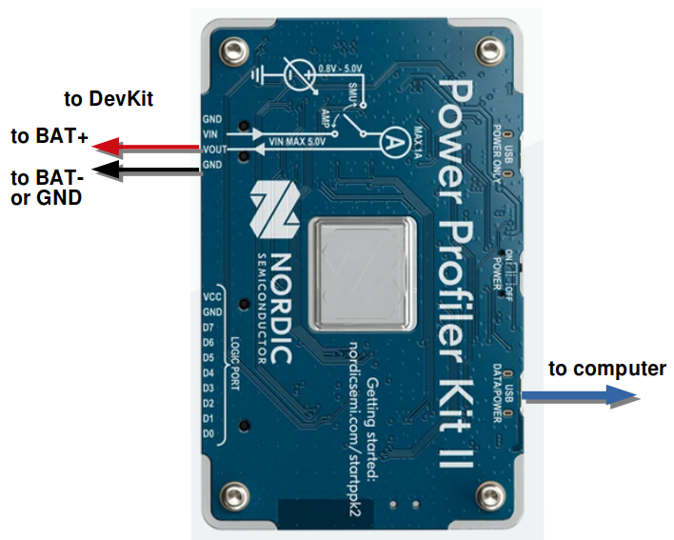
  Power Profiler Kit II : connection
source
Power Profiler with source mode

Slide 14
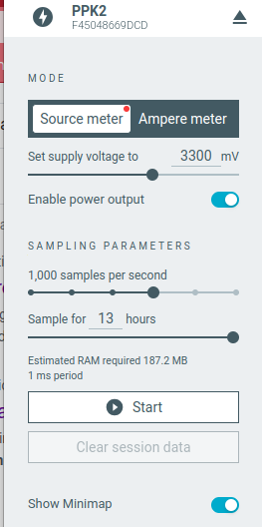
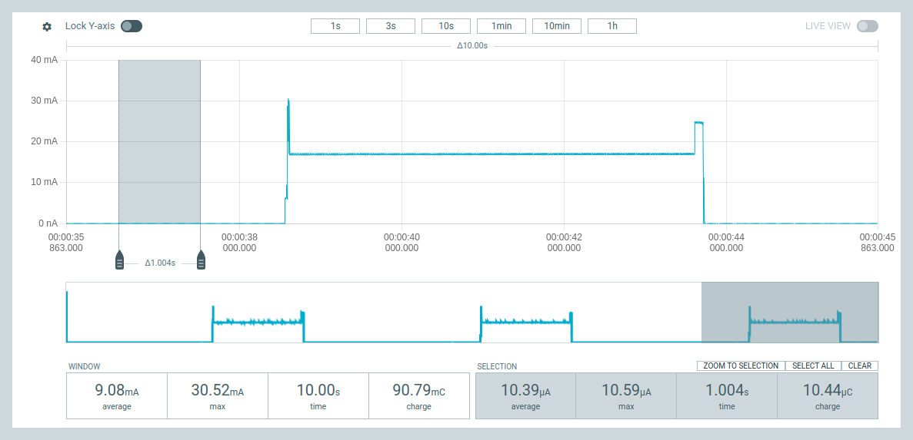
  Power Profiler Kit II - windows
source voltage
main window
source mode
high_power stage
charge consumption (10.44µC)
low_power stage
average current consumption in low_power stage (10.39µA)

Slide 15
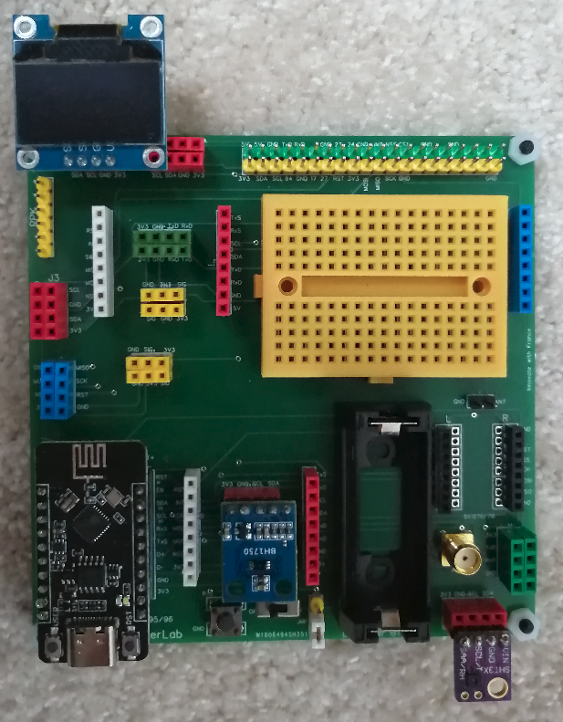
DevKit : HL cycle operation with sensors
two sensors to capture
the temperature,
the humidity, and
the luminosity or brightness values:
BH1750 (L) - luminosity
SHT31 (T/H) – temperature/humidity
Attention:
All these components communicate over the same (shared) I2C bus !

Slide 16
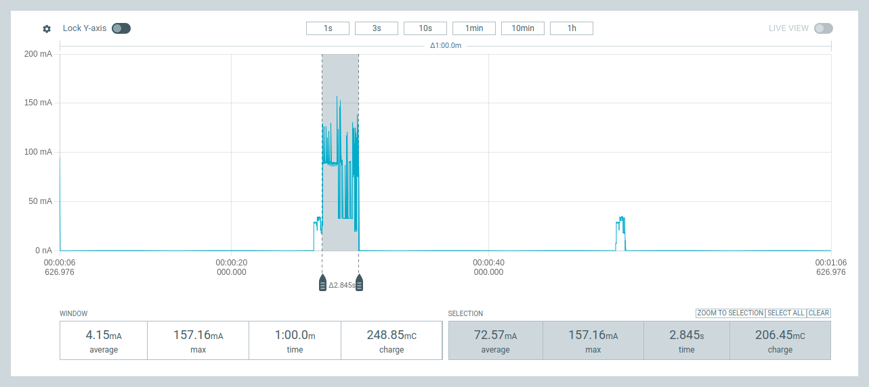
HL cycle operation : sensors, WiFi, delta
DT-WiFi transmission “cost - charge” : 206mC
sensing, processing “cost - charge” : ~12mC
low_power stage
operational cycle
delta : the max difference between the last sent and current sensor value
high_power stage time << low_power stage time
delta as big as possible : example 0.01C° => 1.0C°
operational cycle frequency (16.6 mHz) >> transmission cycle frequency (278 µHz)

Slide 17
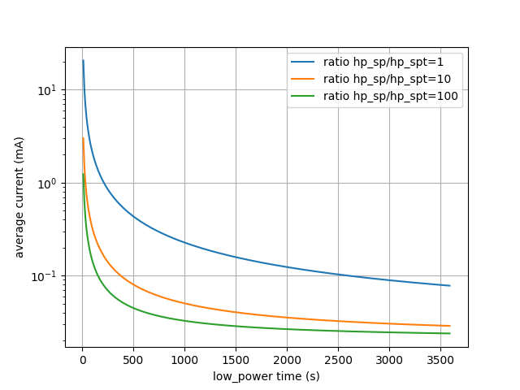
HL cycle operation : sensors, WiFi, delta
operational cycle frequency
Ratio hp_sp/hp_spt :
the number of high_power cycles without transmission
to
the number of high_power cycles with transmission
(16.6 mHz)
(278 µHz)
LP
VLP
The use of delta parameter
may be considered as
“IoT data temporal compression”

Slide 18
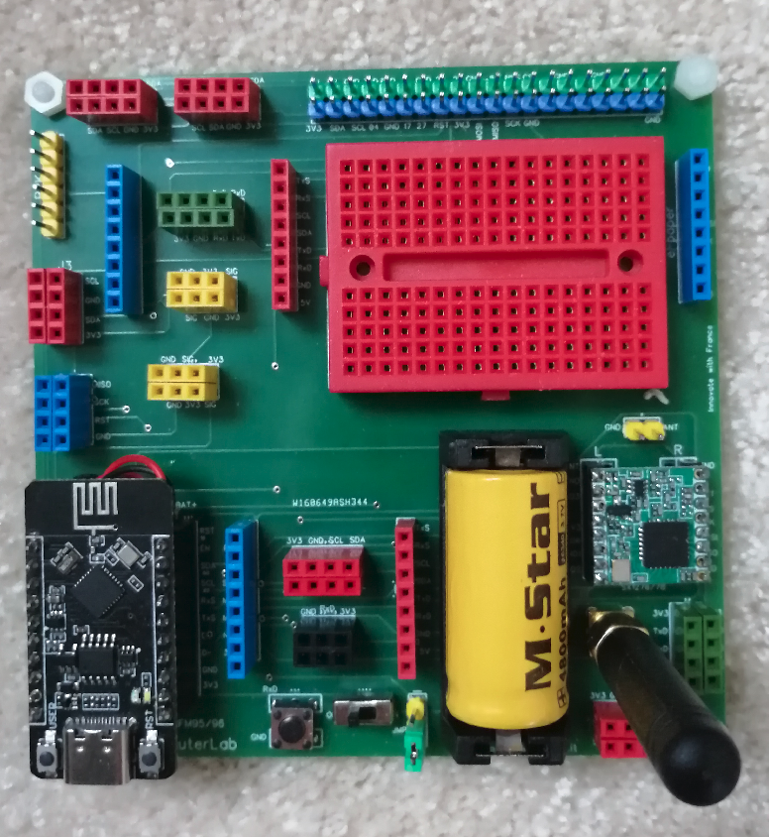
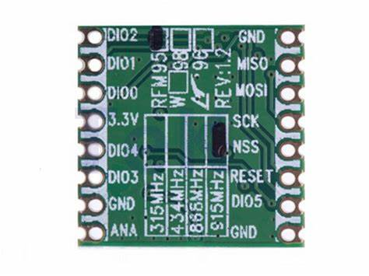
Long Range (LoRa) & Remote Terminals
Remote Terminals or Lora-WiFi Gateway
RFM95 – SX1278

Slide 19
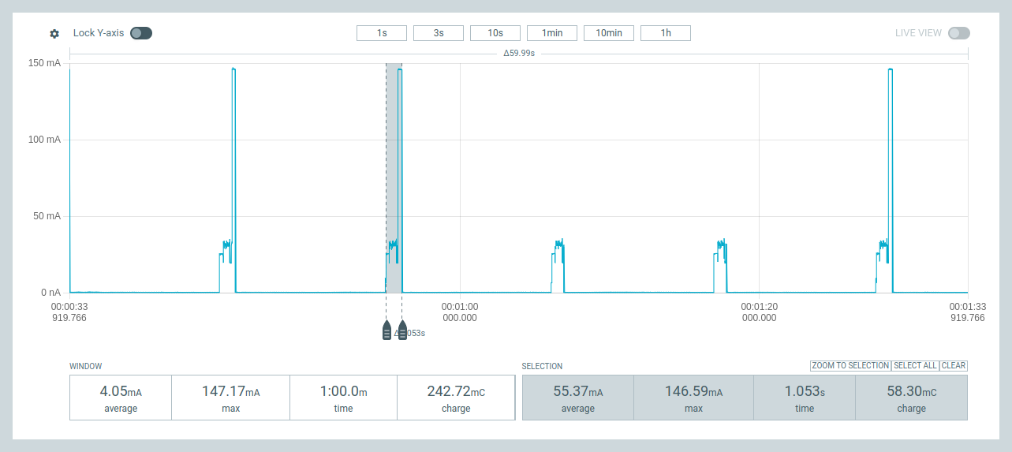
RT - Power consumption with LoRa link
RT-LoRa transmission “cost - charge” : 58.30mC
sensing, processing “cost - charge” : ~15mC
op. cycle
low_power stage – 146.05µA
transmission time: SF=9, CR=4/8, BW=125KHz => 314 ms
transmission charge (avc.145mA) =>45mC

Slide 20
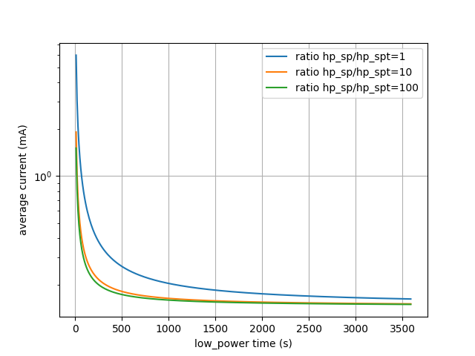
Power consumption with LoRa link : 146µA ?
Ratio hp_sp/hp_spt :
the number of high_power cycles without transmission
to
the number of high_power cycles with transmission
LP
No VLP solution !
(for this board !)
Problem: low_power stage – 146.05µA (much to high !)

Slide 21
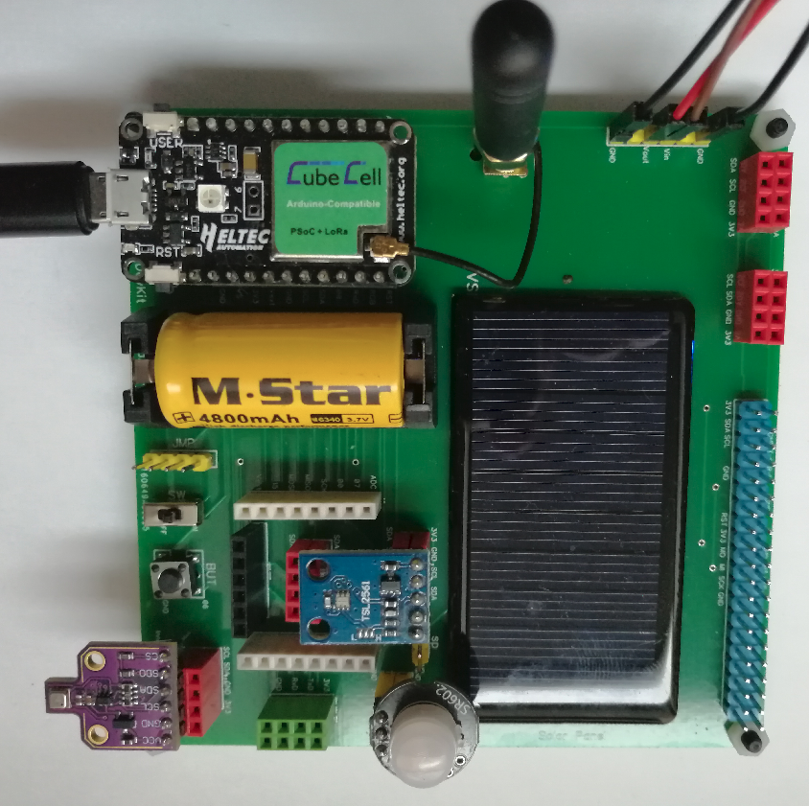
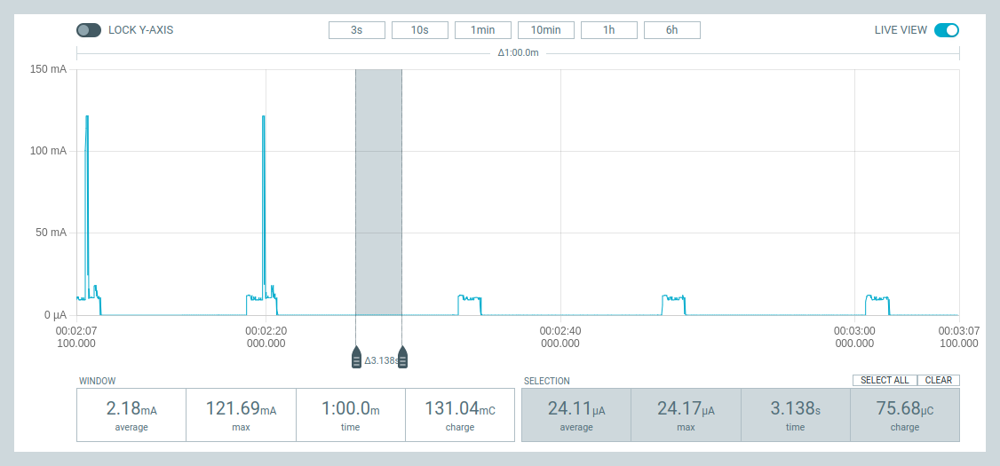
RT - Power consumption with LoRa link
ARM-M0+SX1262
low_power stage = 24µA

Slide 22
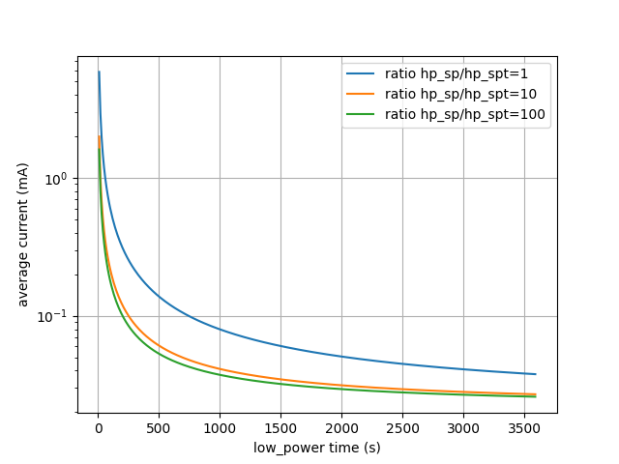
RT - Power consumption with LoRa link
CubeCell
LP
VLP
ARM-M0+SX1262
low_power stage = 32µA

Slide 23
Some conclusions
Direct Terminals - WiFi
Very High transmission “cost” (variable: ~150-300mC)
Usage of delta parameter (“compression”) very efficient
Remote Terminals – LoRa
High transmission “cost” (fixed: ~60mC)
Usage of delta parameter (“compression”) quite efficient

Slide 24
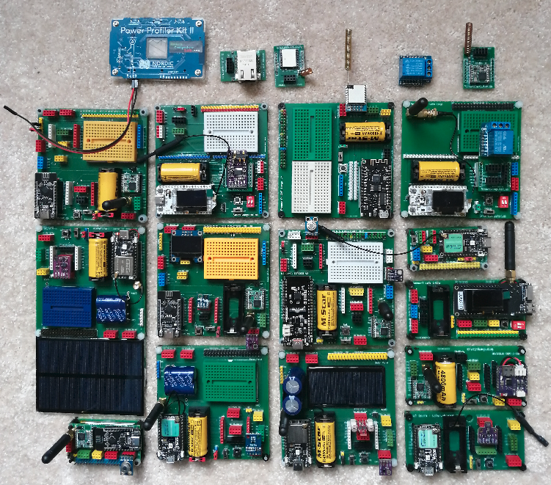
Implementation & test platform (s)
Merci de votre attention!

