Slide 1
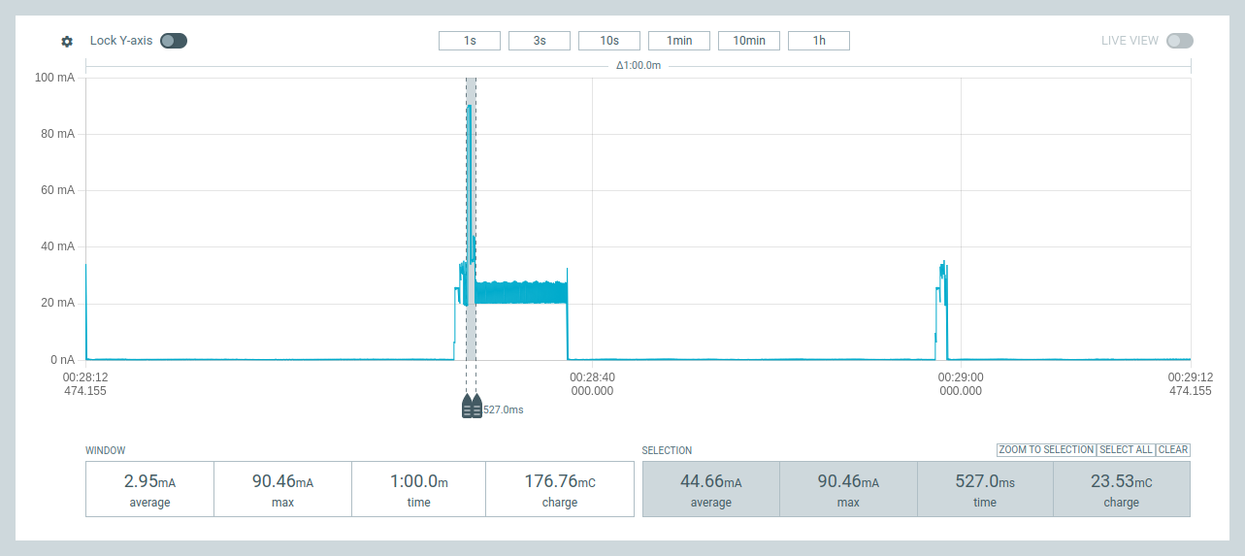
Low Power IoT Architectures
Principles and Practices
IoT Sockets : Direct & Remote Terminals
CPU/ULP
IoT SoC
IoT Board
IoT DevKit
IoT Platform
cycles : stages : phases
IoT data/”power” compression

Slide 2
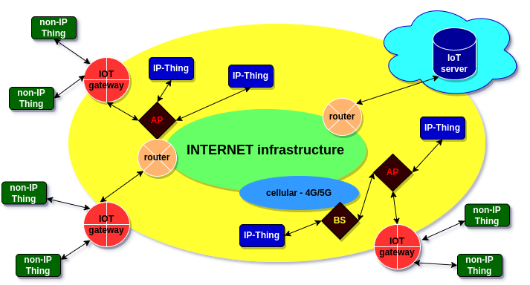
IoT : Direct & Remote Terminals
IP-Thing : Direct Terminal connected to INET via WiFi/4G/5G link
non-IP-Thing : Remote Terminal connected to INET via LoRa link and IoT gateway

Slide 3
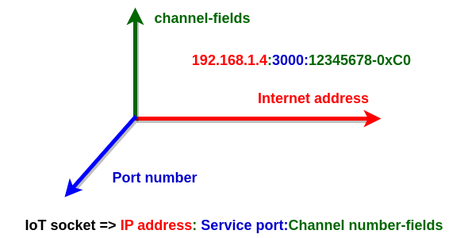
  IoT Sockets : @IP:port:channel
Direct Terminals know: IP address:Service port:Channel number
Gateways know: IP address:Service port
Remote Terminals know only: Channel number (identifier)

Slide 4
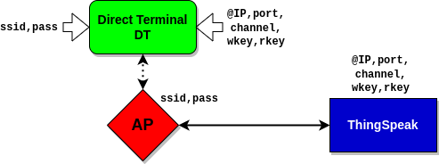
  Direct Terminals and IoT Sockets
IoT Socket
Direct Terminals know: IP address:Service port:Channel number
plus: write and optionally read key
A channel contains fields (max.8) that may be interpreted as IoT data streams to be “compressed”.

Slide 5
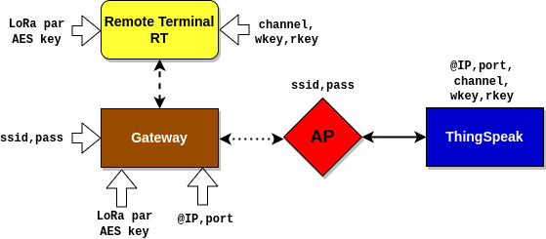
  Remote Terminals and IoT Sockets
IoT Socket
Gateways know IP address : Service port
Remote Terminals know only Channel number (identifier)

Slide 6
  From IoT SoC to IoT Platform
Power
Profiler
ARM-M0
RISC-V, Xtensa: LX6,LX7
IoT Platform
IoT DevKit
EEPROM
USB, solar Converters,
Bus I/O, ..
ESP32C3
ESP32C6
ESP32S3
WiFi/BLE
Bus I/O,..
IoT Board
CPU
SoC
IoT
UART,I2C,SPI
sensors/actuators,
modems, solar panel, battery
supercapacitors, ..
IDF, IDE,
drivers,
libraries, firmware C/C++, µPython, ..

Slide 7
  From Platform to Application
App 1
App 2
App N
IoT Architecture
IoT Services
IoT Platform
AI assisted - Generation/Development process

Slide 8
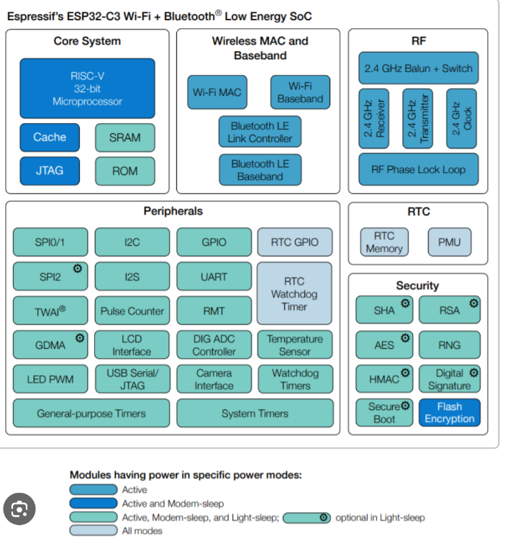
  ESP32C3 IoT SoC
RISC-V : 5-stages pipeline
Radio: WiFi, BT/BLE
Serial interfaces: I2C, SPI, UART, I2S, ..
low power : deepsleep
RTC clock, memory, ..

Slide 9
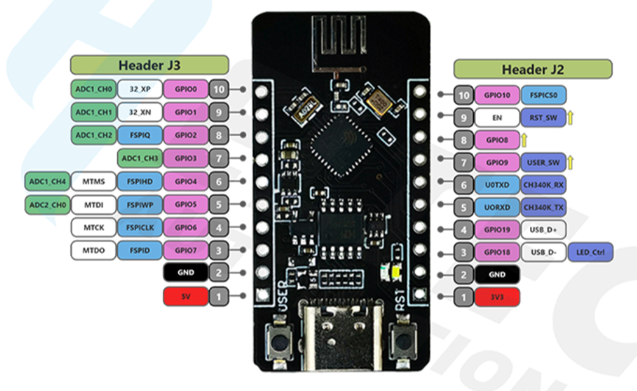
  Heltec – ESP32C3 board
ESP32C3 SoC
WiFi/BT/BLE – 2.4GHz antenna
Serial interfaces: I2C, SPI, UART, I2S, ..
EEPROM (SPI)
USB/UART

Slide 10
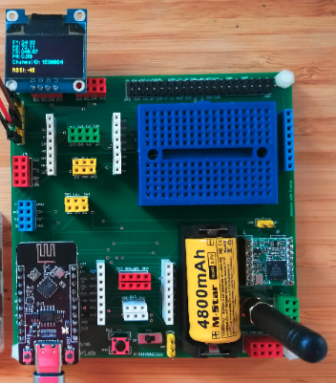
  IoT DevKit – HT ESP32C3
UART interface
GPIO interface
OLED display
I2C interface
RFM95: LoRa module
SPI interface
HT ESP32C3 board
sx1276 modem

Slide 11
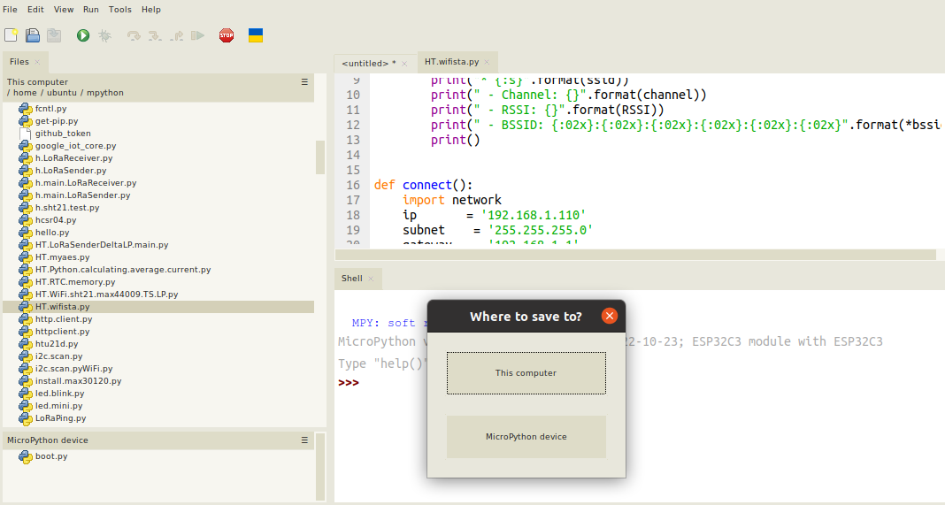
  Platform – Thonny IDE
editor
files
terminal

Slide 12
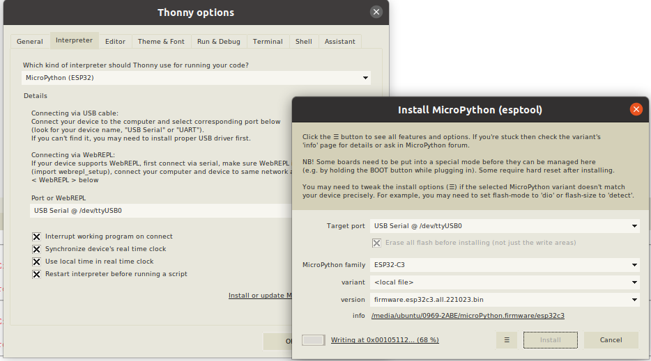
  Platform – Thonny IDE
port to flash
firmware to flash
µPython interpreter type

Slide 13
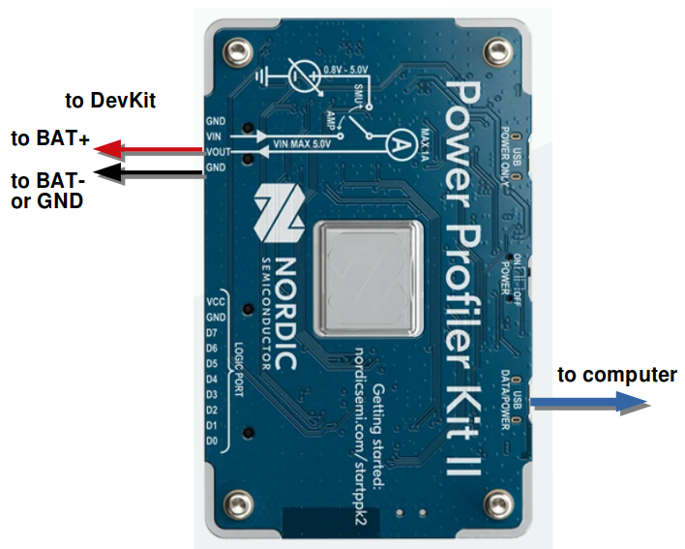
  Power Profiler Kit 2 (PPK2)
BAT-
BAT+

Slide 14
  Chat GPT development assistance
Prompt engineering
requests, descriptions, specifications, ..
LLM engine
ChatGPT, LLAMA,..
feedback, completions, modifications, ..
generic code
non complete code, some errors, ..
post-engineering
final code

Slide 15
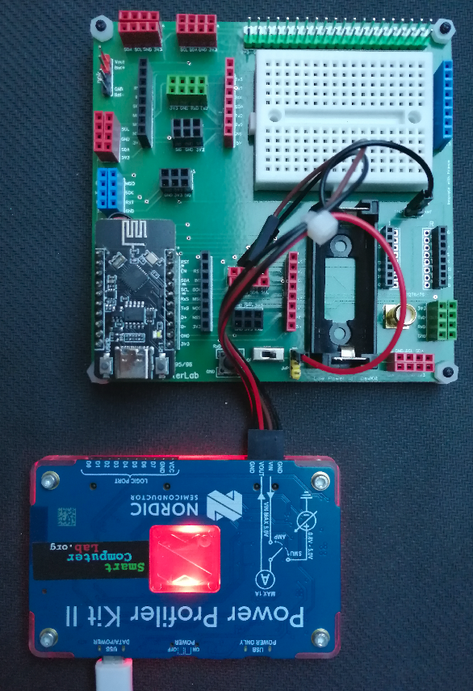
  Simple example
Prompt:
Write MicroPython code for ESP32 to switch on the signal (buzzer) on Pin 3 for 3 seconds. Then switch off the signal and go to deepsleep for 6 seconds.
from machine import Pin, deepsleep
import time
# Initialize the SIG pin
led = Pin(3, Pin.OUT)
# Turn on the SIG
led.value(1)
print("SIG is ON")
time.sleep(3)
# Turn off the LED
led.value(0)
print("SIG is OFF")
# Go to deep sleep for 6 seconds
print("Going to sleep for 10 seconds...")
time.sleep(0.2) # added to see the print
deepsleep(6000) # 6 seconds in milliseconds
Remark:
The code is correct, no post-engineering and/or feedback

Slide 16
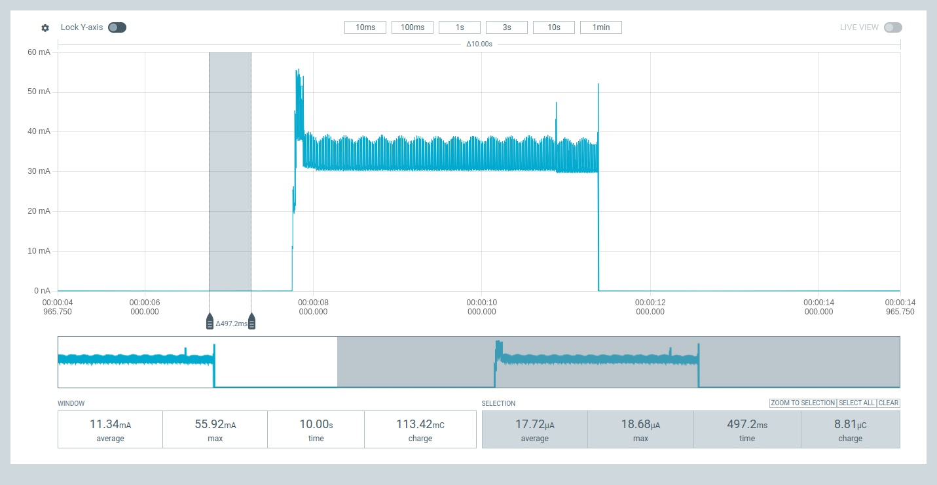
  Simple example – PPK2 diagram
high_power stage ~35mA
low_power stage ~18µA
~3s
Calculate the average current for a cycle with 600s low_power stage ?
(18*600+35000*3)/(600+3) = 192µA

Slide 17
  IoT Labs – Session 1
Lab 1: Working with sensors and displays (I2C bus)
Example Prompts
Prompt:
With ESP32 that is programmed with MicroPython we use frequently I2C bus to connect the sensors. Explain the operations of I2C bus.
from machine import Pin, I2C
# Configure I2C
i2c = I2C(0, scl=Pin(9), sda=Pin(8)) # I2C bus 0 with custom pins
# Scan for I2C devices
devices = i2c.scan()
print("I2C devices found:", devices)
# Assuming a device is found at address 0x3C
device_address = 0x3C
# Write to the device
data_to_write = bytearray([0x00, 0xFF]) # Example data
i2c.writeto(device_address, data_to_write)
# Read from the device
num_bytes = 2
data_read = i2c.readfrom(device_address, num_bytes)
print("Data read:", data_read)

Slide 18
  IoT Labs – Session 1
Lab 1: Working with sensors and displays (I2C bus)
Example Prompts
Prompt:
Write for ESP32 in MicroPython the function and module sensors.py with drivers for max44009 (luminosity) and sht21 (temperature, humidity) sensors operating over I2C bus. The function takes two arguments : sda, scl to specify the pins of I2C bus. It returns 3 values: luminosity,temperature,humidity=sensors(sda,scl).

Slide 19
  IoT Labs – Session 1
Lab 2: Communicating with WiFi and IoT servers
Example Prompts
Prompt:
Write in Micropython for ESP32 a module (wifi_tools.py) with 3 functions related to WiFi: connect_WiFi(ssid,pass), disconnect_WiFi() and scan_WiFi().
Prompt:
Write MicroPython code - function for ESP32 to get WiFi configuration: IP, port, .. after a successful connection to access point.

Slide 20
  IoT Labs – Session 1 – Lab 2
Prompt:
Write MicroPython programs for ESP32 to send and receive simple UDP datagrams with socket() functions
Prompt:
Explain the function and the use of NTP protocol and server.
Prompt:
Write micropython code for ESP32 using the generated wifi_tools.py module to read time from an external NTP server. Read the time in a 10 second infinite cycle. Note that the time must be synchronized only in the first cycle. Print the values of hour, minute, and second.

Slide 21
  IoT Labs – Session 1 – Lab 2
Prompt:
Give simple example in micropython for ESP32 of the usage of RTC memory. The example provides a counter of the cycles built with deepsleep mode for 6 seconds. Print the value of the counter in each cycle.

Slide 22
  IoT Labs – Session 1 – Lab 3
Prompt:
Write MicroPython code for ESP32 to connect to WiFi Access Point and to send (publish) MQTT message. The message contains readings from MAX44009 and SHT21 with sensors.py module. Use previously created wifi_tools.py module to connect to WiFi access point.
Prompt:
Write MicroPython code for ESP32 to send several sensor data values to ThingSpeak server. Use MAX44009 and SHT21 sensors – sensors.py . Use wifi_tools.py module predefined previously to connect to the WiFi and ThingSpeak.com server.

Slide 23
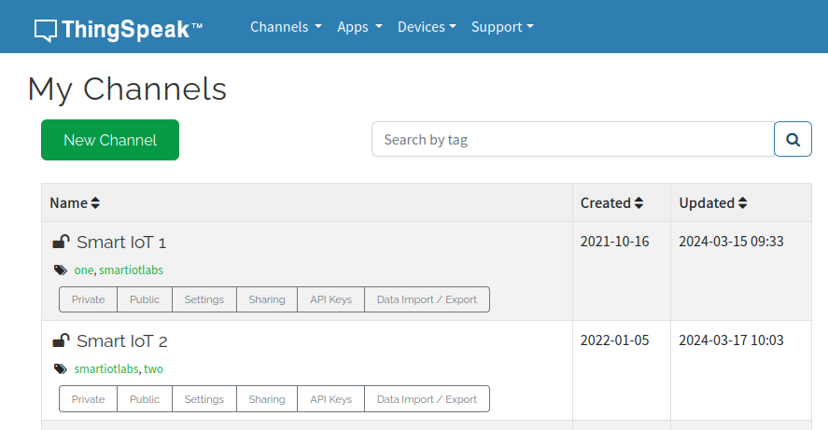
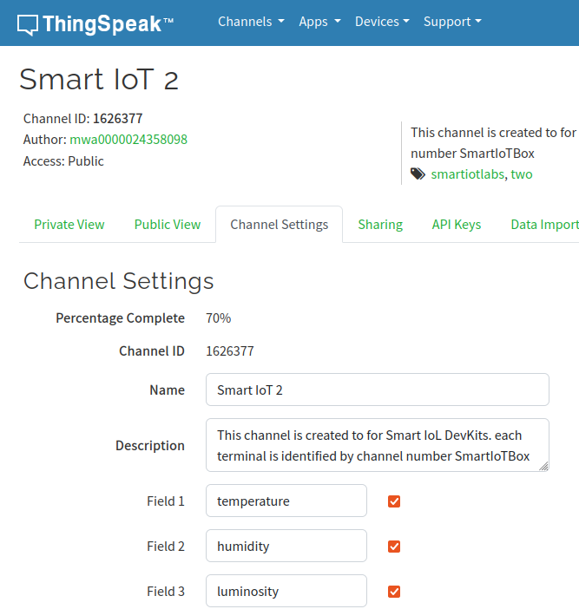
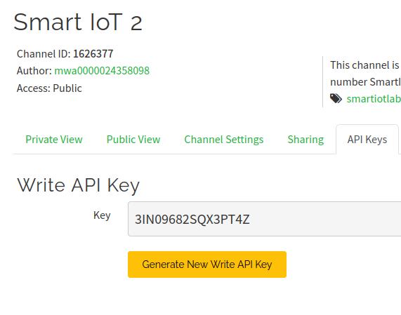
  IoT Labs – Session 1 – Lab 2

Slide 24
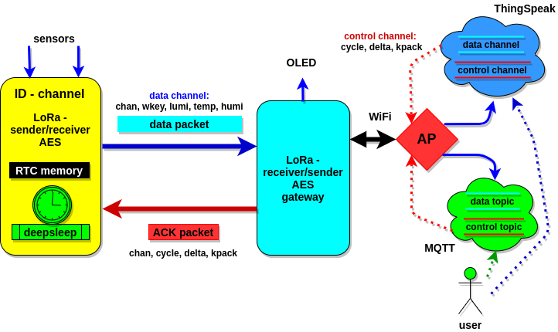
  IoT Labs – Session 1 – Lab 3 & Lab 4
Lab 3: Building Close Terminals and Gateways with MAC-WiFi
Lab 4: Long distance communication with Remote Terminals over LoRa radio links

Slide 25
  IoT Labs – Session 2 - Lab 5 + Project
Lab 5 : AIoT - EDGE
Projects and Applications with advanced IoT boards

