Slide 1
“From Intel x86 to RISC-V”
“Rise of RISC-V: The computer chip design you need to know about”

Slide 2
Three dominant IS Architectures
Past:
Intel x86 – controllers, PCs, servers, ..
Now:
ARM – controllers, smart-phones, laptops, PCs, servers
Future:
RISC-V – .. now: controllers, SBCs, laptops,
    .. soon: PCs, smart-phones, servers

Slide 3

Past: Intel x86 – PCs, servers, ..
Why Past
Generations : 8080 : 8-bit, 8086: 16-bit, 80386: 32-bit, .., I3,5,7,9)
CISC architecture: many formats → CISC to RISC transcoder
no low power design : the designs for stationary use
closed design: no standard (open) HDLs
closed production: mainly produced by the designer company
  Intel IDM: integrated device manufacturer
  AMD : fabless + TSMC silicon foundry

Slide 4
Now: ARM – MCU, phones, PCs, servers
Why Now
Generations: ARM1-11, ARM-Cortex, M,R,A,X
RISC architecture versions: Cortex-A v6,v7,v8,v9
Low power: mobile phones, IoT, ..
Design IPs with licenses : Verilog (synthesis)
    Problem:
      high license – model cost : $100K to $10M or more
      royalties : 1.2% for each chip

Slide 5
Future: RISC-V all devices
Why Future
Standardized ISA formats: 32, 64, and 128-bit
Optimized (for performance) RISC architecture
No ISA use licenses – “open source”
Many open source (mainly Verilog) and licensed designs
Designers free to implement internal architectures
Designers free to add specific ISA extensions (IA, IoT,..)
Great competition : hundreds/thousands designs

Slide 6
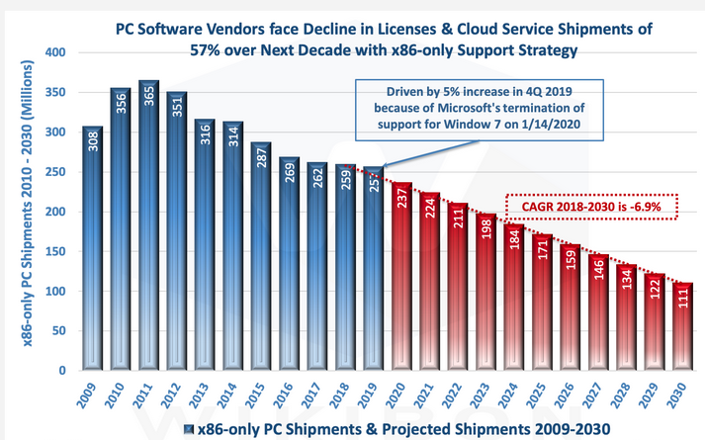
The numbers of produced units
2021: Intel x86 – 400 M

Slide 7
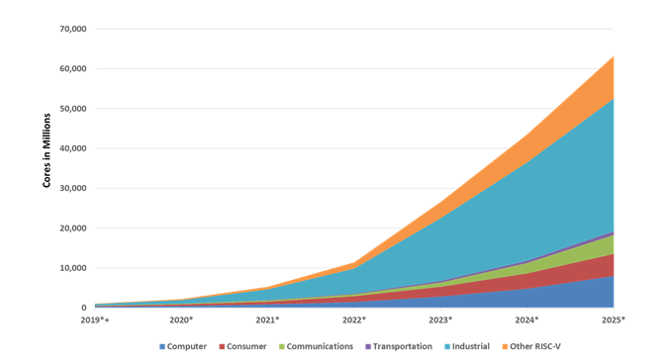
The numbers of produced cores
2022: RISC-V 12 billions
2024: RISC-V 45 billions (RISC-V cores/head)
exponential growth

Slide 8
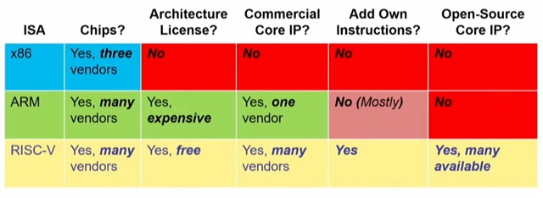
ISA - business models

Slide 9
ISA - design & fabrication (CPUs)
Design: World & fab : Asia
RISC-V
World
2020 - .. ?
Design: West & fab : Asia
ARM
West
2000 - 2050 ?
Intel
X86
USA
Design & fab : USA
1980 - 2040 ?
origin..
extinction ?

Slide 10







RISC-V : prime members - 2024
Asia: ~90% standardization decision
~80% of design
~90% of fabrication

Slide 11
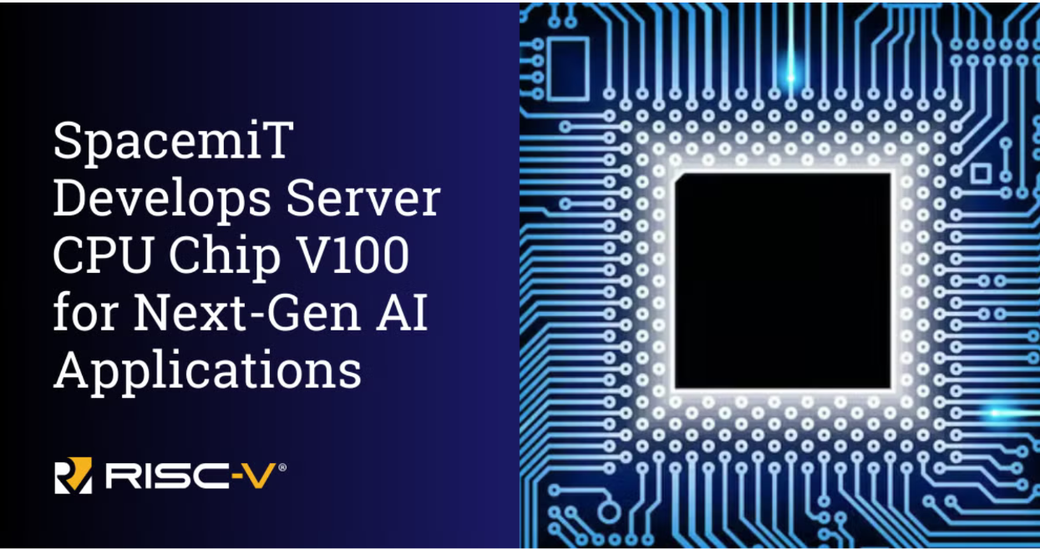
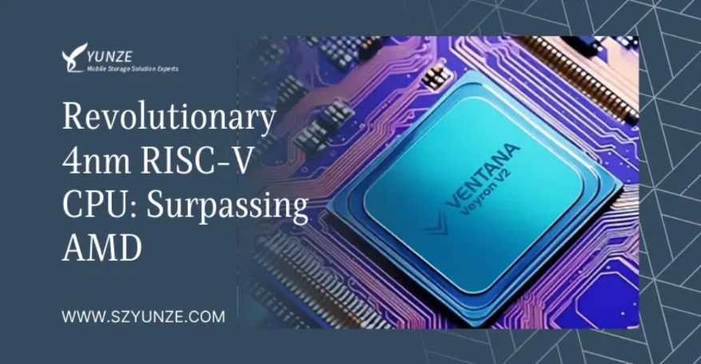
RISC-V for servers - 2025
SpacemiT Vital Stone V100. The chip represents an advancement in RISC-V technology, providing a complete hardware and software platform designed to meet server specifications.
Ventana’s 192-core Veryon V2 surpasses AMD’s Genoa and Bergamo. Veryon V2 will be released into the market in 2025

Slide 12
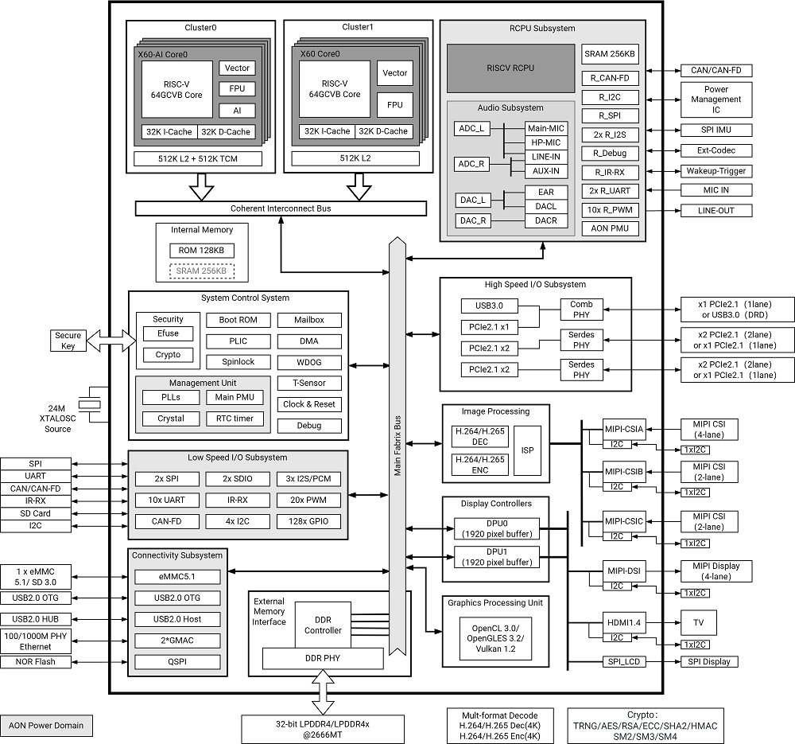
RISC-V for laptops: SpacemiT K1 -V60
Dual-cluster Octa-core processors
RISC-V 64GCVB architecture
- Cluster0
Quad-core
2.0TOPS AI-Power
32K L1-Cache per core
512K L2-Cache
512KB TCM
Vector-256bit
- Cluster1
Quad-core
32K L1-Cache per core
512K L2-Cache
Vector-256bit

Slide 13
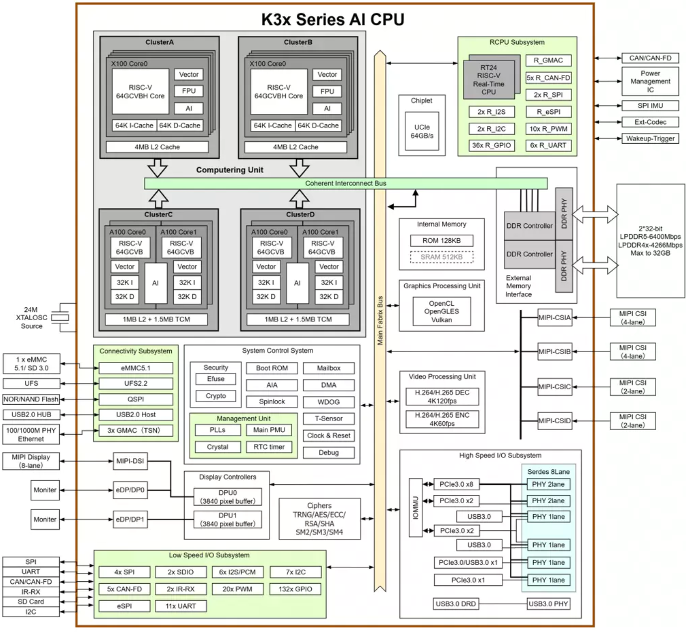
SpacemiT K3 -V100/A100
RVA23 profile (full hardware virtualization )
AI acceleration:
Dedicated A100 AI cores (homogeneous compute platform) delivering up to ~60 TOPS of AI performance.
Supports wide vector processing through RISC-V Vector (RVV) 1.0, up to 1024-bit operations for matrix tasks.
Multi-datatype support: FP16, BF16, FP8, INT8, INT4.
Can run up to medium-size AI models (e.g., ~30 B-parameter class) locally.

Slide 14
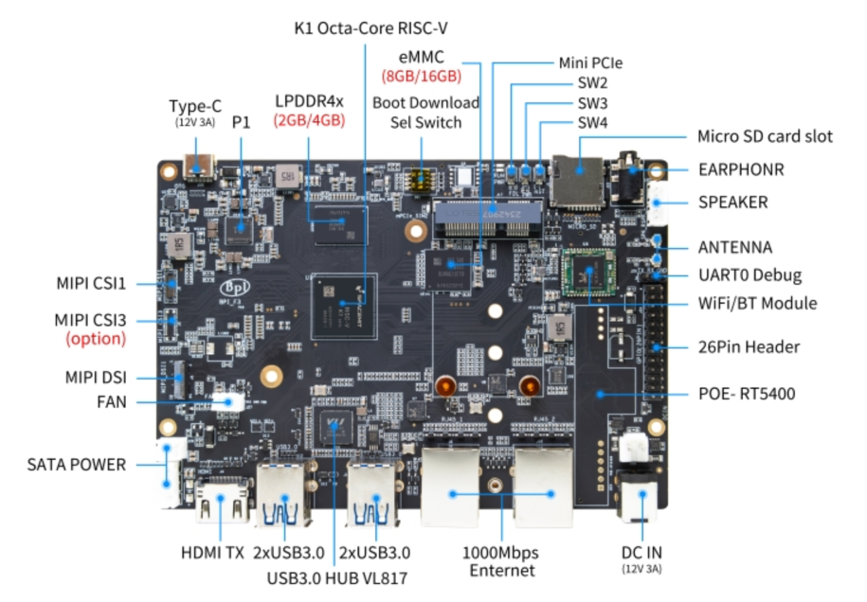
SpacemiT K1 - SBC

Slide 15
RISC-V in “few” words:
Prompt:
What are essential features of RISC-V architecture. Give the answer in few phrases.
Here are the essential features of the RISC-V architecture in a few phrases:
Open-Source ISA: Free and open instruction set architecture (ISA).
Simplicity: Designed for efficiency and ease of implementation.
Modular Design: Base ISA with optional standard extensions.
Scalability: Supports multiple data widths (RV32, RV64, RV128).
Reduced Complexity: Minimal instruction set with a focus on performance.
Extensibility: Allows custom instructions and vendor-specific extensions.
Portability: Suitable for diverse applications (embedded systems to supercomputers).
Endianness: Supports both little-endian and big-endian formats.
Energy Efficiency: Optimized for low-power consumption.
Wide Ecosystem: Growing tools and community support.

Slide 16
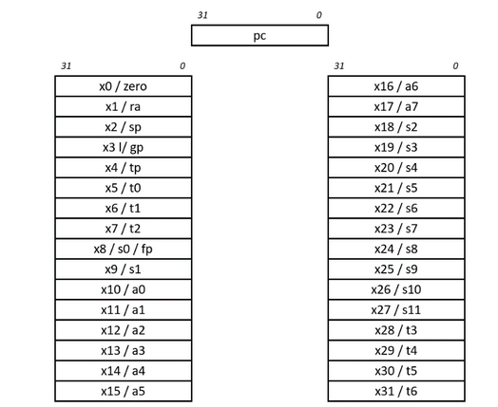
RISC-V ISA - registers (RV32I)
ra: Function return address.
sp: Stack pointer.
gp: Global data pointer.
tp: Thread-local data pointer.
t0-t6: Temporary storage.
fp: Frame pointer for function-local stack data (this usage is optional).
s0-s11: Saved registers (if the frame pointer is not in use, x8 becomes s0).
a0-a7: Arguments passed to functions. Any additional arguments are passed on the stack. Function return values are passed in a0 and a1.

Slide 17
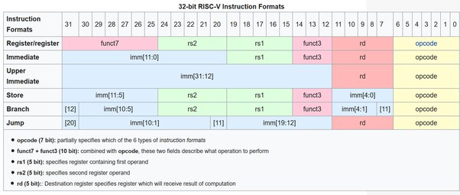
RISC-V ISA - formats
ISA computational instructions use a three-operand format, in which the first operand is the destination register, the second operand is a source register, and the third operand is either a second source register or an immediate value. This is an example three-operand instruction:
add x1, x2, x3

Slide 18
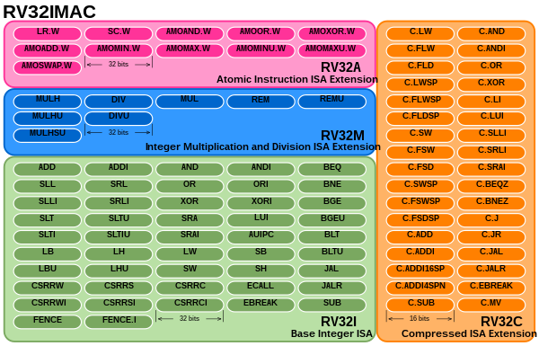
ISA - instructions/mnemonics

Slide 19
RISC-V : Software-Hardware
add a2,a2,a3
high level programming
mulw a5,a4,a5
addi s0,sp,32
assembly level programming
jr ra
USER - binaries
OS
I
M
A
F
D
C
V
B
S
R
I
UI
S
B
J
extension
type
design

Slide 20
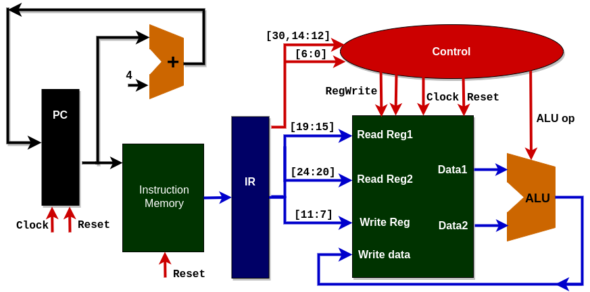
RISC-V : Software-Hardware
I
M
A
F
D
C
V
B
S
R
I
UI
S
B
J
extension
type
design
add a2,a2,a3

Slide 21
RISC-V : Software-Hardware
`include "CONTROL.v"
`include "DATAPATH.v"
`include "IFU.v"
module PROCESSOR(
input clock,
input reset,
output zero
);
wire [31:0] instruction_code;
wire [3:0] alu_control;
wire regwrite;
IFU IFU_module(clock, reset, instruction_code);
CONTROL control_module(instruction_code[31:25],instruction_code[14:12],
instruction_code[6:0],alu_control, regwrite);
DATAPATH datapath_module(instruction_code[19:15], instruction_code[24:20],
instruction_code[11:7], alu_control, regwrite, clock, reset, zero);
endmodule

Slide 22
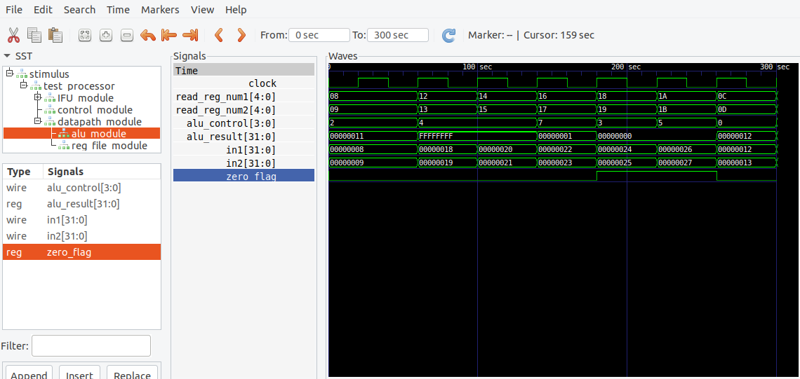
RISC-V : Software-Hardware
GTKWave waveforms

Slide 23
RISC-V: assembly code (K1)
Assembly code: sum of two numbers
.text
.globl _start
_start:
# Load two numbers into registers
li a0, 10 # Load immediate value 10 into register a0
li a1, 20 # Load immediate value 20 into register a1
# Perform addition
add a2, a0, a1 # a2 = a0 + a1 (10 + 20 = 30)
# Exit the program using ecall
li a7, 93 # Syscall number for exit
ecall # Make system call
$as add_simple.s -o add_simple.o
$ld add_simple.o -o add_simple
$./add_simple

Slide 24
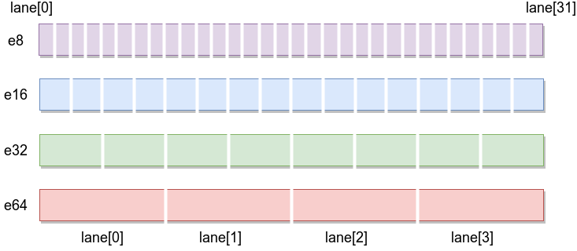
RISC-V: Vector extension (K1)
Assembly code: sum of two vectors
# c[i] = a[i] + b[i] for n elements (int32)
# a0=a, a1=b, a2=c, a3=n
.Lloop:
vsetvli t0, a3, e32, m1, ta, ma # choose VL for remaining int32s
vle32.v v0, (a0) # load A chunk
vle32.v v1, (a1) # load B chunk
vadd.vv v2, v0, v1 # v2 = v0 + v1
vse32.v v2, (a2) # store C chunk
slli t1, t0, 3 # bytes = VL*8
add a0, a0, t1 # bump pointers
add a1, a1, t1
add a2, a2, t1
sub a3, a3, t0 # remaining -= VL
bnez a3, .Lloop
ret
What each part means
vsetvli: configures SEW=32 (e32),LMUL=1 (m1),sets VL VLEN/32=8 (how many elems this pass).
vle32.v: loads VL 32-bit ints from the current pointer.
vadd.vv: lane-wise add.
vse32.v: stores VL results.
Pointer bump uses VL * sizeof(int32); loop repeats until a3==0.

Slide 25
RISC-V: add and printf
Complete assembly code: sum of two vectors with printf
# file: add_printf.s
.section .rodata
fmt: .asciz "a + b = %ld\n"
.section .text
.globl _start
_start:
li a0, 7 # a = 7
li a1, 5 # b = 5
add a2, a0, a1 # a2 = a + b
# Set up printf(fmt, a2)
la a0, fmt # a0 = &fmt (1st arg)
mv a1, a2 # a1 = sum (2nd arg)
call printf # jal ra, printf
li a0, 0 # return 0 from main
ret
Key ideas: note the use of gcc compiler – necessary to import libc
With libc, define _start.
First two args to printf go in a0, a1.
call printf is a convenient alias for jal ra, printf. (jump to address long with return address)
gcc -nostartfiles add_printf.s -o add_printf
% ./add_printf
a + b = 12

Slide 26
RVV: adding two vectors
.text
.globl vector_byte_add_rvv
vector_byte_add_rvv:
beqz a3, .Ldone # if n == 0, return
.Lloop:
# Choose VL for remaining elements, e8 lanes, LMUL=1.
# TA/MA: tail-agnostic, mask-agnostic (simple and fast).
vsetvli t0, a3, e8, m1, ta, ma # t0 := VL (number of lanes we'll process)
# Load a chunk from a and b
vle8.v v0, (a0) # v0 <- a[i .. i+VL-1]
vle8.v v1, (a1) # v1 <- b[i .. i+VL-1]
vadd.vv v2, v0, v1 # v2 <- v0 + v1
vse8.v v2, (a2)
mv t1, t0
add a0, a0, t1
add a1, a1, t1
add a2, a2, t1
sub a3, a3, t0
bnez a3, .Lloop
.Ldone:
ret
This code:
Works on any RVV hardware width
- Automatically scales
- Is portable
- Requires no rewrite for different vector sizes
- Vector Length Agnostic programming

Slide 27
RVV: adding two vectors
2 #include <stdio.h>
3 #include <stdint.h>
4 #include <stddef.h>
5 #include <time.h>
7 extern void vector_byte_add_rvv(const int8_t *a, const int8_t *b, int8_t *c, size_t n);
9 int main(void) {
10 clock_t startv, endv, start, end;
12 double elapsed_secv, elapsed_sec;
14 const int N = 32;
15 int8_t a[N], b[N], c[N];
16 int steps=1000000;
18 for (int i=0; i<N; i++) { a[i] = i; b[i] = i * 2; }
19 startv=clock();
21 for(int i=0;i<steps;i++) vector_byte_add_rvv(a, b, c, N);
22 endv=clock();
23 elapsed_secv = (double)(endv - startv) / CLOCKS_PER_SEC;
24 start=clock();
25 for(int i=0;i<steps;i++)
26 { for( int j=0;j<32;j++) c[j] = a[j] + b[j];}
27 end=clock();
28 elapsed_sec = (double)(end - start) / CLOCKS_PER_SEC;
30 printf("Addition result:\n");
31 for (int i=0; i<N; i++) { printf("%d + %d = %d\n", a[i], b[i], c[i]);}
34 printf("Vector execution time: %.6f sec\n",elapsed_secv);
35 printf("Scalar execution time: %.6f sec\n",elapsed_sec);
36 printf("Speed-up: %.3f \n",elapsed_sec/elapsed_secv);
37 return 0;
38 }
%gcc -O1 -march=rv64gcv vector_byte_add_rvv.s vector_byte_add.c -o vector_byte_add
% ./vector_byte_add
..
30 + 60 = 90
31 + 62 = 93
Vector execution time: 0.013269 sec
Scalar execution time: 0.132186 sec
Speed-up: 9.962 sec

Slide 28
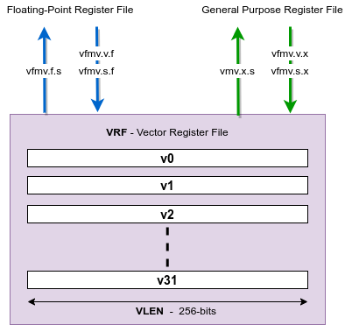
Summary
The rise of RISC-V open architecture exponential growth of cores
RISC-V open source & business model
RISC-V optimized & extensible ISA
RISC-V - RVV hardware
- Automatically scales
- Is portable
- Requires no rewrite for different vector sizes
- Vector Length Agnostic programming

Slide 29
RISC-V International – November 2024

