Slide 1
“RISC-V design”
“Rise of RISC-V: The computer chip design you need to know about”

Slide 2
RISC-V : Hardware Design
I
M
A
F
D
C
V
S
R
I
UI
S
B
J
extension
type
RTL – Verilog : busses,registers,ALUs,memories,decoders,..
Logic - Verilog: and,or,xor,nand,..
FPGA
masks/ASIC
design

Slide 3
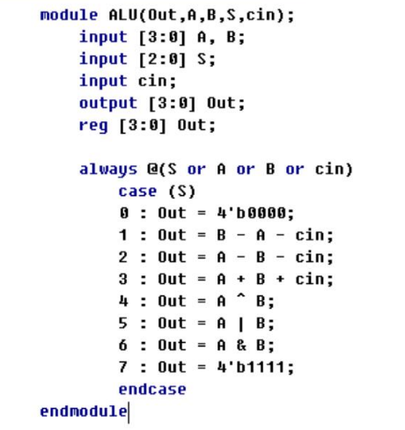
RISC-V : Software-Hardware
RTL - design

Slide 4
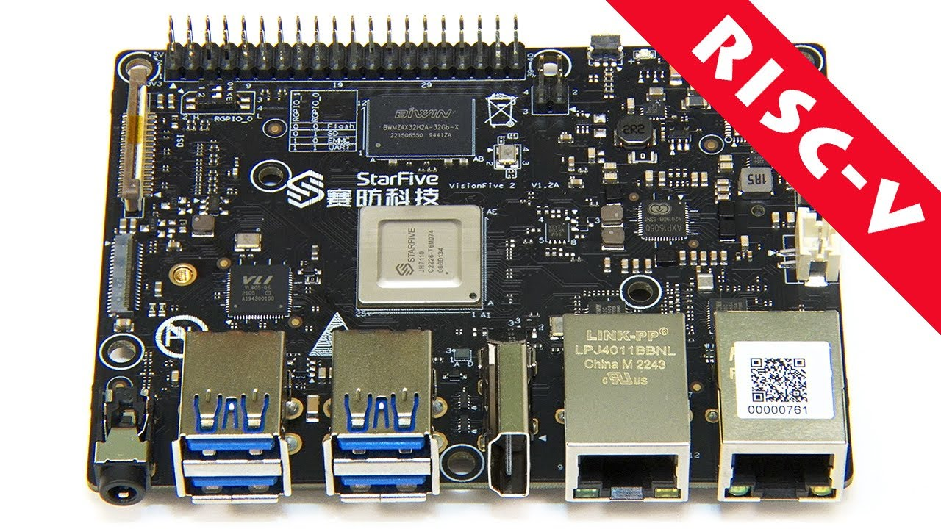
StarFive VisionFive 2 design
VisionFive 2 is high-performance RISC-V single board computer (SBC) with an integrated GPU.
JH7110
(SiFive)

Slide 5
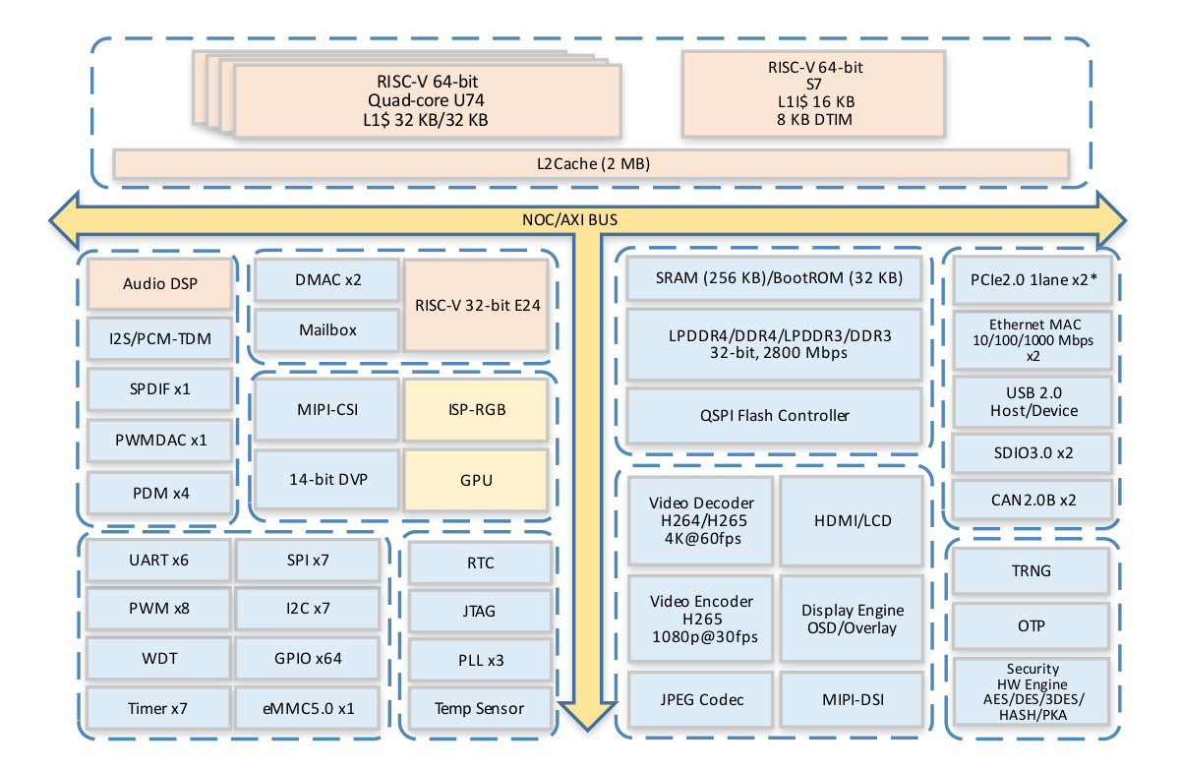
StarFive - JH7110
JH7110 is a high-performance RISC-V SoC with 64 bit quad-core processor (SiFive U74) and 1.5GHz frequency. It integrates high-speed interfaces and GPU, enabling stronger image processing capabilities, such as 3D rendering.
Quad-core U74 (SiFive)

Slide 6
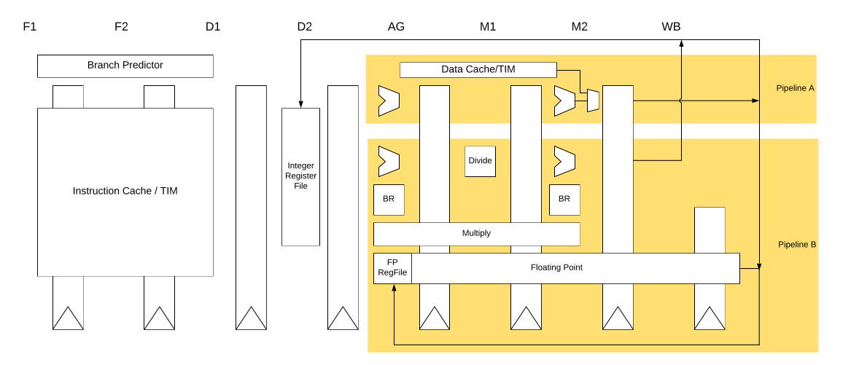
SiFive U74 pipeline – 8 stages
SiFive U74 - The S7 execution unit is a dual-issue, in-order pipeline (8-stages).
- instruction fetch (F1 and F2),
- instruction decode (D1 and D2), address generation (AG),
- data memory access (M1 and M2), and register write-back (WB).

Slide 7
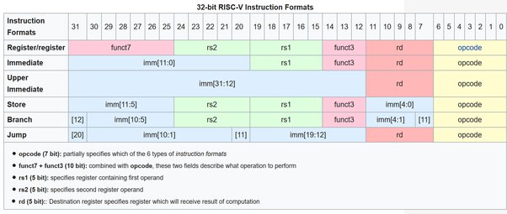
RISC-V ISA - formats
R
I
UI
S
B
J
ISA computational instructions use a three-operand format, in which the first operand is the destination register, the second operand is a source register, and the third operand is either a second source register or an immediate value. This is an example three-operand instruction:
add x1,x2,x3

Slide 8
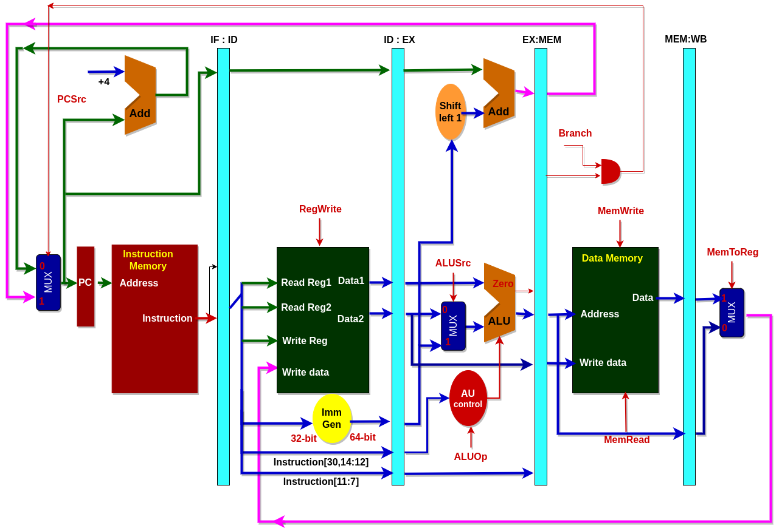
Our design : with pipeline
4-stage pipeline:
- InstructionFetch (IF)
- DataRead (DR)
- Execute (EX)
- WriteBack (WB)

Slide 9
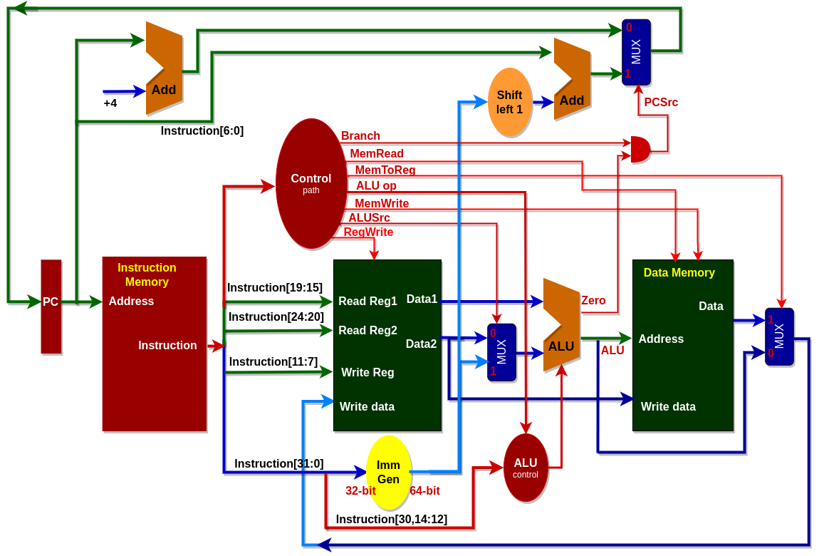
Our design – without pipeline
No pipeline:
One clock cycle !
(very long)

Slide 10
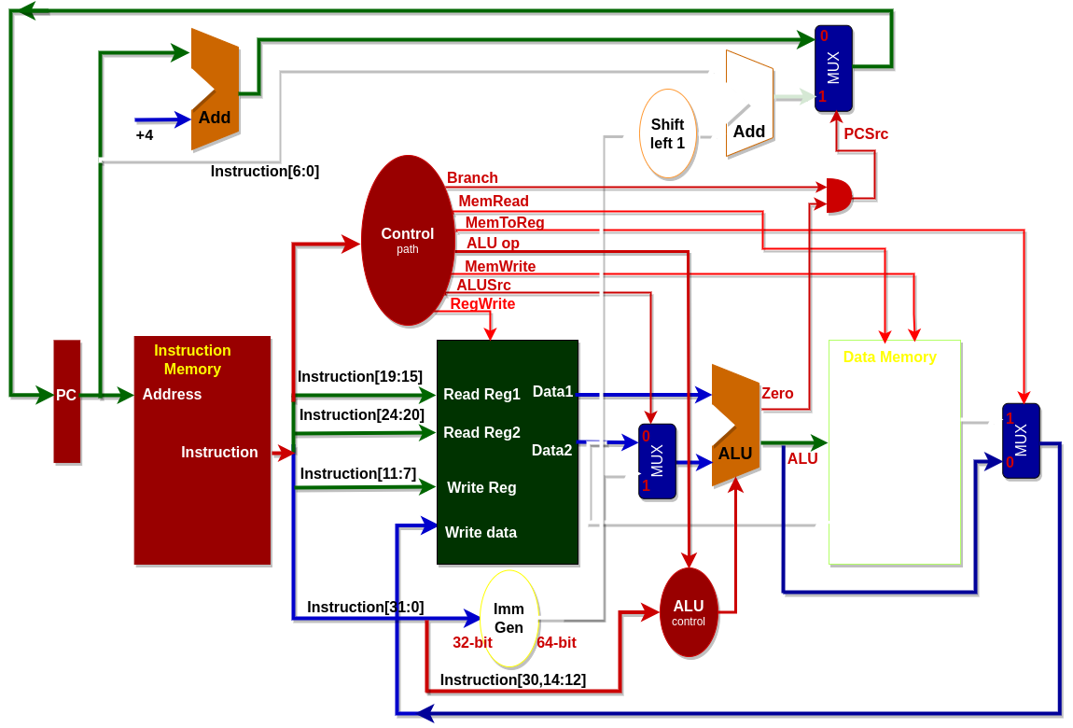
Our design: R-type only
R-type only:
Instruction Memory + PC
Registers
ALU

Slide 11
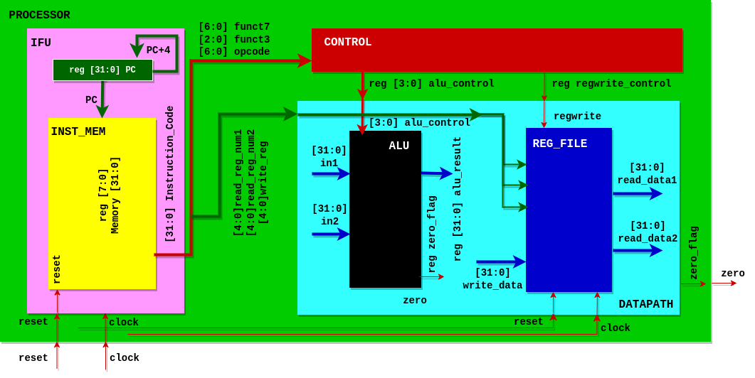
Our design : Verilog model
IFU : Instruction Fetch Unit (INST_MEM: Instruction Memory + PC)
DATAPATH: ALU + REG_FILE: Register File
CONTROL

Slide 12
Our design: PROCESSOR
`include "CONTROL.v"
`include "DATAPATH.v"
`include "IFU.v"
module PROCESSOR(
input clock,
input reset,
output zero
);
wire [31:0] instruction_code;
wire [3:0] alu_control;
wire regwrite;
IFU IFU_module(clock, reset, instruction_code);
CONTROL control_module(instruction_code[31:25],instruction_code[14:12],
instruction_code[6:0],alu_control, regwrite);
DATAPATH datapath_module(instruction_code[19:15], instruction_code[24:20],
instruction_code[11:7], alu_control, regwrite, clock, reset, zero);
endmodule

Slide 13
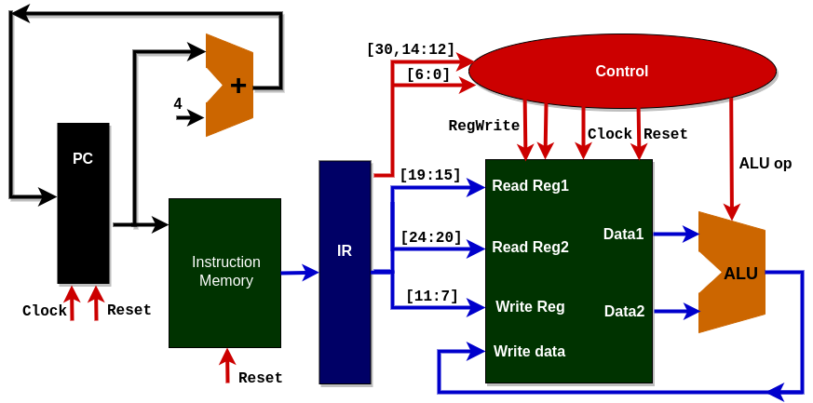
Our design: Lab3
Lab3
with iverilog and gtkwave
bako@lpi4a:~/lab3$iverilog riscv.v riscv_tb.v –o riscv_model
bako@lpi4a:~/lab3$vvp riscv_model
bako@lpi4a:~/lab3$gtkwave riscv_wave.vcd

Slide 14
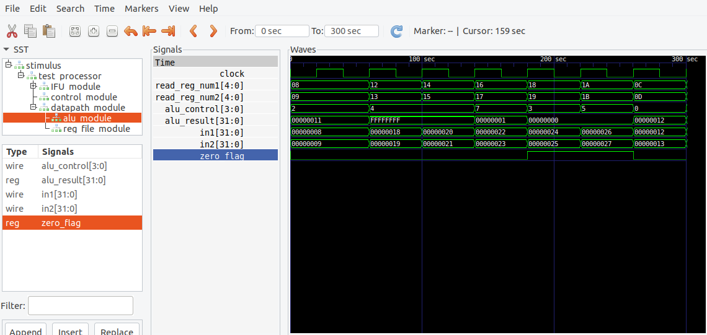
Our design: Lab3
GTKWave waveforms

Slide 15
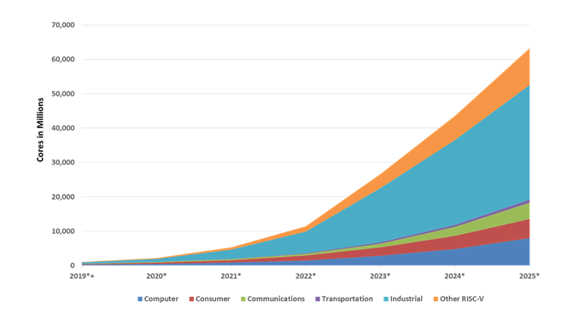
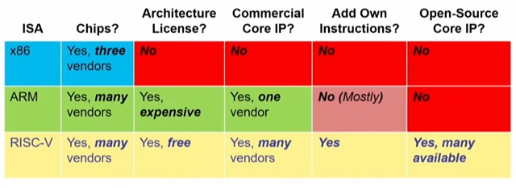
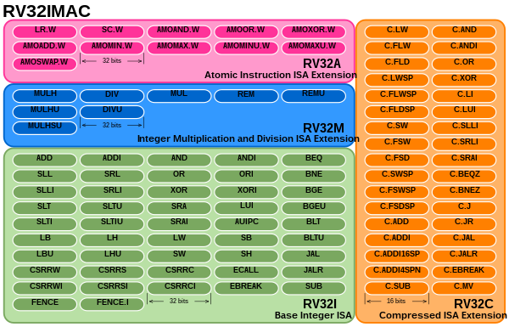

Evaluation !
Write min 2 pages on topic:
RISC-V est notre avenir !
RISC-V is our future !
RISC-V shì wǒmen de wèilái!

