Slide 1
“From Intel x86 to RISC-V”
“Rise of RISC-V: The computer chip design you need to know about”

Slide 2
Three dominant IS Architectures
Past:
Intel x86 – controllers, PCs, servers, ..
Now:
ARM – controllers, smart-phones, laptops, PCs, servers
Future:
RISC-V – .. now: controllers, SBCs, laptops,
    .. soon: PCs, smart-phones, servers

Slide 3

Past: Intel x86 – PCs, servers, ..
Why Past
Generations : 8080 : 8-bit, 8086: 16-bit, 80386: 32-bit, .., I3,5,7,9)
CISC architecture: many formats → CISC to RISC transcoder
no low power design : the designs for stationary use
closed design: no standard (open) HDLs
closed production: mainly produced by the designer company
  Intel IDM: integrated device manufacturer
  AMD : fabless + TSMC silicon foundry

Slide 4
Now: ARM – MCU, phones, PCs, servers
Why Now
Generations: ARM1-11, ARM-Cortex, M,R,A,X
RISC architecture versions: Cortex-A v6,v7,v8,v9
Low power: mobile phones, IoT, ..
Design IPs with licenses : Verilog (synthesis)
    Problem:
      high license – model cost : $100K to $10M or more
      royalties : 1.2% for each chip

Slide 5
Future: RISC-V all devices
Why Future
Standardized ISA formats: 32, 64, and 128-bit
Optimized (for performance) RISC architecture
No ISA use licenses – “open source”
Many open source (mainly Verilog) and licensed designs
Designers free to implement internal architectures
Designers free to add specific ISA extensions (IA, IoT,..)
Great competition : hundreds/thousands designs

Slide 6
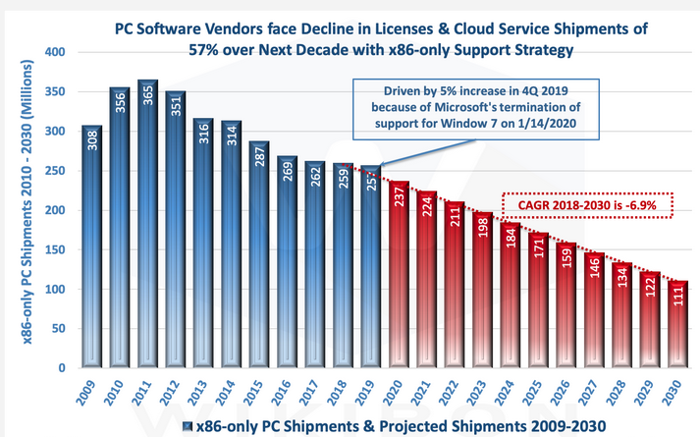
The numbers of produced units
2021: Intel x86 – 400 M

Slide 7
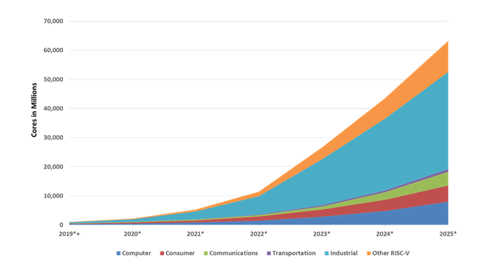
The numbers of produced cores
2022: RISC-V 12 billions
2024: RISC-V 45 billions (RISC-V cores/head)
exponential growth

Slide 8
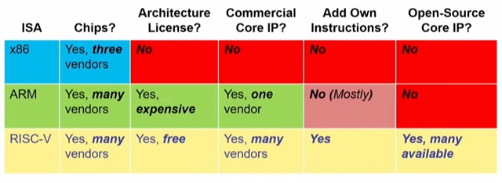
ISA - business models

Slide 9
ISA - design & fabrication (CPUs)
Design: World & fab : Asia
RISC-V
World
2020 - .. ?
Design: West & fab : Asia
ARM
West
2000 - 2050 ?
Intel
X86
USA
Design & fab : USA
1980 - 2040 ?
origin..
extinction ?

Slide 10
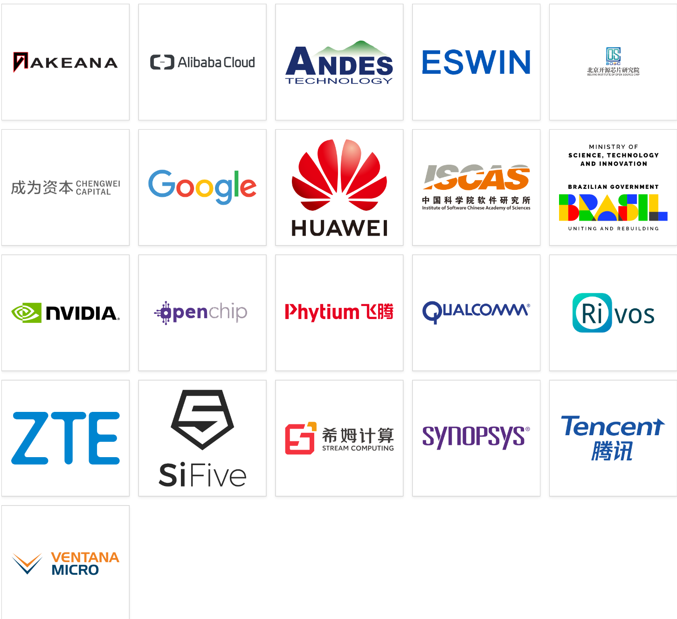






RISC-V : prime members - 2024
Asia: ~90% standardization decision
~80% of design
~90% of fabrication

Slide 11
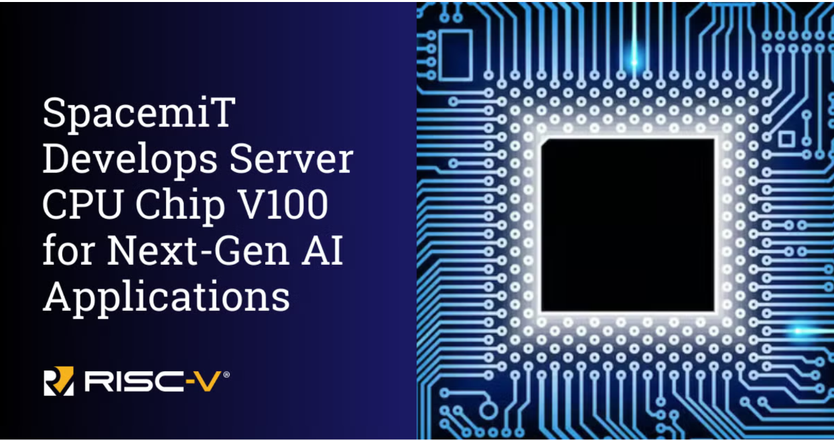
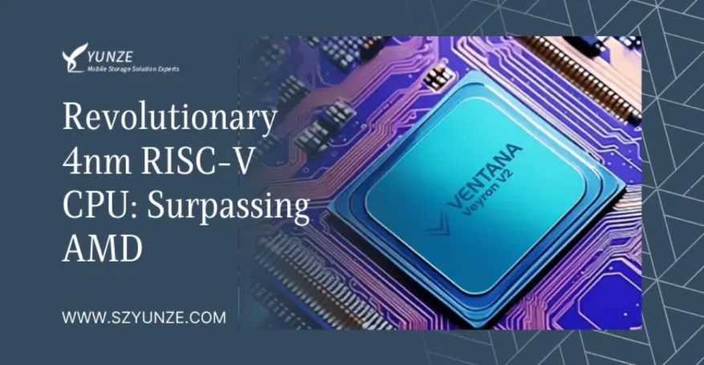
RISC-V for servers - 2025
SpacemiT Vital Stone V100. The chip represents an advancement in RISC-V technology, providing a complete hardware and software platform designed to meet server specifications.
Ventana’s 192-core Veryon V2 surpasses AMD’s Genoa and Bergamo. Veryon V2 will be released into the market in 2025

Slide 12
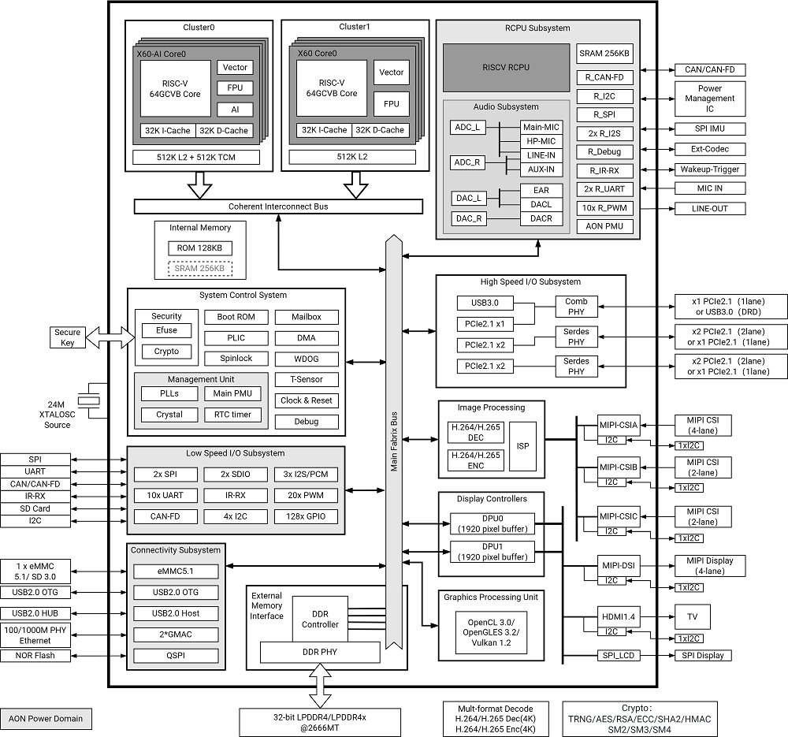
RISC-V for laptops: SpacemiT K1 -V60
Dual-cluster Octa-core processors
RISC-V 64GCVB architecture
- Cluster0
Quad-core
2.0TOPS AI-Power
32K L1-Cache per core
512K L2-Cache
512KB TCM
Vector-256bit
- Cluster1
Quad-core
32K L1-Cache per core
512K L2-Cache
Vector-256bit

Slide 13
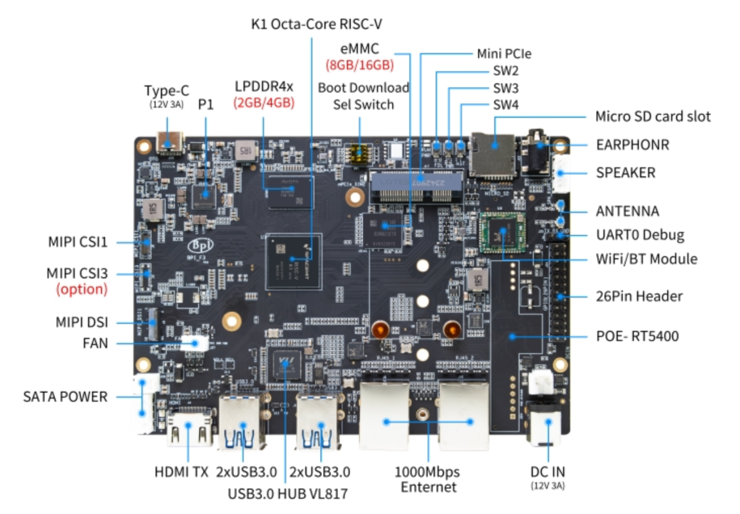
SpacemiT K1 - SBC

Slide 14
RISC-V in “few” words:
Prompt:
What are essential features of RISC-V architecture. Give the answer in few phrases.
Here are the essential features of the RISC-V architecture in a few phrases:
Open-Source ISA: Free and open instruction set architecture (ISA).
Simplicity: Designed for efficiency and ease of implementation.
Modular Design: Base ISA with optional standard extensions.
Scalability: Supports multiple data widths (RV32, RV64, RV128).
Reduced Complexity: Minimal instruction set with a focus on performance.
Extensibility: Allows custom instructions and vendor-specific extensions.
Portability: Suitable for diverse applications (embedded systems to supercomputers).
Endianness: Supports both little-endian and big-endian formats.
Energy Efficiency: Optimized for low-power consumption.
Wide Ecosystem: Growing tools and community support.

Slide 15
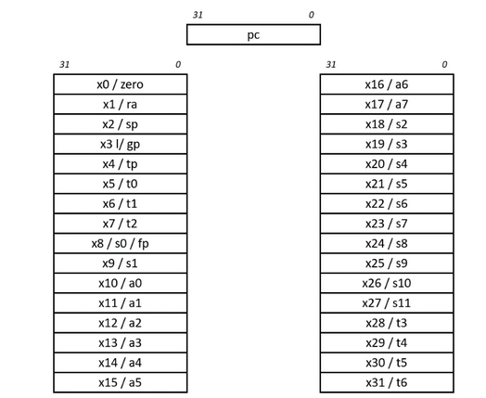
RISC-V ISA - registers (RV32I)
ra: Function return address.
sp: Stack pointer.
gp: Global data pointer.
tp: Thread-local data pointer.
t0-t6: Temporary storage.
fp: Frame pointer for function-local stack data (this usage is optional).
s0-s11: Saved registers (if the frame pointer is not in use, x8 becomes s0).
a0-a7: Arguments passed to functions. Any additional arguments are passed on the stack. Function return values are passed in a0 and a1.

Slide 16
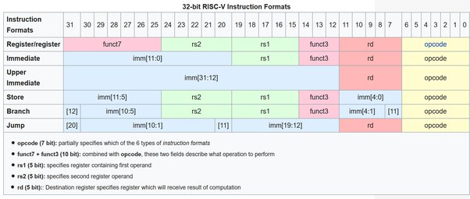
RISC-V ISA - formats
ISA computational instructions use a three-operand format, in which the first operand is the destination register, the second operand is a source register, and the third operand is either a second source register or an immediate value. This is an example three-operand instruction:
add x1, x2, x3

Slide 17
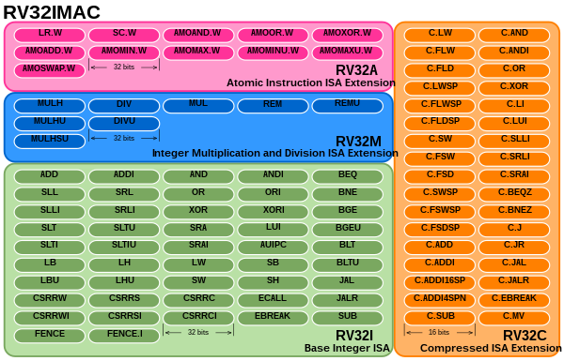
ISA - instructions/mnemonics

Slide 18
RISC-V : Software-Hardware
add a2,a2,a3
high level programming
mulw a5,a4,a5
addi s0,sp,32
assembly level programming
jr ra
USER - binaries
OS
I
M
A
F
D
C
V
B
S
R
I
UI
S
B
J
extension
type
design

Slide 19
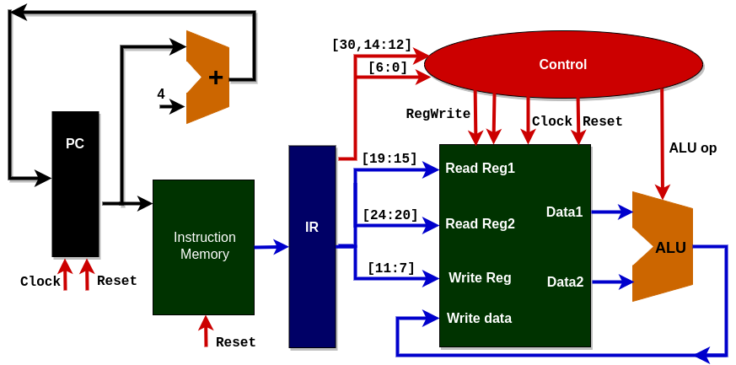
RISC-V : Software-Hardware
I
M
A
F
D
C
V
B
S
R
I
UI
S
B
J
extension
type
design
add a2,a2,a3

Slide 20
RISC-V : Software-Hardware
`include "CONTROL.v"
`include "DATAPATH.v"
`include "IFU.v"
module PROCESSOR(
input clock,
input reset,
output zero
);
wire [31:0] instruction_code;
wire [3:0] alu_control;
wire regwrite;
IFU IFU_module(clock, reset, instruction_code);
CONTROL control_module(instruction_code[31:25],instruction_code[14:12],
instruction_code[6:0],alu_control, regwrite);
DATAPATH datapath_module(instruction_code[19:15], instruction_code[24:20],
instruction_code[11:7], alu_control, regwrite, clock, reset, zero);
endmodule

Slide 21
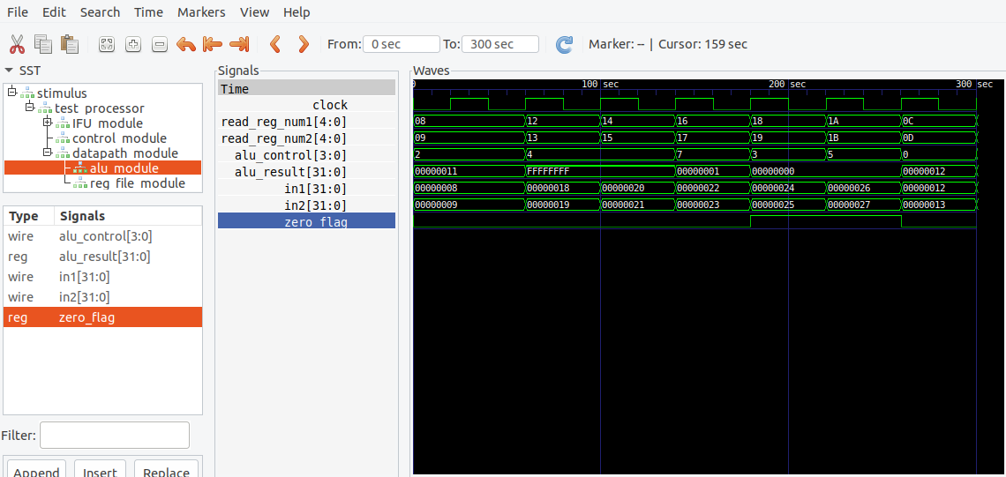
RISC-V : Software-Hardware
GTKWave waveforms

Slide 22
Summary
The rise of RISC-V open architecture exponential growth of cores
RISC-V open source & business model
RISC-V optimized & extensible ISA
RISC-V architecture & Verilog synthetisable models

Slide 23
RVLabs : Plabs & MLabs
PLabs: Lab1, Lab2, Lab3, ..
RISC-V ISA and assembly programming
add a2,a2,a3
mulw a5,a4,a5
addi s0,sp,32
jr ra
Mlabs: Lab1, Lab2, Lab3, ..
RISC-V design:
architecture &
Verilog models
case(alu_control)
4'b0000: alu_result = in1&in2;
4'b0001: alu_result = in1|in2;
4'b0010: alu_result = in1+in2;
4'b0100: alu_result = in1-in2;

Slide 24
RISC-V International – November 2024

