Slide 1
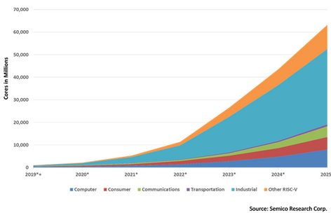
Programming and Modeling RISC-V ISA
RISC-V assembly programming and Verilog RTL modeling
ISA – bilateral : Software/Hardware
self-contained : RISC-V on RISC-V
affordable-available : ~100€
RISC-V cores

Slide 2

RVLabs – RVPLabs & RVMLabs
RVPLabs - Software – ISA
Lab 1 – assemble with C libraries : gcc
Lab 2 – assemble and debug with : as, ld, gdb
RVMLabs - Hardware – ISA
Lab 1 – modeling with Verilog
Lab 2 – modeling RV32I and RV32IM

Slide 3
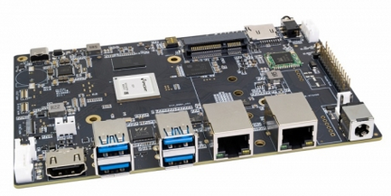
RISC-V : Software ISA (assembly)
C programming + intrinsics (V)
RV64
Assembly level programming
USER - binaries
OS
I
M
A
F
D
C
V
B
AI
S
SpacemiT K1 - X60
PLabs

Slide 4
RISC-V : Hardware ISA (Verilog)
I
M
A
F
D
C
V
B
AI
S
R
I
U
S
B
J
defined with Verilog
type
RTL – Verilog : busses,registers,ALUs,memories,decoders,..
Logic - Verilog: and,or,xor,nand,..
MLabs

Slide 5
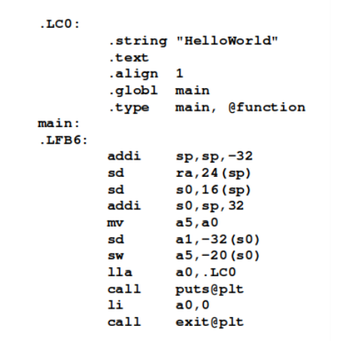
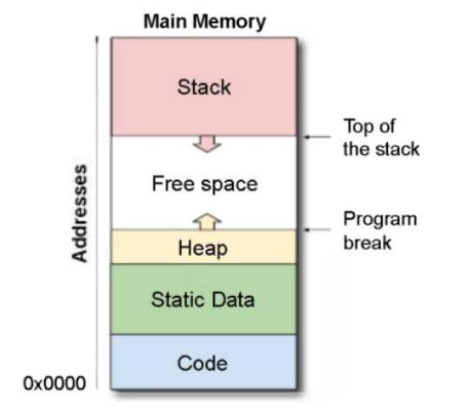
PLab1 : assemble with gcc

Slide 6
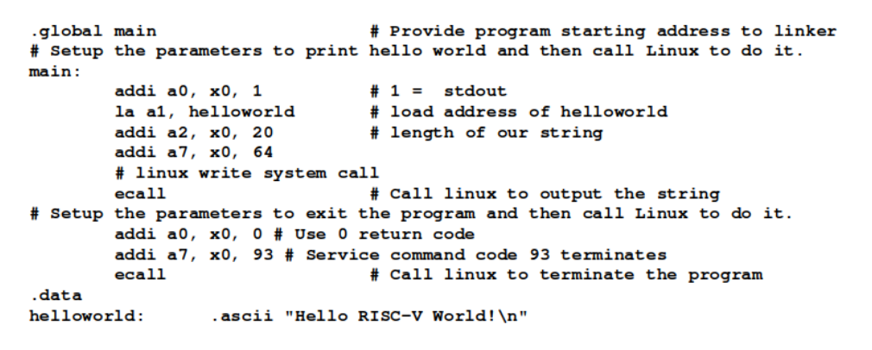
PLab2 : as, ld and gdb
puts (a7): 20 characters (a2)
on stdio a0=1, address in a1
exit (a7) with (a0=0)

Slide 7
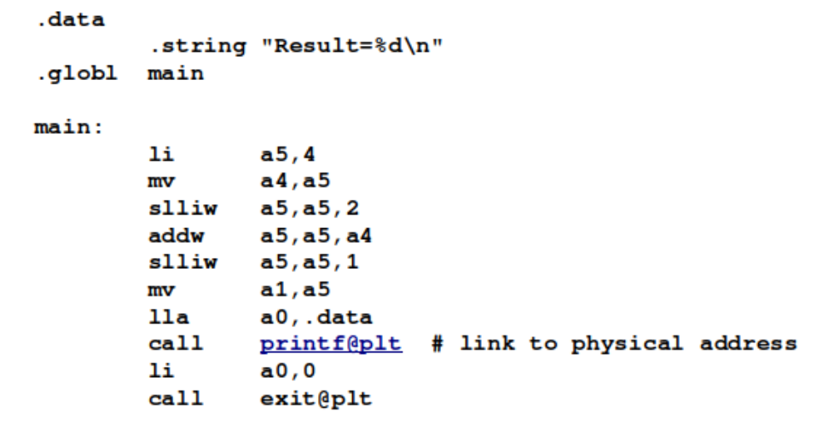
PLabs : arithmetics
MultTen.s
only add and shift
gcc MultTen.s -g -nostartfiles -o MultTen
riscv64-linux-gnu-objdump -d MultTen

Slide 8
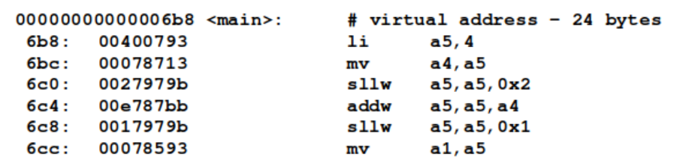
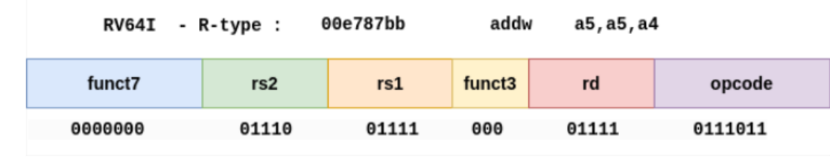
PLabs : arithmetics

Slide 9
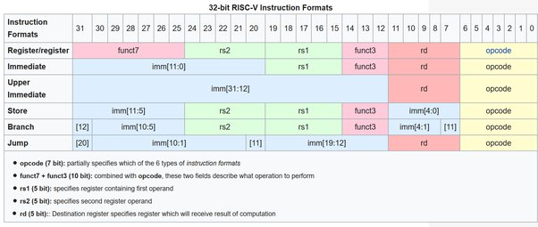
RV32I ISA - formats
ALUop: 0000000
R
I
U
S
B
J
addw a5,a5,a4
addw x15,x15,x14

Slide 10
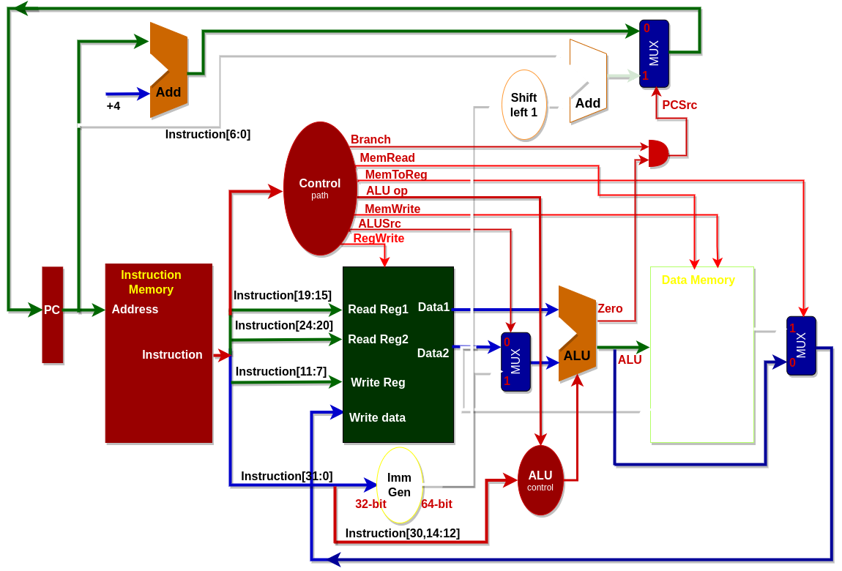
MLabs : Verilog (1) & Modeling (2-..)
MLab2.1
R-type only:
Instruction Memory + PC
Registers +ALU

Slide 11
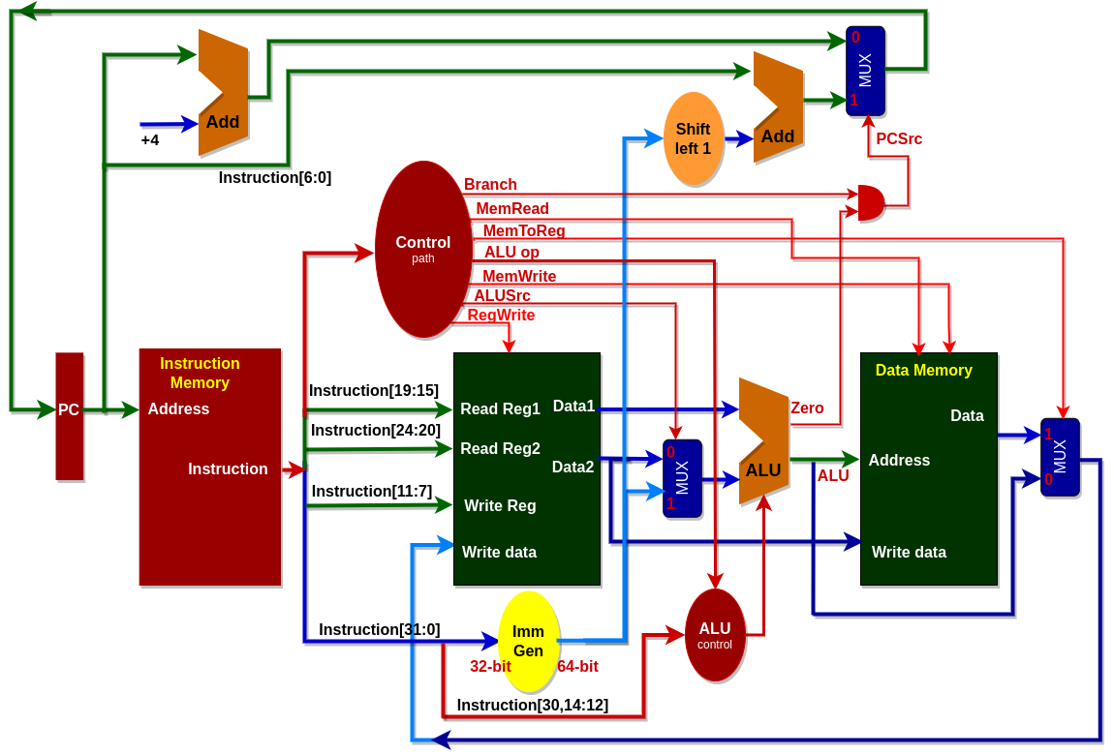
MLab 2.2 & 2.3 : RV32I & RV32IM
MLab2.2 & MLab2.3
RV32I & RV32IM

Slide 12
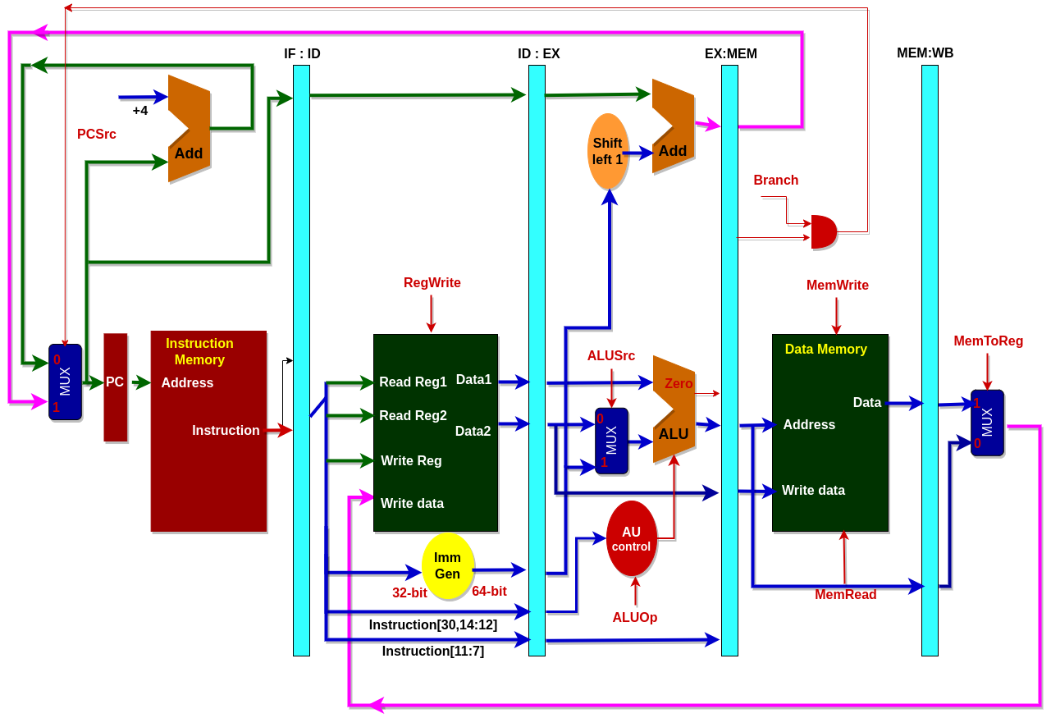
MLabs3,4 .. : RV32I pipeline
MLab3, MLab4:
5-stage pipeline
- Program Counter (PC)
- InstructionFetch (IF)
- DataRead (DR)
- Execute (EX)
- WriteBack (WB)

Slide 13
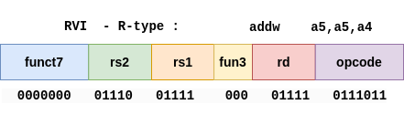
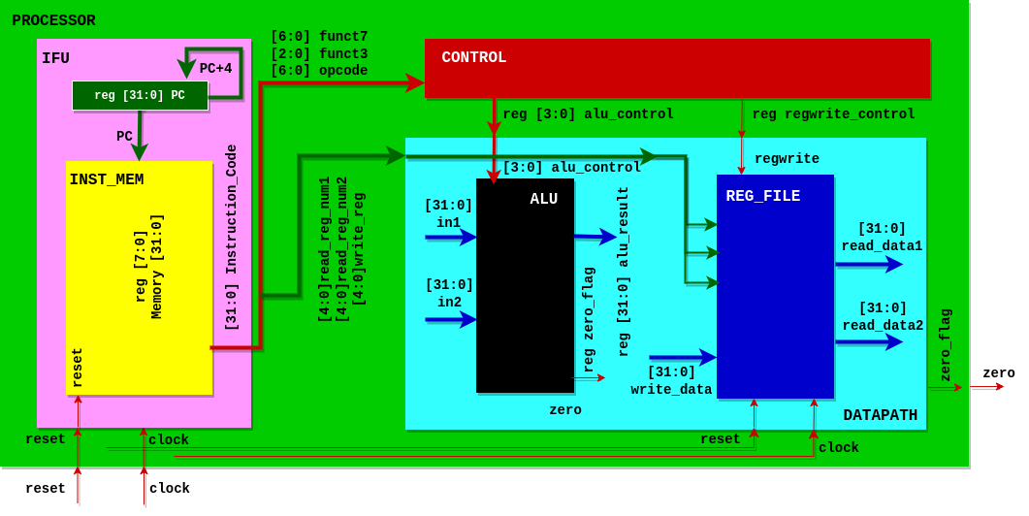
MLab2.1 : First design: R-type

Slide 14
MLab2.1 : PROCESSOR
`include "CONTROL.v"
`include "DATAPATH.v"
`include "IFU.v"
module PROCESSOR(
input clock,
input reset,
output zero
);
wire [31:0] instruction_code;
wire [3:0] alu_control;
wire regwrite;
IFU IFU_module(clock, reset, instruction_code);
CONTROL control_module(instruction_code[31:25],instruction_code[14:12],
instruction_code[6:0],alu_control, regwrite);
DATAPATH datapath_module(instruction_code[19:15], instruction_code[24:20],
instruction_code[11:7], alu_control, regwrite, clock, reset, zero);
endmodule

Slide 15
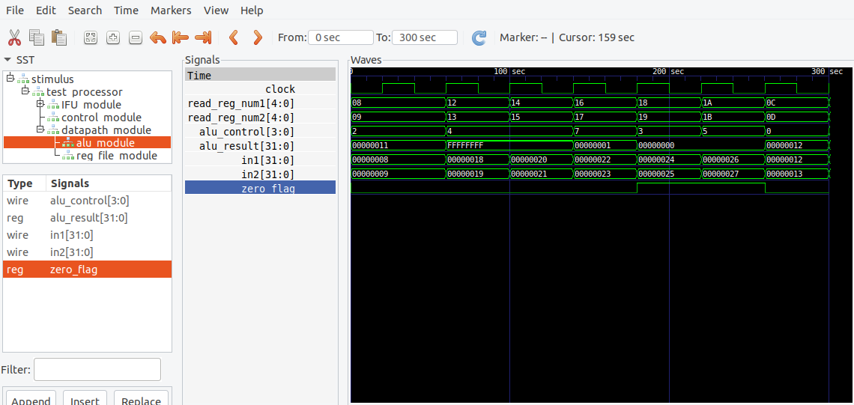
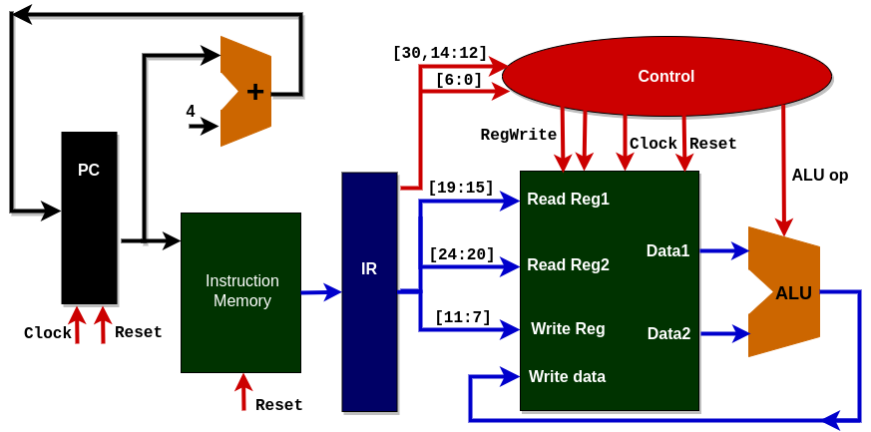
MLab2.1 : test & waveforms
GTKWave waveforms

Slide 16
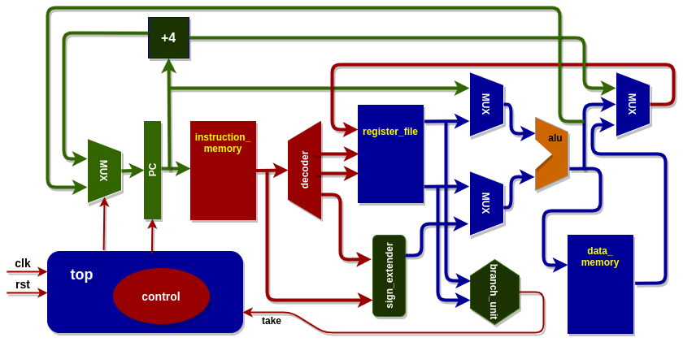
MLab2.2 : RV32I architecture
RV32I architecture
RV32I Verilog model (modules)

Slide 17
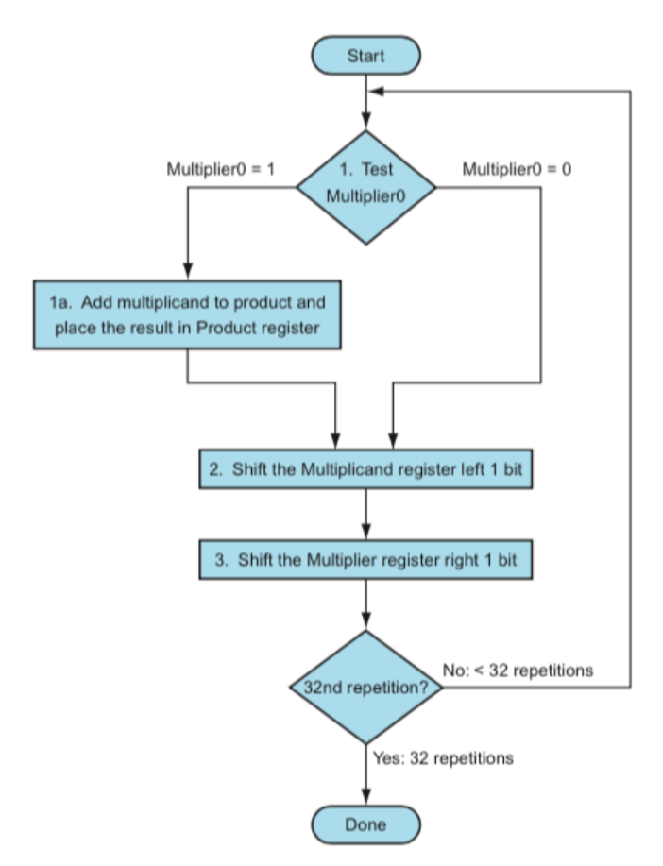
MLab2.2 : binary program & test
The following is our test program elaborated in programming labs PLab2 with the debugging test of macros.
// instructions.hex
00000013 // addi x0, x0, 0 -nop
00000013 // addi x0, x0, 0 -nop
00600313 // li t1,6 : 0x000
00700393 // li t2,7 : 0x004
00000e13 // li t3,0 : 0x008
02000593 // li a1,32 : 0x00c
0013f293 // andi t0,t2,1 : 0x010
00028463 // beqz t0,0x101ac <skip_add> : 0x014
006e0e33 // add t3,t3,t1 : 0x018
00131313 // slli t1,t1,0x1 : 0x01c
0013d393 // srli t2,t2,0x1 : 0x020
fff58593 // addi a1,a1,-1 : 0x024
fe0594e3 // bnez a1,0x101a0 <loop> : 0x028
00000013 // addi x0, x0, 0 -nop

Slide 18
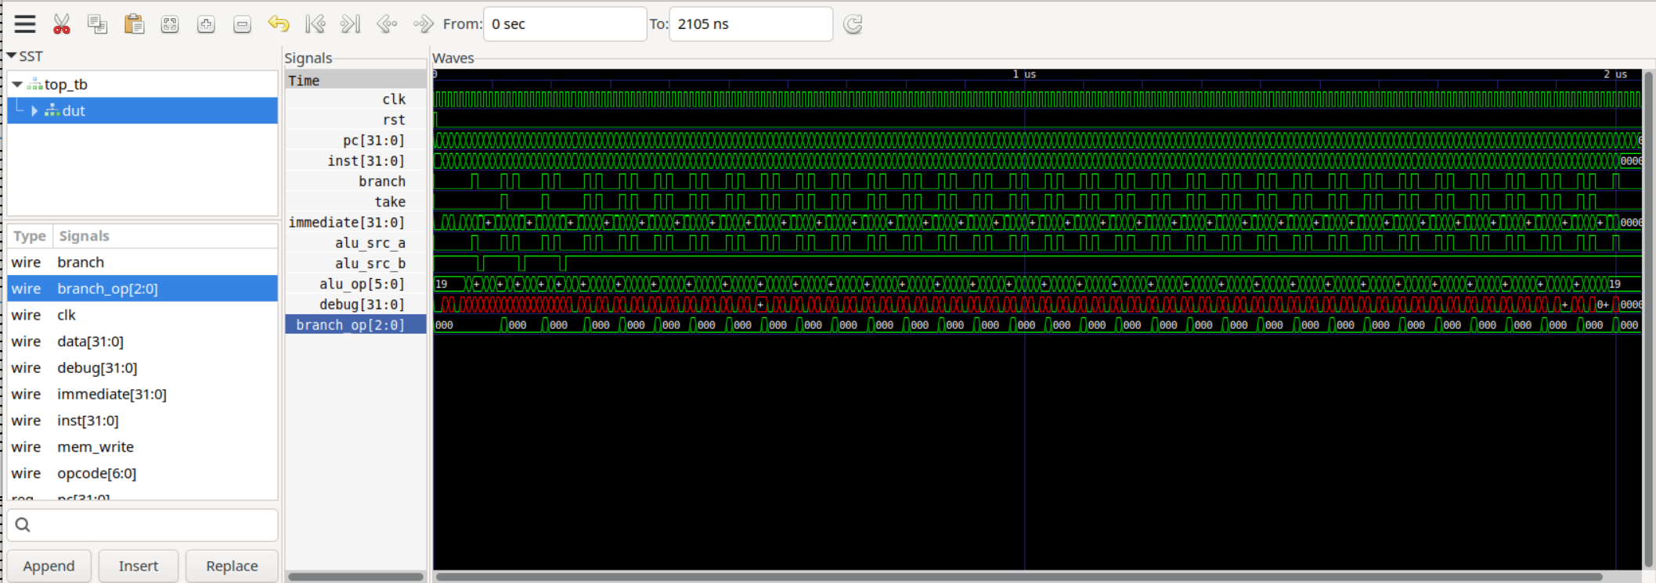
MLab2.2 : test and waveforms
Multiplication cycle: 32 steps

Slide 19
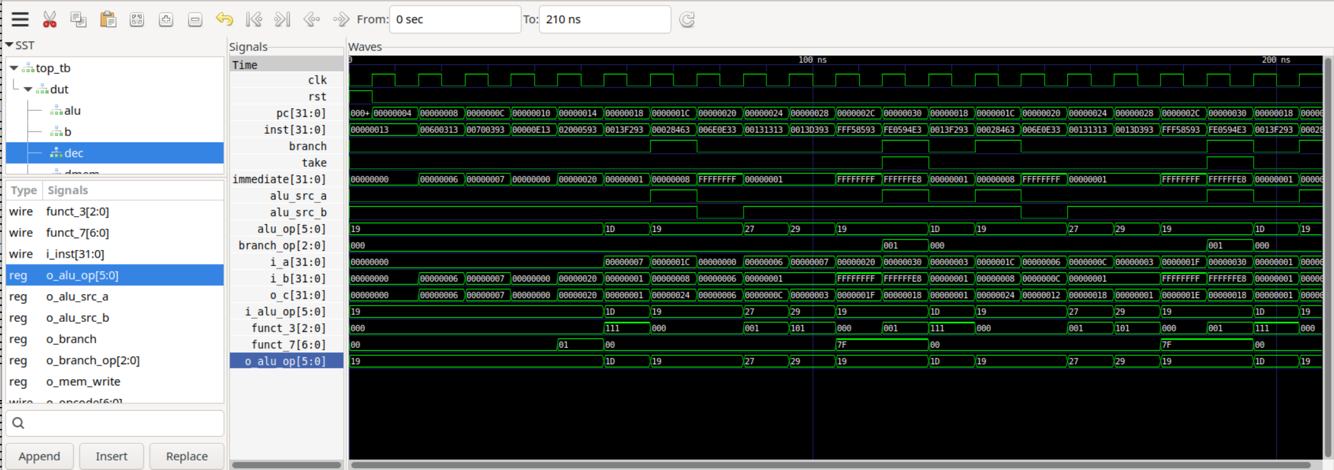
MLab2.2 : test and waveforms
0x06*0x07 = 0x24

Slide 20
MLab2.3 : RV32IM – final project
Final project:
1. Programming assembly function (macro) for pow(a,b)
2 Disassembly to binary code
3. Implement on the RV32IM model with multiplication instructions.
Decoding:
MUL, MULH, DIV, DIVU, REM, REMU
Extending:
MUL, MULH, DIV, DIVU, REM, REMU

Slide 21
MLab2.3 : program & disassemble
.section .data
result: .word 0 # Memory space to store the result
.section .text
.globl _start
# Macro Definition: Computes result = base ^ exponent
.macro power_mult result, base, exponent
li \result, 1 # Initialize result with 1
beqz \exponent, end_\@ # If exponent is 0, jump to end (result = 1)
loop_\@:
mul \result, \result, \base # result *= base
addi \exponent, \exponent, -1 # Decrement exponent
bnez \exponent, loop_\@ # Repeat until exponent == 0
end_\@:
.endm
_start:
# Load base and exponent
li t1, 3 # t1 = base = 3
li t2, 4 # t2 = exponent = 4
# Call the power_mult macro: power_mult t3, t1, t2
power_mult t3, t1, t2
# Store result in memory
la t0, result # Load address of result in t0
sw t3, 0(t0) # Store t3 (result) to memory
# Exit the program (using an environment call)
li a7, 93 # ECALL for exit
ecall

Slide 22
MLab2.3 : program & disassemble
(gdb) b _start
Note: breakpoints 1, 2 and 3 also set at pc 0x100e8.
Breakpoint 4 at 0x100e8: file macro_pow.s, line 22.
(gdb) disassemble /r &_start, +56
Dump of assembler code from 0x100e8 to 0x10120:
0x00000000000100e8 <_start+0>: 00002197 auipc gp,0x2
0x00000000000100ec <_start+4>: 83818193 addi gp,gp,-1992 # 0x11920
0x00000000000100f0 <_start+8>: 00300313 li t1,3
0x00000000000100f4 <_start+12>: 00400393 li t2,4
0x00000000000100f8 <_start+16>: 00100e13 li t3,1
0x00000000000100fc <_start+20>: 00038863 beqz t2,0x1010c <end_0>
0x0000000000010100 <loop_0+0>: 026e0e33 mul t3,t3,t1
0x0000000000010104 <loop_0+4>: fff38393 addi t2,t2,-1
0x0000000000010108 <loop_0+8>: fe039ce3 bnez t2,0x10100 <loop_0>
0x000000000001010c <end_0+0>: 00001297 auipc t0,0x1
0x0000000000010110 <end_0+4>: 01428293 addi t0,t0,20 # 0x11120
0x0000000000010114 <end_0+8>: 01c2a023 sw t3,0(t0)
0x0000000000010118 <end_0+12>: 05d00893 li a7,93
0x000000000001011c <end_0+16>: 00000073 ecall

Slide 23
MLab2.3 : load in instruction.hex
Copy the red part of the disassembled code and use it in the instructions.hex file loaded into simulated instruction_memory.v .
Replace other instructions with nop instruction: 00000013
00000013 // addi x0, x0, 0 -nop
00000013 // addi x0, x0, 0 -nop
00300313 // li t1,3 : 0x000
00400393 // li t2,4 : 0x004
00100e13 // li t3,1 : 0x008
00838663 // beq t2, zero, 0x1010c <end_0> : bne t0,zero, offset (4*2)
026e0e33 // mul t3,t3,t1 : 0x018
fff38393 // addi t2,t2,-1 : 0x024
fe039ce3 // bnez t2,0x10100 <loop_0> : 0x028
00000013 // addi x0, x0, 0 -nop
00000013 // addi x0, x0, 0 -nop
00000013 // addi x0, x0, 0 -nop

Slide 24
MLab2.3 : simulate with testbench
$ iverilog alu_mult.v branch_unit.v data_memory.v decoder.v instruction_memory.v register_file.v sign_extension.v top_final.v tb_top_final.v -o tb_top_final_mult
$ vvp tb_top_final_mult
zero = 00000000 ra = 00000000 sp = 00000000 gp = 00000000
tp = 00000000 t0 = 00000000 t1 = 00000003 t2 = 00000004
s0 = 00000000 s1 = 00000000 a0 = 00000000 a1 = 00000000
a2 = 00000000 a3 = 00000000 a4 = 00000000 a5 = 00000000
a6 = 00000000 a7 = 00000000 s2 = 00000000 s3 = 00000000
s4 = 00000000 s5 = 00000000 s6 = 00000000 s7 = 00000000
s8 = 00000000 s9 = 00000000 s10 = 00000000 s11 = 00000000
t3 = 00000001 t4 = 00000000 t5 = 00000000 t6 = 00000000
..
..
zero = 00000000 ra = 00000000 sp = 00000000 gp = 00000000
tp = 00000000 t0 = 00000000 t1 = 00000003 t2 = 00000001
s0 = 00000000 s1 = 00000000 a0 = 00000000 a1 = 00000000
a2 = 00000000 a3 = 00000000 a4 = 00000000 a5 = 00000000
a6 = 00000000 a7 = 00000000 s2 = 00000000 s3 = 00000000
s4 = 00000000 s5 = 00000000 s6 = 00000000 s7 = 00000000
s8 = 00000000 s9 = 00000000 s10 = 00000000 s11 = 00000000
t3 = 00000051 t4 = 00000000 t5 = 00000000 t6 = 00000000

Slide 25
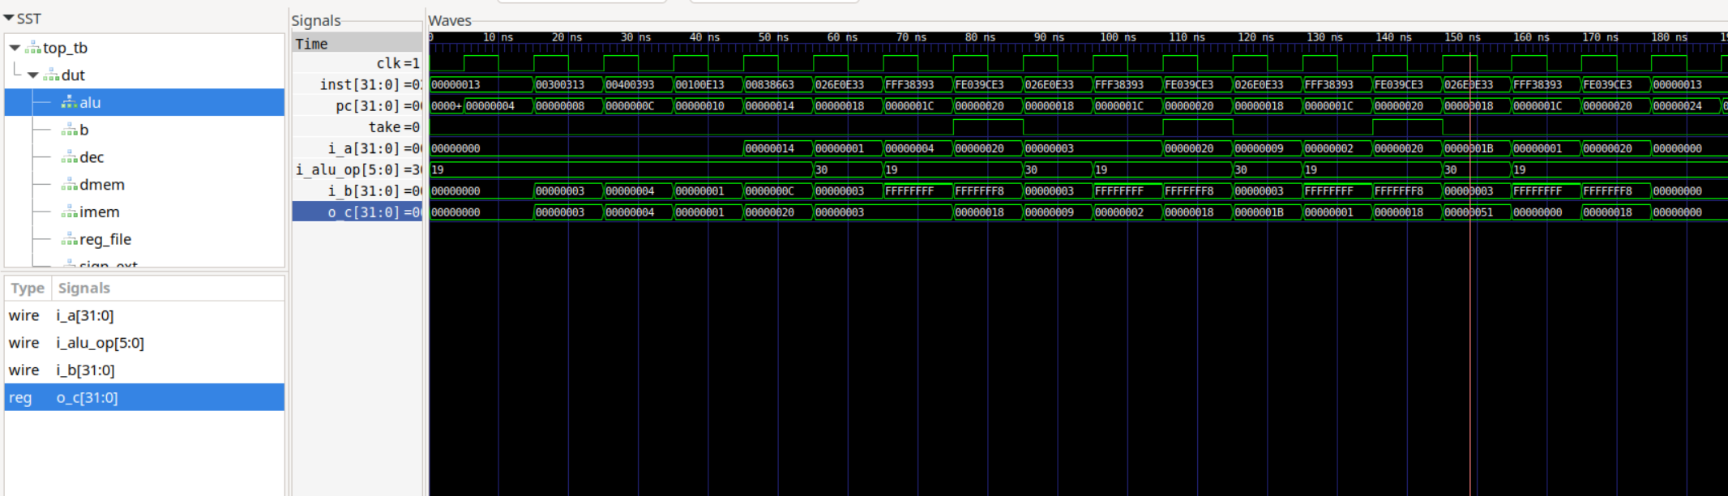
MLab2.3 : simulation wave
0x03^0x04 = 0x51

Slide 26
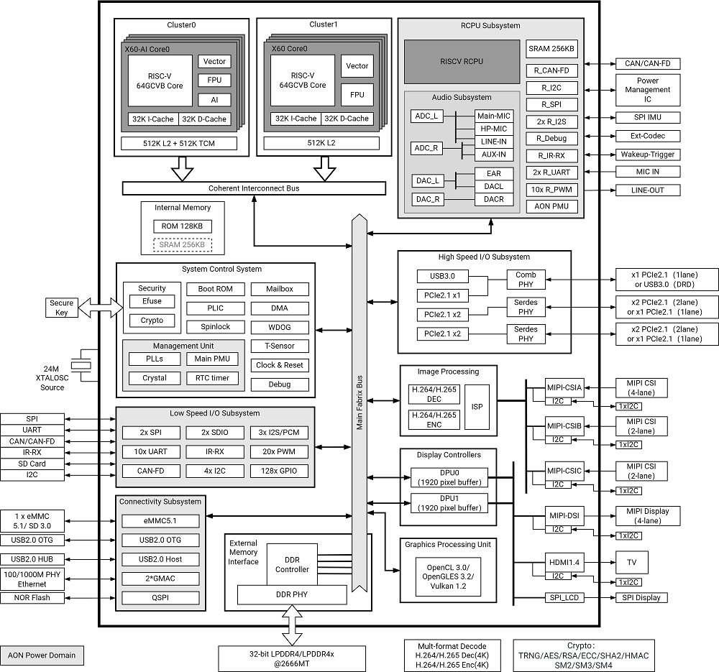
The Platform
Software:
Ubuntu, C/V-intrinsics/assembly, gcc, riscv64-linux-gnu-objdump; Verilog, iverilog, GTKwave, ..
Hardware:
BPI-SF3, SpacemiT K1–X60: RV64GCVB + AI (16 instructions)
4*RV64GCVB + AI and
4*RV64GCVB

Slide 27
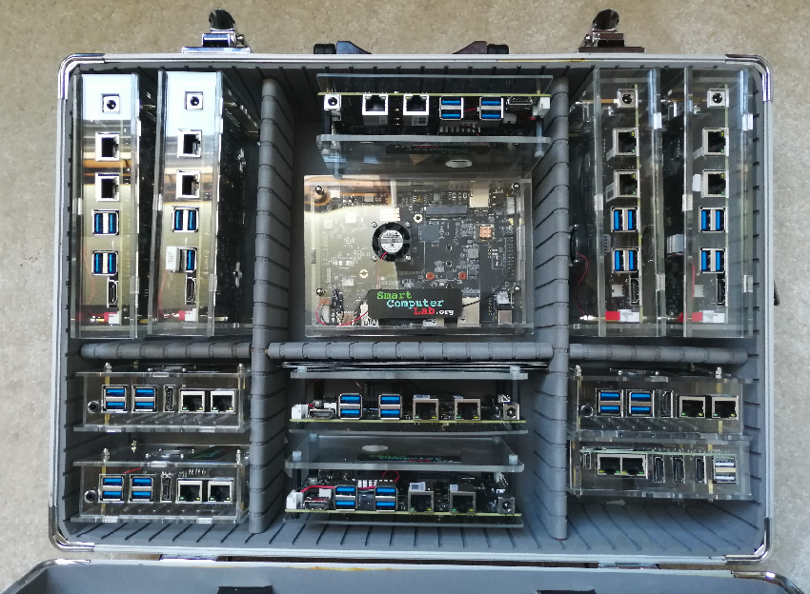
The Platform
Thank you for your attention !

