Slide 1
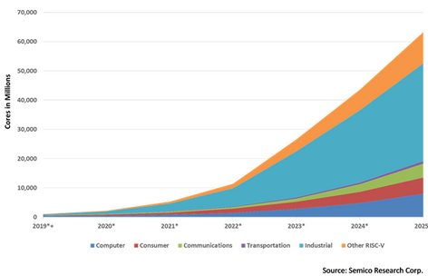
“Teaching RISC-V ISA
with RISC-V assembly programming and Verilog RTL modeling”
ISA – bilateral : Software/Hardware
self-contained : RISC-V on RISC-V
affordable-available : ~100€
6.8mln/hour

Slide 2
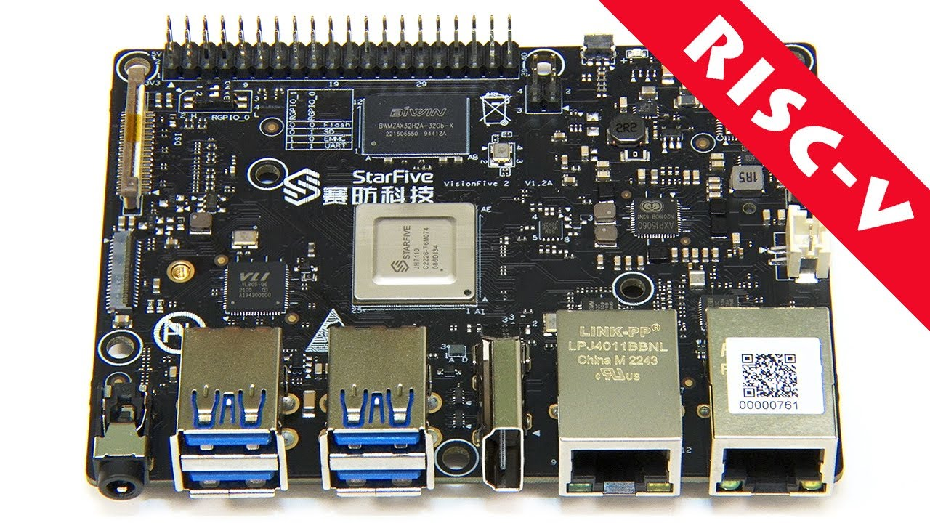
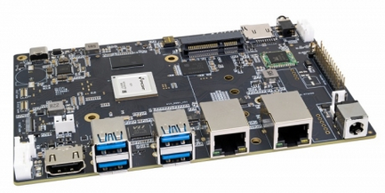
RISC-V : Software Programming
C programming + intrinsics (V)
RV64
Assembly level programming
USER - binaries
OS
I
M
A
F
D
C
V
B
AI
S
StarFive JH7110
SiFive U74
SpacemiT K1 - X60
PLabs

Slide 3
RISC-V : Hardware Design/Modeling
I
M
A
F
D
C
V
B
AI
S
R
I
U
S
B
J
defined with Verilog
type
RTL – Verilog : busses,registers,ALUs,memories,decoders,..
Logic - Verilog: and,or,xor,nand,..
DLabs

Slide 4
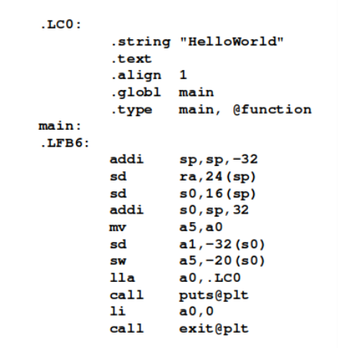
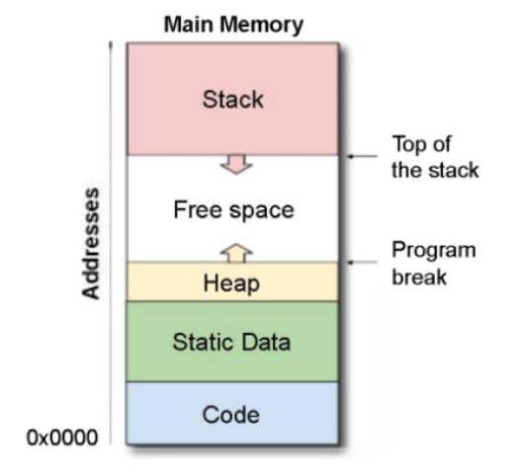
PLabs : Programming Labs

Slide 5
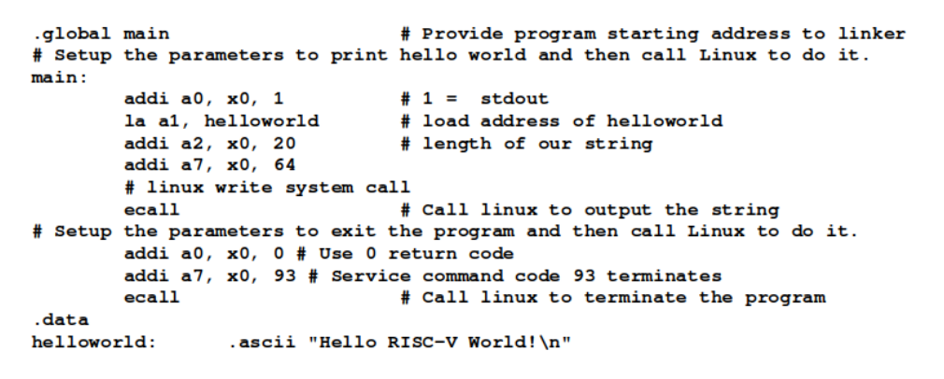
PLabs : system calls
puts (a7): 20 characters (a2)
on stdio a0=1, address in a1
exit (a7) with (a0=0)

Slide 6
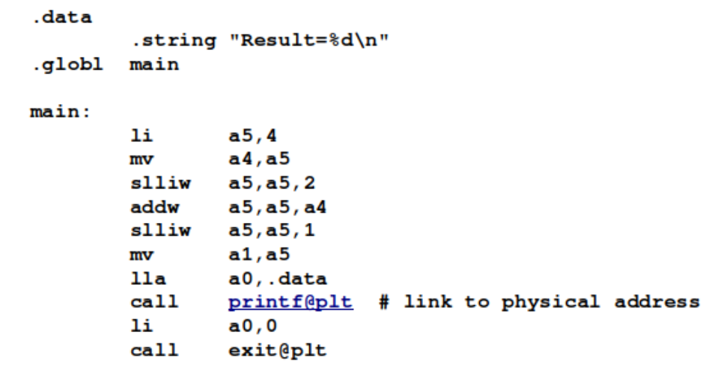
PLabs : arithmetics
MultTen.s
only add and shift
gcc MultTen.s -march=rv64g -o MultTen
riscv64-linux-gnu-objdump -d MultTen

Slide 7
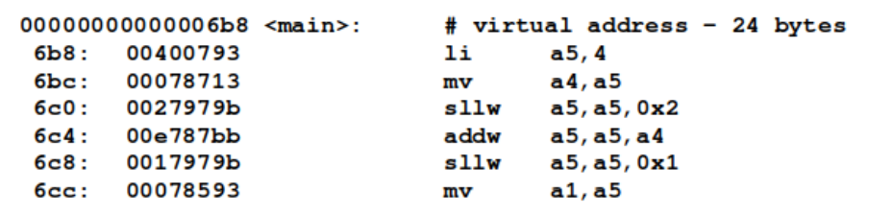
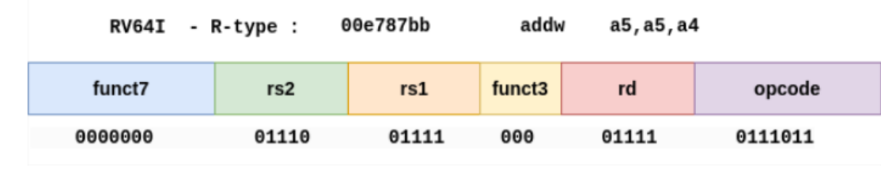
PLabs : arithmetics

Slide 8
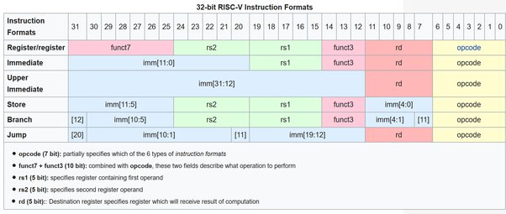
RV32I ISA - formats
R
I
U
S
B
J
addw a5,a5,a4
addw x15,x15,x14

Slide 9
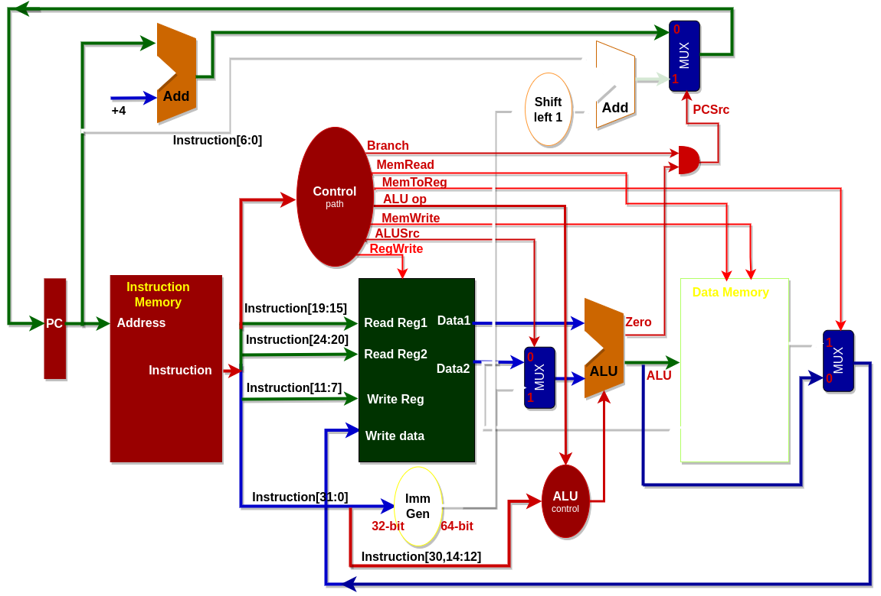
DLabs : Verilog (0-3) & Design (4-..)
DLab4
R-type only:
Instruction Memory + PC
Registers +ALU

Slide 10
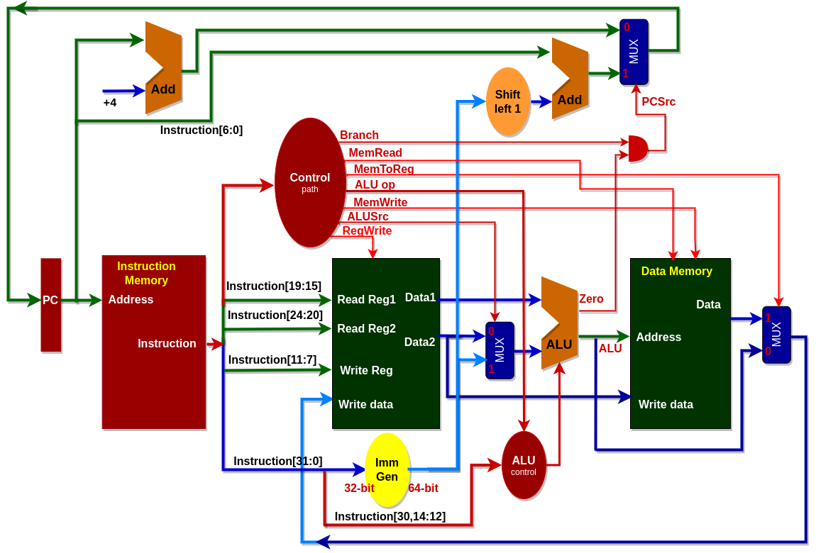
DLab 5 : RV32I
DLab5
RV32I
No pipeline

Slide 11
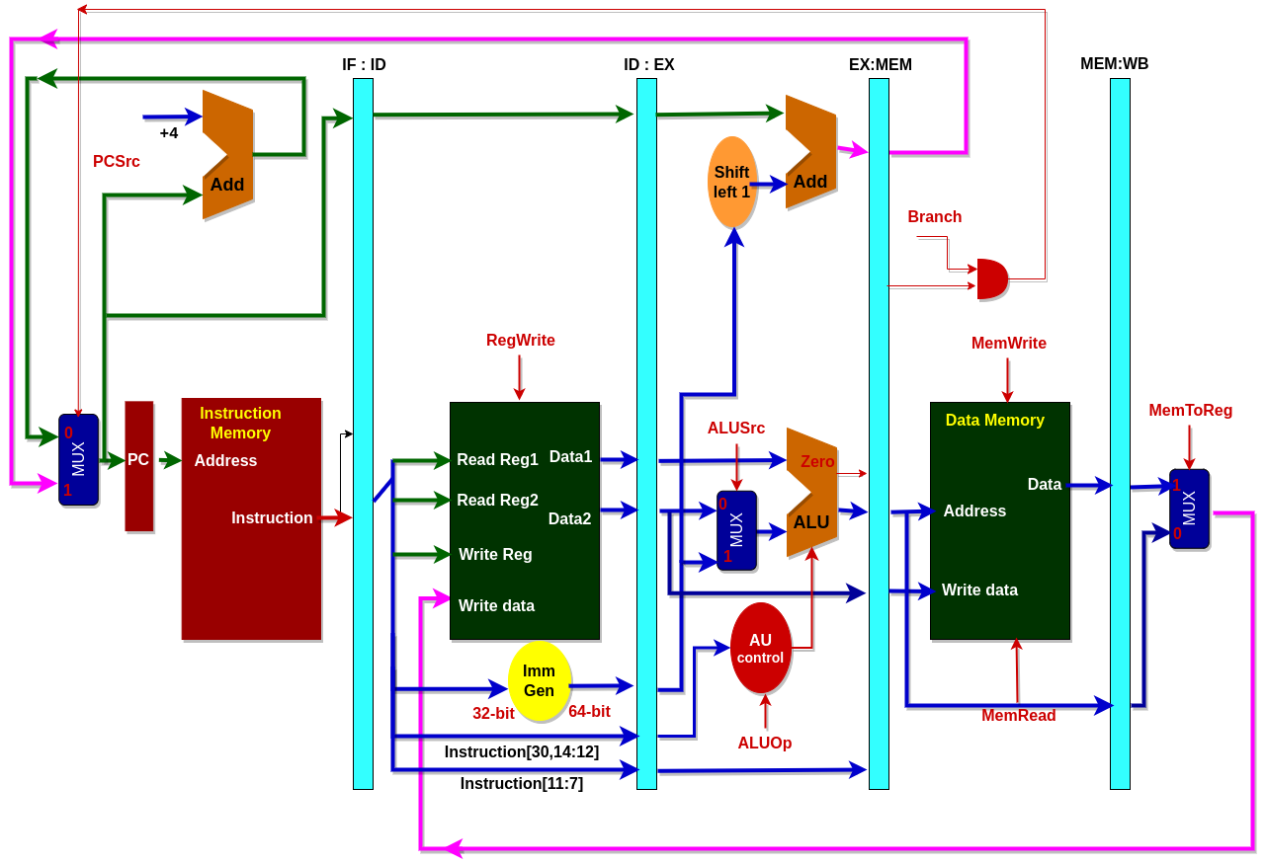
DLabs 6,7 .. : RV32I pipeline
DLab6, DLab7:
5-stage pipeline
- Program Counter (PC)
- InstructionFetch (IF)
- DataRead (DR)
- Execute (EX)
- WriteBack (WB)

Slide 12
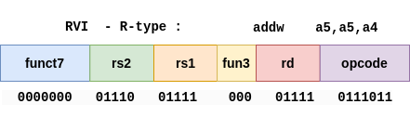
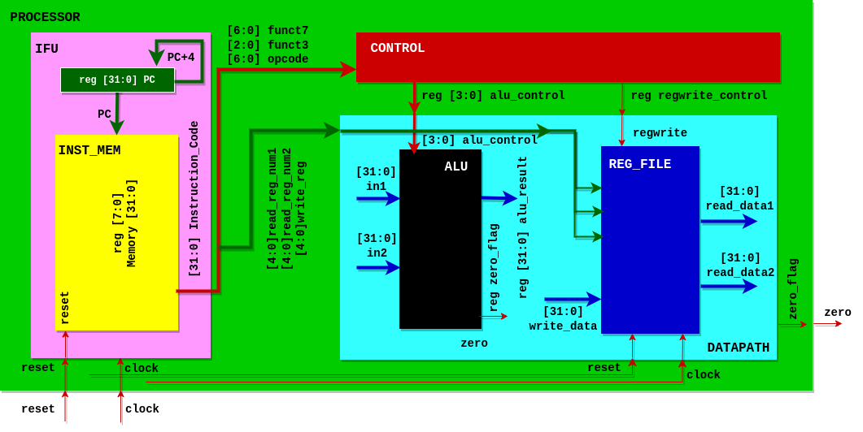
DLab4 : First design: R-type

Slide 13
DLab4 : PROCESSOR
`include "CONTROL.v"
`include "DATAPATH.v"
`include "IFU.v"
module PROCESSOR(
input clock,
input reset,
output zero
);
wire [31:0] instruction_code;
wire [3:0] alu_control;
wire regwrite;
IFU IFU_module(clock, reset, instruction_code);
CONTROL control_module(instruction_code[31:25],instruction_code[14:12],
instruction_code[6:0],alu_control, regwrite);
DATAPATH datapath_module(instruction_code[19:15], instruction_code[24:20],
instruction_code[11:7], alu_control, regwrite, clock, reset, zero);
endmodule

Slide 14
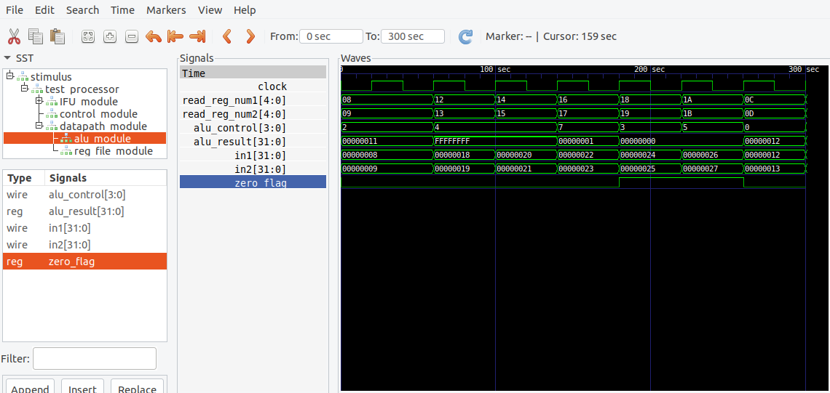
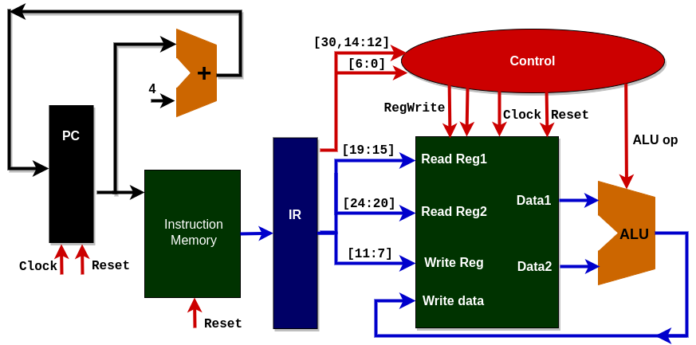
DLab4 : test & waveforms
GTKWave waveforms

Slide 15
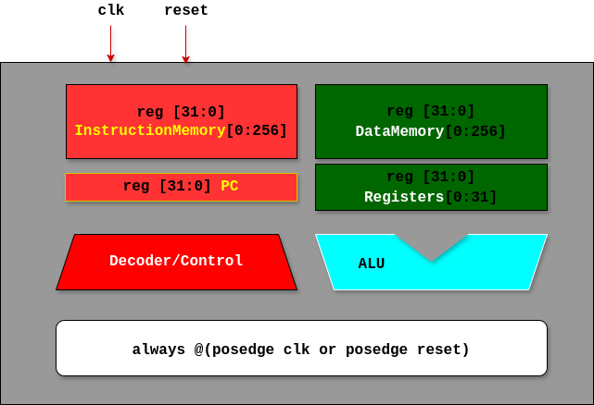
DLab5 : RV32I architecture

Slide 16
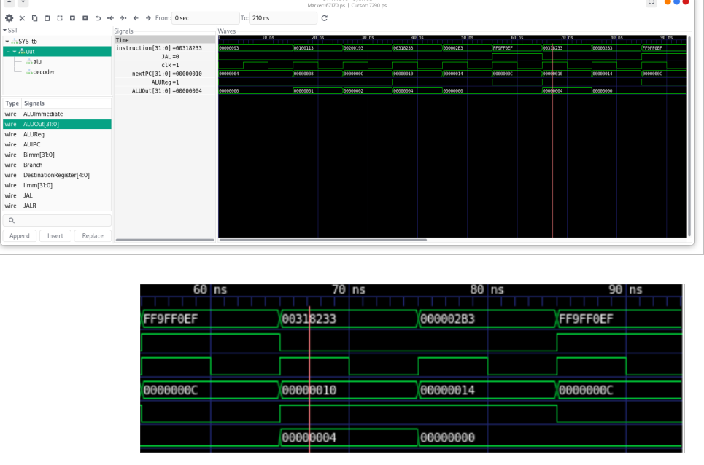
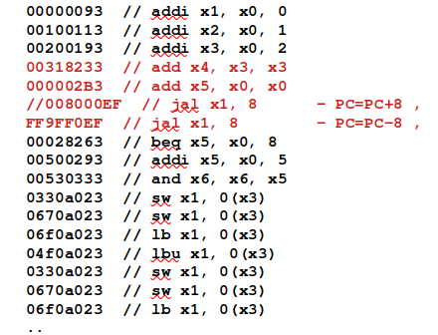
DLab5 : test and waveforms

Slide 17
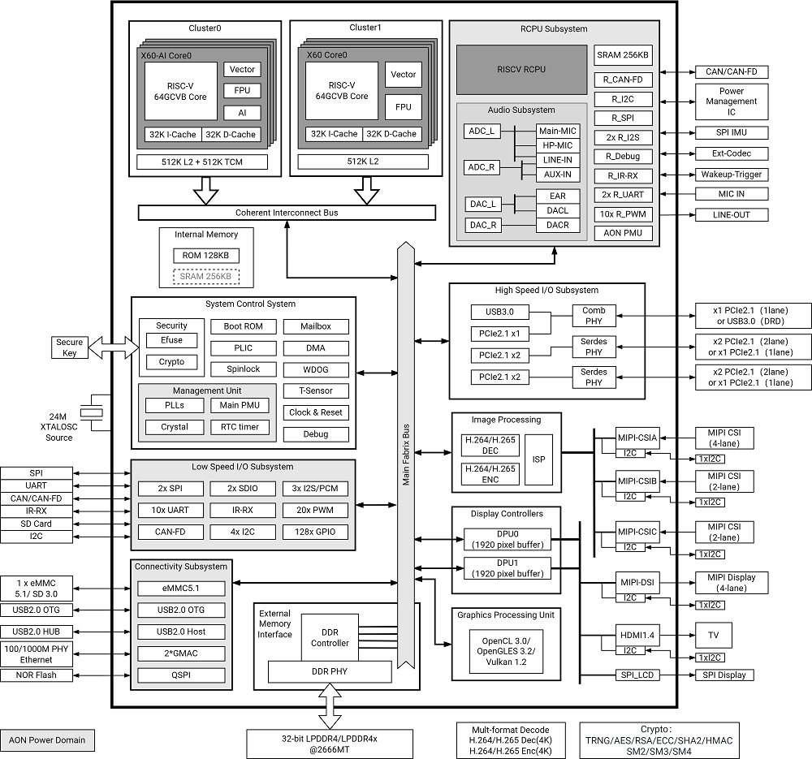
The Platform
Software:
Ubuntu, C/V-intrinsics/assembly, gcc, riscv64-linux-gnu-objdump; Verilog, iverilog, GTKwave, ..
Hardware:
BPI-SF3, SpacemiT K1–X60: RV64GCVB + AI (16 instructions)
4*RV64GCVB + AI and
4*RV64GCVB

Slide 18
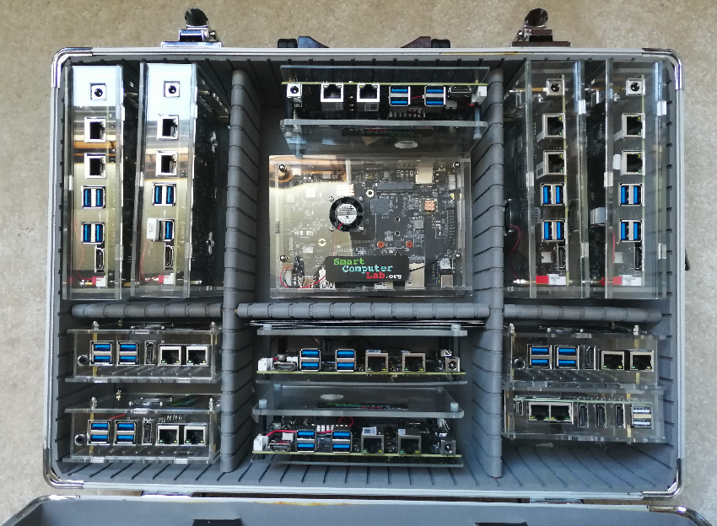
The Platform
Thank you for your attention !

