Slide 1

SmartCORE MTU HEMS Solution
Home Energy Management System — Research Development
Munster Technological University | Interreg NWE SmartCORE

Slide 2
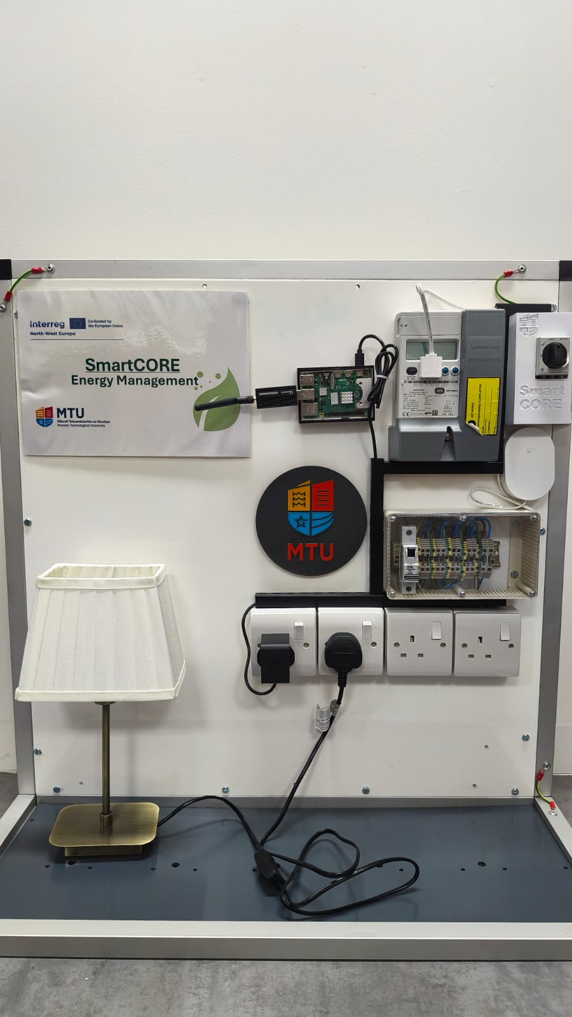

Slide 3
The Challenge
Why do we need a bespoke HEMS gateway?
Fragmented Sensor Ecosystem
Data Sovereignty & Privacy
Zigbee, Z-Wave, BLE — no common protocol
Utility meters rarely IoT-ready
Off-the-shelf hubs lack research-grade data access
Cloud-dependent products = no local control
GDPR concerns with home energy data
Partners need raw data, not vendor-filtered APIs
Remote Manageability at Scale
Open & Extensible Research Platform
30+ homes across Ireland — no on-site engineers
Firmware updates must be zero-touch
Self-healing critical — no single point of failure
Off-the-shelf systems are black boxes
We need to add sensors, change algorithms, export data
Must integrate with SmartCORE EU data platform
MTU SmartCORE HEMS
Interreg NWE SmartCORE

Slide 4
The HEMS Box — What Is It?
An open, containerised edge gateway for residential energy monitoring
Hardware
Software Stack
Design Principles
Raspberry Pi 5 (arm64 / aarch64)
– 4 GB RAM, Quad-core Cortex-A76
– Runs BalenaOS (Yocto Linux)
Sonoff ZBDongle-E (USB)
– EZSP Zigbee coordinator
– IEEE 802.15.4 @ 2.4 GHz
Frient SMSZB-120
– Smart meter interface sensor
– Blink counter → power & energy
[ Photo placeholder: Pi 5 + USB dongle ]
BalenaOS — container OS + OTA
Docker Compose — 8 services
Home Assistant — data hub & UI
InfluxDB 2 — time-series database
Nginx — reverse proxy & auth
Mosquitto — MQTT broker
hass-configurator — config UI
system-manager — watchdog
led-status — GPIO health LEDs
Bridge network 172.18.4.0/24
Isolated, static IPs per service
Open-source throughout
No cloud dependency
(works fully offline)
Self-healing & self-updating
via BalenaOS Supervisor
Extensible — add sensors,
services, or integrations
without hardware changes
Research-grade data access
— full InfluxDB query API
MTU SmartCORE HEMS
Interreg NWE SmartCORE
Notes:
So what exactly is the HEMS box? Let me describe it in concrete terms.
On the hardware side, it's built around a Raspberry Pi 5. That's a small, low-power single-board computer — roughly the size of a credit card, runs on about five watts, and costs around eighty euros. It runs a specialised operating system called BalenaOS, which is purpose-built for running containerised applications on edge devices.
Plugged into the Pi via USB is a Sonoff ZBDongle-E — this is a Zigbee coordinator stick. Zigbee is the wireless protocol used by many smart home sensors, and this dongle acts as the radio gateway that lets the Pi talk to those sensors.
The sensor we're currently working with is the Frient SMSZB-120, which is a smart meter interface device. It clips onto the optical port of an Irish smart meter, counts the infrared blink pulses the meter emits, and converts those into real-time power readings in watts and cumulative energy readings in kilowatt-hours. It communicates back to the Pi over Zigbee.
On the software side, everything runs as Docker containers — eight separate services, all managed together using Docker Compose. I'll walk through what each of those services does in a moment.
The key design principles are: fully open-source throughout, no cloud dependency — the system works completely offline if needed — self-healing and self-updating via the BalenaOS infrastructure, extensible without hardware changes, and providing research-grade data access.
Think of it as a small, silent, self-managing computer that lives in a kitchen cupboard and watches the electricity meter.

Slide 5
System Architecture
8 containerised services on a private Docker bridge network
Raspberry Pi 5 (BalenaOS Host)
Docker Bridge 172.18.4.0/24
Home Assistant
InfluxDB 2
Nginx Proxy
Mosquitto MQTT
BalenaOS Supervisor
172.18.4.2 :8123
172.18.4.3 :8086
172.18.4.4 :80
172.18.4.7 :1883
Balena Cloud (OTA updates)
hass- configurator
led-status
system- manager
wifi- connect
172.18.4.6 :3218
172.18.4.9 GPIO 17/27/22
host network Supervisor API
host network Captive portal
Sonoff ZBDongle-E (USB / EZSP Zigbee coordinator)
← Zigbee 802.15.4 →
Frient SMSZB-120 (Zigbee sensor)
MTU SmartCORE HEMS
Interreg NWE SmartCORE

Slide 6
Energy Data Flow
From physical smart meter pulse to database — end-to-end
Smart Meter
Frient SMSZB-120
Sonoff ZBDongle-E
ZHA (in HA)
HA State Machine
InfluxDB Integration
InfluxDB 2
IR pulse output (blink counter)
→
Counts pulses → kWh / W
→
USB Zigbee coordinator (EZSP)
→
Zigbee Home Automation integration
→
Entity states updated every 60 s
→
HTTP POST Line Protocol → InfluxDB
→
Time-series DB bucket: home_assistant
Zigbee 802.15.4
EZSP/USB serial
HA internal bus
HTTP /api/v2/write (Line Protocol)
Note: MQTT broker is present but idle in the current ZHA deployment. Zigbee2MQTT is an alternative architecture that routes all data through MQTT (see Slide 10).
MTU SmartCORE HEMS
Interreg NWE SmartCORE

Slide 7
Key Services — What Each One Does
Home Assistant
InfluxDB 2
Nginx Reverse Proxy
• Central data hub & user dashboard
• Manages Zigbee devices via ZHA integration
• Syncs all sensor states → InfluxDB automatically
• Automation engine (backups, alerts)
• Trusted proxy via Nginx
• Time-series database for all energy data
• Bucket: home_assistant | Org: hems
• Queried via Flux language / REST API
• Retains full history for research analysis
• UI accessible at /influx/ via Nginx
• Single entry point — port 80 on host
• Basic auth (CONFIG_USER / CONFIG_PASSWORD)
• Routes / → HA, /influx/ → InfluxDB
• WebSocket upgrade headers for HA live UI
• Sub-filter rewrites InfluxDB JS asset paths
system-manager (Watchdog)
Mosquitto MQTT
led-status
• Runs every 30 s on host network
• Restarts HA on new BalenaOS release
• Reboots device if internet down > 30 min
• Uses Balena Supervisor REST API
• iptables rules: Docker ↔ WiFi repeater
• Message broker (port 1883)
• Ready for Zigbee2MQTT alternative arch
• Retained messages → sensor state on restart
• Persistence to mosquitto.db volume
• Currently idle (ZHA deployment)
• GPIO 17 → green LED (HA reachable?)
• GPIO 27 → blue LED (internet alive?)
• GPIO 22 → red LED (HA errors in log?)
• Pi 5 lgpio patch (chip=0)
• Polls every 2 seconds
MTU SmartCORE HEMS
Interreg NWE SmartCORE

Slide 8
Self-Healing & Remote Management
Zero-touch operation across distributed pilot deployments
BalenaOS — OTA Updates
system-manager Watchdog (30 s loop)
Yocto-based container OS with Supervisor daemon
Push new Docker images from Balena Cloud → device auto-pulls
No SSH access required — fully managed via Balena dashboard
Balena App ID / Release ID tracked for graceful HA restart
1. Stops wifi-repeater after 10 min (bandwidth management)
2. Detects new Balena release → graceful HA restart (2 min grace)
3. Pings google.com — reboots device if down > 30 min
4. Sets iptables rules on startup (Docker ↔ WiFi subnets)
LED Status Indicators (Physical Feedback)
WiFi Onboarding — wifi-connect
🟢 GPIO 17 — Home Assistant reachable (internal ping)
🔵 GPIO 27 — Internet connectivity (8.8.8.8 ping)
🔴 GPIO 22 — Error state (scans HA log for ERROR keyword)
Allows non-technical householders to see system health at a glance
On first boot (or lost WiFi): launches captive portal
Householder connects phone → selects home WiFi → enters password
NetworkManager configures WiFi via D-Bus on host
No LAN cable or technical knowledge required
MTU SmartCORE HEMS
Interreg NWE SmartCORE

Slide 9
Energy Monitoring Dashboard
Real-time visibility into household energy consumption
Data Captured
Power (W) — real-time consumption
Energy (kWh) — cumulative total
Link quality — Zigbee signal strength
Timestamps at 60 s resolution
Full history in InfluxDB
[ Screenshot Placeholder ] Home Assistant Energy Dashboard InfluxDB Grafana-style charts Real-time power (W) & cumulative energy (kWh)
Access Points
Local LAN: http://<pi-ip>/
InfluxDB UI: http://<pi-ip>/influx/
Config UI: http://<pi-ip>/configurator/
All behind Nginx basic auth
WebSocket live updates supported
MTU SmartCORE HEMS
Interreg NWE SmartCORE

Slide 10
Extensibility & Future Work
The HEMS box is designed to grow with research requirements
Alternative: Zigbee2MQTT
Mobile Access — Tailscale VPN
Mobile Access — Cloudflare Tunnel
Swap ZHA for Zigbee2MQTT container
All data routed through MQTT broker
Enables multi-subscriber architecture
→ Edge ML, alerting, custom exporters
MQTT Discovery → HA auto-creates entities
Add tailscale container (WireGuard VPN)
Researcher/admin accesses dashboard remotely
Peer-to-peer — no cloud server needed
Stable Tailscale IP survives dynamic WAN IP
TS_AUTH_KEY via Balena env var (never in repo)
Add cloudflared container
4 outbound HTTPS connections to Cloudflare
Public HTTPS URL: hems.yourdomain.com
No port forwarding or router changes
Cloudflare Access for pre-auth layer (free)
Additional Sensors
Data Export & Integration
Known Gaps to Resolve
Any Zigbee sensor pairs via ZHA/Z2M
Temperature, humidity, occupancy, gas
EV charger monitoring (eesmart-d2l path)
Clamp-on CT sensors via ESPHome/WiFi
Solar PV integration (planned)
InfluxDB REST API → SmartCORE EU platform
Export to CSV / Parquet for research
Grafana compatible (Flux queries)
MQTT → Node-RED for custom pipelines
REST hook → external ML inference
eesmart-d2l: TCP proxy in Nginx but no container
No TLS on Nginx (plain HTTP on LAN only)
MQTT allow_anonymous (harden for production)
template_sensors/ not in git (on-device only)
Pilot home deployment tooling — in progress
MTU SmartCORE HEMS
Interreg NWE SmartCORE

Slide 11
MTU's Research Contribution
What we bring to SmartCORE NWE
What MTU Has Built
• Full open-source HEMS software stack
– Containerised, reproducible, version-controlled
– Deployable from a single docker-compose.yml
• Raspberry Pi 5 validated deployment
– Pi 5 GPIO lgpio patch for led-status
– aarch64/arm64 Docker image selection
• Self-healing watchdog architecture
– Balena Supervisor API integration
– Graceful HA restart on new firmware
• Technical documentation & architecture reference
– ARCHITECTURE.md, COMPONENTS.md
– MQTT & Mobile Access reference
– PlantUML system diagrams
Impact for SmartCORE Partners
Any partner can clone repo & deploy
No proprietary hardware lock-in
OTA updates mean pilot homes update silently
Full data access — no vendor API restrictions
Adapts to local smart meter standards
Research Outputs (Planned)
Peer-reviewed publication on HEMS architecture
Open dataset from pilot homes (anonymised)
Comparison: ZHA vs Zigbee2MQTT performance
Energy baseline per household profile
Integration template for EU SmartCORE platform
Technology Readiness
TRL 4 → 5 transition (lab → pilot validated)
Core stack functional on Pi 5 hardware
Sensor integration confirmed end-to-end
Pilot deployment tooling in progress
MTU SmartCORE HEMS
Interreg NWE SmartCORE

Slide 12
Current Status & Roadmap
Early prototype → pilot deployment
✓ Stack Running
✓ Sensor Data
✓ OTA Updates
✓ Self-Healing
~ Mobile Access
→ Pilot Homes
All 8 containers operational on Pi 5
Frient → InfluxDB end-to-end confirmed
BalenaOS push validated in lab
Watchdog tested (reboot, HA restart)
Architecture designed, implementation pending
Site survey in progress, deployment Q3 2026
Roadmap
Q2 2026
Q3 2026
Q4 2026
2027
Pilot preparation
Pilot deployment
Scale & analyse
Research outputs
Finalise deployment tooling Mobile access (Tailscale / Cloudflare) Harden MQTT security
Install HEMS in first 5–10 Irish homes Live data flowing to SmartCORE platform On-site WiFi onboarding validation
Expand to 20 homes Baseline energy profiles Peer-reviewed publication draft
Full dataset analysis HEMS v2 design (lessons learned) Results shared with all NWE partners
MTU SmartCORE HEMS
Interreg NWE SmartCORE

Slide 13
Thank You
Questions & Discussion

