Slide 1
Instruct2Act: Mapping Multi-modality Instructions to Robotic Actions with Large Language Model
Wenyao Zhang
wenyao.zhang@connect.umac.mo
2024.8.14

Slide 2
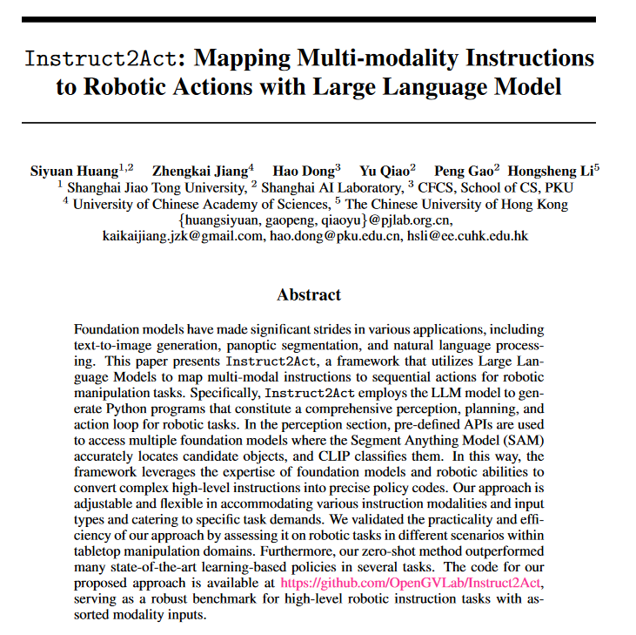

Slide 3
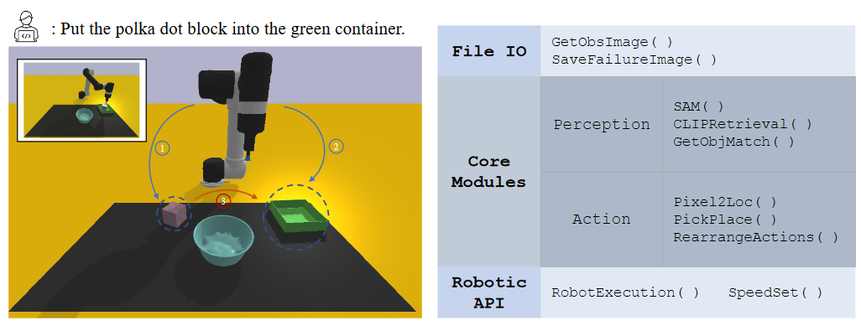
Application of the Instruct2Act framework to real robotics tasks and its components
Robots are able to execute instructions that are provided as input in natural language.
Module examples utilized in Instruct2Act. The modules’ definitions are hierarchical and aligned with the robotic system design.

Slide 4
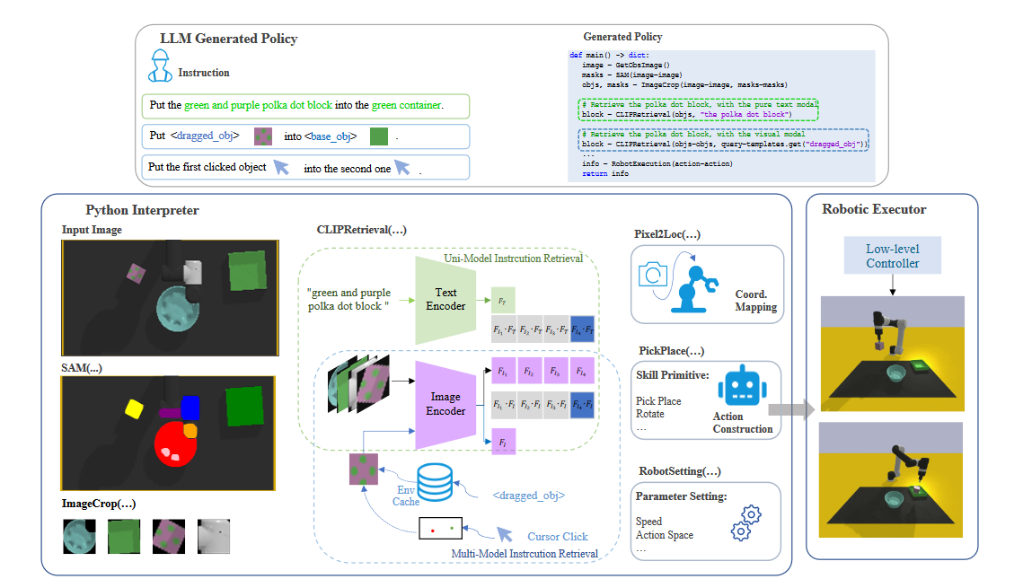
The paradigm of this proposed Instruct2Act framework

Slide 5
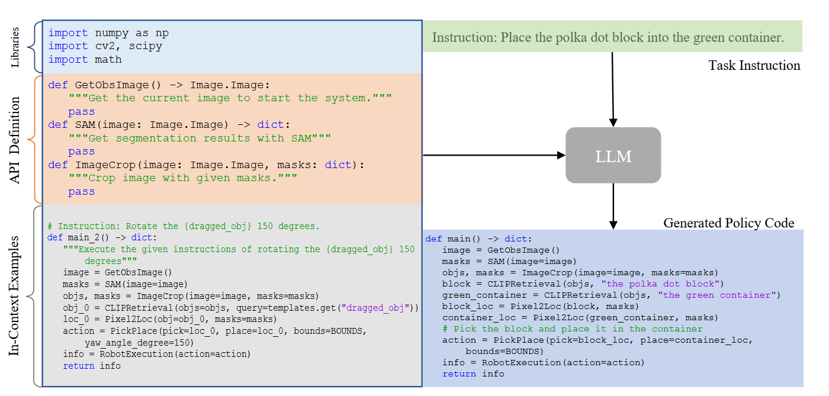
robotic program generation process

Slide 6
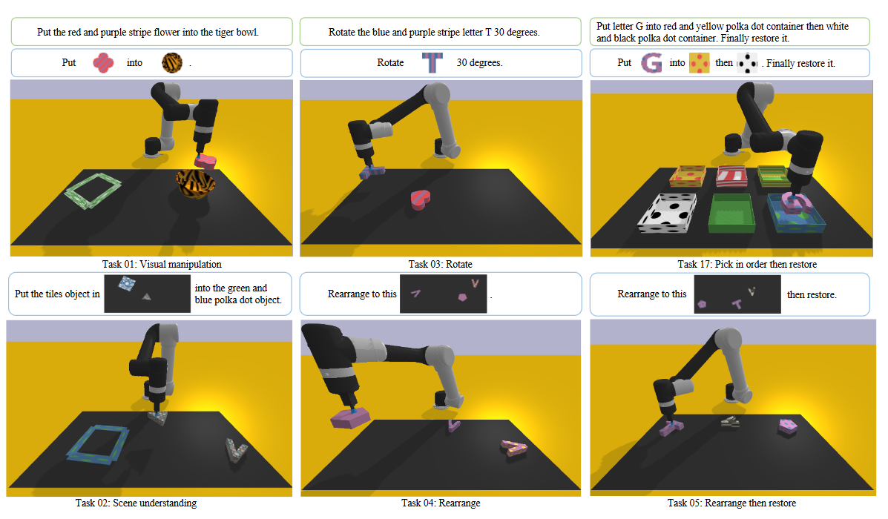
Evaluation task suite

Slide 7
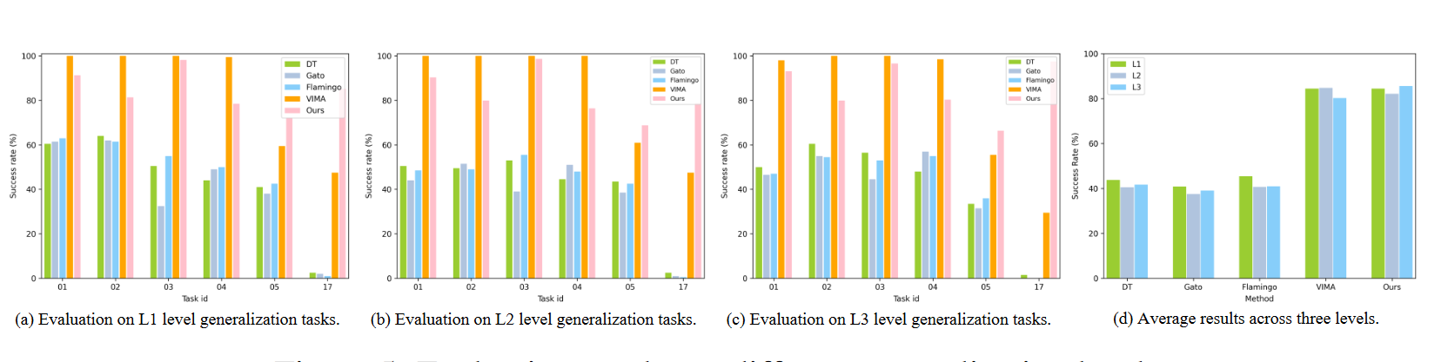
Evaluation results on different generalization levels.

Slide 8
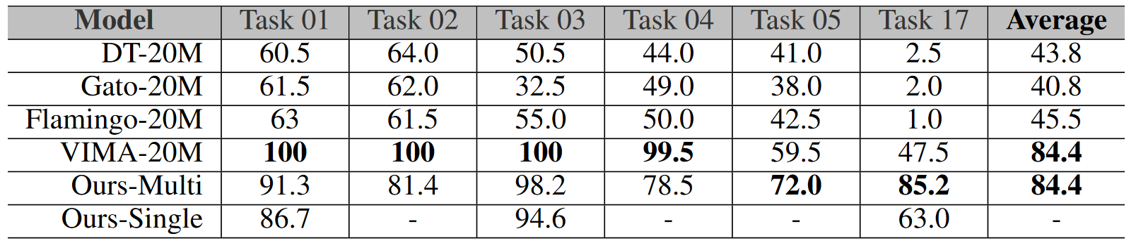
Results on the selected VIMABench tasks for L1 level generalization.

Slide 9
Thank You!
Wenyao Zhang
tel:65869860
Wenyao.Zhang@connect.umac.mo

