Slide 1
Deterministic Point Cloud Registration via Novel Transformation Decomposition
翁霄羽
wengxiaoyu2009@163.com

Slide 2

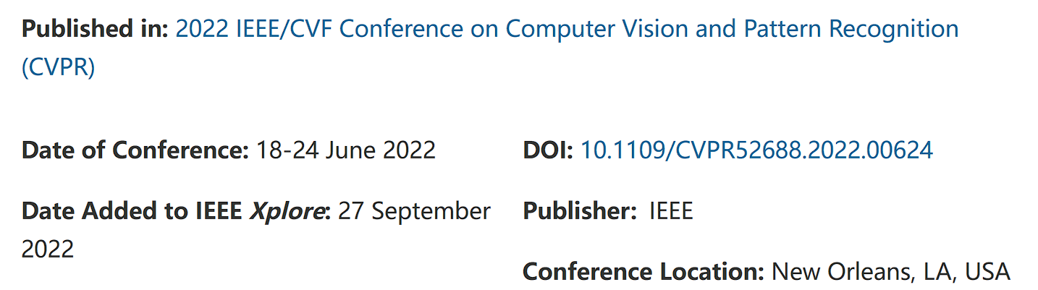

Slide 3
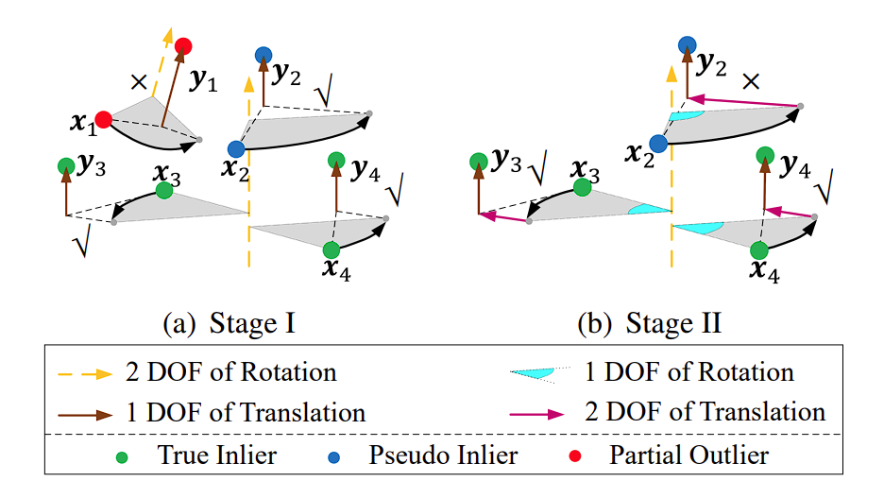
Introduction
High non-linearity of 3-DOF rotation still limits the algorithm efficiency , In contrast, we propose to decompose 6 DOF into (2+1) and (1+2) DOF.

Slide 4
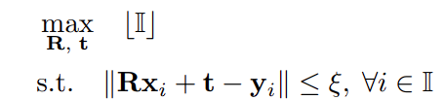

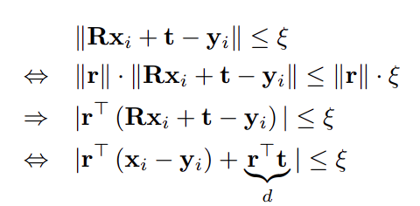

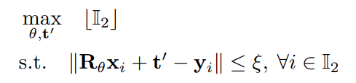
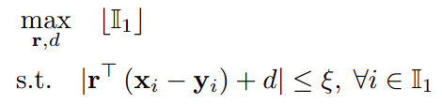
Problem Formulation
Find the optimal transformation that fits the largest number of (inlier) correspondences
New Transformation Decomposition
First sub-problem
Second sub-problem
“candidate” inliers
true inliers

Slide 5
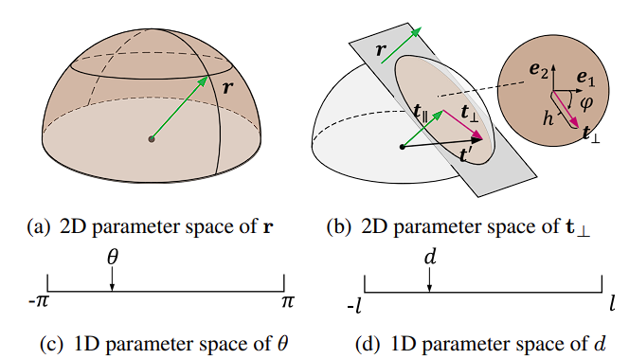
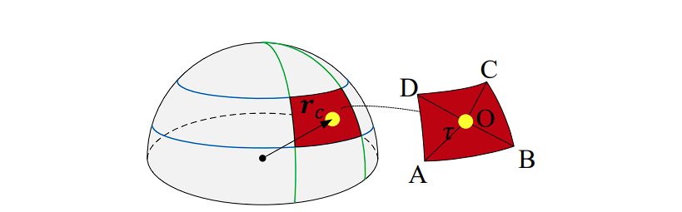



Two-stage Search Strategy
Parameter Space of Rotation and Translation
Stage I: Searching for (2+1) DOF

Slide 6
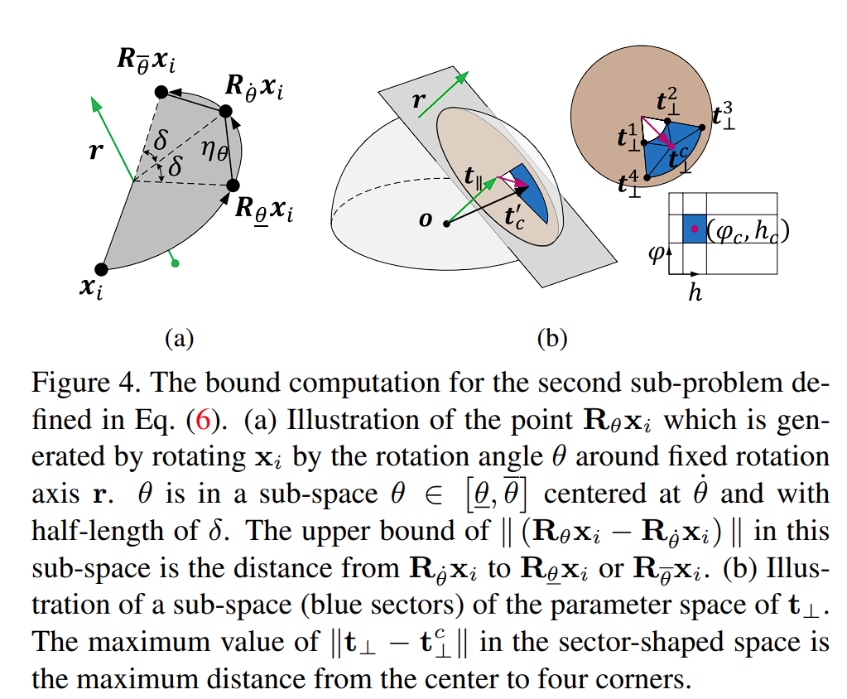


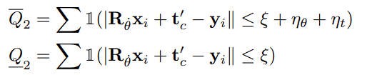
Two-stage Search Strategy
Stage II: Searching for Remaining (1+2) DOF
For arbitrary θ and t⊥ in their sub-spaces, we have

Slide 7
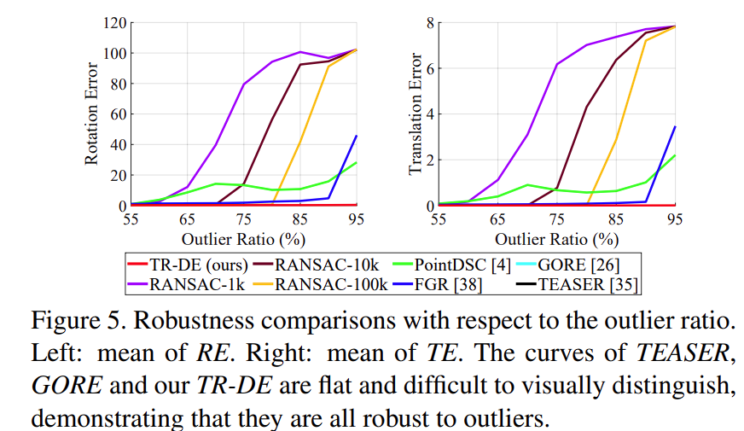
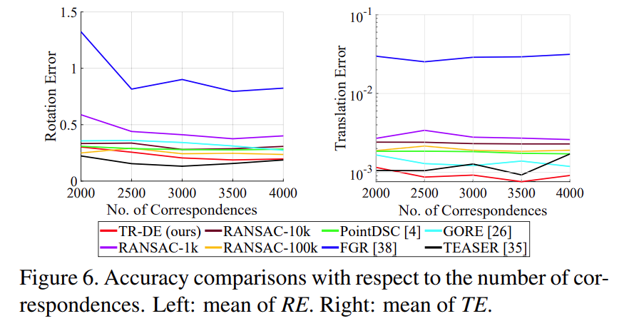
Experiments
The deterministic methods such as GORE, TEASER and our TR-DE provide low error under high outlier ratios.
TR-DE computes more accurate translation

Slide 8
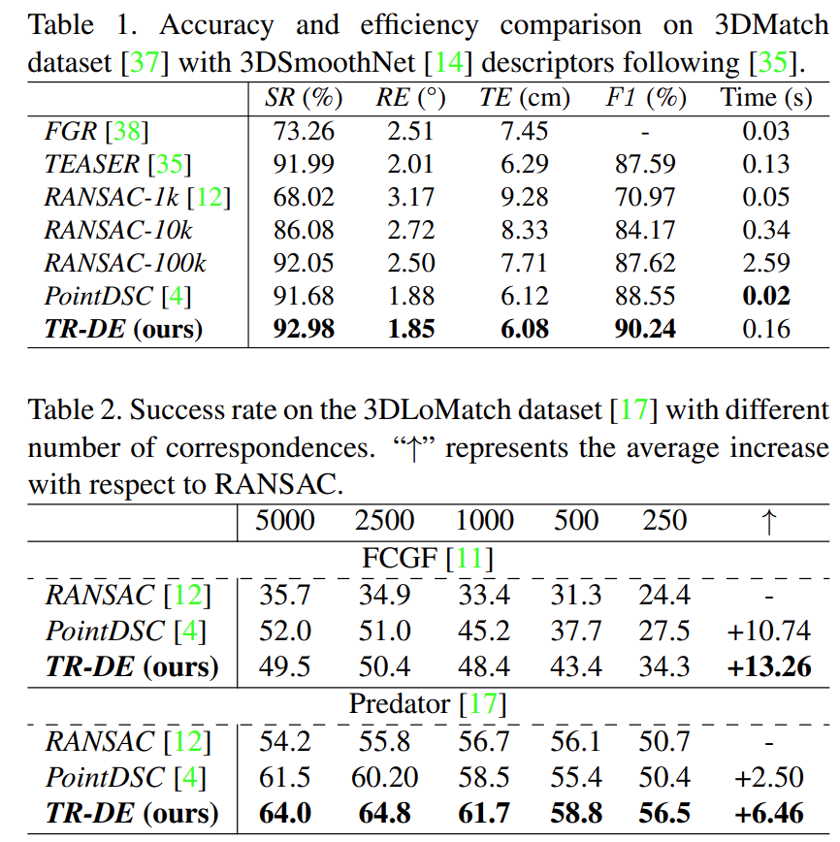
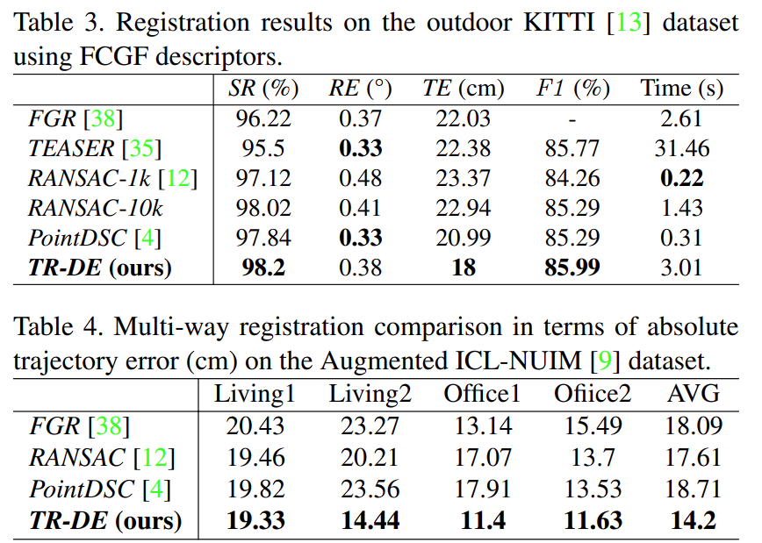
Experiments

Slide 9
Conclusion
Decompose 6 DOF of transformation into (2+1) DOF and (1+2) DOF. It reduces the non-linearity of 3-DOF rotation, and thus improves the algorithm efficiency.
Design a deterministic and efficient two-stage search strategy for parameter estimation. It leads to tight bounds and low computational complexity

Slide 10
Thank You!
Avenida da Universidade, Taipa, Macau, China
Tel : (853) 8822 8833 Fax : (853) 8822 8822
Email : info@um.edu.mo Website : www.um.edu.mo

