Slide 1
Closed-Loop Open-Vocabulary Mobile Manipulation with GPT-4V
Speaker：Xiongyi Li
Mail: xiongyilee@outlook.com
May 10th 2024

Slide 2
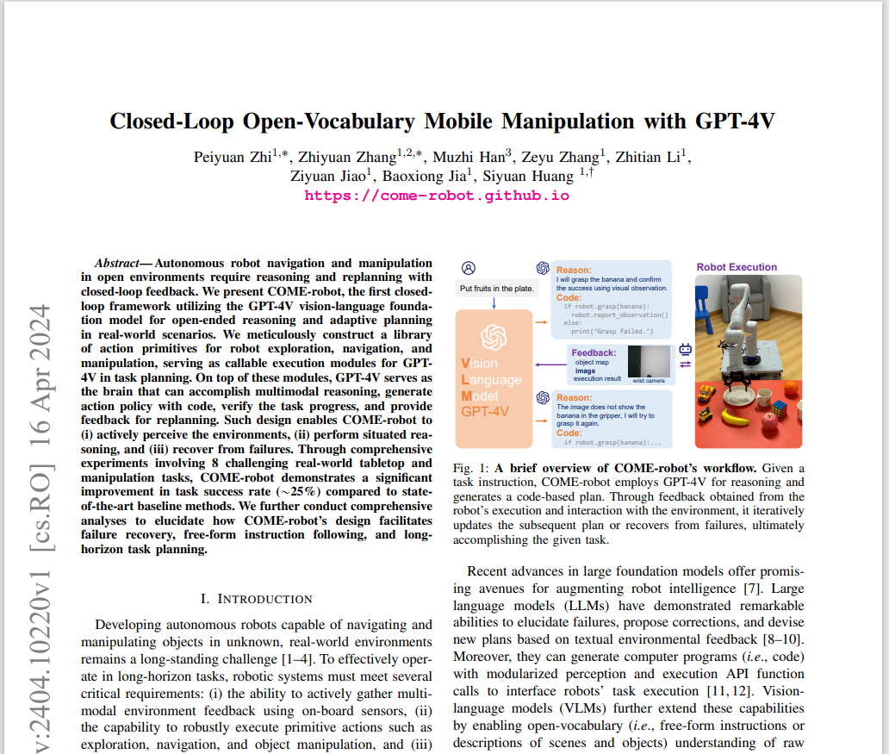
State Key Laboratory of General Artificial Intelligence, Beijing Institute for General Artificial Intelligence (BIGAI).
Department of Automation, Tsinghua University.
University of California, Los Angeles.

Slide 3
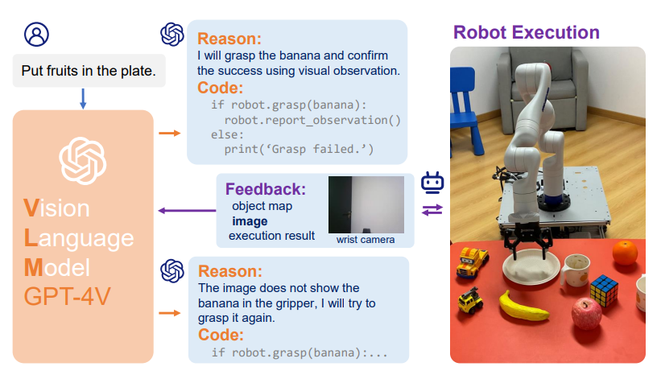
Overview

Slide 4
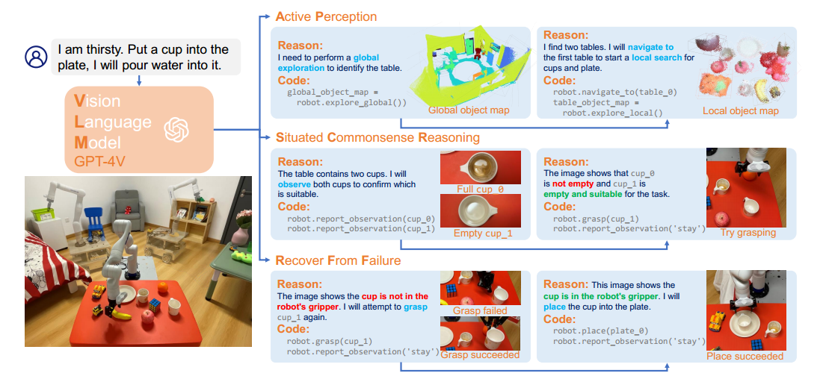
Perception
Red:fault; Blue: reason; Green: correction

Slide 5
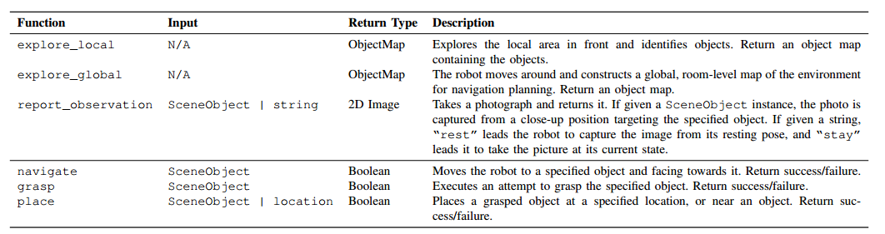
Primitive action APIs

Slide 6
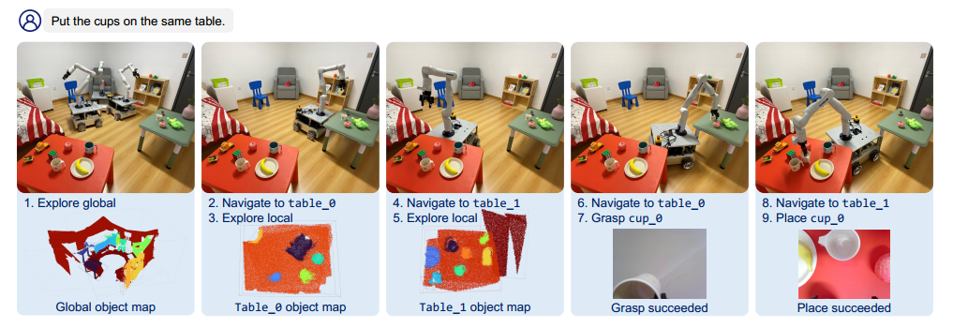
Experiment

Slide 7
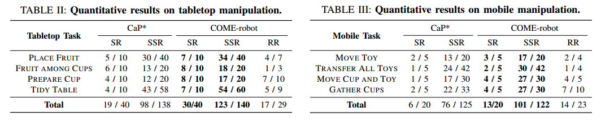
Result

Slide 8
Thank You!
Avenida da Universidade, Taipa, Macau, China
Tel : (853) 8822 8833 Fax : (853) 8822 8822
Email : xiongyilee@outlook.com Website : www.um.edu.mo

