Slide 1

Velocity
Often time-sensitive, big data must be used as it is stream
Batch, Near time, Real time, Streams
SmarTek21
Big Data – Hadoop and HBase Overview
21st Jan, 2013
Value
Volume
Enterprises typically collect & amass terabytes or even petabytes of Information
PB, TB, Records, Transactions, Files
Varie

Slide 2
How Familiar is ST21 with
the Various Modules in Hadoop?
HDFS
Implemented cluster with five data nodes.
Handled 2Gb of daily input data from
social media networks (500Mb) and network packet streams.
MapReduce
Developed Map Reduce queries in Java, Scala and Python.
Examples:
1) Job to aggregate Twitter trends based on
user demographics
2) Job to retrieve top products based on user sentiments

Slide 3
(cont.,)
ETL
Pig Latin
1) Used Pig Latin scripts to load complex
Twitter JSON response into HDFS.
2) Registered custom java functions in Pig Latin to parse
input files.
Python Scripts
Python scripts to retrieve (scrapper) and load
Twitter response into HDFS.
Hive
Stored large datasets of User details, Geo details,
messages and trends in hive (fact table partitions)
Used Thrift API to retrieve data from Hive.

Slide 4
(cont.,)
Hbase and Cassandra
Implemented key-values stores for Twitter and
network stream data.
Flume
1) Implemented custom source, sink and channel for both
Twitter and network packet capturing using Flume.
2) Jpcap based Flume agents have been implemented
to capture network packet streams.
Natural Language processing and Machine Learning
algorithms
Implemented text sentiment analyzer using NLTK and
baseline algorithms to classify the tweets.

Slide 5
(cont.,)
In Under Estimate Tools
Mahout
Used Mahout for trend statistical analysis for
Twitter and network packet monitoring.
Zoo Keeper
Used Zookeeper for configuration maintenance across
Hadoop cluster and to avoid single point of failure.
Oozie
Oozie is used to manage map reduce jobs in Hadoop.

Slide 6
What related projects is ST21
familiar with?
  Storage
Key-Valued, Relational, Document, Cloud, File system,
Big data etc.
Products :
Key-Valued : Riak, Amazon ‘dynamo’
Relational : MySQL, Oracle, SQL Server
Document : MongoDb, CouchDb
Big Data : HDFS, Cassandra, HBase
Cloud : S3, Blob Store (Azure)
  Configuration Maintenance
Zoo Keeper
  ETL
Pig
Python Scripts

Slide 7
(cont.,)
  Query, Search & Log
Hive, Map Reduce, Solr, Splunk
  Platform
Python, Java, Scala
  IaaS (Information as a Service)
Django/Piston
  Protocol support
SOAP, HTTP, REST (JSON), REST (XML)

Slide 8
Twitter trends and sentiment analysis

Slide 9
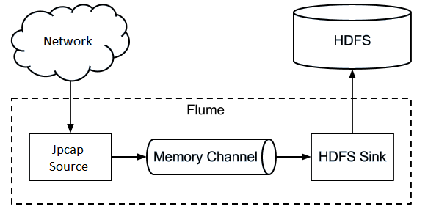
Network Packet Monitor

Slide 10
What Resources are Currently Available
We currently staff 6 developers with working knowledge on Big Data and Hadoop. They are well versed in all the modules and can configure and work with a Hadoop eco system.
Skill Set type | Skill Set
Type A (2) | 1. HDFS cluster monitoring 2. ETL/MR development and monitoring 3. Writing algorithms 4. Developing the Front end (Rest API's & UI)
Type B (1) | 1. HDFS cluster monitoring 2. ETL/MR development and monitoring
Type C (3) | 1. Writing algorithms 2. Developing the Front end (Rest API's & UI)
Note: number in () denotes the number of developers available in that area.

Slide 11
Top Big Data Sources
Social network profiles
Social influencers
Activity-generated data
SaaS & Cloud Apps
Public web information
MapReduce results
Data warehouse appliances
Columnar/NoSQL databases
Network and in-stream monitoring techologies
Legacy document
In house RDBMS data

Slide 12
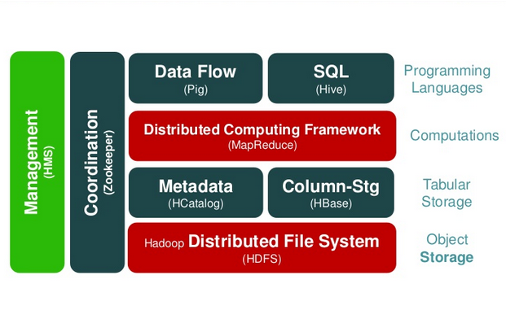
Hadoop - Overview

Slide 13
HDFS & MapReduce
Hadoop Distributed File System
A scalable, fault tolerant, high performance distributed file system
Asynchronous replication
Write-once and read-many
Hadoop cluster with 3 DataNodes minimum
Data divided into blocks, each block replicated 3 times (default)
No RAID required for DataNode
Interfaces: Java, C Library, FUSE, HTTP, FTP, WebDAV
NameNode holds file system metadata
Files are broken up and spread over the DataNodes
Hadoop Distributed File System
Software framework for distributed computation
Input | Map() | Copy/Sort | Reduce() | Output
JobTracker schedules and manages jobs
TaskTracker executes individual map() and reduce() tasks on each cluster node
Master Node
JobTracker
NameNode
sdsdsds
sdsdsds
TaskTracker
TaskTracker
DataNode
DataNode
Host 1
Host 2
sdsdsds
sdsdsds
TaskTracker
TaskTracker
DataNode
DataNode
Host 3
Host N
Worker Nodes

Slide 14
What is HBase?
Clone of Big Table (Google)
Implemented in Java (Clients: Java, C++, Ruby …)
Data is stored “Column-oriented”
Distributed over many servers
Tolerant of machine failure
Layered over HDFS
Strong consistency
Not a relational data store (No joins)
Sparse data – nulls are stored for free
Semi-structured or unstructured data
Scalable – billions of rows X millions of columns

Slide 15
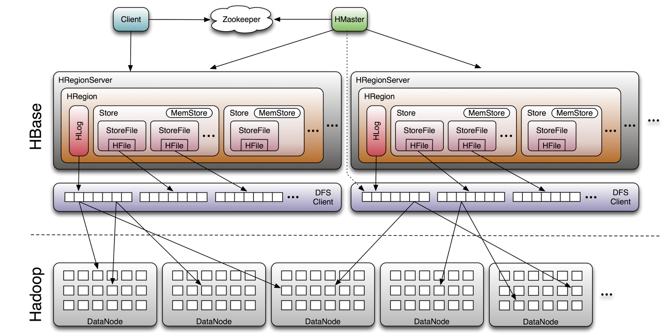
HBase Storage Architecture
Original: http://www.larsgeorge.com/2009/10/hbase-architecture-101-storage.html

Slide 16
HBase Architecture (Contd)
Table
  Regions for scalability, defined by row [start-key, end-key]
  Store for efficiency, 1 per Family
    1…n StoreFiles (HFile format on HDFS)
Everything is byte
Rows are ordered sequentially by key
Special tables – ROOT, .META
  Tells cells where to find user data
Design will prevent data loss due to failure while providing good performance (In a distributed system, parts of it will fail over time)

Slide 17
How Big Data Can Help You?
Data driven recommendations to customers
Increased operational intelligence
Better customer insight
Automated operations
Better relevance in research and profiling
Faster and better business decisions through visualization of related data

Slide 18
Big Data – Deriving Value
Organize
Segregate data for easy analysis and for better insights.
Approach
Acquire
Collect and store information in a reliable, high throughput data store
Solution
Present the analyzed data to the end user in a form that is easily comprehensible
Analyze
Algorithms to derive patterns and correlate information from stored data

Slide 19
Thank you…
Notes:
Chapter slide example

