Slide 1
Python
Basics

Slide 2
A simple interpreted language
Notes:
2

Slide 3
A simple interpreted language
no separate compilation step
Notes:
3

Slide 4
A simple interpreted language
no separate compilation step
$ python
>>>
Notes:
4

Slide 5
A simple interpreted language
no separate compilation step
$ python
>>> print(1 + 2)
3
>>>
Notes:
5

Slide 6
A simple interpreted language
no separate compilation step
$ python
>>> print(1 + 2)
3
>>> print('Charles' + 'Darwin')
CharlesDarwin
Or remove print (when in the interactive python shell):
>>> 'Charles' + 'Darwin'
CharlesDarwin
Notes:
6

Slide 7
Put commands in a file and execute that
Notes:
7

Slide 8
Put commands in a file and execute that
$ gedit very-simple.py
Notes:
8

Slide 9
Put commands in a file and execute that
$ gedit very-simple.py
print(1 + 2)
print('Charles' + 'Darwin')
Notes:
9

Slide 10
Put commands in a file and execute that
$ gedit very-simple.py
print(1 + 2)
print('Charles' + 'Darwin')
$ python very-simple.py
3
CharlesDarwin
$
Notes:
10

Slide 11
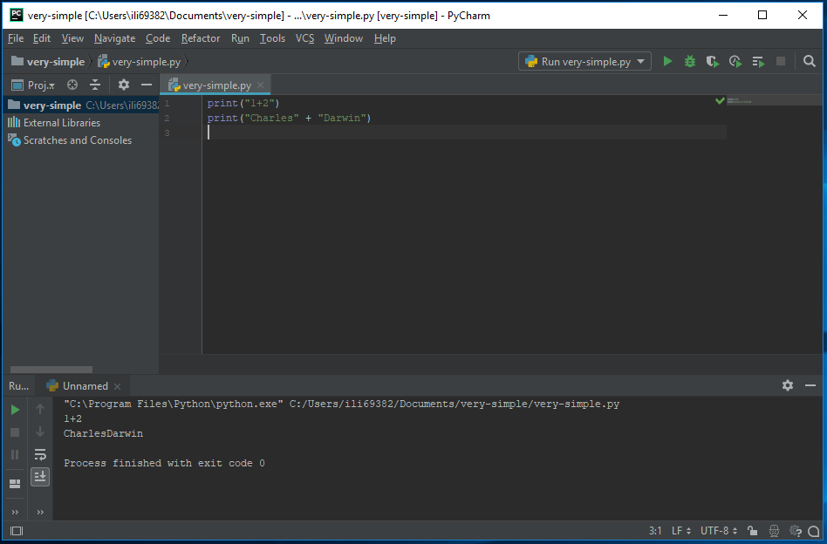
Use an integrated development environment (IDE)
Notes:
11

Slide 12
Use an integrated development environment (IDE)
Source
file
Notes:
12

Slide 13
Use an integrated development environment (IDE)
Source
file
Execution
shell
Notes:
13

Slide 14
Variables are names for values
Notes:
14

Slide 15
Variables are names for values
Created by use
Notes:
15

Slide 16
Variables are names for values
Created by use: no declaration necessary
Notes:
16

Slide 17


Variables are names for values
Created by use: no declaration necessary
int x;
x = 3;
Notes:
17

Slide 18
Variables are names for values
Created by use: no declaration necessary
>>> planet = 'Pluto'
>>>
Notes:
18

Slide 19
Variables are names for values
Created by use: no declaration necessary
>>> planet = 'Pluto'
>>> print(planet)
Pluto
>>>
Notes:
19

Slide 20
Variables are names for values
Created by use: no declaration necessary
>>> planet = 'Pluto'
>>> print(planet)
Pluto
>>>
variable
value
planet
'Pluto'
Notes:
20

Slide 21
Variables are names for values
Created by use: no declaration necessary
>>> planet = 'Pluto'
>>> print(planet)
Pluto
>>> moon = 'Charon'
>>>
variable
value
planet
moon
'Pluto'
'Charon'
Notes:
21

Slide 22
Variables are names for values
Created by use: no declaration necessary
>>> planet = 'Pluto'
>>> print(planet)
Pluto
>>> moon = 'Charon'
>>> p = planet
>>>
variable
value
planet
moon
'Pluto'
'Charon'
Notes:
22

Slide 23
Variables are names for values
Created by use: no declaration necessary
>>> planet = 'Pluto'
>>> print(planet)
Pluto
>>> moon = 'Charon'
>>> p = planet
>>>
variable
value
planet
moon
p
'Pluto'
'Charon'
Notes:
23

Slide 24
Variables are names for values
Created by use: no declaration necessary
>>> planet = 'Pluto'
>>> print(planet)
Pluto
>>> moon = 'Charon'
>>> p = planet
>>> print(p)
Pluto
>>>
variable
value
planet
moon
p
'Pluto'
'Charon'
Notes:
24

Slide 25
A variable is just a name
Notes:
25

Slide 26
A variable is just a name
Does not have a type
Notes:
26

Slide 27
A variable is just a name
Does not have a type
>>> planet = 'Pluto'
>>>
Notes:
27

Slide 28
A variable is just a name
Does not have a type
string
>>> planet = 'Pluto'
>>>
variable
value
planet
'Pluto'
Notes:
28

Slide 29
A variable is just a name
Does not have a type
>>> planet = 'Pluto'
>>> planet = 9
>>>
variable
value
planet
'Pluto'
9
integer
Notes:
29

Slide 30
A variable is just a name
Does not have a type
>>> planet = 'Pluto'
>>> planet = 9
>>>
variable
value
planet
'Pluto'
9
Values are garbage collected
Notes:
30

Slide 31
A variable is just a name
Does not have a type
>>> planet = 'Pluto'
>>> planet = 9
>>>
variable
value
planet
'Pluto'
9
Values are garbage collected
If nothing refers to data any longer, it can be recycled
Notes:
31

Slide 32

A variable is just a name
Does not have a type
>>> planet = 'Pluto'
>>> planet = 9
>>>
variable
value
planet
'Pluto'
9
Values are garbage collected
If nothing refers to data any longer, it can be recycled
Notes:
32

Slide 33
Must assign value to variable before using it
Notes:
33

Slide 34
Must assign value to variable before using it
>>> planet = 'Sedna'
>>>
Notes:
34

Slide 35
Must assign value to variable before using it
>>> planet = 'Sedna'
>>> print(plant)# note the deliberate misspelling
Notes:
35

Slide 36
Must assign value to variable before using it
>>> planet = 'Sedna'
>>> print(plant)# note the deliberate misspelling
Traceback (most recent call last):
print(plant)
NameError: name 'plant' is not defined
>>>
Notes:
36

Slide 37
Must assign value to variable before using it
>>> planet = 'Sedna'
>>> print(plant)# note the deliberate misspelling
Traceback (most recent call last):
print(plant)
NameError: name 'plant' is not defined
>>>
Python does not assume default values for variables
Notes:
37

Slide 38
Must assign value to variable before using it
>>> planet = 'Sedna'
>>> print(plant)# note the deliberate misspelling
Traceback (most recent call last):
print(plant)
NameError: name 'plant' is not defined
>>>
Python does not assume default values for variables
Doing so can mask many errors
Notes:
38

Slide 39
Must assign value to variable before using it
>>> planet = 'Sedna'
>>> print(plant)# note the deliberate misspelling
Traceback (most recent call last):
print(plant)
NameError: name 'plant' is not defined
>>>
Python does not assume default values for variables
Doing so can mask many errors
Anything from # to the end of the line is a comment
Notes:
39

Slide 40
Values do have types
Notes:
40

Slide 41
Values do have types
>>> string = "two"
>>> number = 3
>>> print(string * number)# repeated concatenation
twotwotwo
>>>
Notes:
41

Slide 42
Values do have types
>>> string = "two"
>>> number = 3
>>> print(string * number)# repeated concatenation
twotwotwo
>>> print(string + number)
Traceback (most recent call last)
number + string
TypeError: can only concatenate str
(not "int") to str
>>>
Notes:
42

Slide 43
Values do have types
>>> string = "two"
>>> number = 3
>>> print(string * number)# repeated concatenation
twotwotwo
>>> print(string + number)
Traceback (most recent call last)
number + string
TypeError: can only concatenate str
(not "int") to str
>>>
Would probably be safe here to produce 'two3'
Notes:
43

Slide 44
Values do have types
>>> string = "two"
>>> number = 3
>>> print(string * number)# repeated concatenation
twotwotwo
>>> print(string + number)
Traceback (most recent call last)
number + string
TypeError: can only concatenate str
(not "int") to str
>>>
Would probably be safe here to produce 'two3'
But then what should '2'+'3' be?
Notes:
44

Slide 45
Values do have types
>>> string = "two"
>>> number = 3
>>> print(string * number)# repeated concatenation
twotwotwo
>>> print(string + number)
Traceback (most recent call last)
number + string
TypeError: can only concatenate str
(not "int") to str
>>>
Would probably be safe here to produce 'two3'
But then what should '2'+'3' be?
Doing too much is as bad as doing too little…
Notes:
45

Slide 46
Use functions to convert between types
Notes:
46

Slide 47
Use functions to convert between types
>>> print(int('2') + 3)
5
>>>
Notes:
47

Slide 48
Use functions to convert between types
>>> print(int('2') + 3)
5
>>> print('2' + str(3))
23
>>>
Notes:
48

Slide 49
Numbers
Notes:
49

Slide 50
Numbers
14 | integer with unlimited precision (as much memory as available)
Notes:
50

Slide 51
Numbers
14 | integer with unlimited precision (as much memory as available)
14.0 | 64-bit float (on most machines)
Notes:
51

Slide 52
Numbers
14 | integer with unlimited precision (as much memory as available)
14.0 | 64-bit float (on most machines)
1+4j | complex number (two 64-bit floats)
Notes:
52

Slide 53
Numbers
14 | integer with unlimited precision (as much memory as available)
14.0 | 64-bit float (on most machines)
1+4j | complex number (two 64-bit floats)
x.real, x.imag | real and imaginary parts of complex number
Notes:
53

Slide 54
Arithmetic
Notes:
54

Slide 55
Arithmetic
Addition | + | 35 + 22 | 57
Notes:
55

Slide 56
Arithmetic
Addition | + | 35 + 22 | 57
 |  | 'Py' + 'thon' | 'Python'
Notes:
56

Slide 57
Arithmetic
Addition | + | 35 + 22 | 57
 |  | 'Py' + 'thon' | 'Python'
Subtraction | - | 35 - 22 | 13
Notes:
57

Slide 58
Arithmetic
Addition | + | 35 + 22 | 57
 |  | 'Py' + 'thon' | 'Python'
Subtraction | - | 35 - 22 | 13
Multiplication | * | 3 * 2 | 6
Notes:
58

Slide 59
Arithmetic
Addition | + | 35 + 22 | 57
 |  | 'Py' + 'thon' | 'Python'
Subtraction | - | 35 - 22 | 13
Multiplication | * | 3 * 2 | 6
 |  | 'Py' * 2 | 'PyPy'
Notes:
59

Slide 60
Arithmetic
Addition | + | 35 + 22 | 57
 |  | 'Py' + 'thon' | 'Python'
Subtraction | - | 35 - 22 | 13
Multiplication | * | 3 * 2 | 6
 |  | 'Py' * 2 | 'PyPy'
Division | / | 3 / 2 | 1.5
Notes:
60

Slide 61
Arithmetic
Addition | + | 35 + 22 | 57
 |  | 'Py' + 'thon' | 'Python'
Subtraction | - | 35 - 22 | 13
Multiplication | * | 3 * 2 | 6
 |  | 'Py' * 2 | 'PyPy'
Division | / | 3 / 2 | 1.5
 |  | 3 // 2 | 1
Notes:
61

Slide 62
Arithmetic
Addition | + | 35 + 22 | 57
 |  | 'Py' + 'thon' | 'Python'
Subtraction | - | 35 - 22 | 13
Multiplication | * | 3 * 2 | 6
 |  | 'Py' * 2 | 'PyPy'
Division | / | 3 / 2 | 1.5
 |  | 3 // 2 | 1
Exponentiation | ** | 2 ** 0.5 | 1.41421356...
Notes:
62

Slide 63
Arithmetic
Addition | + | 35 + 22 | 57
 |  | 'Py' + 'thon' | 'Python'
Subtraction | - | 35 - 22 | 13
Multiplication | * | 3 * 2 | 6
 |  | 'Py' * 2 | 'PyPy'
Division | / | 3 / 2 | 1.5
 |  | 3 // 2 | 1
Exponentiation | ** | 2 ** 0.5 | 1.41421356...
Remainder | % | 13 % 5 | 3
Notes:
63

Slide 64
Prefer in-place forms of binary operators
Notes:
64

Slide 65
Prefer in-place forms of binary operators
>>> years = 500
>>>
Notes:
65

Slide 66
Prefer in-place forms of binary operators
>>> years = 500
>>> years += 1
>>>
Notes:
66

Slide 67
Prefer in-place forms of binary operators
>>> years = 500
>>> years += 1
>>>
The same as years = years + 1
Notes:
67

Slide 68
Prefer in-place forms of binary operators
>>> years = 500
>>> years += 1
>>> print(years)
501
>>>
Notes:
68

Slide 69
Prefer in-place forms of binary operators
>>> years = 500
>>> years += 1
>>> print(years)
501
>>> years %= 10
>>>
Notes:
69

Slide 70
Prefer in-place forms of binary operators
>>> years = 500
>>> years += 1
>>> print(years)
501
>>> years %= 10
>>>
The same as: years = years % 10
Notes:
70

Slide 71
Prefer in-place forms of binary operators
>>> years = 500
>>> years += 1
>>> print(years)
501
>>> years %= 10
>>> print(years)
1
>>>
Notes:
71

Slide 72
Comparisons
Notes:
72

Slide 73
Comparisons
3 < 5 | True
Notes:
73

Slide 74
Comparisons
3 < 5 | True
3 != 5 | True
Notes:
74

Slide 75
Comparisons
3 < 5 | True
3 != 5 | True
3 == 5 | False
Notes:
75

Slide 76
Comparisons
3 < 5 | True
3 != 5 | True
3 == 5 | False
Single = is assignment
Double == is equality
Notes:
76

Slide 77
Comparisons
3 < 5 | True
3 != 5 | True
3 == 5 | False
3 >= 5 | False
Notes:
77

Slide 78
Comparisons
3 < 5 | True
3 != 5 | True
3 == 5 | False
3 >= 5 | False
1 < 3 < 5 | True
Notes:
78

Slide 79
Comparisons
3 < 5 | True
3 != 5 | True
3 == 5 | False
3 >= 5 | False
1 < 3 < 5 | True
1 < 5 > 3 | True
But please don't
do this
Notes:
79

Slide 80
Comparisons
3 < 5 | True
3 != 5 | True
3 == 5 | False
3 >= 5 | False
1 < 3 < 5 | True
1 < 5 > 3 | True
3+2j < 5 | error
Notes:
80

Slide 81
Python
Boolean types

Slide 82
What is a Boolean?
A simple data type in Python is the Boolean. It has only two possible values:
True
False
Comparisons result in Boolean values:
(3 > 5) is False
(2 == 2.0) is True

Slide 83
Tests in if/while result in a Boolean
if x > 3: # Will run if (x > 3) is True
...do something...
while my_list: # Will loop until my_list is empty
...something that reduces size of my_list...
Note: Boolean values are case-sensitive!
True # but not "true"
False # but not "false"

Slide 84
Python
Saving your code to a script

Slide 85
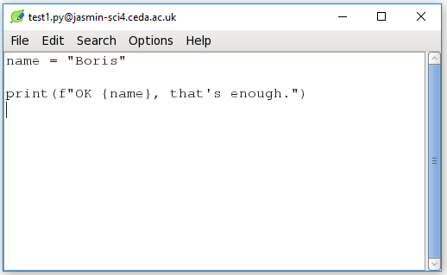
Open an editor (leafpad)
$ leafpad test1.py & # "&" means run in background
so you can still type here.
Opens an
editor
window...
make a
change...
and
Save!

Slide 86
Now run it
With...
$ python test1.py
...your output appears here...

Slide 87
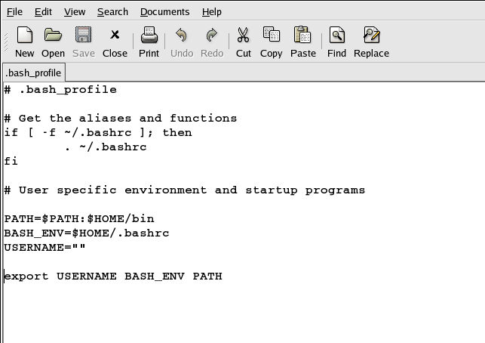
Open an editor (gedit)
$ gedit .bash_profile &
# "&" means run in background so you can still type here.
Opens an
editor
window...
make a
change...
and
Save!

Slide 88

created by
Greg Wilson
October 2010
Copyright © Software Carpentry 2010
This work is licensed under the Creative Commons Attribution License
See http://software-carpentry.org/license.html for more information.

