Slide 1
Python
Logging and Debugging

Slide 2
Logging
Python has the "logging" module which allows you to log in many useful ways:
To the terminal
To file(s)
To custom-handlers (e.g. e-mail)
To system log files

Slide 3
Logging options
You can configure:
The number of loggers
The format of log messages
The level of ferocity with which logging should happen, e.g.:
Log everything in "DEBUG" mode
Only log errors in "operational" mode

Slide 4
Logging – getting started
>>> import logging
>>> logging.basicConfig(level=logging.INFO)
>>> log = logging.getLogger(__name__)
>>> log.info("The system is running")
INFO:root:The system is running.
>>> log.debug("Nothing said") # Not displayed
because logging at lower than
priority level
>>> log.error("Now it's serious!")
ERROR:<module_name>:Now it's serious!

Slide 5
Logging – more options
We do not have time to cover logging properly. There are lots you can do with it: https://docs.python.org/3/library/logging.html
>>> import sys, logging # You'll need both these modules
>>> stream_handler = logging.StreamHandler(sys.stderr)
>>> stream_handler.formatter = logging.Formatter(logging.BASIC_FORMAT)
>>> log = logging.getLogger(__name__) # Create logger
>>> log.addHandler(stream_handler) # Add handler to display
>>> log.setLevel(logging.DEBUG) # Set minimum logging level
>>> log.warning("Danger! Will Robinson! Danger!")
WARNING:<module_name>:Danger! Will Robinson! Danger!

Slide 6
What is the python debugger?
We all write code with bugs in...that is why it is important to write tests for our code.
The python debugger is a tool that allows you to:
Run through your code interactively;
Inspect/change the variables at run-time;
Set "break points" in the code where you can step in and examine the state.
Best illustrated through an example...

Slide 7
A simple script
def double_it(x):
double = 2 * x
return double
# Now the main code
items = [34, 6.2, {"key": 34}]
for i in items:
print(double_it(i))
Can you guess where python raises an error?

Slide 8
A simple script – with debugger
import pdb # Import the debugger
def double_it(x):
pdb.set_trace() # Set a break point
double = 2 * x
return double
# Now the main code
items = [34, 6.2, {"key": 34}]
for i in items:
print(double_it(i))

Slide 9
Debugger in action
$ python double.py
> /home/vagrant/double.py(5)double_it()
-> double = 2 * x
(Pdb) n Run the next line of code
> /home/vagrant/double.py(6)double_it()
-> return double
(Pdb) print(double, x) Display current values of double and x
68 34
(Pdb) n Run the next line of code
--Return--
> /home/vagrant/double.py(6)double_it()->68
-> return double

Slide 10
Finding the error
...
(Pdb) n Step through until we hit the error
TypeError: unsupported operand type(s) for *: 'int' and 'dict'
> /home/vagrant/double.py(5)double_it()
-> double = 2 * x The line where the error occurred
(Pdb) print(x) Let's look at x when the error occurred
{'key': 34}
(Pdb) type(x) It failed because we can't double a dictionary!
<class 'dict'>
https://docs.python.org/3/library/pdb.html#debugger-commands

Slide 11
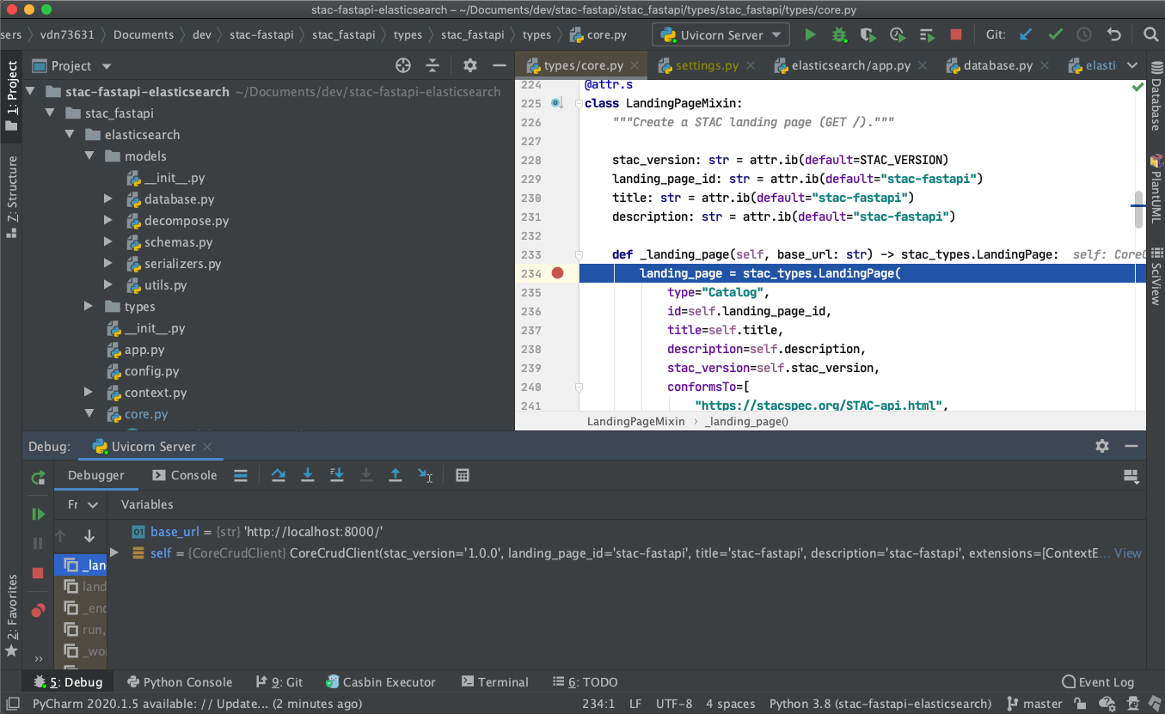
IDEs Wrap this up nicely

Slide 12
IDEs Wrap this up nicely
Set breakpoint

Slide 13
IDEs Wrap this up nicely
Variables in scope

Slide 14
IDEs Wrap this up nicely
Controls to step through code and explore

