Slide 1
Where next?
ISC summary

Slide 2

CONGRATULATIONS!
You did it!

Slide 3
We learnt about python basics
Basics and control flow, booleans
Lists, slicing and tuples
Input/output
Strings and text processing
Functions, libraries and scripts
Sets and dictionaries
Errors and debugging
OOP

Slide 4
And more advanced libraries
Numpy: arrays and masked arrays
Matplotlib: plotting
NetCDF (& CF): reading and writing data

Slide 5

We didn't have time for…
https://pandas.pydata.org/pandas-docs/stable/user_guide/10min.html
For tabulated data (e.g. Excel on steroids)
Powered by Numpy
Fast and efficient
Can be integrated with Dask (for parallel / delayed / out-of-memory operations)

Slide 6
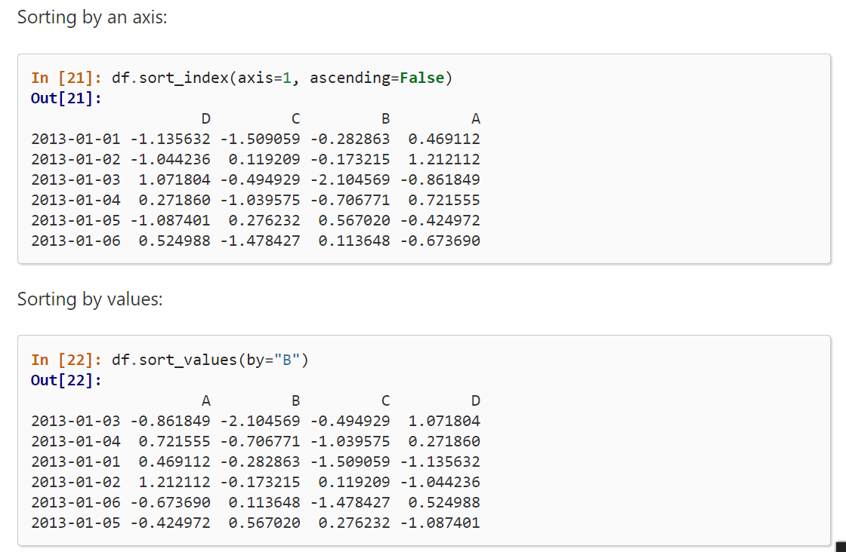
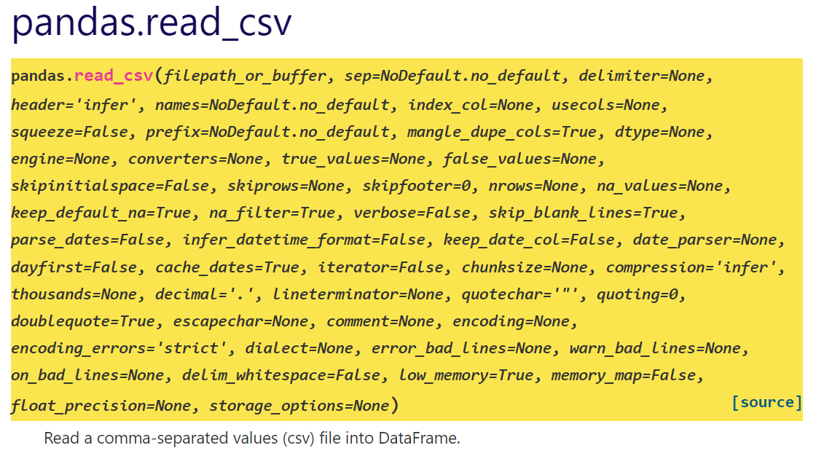
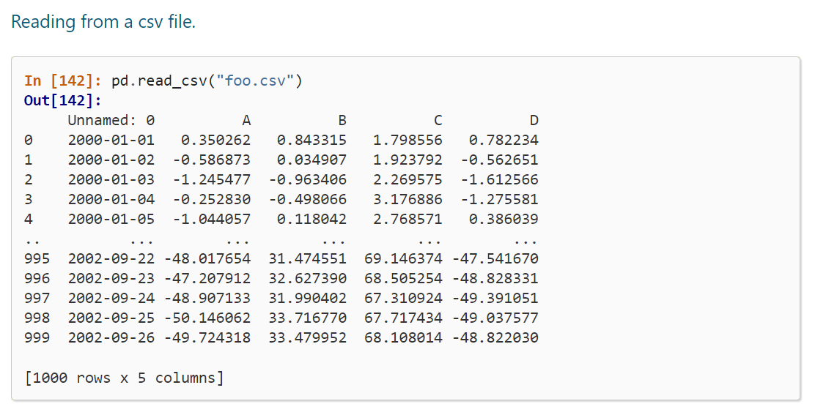
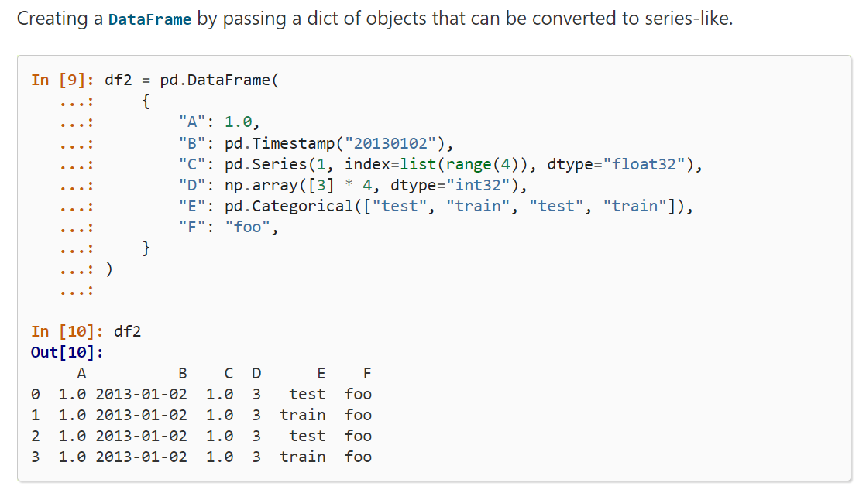
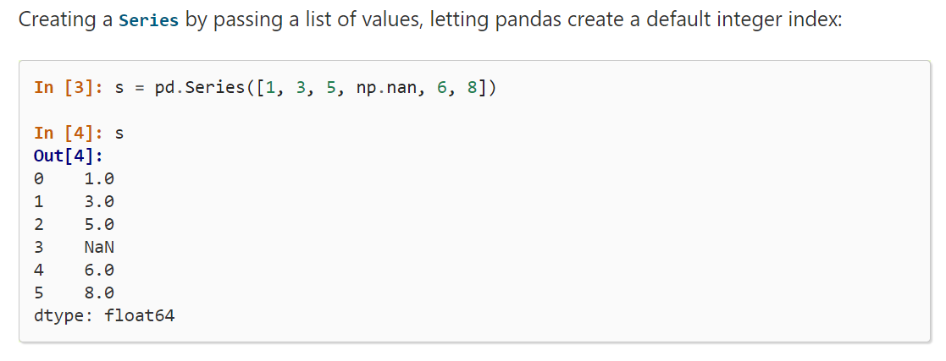
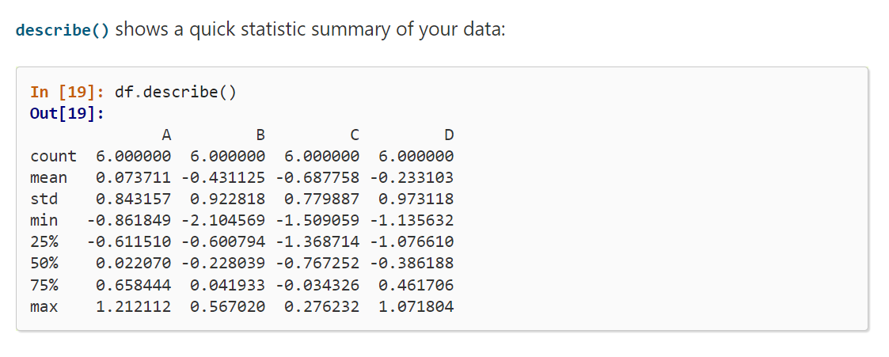
for tabulated data

Slide 7



We didn't have time for…
python library: handles NC, PP
integrates with matplotlib/cartopy (cfplot)
subsetting, averaging, regridding etc.
python library: handles NC, PP, GRIB
integrates with matplotlib/cartopy
subsetting, averaging, regridding etc.
python library: handles NC, Zarr
integrates with matplotlib/cartopy
subsetting, averaging, regridding etc.
https://ncas-cms.github.io/cf-python/
http://xarray.pydata.org/en/stable/
https://scitools-iris.readthedocs.io/en/latest/

Slide 8
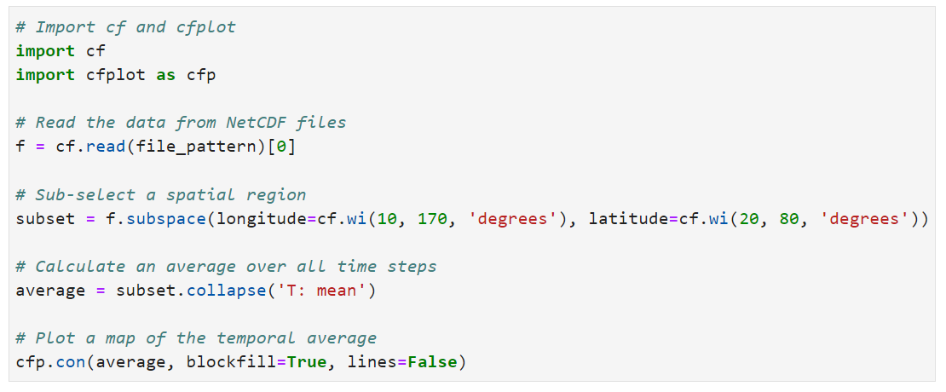
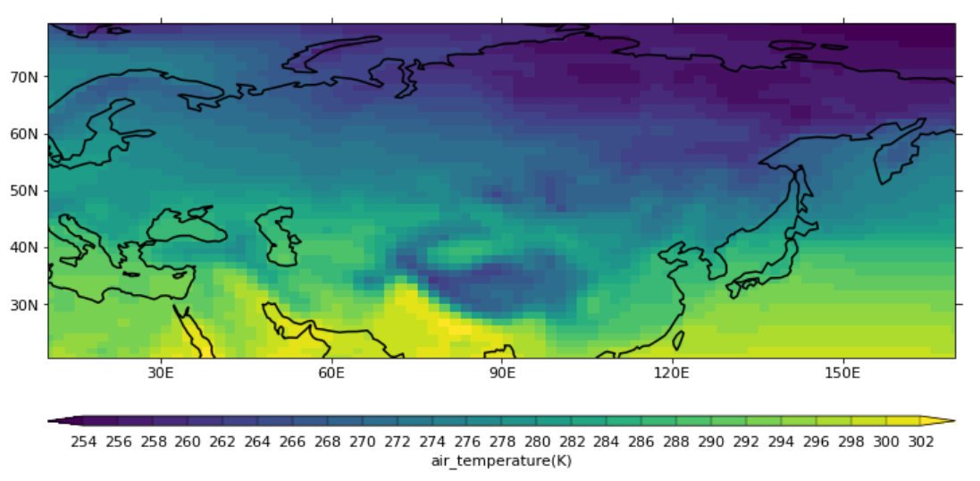
Look out for the next NCAS course:
https://ncas.ac.uk/study-with-us/data-analysis-tools/

Slide 9
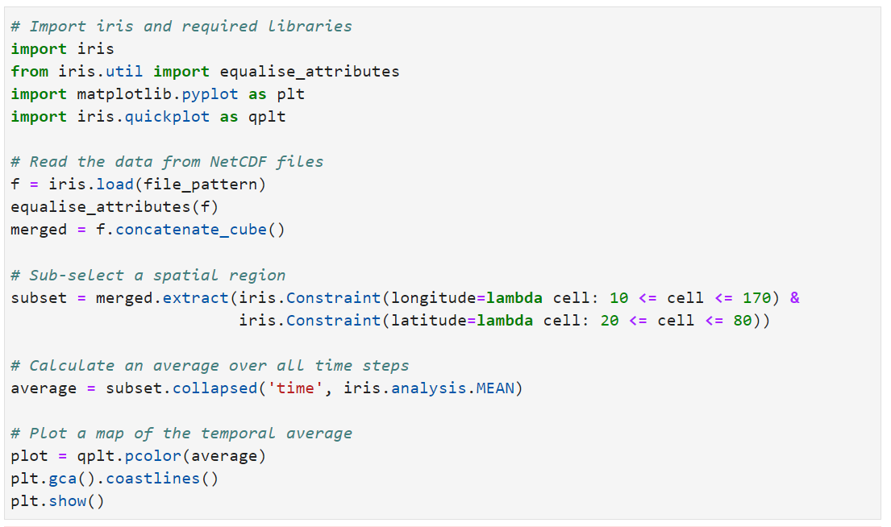
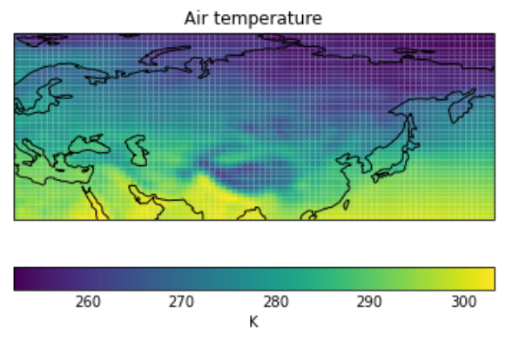

Slide 10
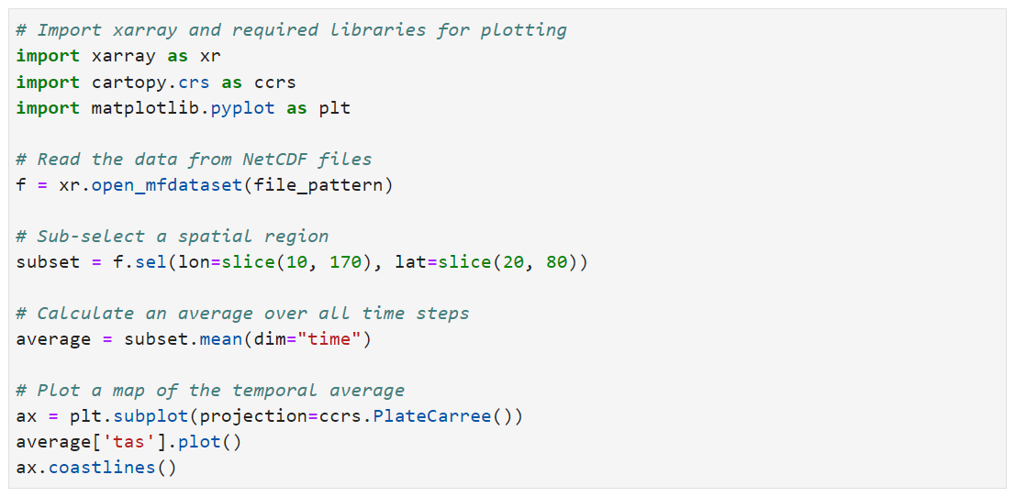
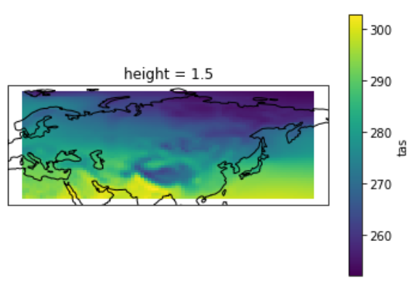

Slide 11
Where to go next?
The best way to learn is to play...
Get python installed on your desktop/laptop (on Windows, MAC or Linux).
Read/write files
Move/copy files/folders using scripts
Make some nice plots
Start a small project:
Write down the steps – think algorithmically!
Convert the steps to pseudo-code – test ideas/code as you go
Convert to Python functions / classes / scripts / modules

Slide 12
Places to learn more/practice
Codecademy site has great exercises:
https://www.codecademy.com/learn/learn-python
Free Code Camp: https://www.freecodecamp.org/learn/scientific-computing-with-python/
Python website has documentation for all the standard library modules (sys, maths, etc.):
https://docs.python.org/

Slide 13
Places to learn more/practice
Python website also has tutorials:
https://docs.python.org/3/tutorial/
Software-Carpentry web site hosts videos and presentations and lots more:
https://software-carpentry.org/lessons/

Slide 14
ISC course materials
Full version of the modules and exercises/solutions:
https://github.com/ncasuk/ncas-isc

Slide 15
Good luck!

