Slide 1

Reconciliation And Peace Innovative Development
(RAPID)
WEB SITE:www.rapidcharity.org
E-MAIL:info@rapidcharity.org

Slide 2
RAPID CHARITY
Rapid Charity believes in the power of dream
And our objective is to empower students to believe they can achieve their dreams
(RAPID) is a non-political, non-sectarian and non-profit organization registered in the United States of America, focusing on philanthropic goals with a commitment of serving those in need.

Slide 3
Our Mission is to promote career based higher education amongst talented, qualified and aggressive young people, assisting them to realize
their full potential in deprived and peripheral situations within the context of Pakistan.
Our Goal is encouraging students in rising to top professions in community, state and nation and thereby uplifting the needy students in minority communities of Pakistan.

Slide 4
OUR OBJECTIVES
To give / distribute donor funding to financially poor and able individuals in need, by making charitable giving positive for purposes of leading to advancement of education in professional / career development, self reliance and confidence building.
​
To encourage activities leading to the implementations of Peace, with the goal of building Trust and Cooperation amongst different faith communities through joint programs.

Slide 5
OUR OBJECTIVES
To organize, encourage, conduct and participate in development programs and training courses for promoting the rights and dignity of all people, with emphasis on better utilization of local resources.
To work with medical centres, nursing homes, orphanages and centres for the mentally and physically disabled, in order to equip and help the beneficiaries to acquire quality of life.

Slide 6
Narrative Report of the RAPID Higher Education Scholarships Program
From January to August 2025

Slide 7
RAPID Offered the following Scholarships for Spring 2025 and Fall 2025 Semesters

Slide 8
JOHN-IVY AZARIAH SCHOLARSHIP
We are offering J-IA Scholarship to students who are admitted in professional colleges and universities.
Preference is given to high achiever needing financial assistance having scores of (GPA-3.5 & above) (grade A+).

Slide 9
ROBERT MATHIAS SCHOLARSHIP
We are offering RMS to students who are studying Business and Accounting in professional colleges and universities.
Preference is given to high achiever needing financial assistance having scores of (GPA-3.5 & above) (grade A+).

Slide 10
IVY AZARIAH SCHOLARSHIP
This Scholarship is awarded to Female individuals who are not looking for just making themselves better, but how they could be an important part in the development of others

Slide 11
Procedure for Selection

Slide 12

Messages and pamphlets were circulated through our website, WhatsApp, and other social media platforms to students. These messages were also sent to Christian colleges and universities.

Slide 13
Procedure for Selection of students for the Spring & Fall 2025 Semester
Step 1: Online Application
Applicants from all over Pakistan applied online for scholarships offered by RAPID through the website (www.rapidcharity.org ) The deadline for Spring 2025 semester was 15th October 2024, and for Fall 2025 semester it was 15th April 2025

Slide 14
Step 2: Initial Data & Documents Collection
After the application deadline, RAPID staff in Pakistan collected the initial data from online submissions. And then further information like personal data, family data and family finances, academic data and achievements, need for financial assistance, and references from institution, church and family were collected.
students were also required to submit previous results, proof of admission and any other information left out in the form. (4-6 weeks)

Slide 15
Procedure of Selection
Step 3: Data Arranging/Organization
The collected data was organized into a tabular form, categorized by education level, fields of study and college and university. Missing information was gathered through emails, Whats-app messages, regular text, or phone calls as needed. This took another 4-5 weeks.

Slide 16
Procedure of Selection
Step 4: Reviewing and Shortlisting
The organized data of all applicants was shared with the CEO-RAPID, and then a series of Zoom meetings were scheduled to discuss each applicant individually. During these meetings, students were shortlisted based on merit, considering factors such as GPA (minimum 3.5), field of study, budget availability, city, gender, and family needs.
A final Data sheet of exel was prepared

Slide 17
Procedure of Selection
Step 5: Refusal Notification
Students not meeting the criteria of RAPID were sent a "RAPID Letter of Refusal."
Step 6: Acceptance Notification
Selected students were notified via email with a "RAPID Letter of Acceptance," specifying the approved fee amount.

Slide 18
Step 7: Fee Voucher Collection
Selected students were asked to send their fee vouchers, which were first verified by RAPID staff and then forwarded to the accounts personnel for direct payment to the concerned college/university bank account.
We donot deposit funds into students personal account nor we pay cash to them.

Slide 19
Procedure of Selection
Step 8: Ongoing Communication
Students were required to keep RAPID updated on any changes in their studies, institution, address, or contact information. They were also asked to send their result transcripts regularly.
Regular communication is maintained with students to address queries, collect result transcripts, and provide support.

Slide 20
Spring & Fall 2025 Students
 | Spring 2025 Semester | Fall 2025 Semester | Total
Applicants | 175 | 132 | 307
Provided Complete documents | 140 | 118 | 258
Approved | 71 | 76 | 147
Females | 40 | 39 | 79
Males | 31 | 37 | 68

Slide 21
Spring & Fall 2025 Different fields of studies
 | Spring 2025 | Fall 2025 | Total
Under Grads | 5 | 1 | 6
BS Business | 7 | 8 | 15
BS Nursing | 17 | 19 | 36
BS Computer Science | 2 | 4 | 6
BS other streams | 19 | 20 | 39
M S/M. Phil | 6 | 10 | 16
Post RN | 0 | 1 | 1
BDS | 1 | 1 | 2
DVM | 3 | 3 | 6
DPT | 4 | 2 | 6
Pharm D | 5 | 5 | 10
ACCA | 1 | 1 | 2
CA | 1 | 1 | 2

Slide 22
In Spring 2025 semester 20 students completed their degrees.
Personal statements of few students is shared

Slide 23
Ephron Amir BS (Hons) Biotechnology
Forman Christian College-A Chartered University Lahore
Fall 2022, Sp 2023, Fall 2023, Sp 2024, Fall 2024, Spring 2025
From the moment I first peered through a microscope, I knew that science was my calling—especially as the COVID-19 pandemic underscored how vital groundbreaking innovation is. I'm Ephron Amir, a Biotechnology major at Forman Christian College, raised by two devoted teachers in a humble home.
My first semester was daunting, as paying full tuition without concessions placed a heavy burden on my hardworking family. Then, I discovered RAPID’s scholarship support, a generous intervention that lifted the financial weight off my father and reinvigorated my determination to pursue my dreams.

Slide 24
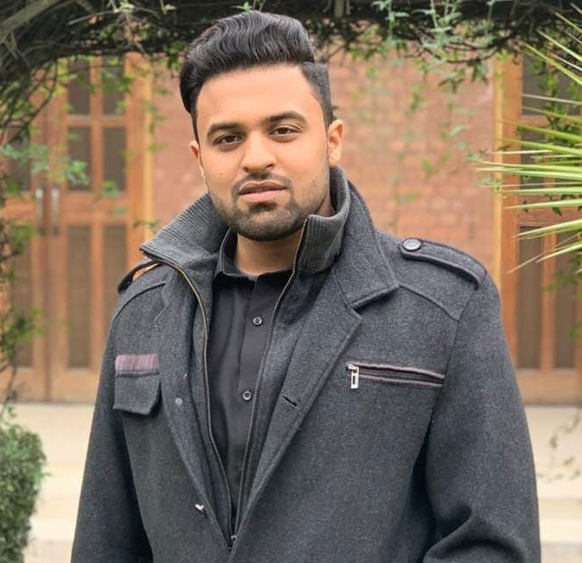
Ephron Amir
BS (Hons) Biotechnology
I am deeply grateful to RAPID and its entire team—especially Miss Resha and Rev. Khushnud Azariah—for believing in my potential and empowering my academic journey. Your support not only advanced my academic journey but inspires me to pay it forward.
Thank you, RAPID, for empowering my dreams and shaping my future.

Slide 25
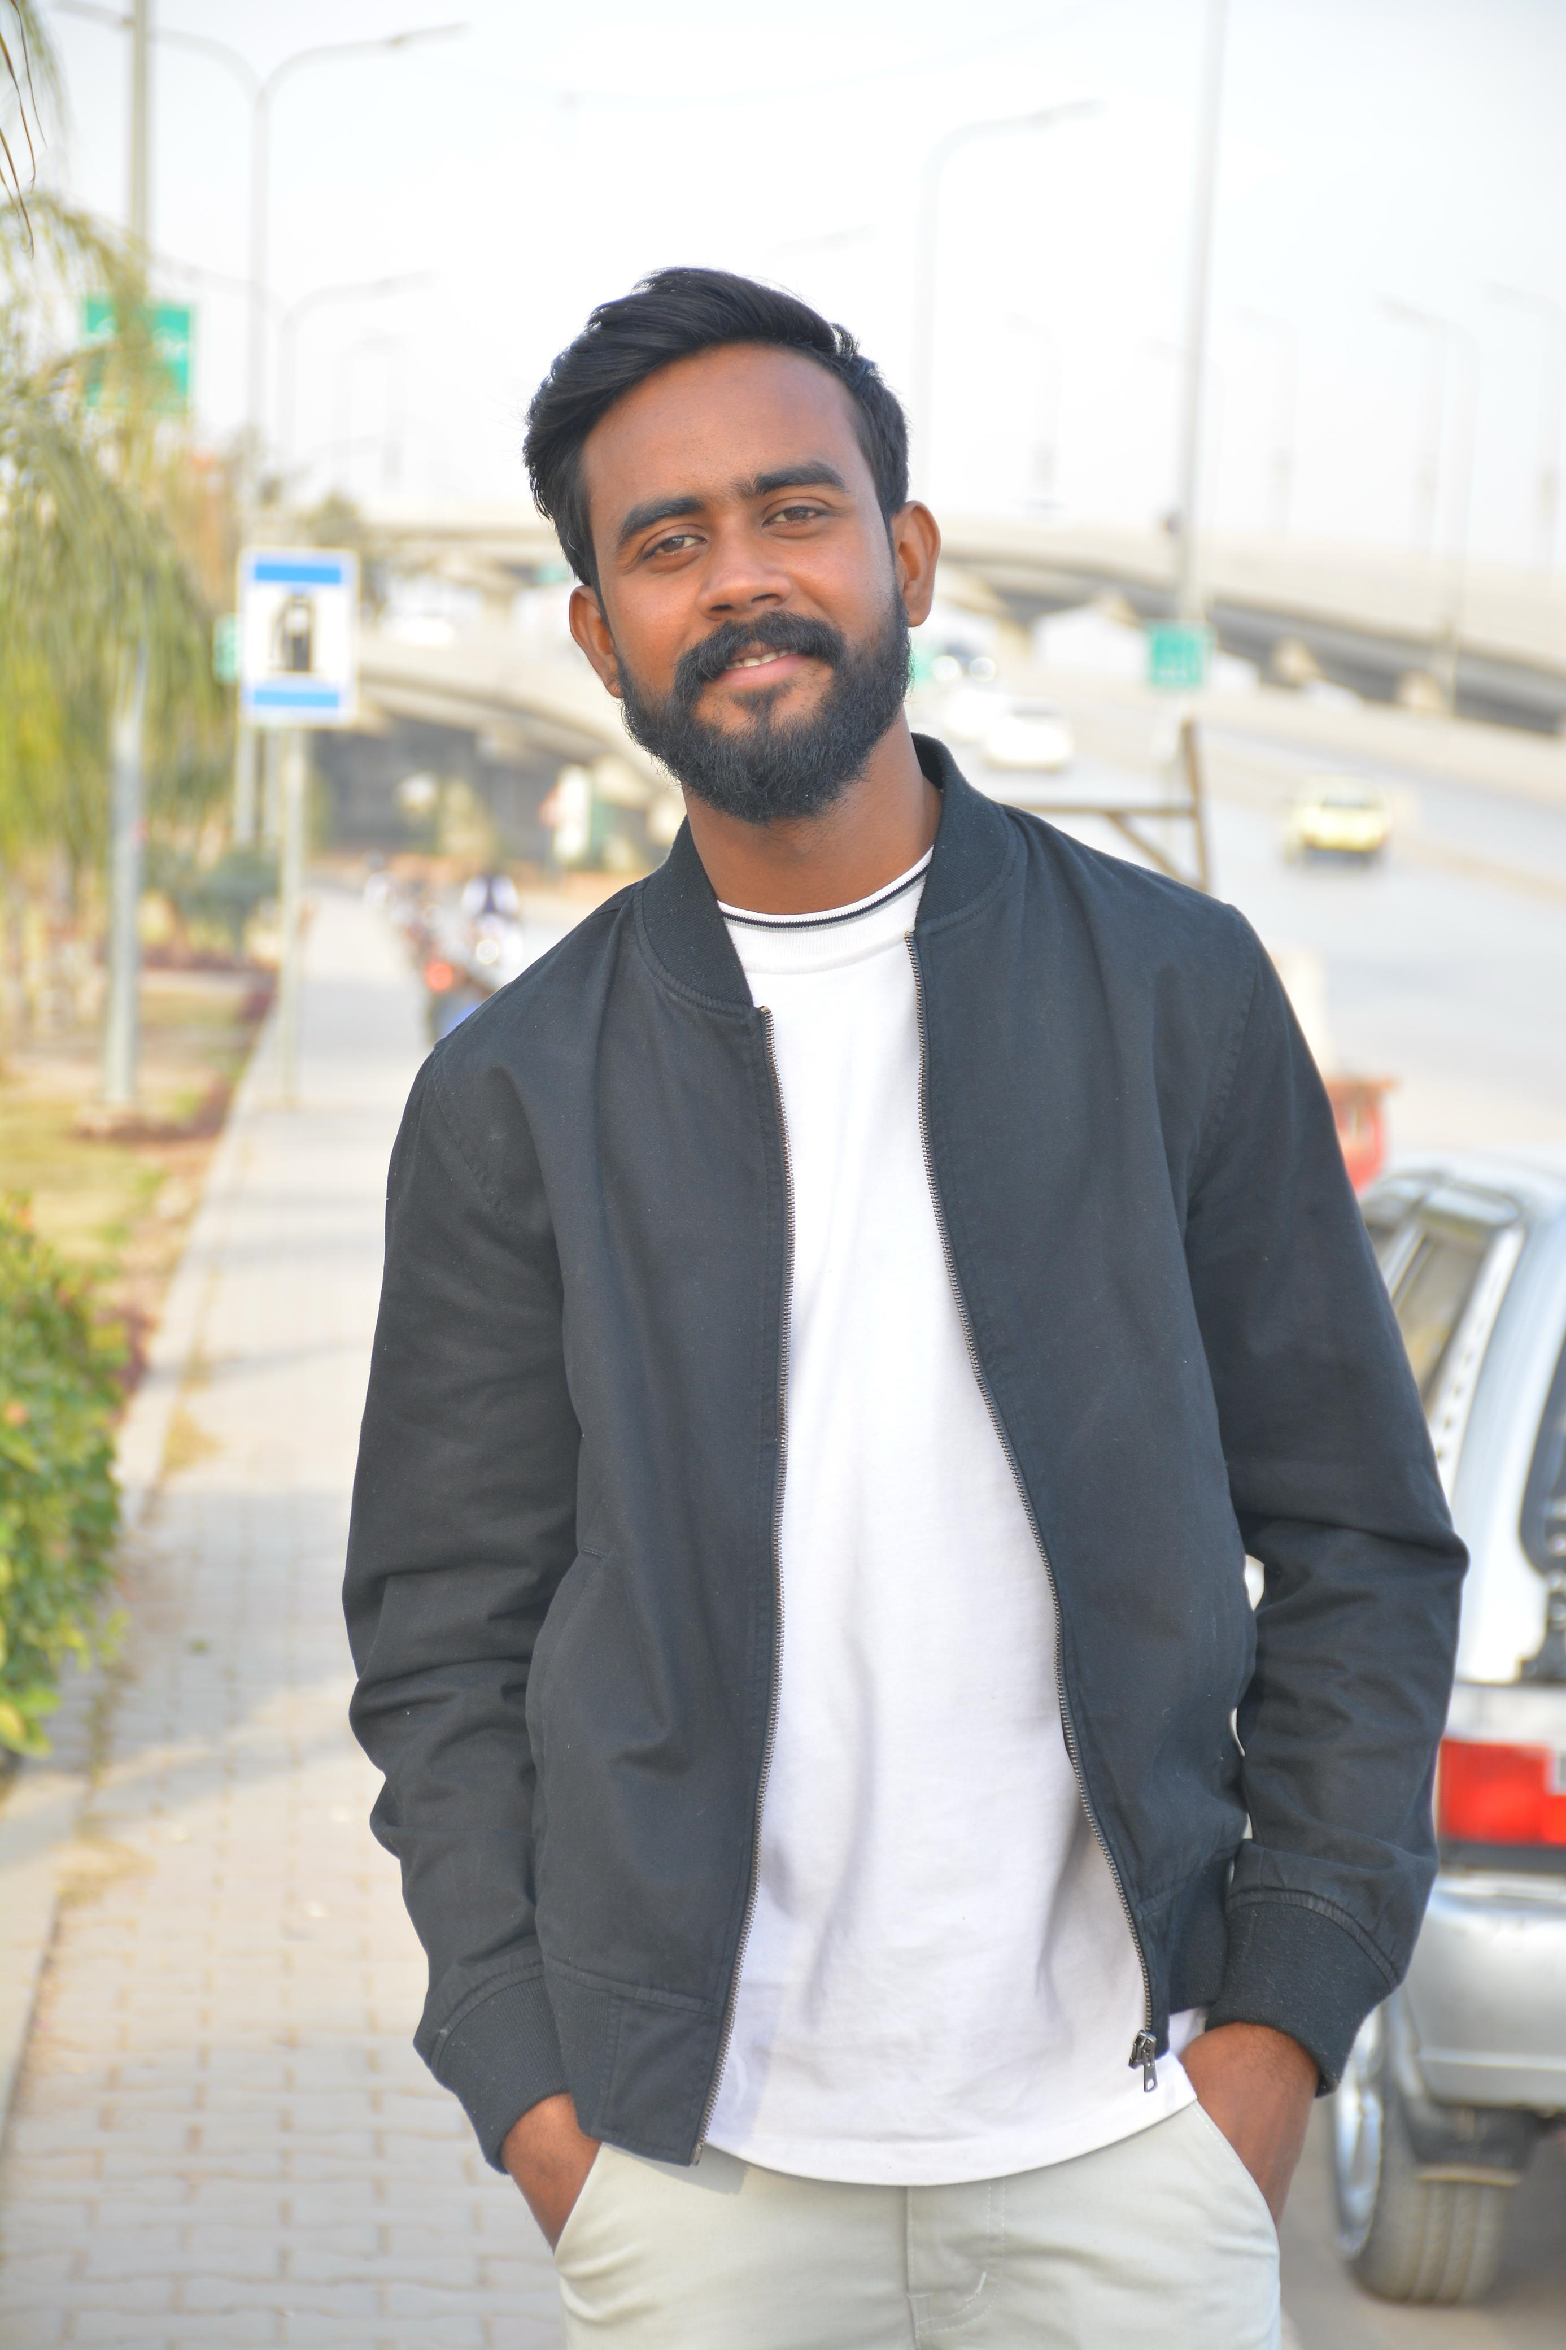
Nouman Stephen BS-Nursing Generic
Amazing Grace school of Nursing Karachi,
LUMHS
Spring 2024, Fall 2024 & Spring 2025
I’m Nouman Stephen I belongs to Peshawar Pakistan. But studying in Karachi. Completed my BSN generic from Amazing Grace School of Nursing Karachi (affiliated with. LUMHS. Liaqat University of Medical health sciences jamshoro Sindh Pakistan).
And I belongs to Christian family. We are 7( seven) siblings mom doing her job at khyber teaching hospital And dad work private medical rap. Honestly monthly income are not enough for our educational expense.

Slide 26

I’m thankful to RAPID who help me three times in the shape of scholarship. And My goal is to become Qualified Masters in nursing scholars and gain highest rank in my field.
Serve humanity to our community specially Christian’s.( as well as other communities around us).
If RAPID did not give me this scholarship it would be difficult for me to move constantly pursue my dreams and Goals.
Nouman Stephen
BS-Nursing Generic
RAPID Thank you so much for this amazing opportunity. This scholarship is a true blessing and will allow me to focus on my goal and achieve my dreams.

Slide 27
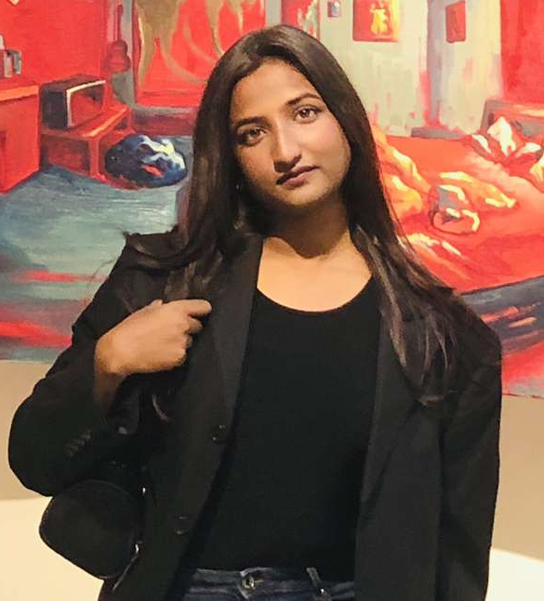
Alica Sakherab BS-(Hons) English Literature & Linguistics
National University Of Modern Languages Rawalpindi
Spring 2023, Fall 2023,Spring 2024, Fall 2024, Spring 2025
Alica Sakherab, I come from a family of three sisters and two incredibly loving and supportive parents.
However, growing up in a household without a brother—especially in a deeply patriarchal society—I was constantly reminded of the void I could never fill for my parents or my sisters.
University once felt like an unattainable dream, as I was always acutely aware of our financial constraints. Yet, I placed my faith in both God and me, took a leap of courage, and secured admission to my desired program: English Literature and Linguistics.

Slide 28
Alica Sakherab
BS-(Hons) English Literature & Linguistics
Since my first semester, I have been working relentlessly to become financially independent. However, balancing tuition fees and daily expenses as a freshman was an immense challenge.
I will forever be grateful to the friend who introduced me to this scholarship, as it arrived at a time when I desperately needed support. RAPID has been one of the most significant pillars of my academic journey, enabling me to persist despite hardships.
Now, as I stand on the threshold of completing my final semester, I am overwhelmed with gratitude and a profound sense of purpose. The generosity I have received from RAPID has instilled in me an unwavering determination to give back to my community, just as I was uplifted in my time of need. Financial stability undeniably shapes our realities, and I aspire to reach a position where I can support others in accessing education, just as I was once supported.

Slide 29
General Overview of Students Data
As in
Previous Years

Slide 30
Comparison of Scholarships awarded in previous Years

Slide 31
Graduated students in previous Years (71)

Slide 32
Students belong to Rural & Urban Area of Pakistan
We have been receiving applications and awarding scholarships to students from all over Pakistan
Bannu, Bhawalnagar, Clarkabad, Daska, Faisalabad, Gujranwala, Haroonabad, Islamabad, Karachi, Kasur, Kohat, Lahore, Layya, Multan, Narangmandi, Nizampura, Nowshera, Okara,Peshawar, Phool Nagar, Quetta, Rawalpindi, Sahiwal, Sialkot, Wah Cantt.

Slide 33
Ivy Azariah Scholarship awarded in 2025
 | Name | Home Address | Program | Institution | Spring 2024 | Fall 2024 | Spring 2025 | Fall 2025
1 | Shiza Shahzad | House#72, St.#3, H-Block Youhanabad Lahore | BS-Microbiology and Molecular Genetics | University of the Punjab Lahore | 6th Sem 4.0 | 7th Sem 4.0 | 8th Sem 4.0
2 | Emaan Farrukh | H# 35-S- 4 Bahar Colony, Kot Lakhpat Lahore. | BS Environmental Sciences | Kinnaird College For Women University | 5th Sem 3.84 | 6th Sem 3.65 | 7th Sem 3.93 | 8th Sem
3 | Jessica Ilyas | House no 334 bara maidan, Jamhuria colony, Nazimabad no 3, Karachi | BS Nursing | Saifee Burhani College of Nursing Karachi | 2nd Semester 4.0 | 3rd Sem 3.92 | 4th Sem | 5th Sem
4 | Malaika Arif | Bilal Town Street no 5, Faisalabad. | MS Public Administration | Government College University, Faisalabad. | 1st Semester 3.91 | 2nd Sem 3.92 | 3rd Sem | 4th Sem
5 | Arooj Amir | village Data Zaidka Tehsil Pasrur District Sialkot | M.Phil Chemistry | Minhaj University Lahore | 1st Semester 3.68 | 2nd Sem 3.75 | 3rd Sem | 4th Sem
6 | Visha Bhatti | H# NE-317 E/A Church Gali Hafeez Road, Hakem Abad Rawalpindi | Doctor of Pharmacy | Abasyn University Islamabad Campus | 6th Semester 3.93 | 7th Sem 4.0 | 8th Sem | 9th Sem

Slide 34
Ivy Azariah Scholarship awarded in 2025
 | Name | Home Address | Program | Institution | Spring 2024 | Fall 2024 | Spring 2025 | Fall 2025
7 | Eman Jackson | Phandu road Charagabad Christian colony Peshawar | Doctor of Pharmacy | Qurtuba University of Science and IT Peshawar | 2nd Semester 3.95 | 3rd Sem 3.86 | 4th Sem | 5th Sem
8 | Leaticia Shahid | 12/5 B Nazimabad No 3 block B Karachi | Doctor of physical therapy | Ziauddin University Karachi | 7th Semester 3.66 | 8th Semester 3.83 | 9th Sem 3.9 | 10th Sem
9 | Rimla Ejaz Gul | Bhatti Flats no 8, peco road, near life pharmacy, lahore. | BS Mass Communication | Forman Christian College Lahore | 1st Semester 4.0 | 2nd Semester 4.0 | 3rd Sem | 4th Sem
10 | Rowena Javaid | House number 238/12 (upper storey) Modern colony kotlakhpat Lahore | Bachelors in Psychology | Forman Christian College Lahore | 1st Semester 3.97 | 2nd Semester 4.0 | 3rd Sem 4.0 | 4th Sem

Slide 35
Robert Mathias Scholarship awarded in 2025
Sr. # | Name | Degree Program Studying | Institution | Spring 2024 Semester | Fall 2024 Semester | Spring 2025 Semester | Fall 2025 Semester
1 | Eglaim Pervaiz | BS-Business | Forman Christian College University | 3rd Semester 4.0 | 4th Semester | 5th Semester | 6th Semester
2 | Eshna Ejaz | BS Business | Forman Christian College University | 5th Semester 4.0 | 6th Semester | 7th Semester | 8th Semester
3 | Shalal Farhat | BS Business | Forman Christian College University | 3rd Semester 4.0 | 4th Semester | 5th Semester | 6th Semester
4 | Umair Asif | BS Business | Forman Christian College University | 3rd Semester 2.47 | 4th Semester | 5th Semester | 6th Semester
5 | Godwin cornelius | BS-Business | Forman christian college university | 4th Semester 4.0 | 5th Semester 4.0 | 6th Semester 3.66 | 7th Semester
6 | Armitiah Sheral | BS-Accounting & Finance | Kinnaird College for Women | F.Sc 844/1200 70.3% | 1st Semester 3.24 | 2nd Semester | 3rd Semester
7 | David Joseph Firdous | BBMA | University of Management and Technology Lahore | F.Sc 481/1100 43.7% | 1st Semester 3.52 | 2nd Semester | 3rd Semester
8 | Shayan Imtiaz | BBA | KUST University Kohat | F.Sc 69.1% | 1st Semester 3.58 | 2nd Semester | 3rd Semester
9 | Adam Russel Candara | ACCA | Institute of Chartered Accountants of Pakistan (ICAP) | B.Com 790/1400 56.4% | Pass marks 52
10 | Shulmiat Tariq Gill | Chartered accountancy | Crescent college of accountancy | Company law, F&R2 Cost & management accounting | 2 papers pass | Status:P.Credit in 1-paper CMA=*CLW=pass

Slide 36
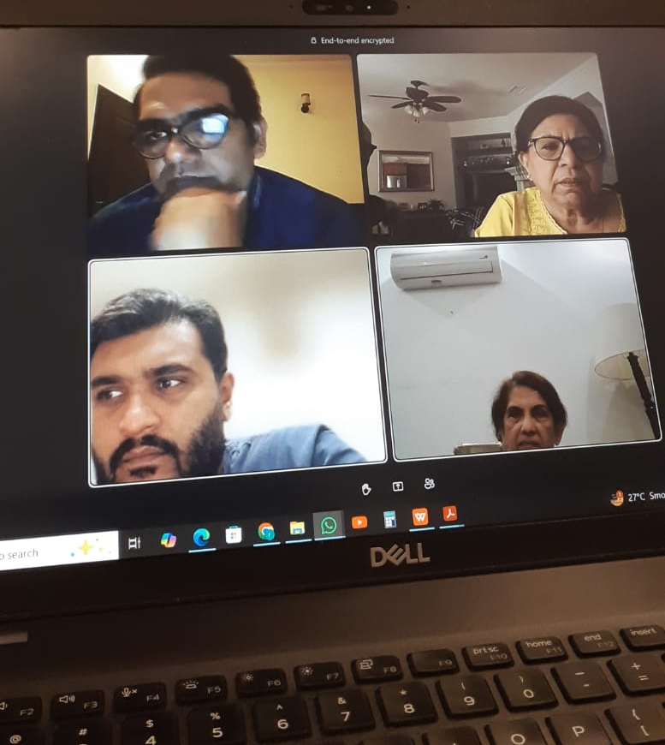
RAPID-TEAM
We have an excellent team that works in close coordination under the leadership of our RAPID CEO. Whether it's discussing student matters, managing finances, arranging events, communicating with students, or handling fee payments, we collaborate effectively. We hold bi-monthly Zoom meetings, regardless of our locations, whether in California, Lahore, or Rawalpindi. Our RAPID team members are highly qualified and possess vast experience in their respective fields.
Our Team members are
1-CEO-RAPID (Rev. Dr. Khushnud Azariah)
2- RAPID-Liason staff for students communication (ReshaQadirBakhsh)
3-RAPID-Finance officer (Uphaz Tasawar)
4- RAPID-Office Admn & Digital Media Manager (Azhar Adil)

Slide 37
"Out ofSchool",
Mughalabad, Rawalpindi
Report

Slide 38


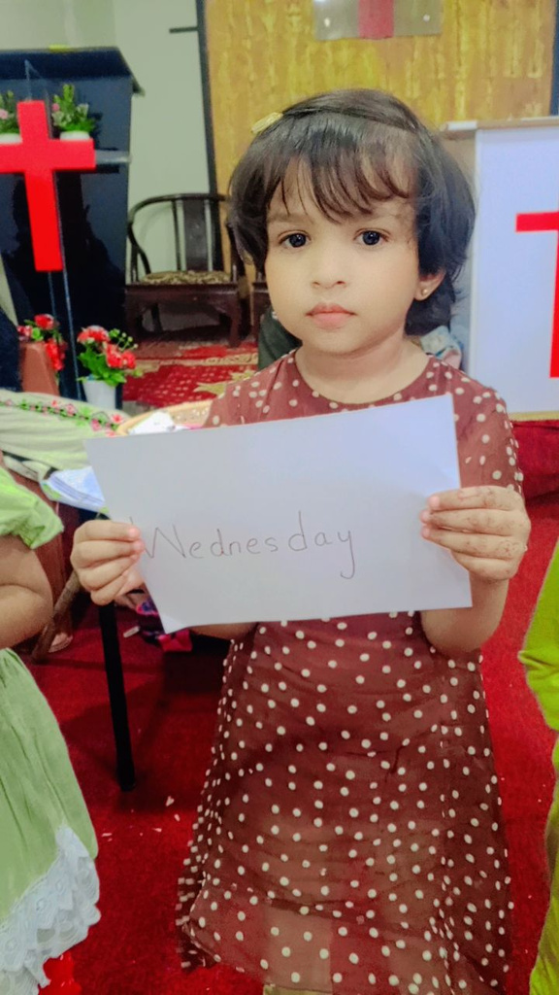
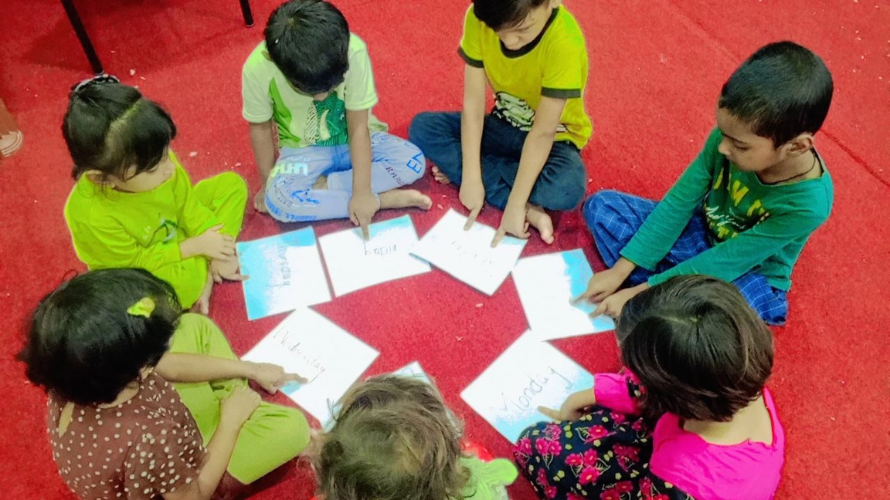
AL-NOOR LEARNING CENTER
“No Child Left Behind”
Teachers Training

Slide 39
Monthly Enrollment Summary – January to July 2025
Month | Total Student | Boys | Girls | Key Notes
January | 20 | 12 | 8 | Baseline data
February | 21 | 13 | 8 | 1 new student enrolled
March | 17 | 11 | 6 | 4 students left
April | 18 | 11 | 7 | 1 student transferred to a formal school
May | 17 | 9 | 8 | 9 student mainstreamed
June | 17 | 10 | 7 | Summer vacation begins on 13 June
July | 17 | 10 | 7 | 1 girl dropped from Nursery

Slide 40
Major development
In May 2025, a significant milestone was achieved when nine students who had previously been receiving foundational education at Al-Noor Learning Center were successfully mainstreamed into Spectrum School.
These students demonstrated readiness in basic literacy, numeracy, and classroom behavior, making them eligible for formal school enrollment.
  Oram
  Palak
  Kamil
  Philippas
  Rosemerry
  Adan
  Silvia
  Emmanuel
  Micael
This successful transition reflects the impact and effectiveness of the learning center in preparing students for mainstream education.

Slide 41

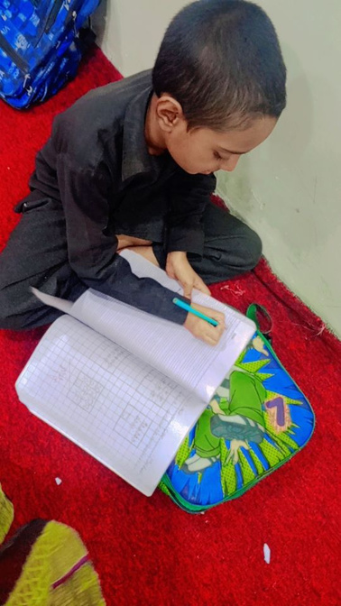
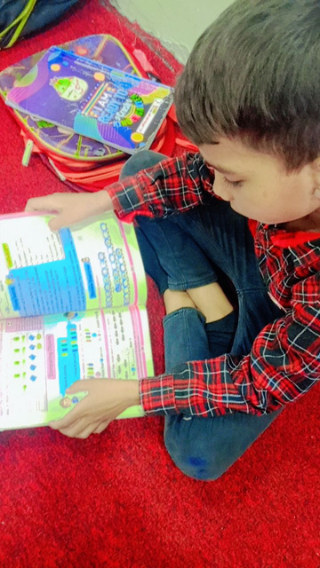
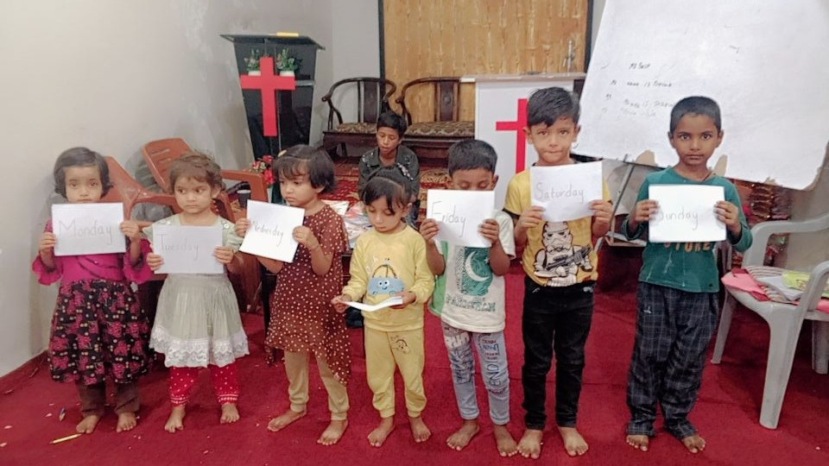
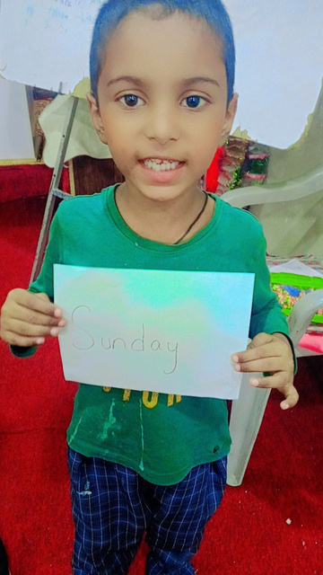
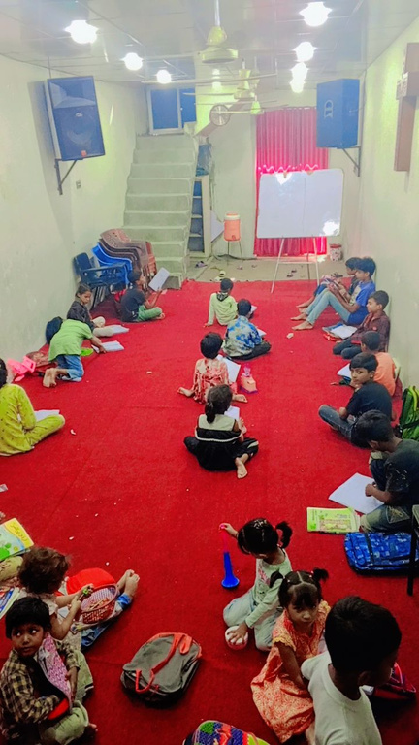
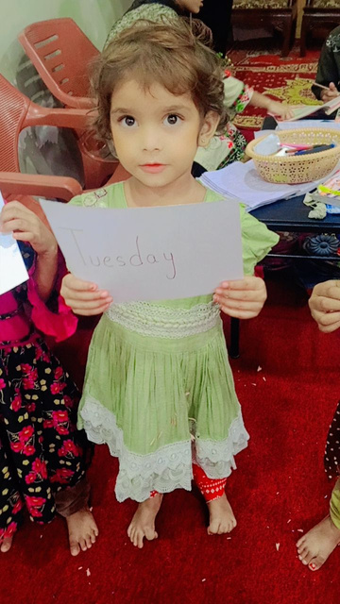

Slide 42
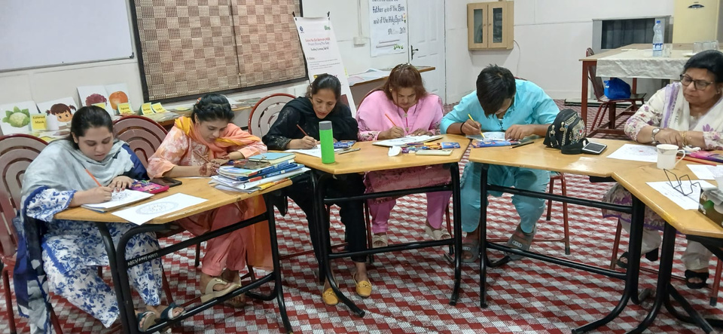
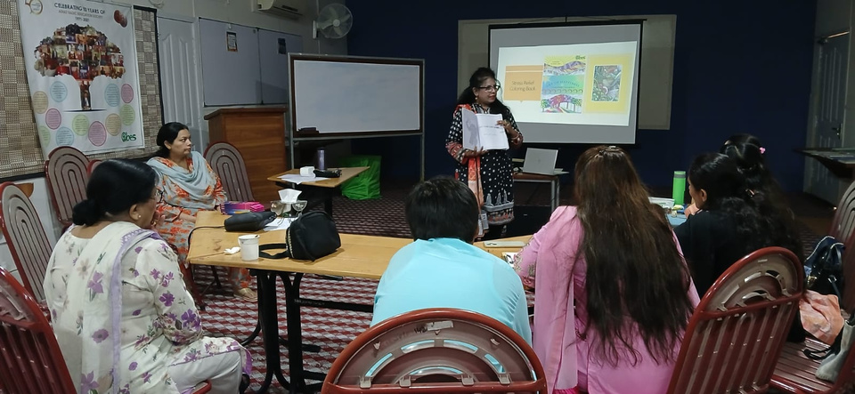
3-Days Teachers Training on Joyful Learning & Adult Literacy Teaching Methodologies
Date: 14th–16th May 2025
Venue: ABES Hall

Slide 43
Introduction of Training
3-day training organized to enhance teaching for out-of-school children and illiterate adults.
  Focused on Adult Literacy & Joyful Learning methodologies.
  4 active participants (2 teachers + 2 community members).
  Hands-on tools: flashcards, pocket boards, workbooks, and creative learning activities.

Slide 44
Training Objectives
  Enhance teaching skills.
  Apply learning aids in classrooms.
  Understand children’s psychology.
  Promote creative and effective teaching methods.

Slide 45
Day 1 of Training
Overview
  Opening Prayer & Introductions.
  Sessions:
    Social Mobilization
    Adult Literacy (Intro + Eclectic Method)
Social Mobilization
  Purpose & function in communities.
  Strategies:
  Work with local leaders & influencers.
  Engage parents & community members.
  Promote benefits of education.
  Real-life examples & group activity for better understanding.
Adult Literacy
  Challenges of adult learners.
  Eclectic Method (as shown by Sir David):
  Pictorial lessons
  Division of syllables
  Homophones & signs
  Tools used:
  Zindagi Qaida
  Teaching aids: flashcards, Urdu/English/Math workbooks

Slide 46
Day 2 of Training
Teaching Aids
  Continued Eclectic Method training:
  Sounds, syllables, word beginnings.
  Introduction to:
  Teaching Kit contents
  National Curriculum-based workbooks
  Hands-on practice with phonetic drills, creative exercises.
Interactive Methods
  Poem recitations.
  Group discussion and reflections.
  Focus on:
  Letter-sound recognition.
  Literacy skills.
  Replication in real-life settings.

Slide 47
Day 3 of Training
Psychosocial Support
  Meditation & deep breathing techniques.
  Understanding children’s emotional needs.
  Signs of psychological distress.
  Creating supportive environments.
Group Activities
  Coloring Activity:
  Encourages creativity, reduces stress.
  Math Activity:
  Real-world examples of addition & subtraction.
  Hands-on activities: using puzzles, charts, pocket boards.

Slide 48
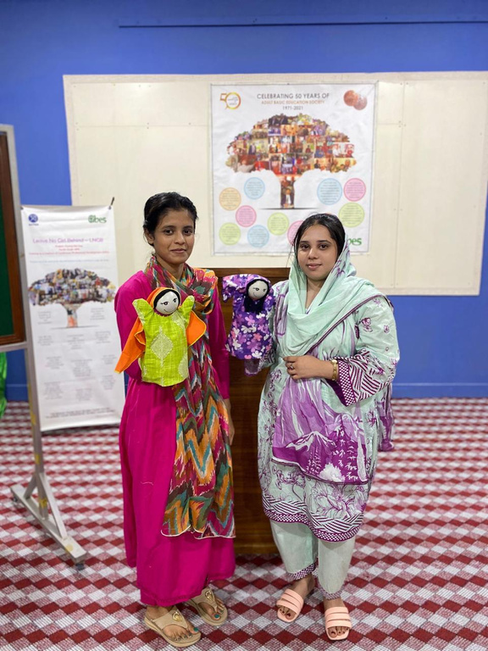
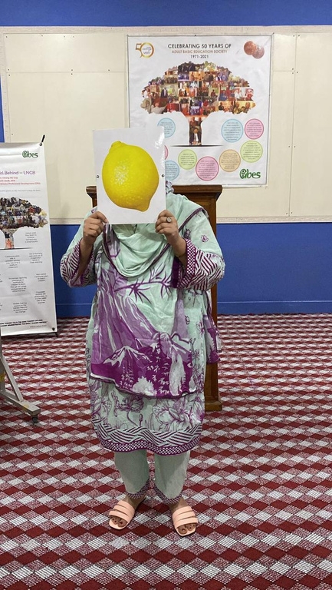
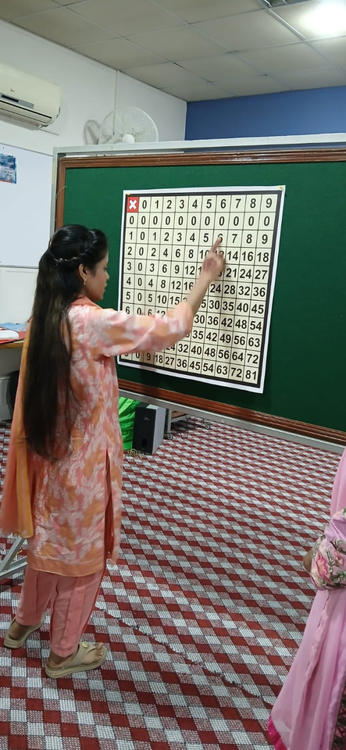
Joyful Learning Approach
Learning should be fun & meaningful.

Slide 49
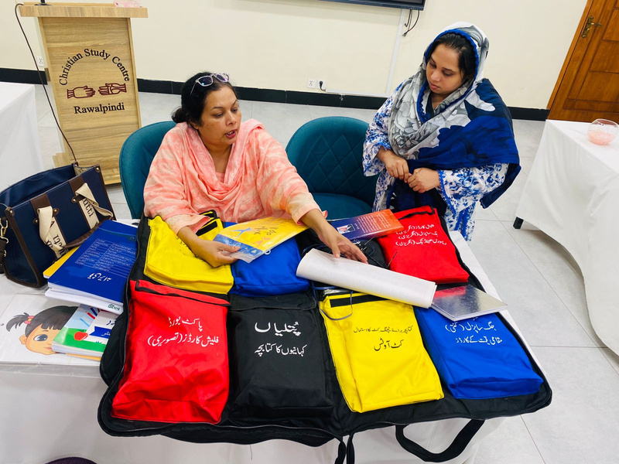
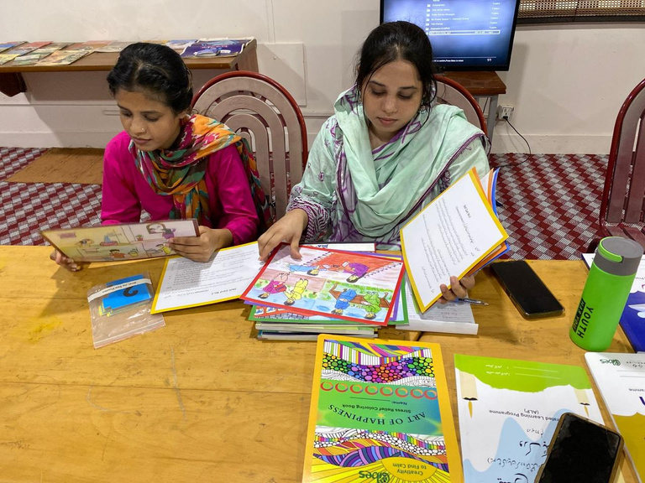
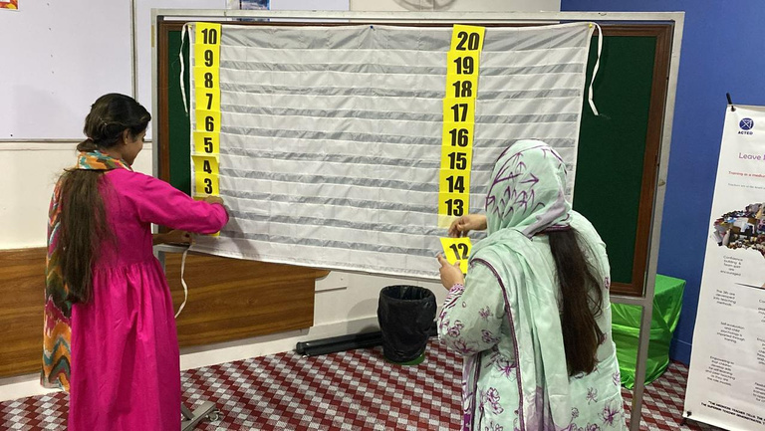
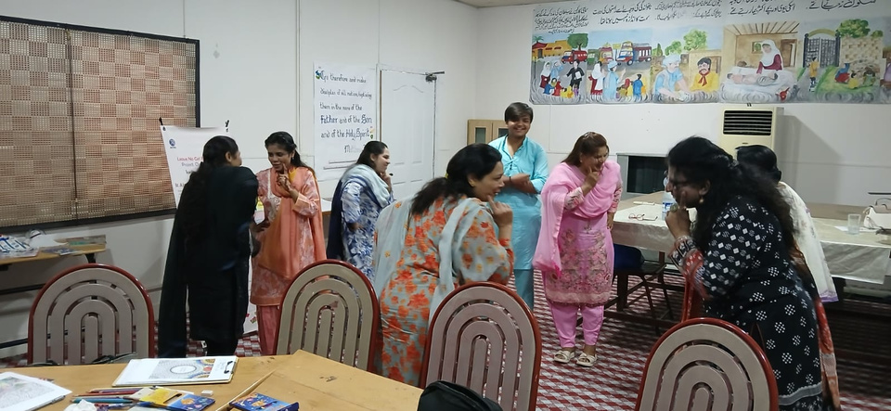
Joyful Learning Tools
  Pocket Board
  Flashcards
  Magic Chart
  Life Skills Cards
  Ludo Game.
  Jigsaw Puzzles

Slide 50
Participant Feedback
"I’ve learned many valuable things and started improving."
"The teaching style was unique and enjoyable."
"Trainer explained everything clearly – it was very beneficial."
Conclusion
Training enhanced skills in:
Joyful Learning
Adult Literacy
Child Psychology
Community Engagement
Empowered educators to deliver inclusive, learner-centered education in Mughal Abad.

Slide 51
All accounts are handled
by Mr. Uphaz Tasawar
Academic Fees are regularly deposited/transferred directly into the concerned institution’ bank account, and no cash is given to any student in person.

Slide 52
Sanja Vehra Report

Slide 53

Thank you
Reported by:
Resha Qadir Bakhsh

