Slide 1
Classification
Lab
Luca Morreale

Slide 2
Linear classifier
Taken from Tobias Ritschel Slides

Slide 3
Optimization
Finding w is a least squares (LS) problem
Taken from Tobias Ritschel Slides

Slide 4
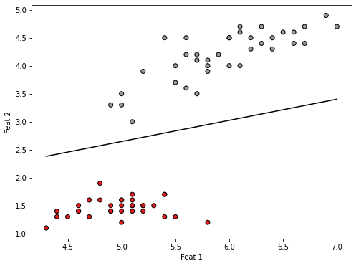
Decision boundary

Slide 5
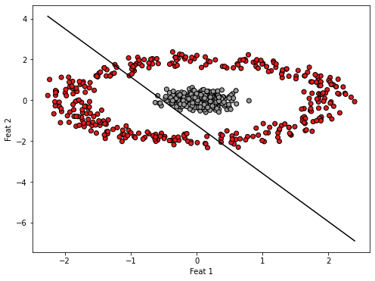
Decision boundary

Slide 6
Logistic Regression
Finding w now required non-linear least squares (e.g. Gradient descent)
Has analytic gradients
Taken from Tobias Ritschel Slides

Slide 7
Support and Margin
“Support vectors” is the exemplar subset that is hard to classify
“Margin” is the “street” between them
Support
Trout
Salmon
Margin
Support
Taken from Tobias Ritschel Slides

Slide 8
Support and Margin
Only the support vectors matter
Taken from Tobias Ritschel Slides

Slide 9
Kernel Trick, Definitions 2
Remember the dual form of the SVM
We can now use
Taken from Tobias Ritschel Slides
Notes:
z(\mathbf x)=\sum_i\alpha_i z_i \left<\phi(\mathbf x_i), \phi(\mathbf x)\right>=\sum_i\alpha_i z_i \kappa(\mathbf x_i,\mathbf x_i)

Slide 10
Other Kernels
Any function 𝜅(x₁, x₂) is a kernel, as long its kernel matrix is symmetric positive semi-definite
Other kernels:
  Polynomial
  Radial basis function
  Sigmoid
Taken from Tobias Ritschel Slides
Notes:
\kappa(\mathbf x_1, \mathbf x_2)_\mathrm{Poly}=(1+\mathbf x_1^\mathsf T\mathbf x_2)^p
\kappa(\mathbf x_1, \mathbf x_2)_\mathrm{Radial}=\exp(\frac{||\mathbf x_1-\mathbf x_2||^2}{2\sigma})
\kappa(\mathbf x_1, \mathbf x_2)_\mathrm{Sigmoid}=\tanh(\beta_0+\beta_1\mathbf x_1^\mathsf T\mathbf x_2)

Slide 11
Classification Metrics
Once we have classifier we need to numerically evaluate it.
How?
  Confusion Matrix
  Accuracy
  Precision

Slide 12
Confusion Matrix
Give a complete overview of model performances
How many sample positive are predicted positive? TP
How many sample negative are predicted negative? TN
How many sample positive are predicted negative? FP
How many sample negative are predicted positive? FN
TP | FP
FN | TN
1
Predictions
0
1
Targets
0

Slide 13
Confusion Matrix (few notes)
Entries order can change!
Axis can be swapped!
  Always specify axis and values
Matrix show works for binary, can be extended to multi-class.
TP | FP
FN | TN
1
Predictions
0
1
Targets
0

Slide 14
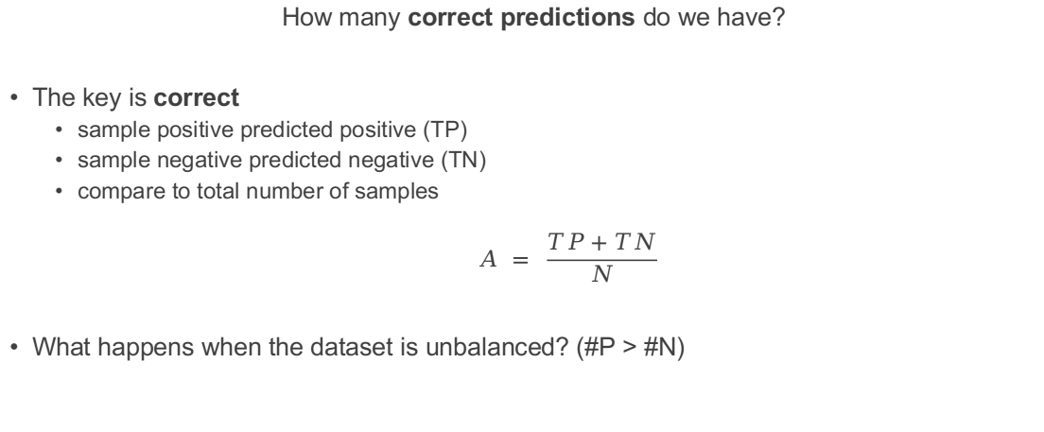
Accuracy
How many correct predictions do we have?
The key is correct
  sample positive predicted positive (TP)
  sample negative predicted negative (TN)
  compare to total number of samples
  $$A = \frac{TP+TN}{N}$$
What happens when the dataset is unbalanced? (#P > #N)

Slide 15
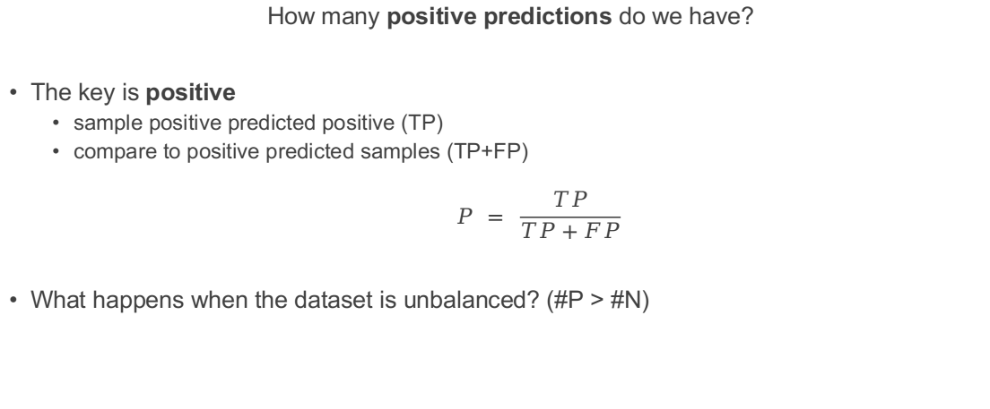
Precision
How many positive predictions do we have?
The key is positive
  sample positive predicted positive (TP)
  compare to positive predicted samples (TP+FP)
  $$P = \frac{TP}{TP+FP}$$
What happens when the dataset is unbalanced? (#P > #N)

Slide 16
There are many more measure
There are plenty measure to quantify the quality of your model
  Recall
  F1 score
  ROC curve
  ....
We are not diving into all of them
Note some of them are suffer in case unbalanced dataset

