Slide 1
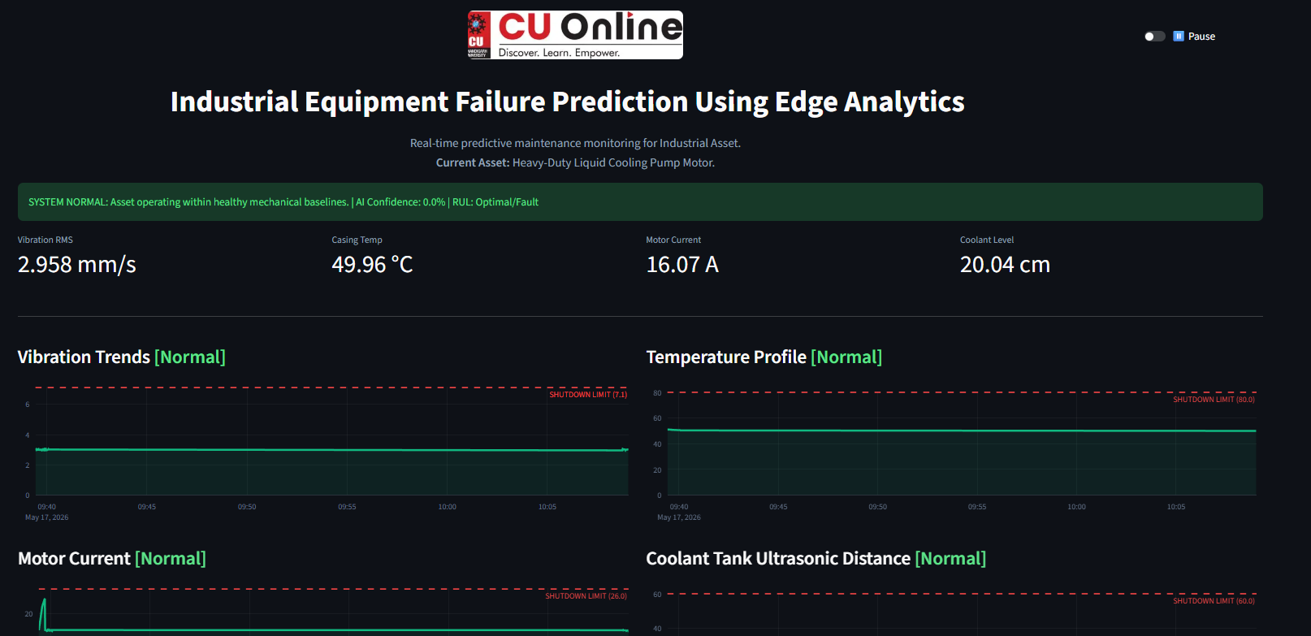


Industrial Equipment Failure Prediction Using Edge Analytics
ML approach using Isolation Forest & Linear Regression
Course: Major Project | MCA – AI/ML
Student Name: Smarth Salaria
Student UID: O24MCA112144
Mentor Name: Vikas Kumar Atray

Slide 2

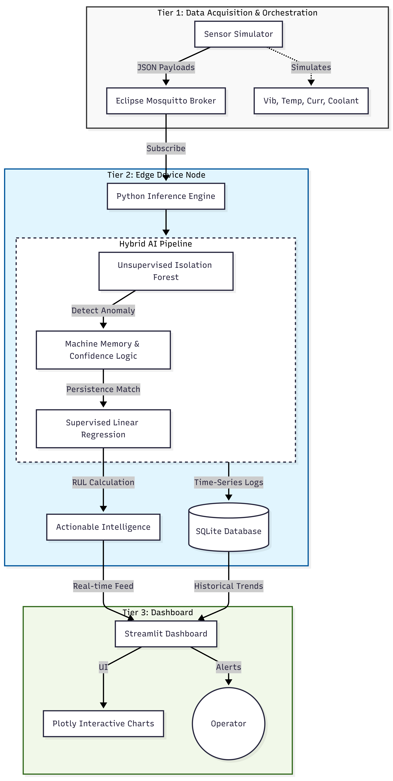

SYSTEM OVERVIEW
Problem Statement
Existing System like Standard SCADA systems rely on static thresholds, often missing the subtle "drift" of mechanical degradation. Whereas the Cloud based compute creates latency risk, bandwidth inefficiency and connectivity blind-spots. Our solution employs a hybrid methodology at the edge device using following:
•
Deterministic Layer: Statistical Z-Score overrides for sudden spikes.
•
Probabilistic Layer: Unsupervised Isolation Forest for multi-vector anomaly detection.
•
Prognostic Layer: Linear Regression for real-time RUL forecasting.

Slide 3





USE CASE ANALYSIS
UC-01: ML Training
UC-02: Evaluation
UC-03: RUL Predict
Initializes "Machine Memory" from SQLite history; fits Isolation Forest model on healthy operational data baseline.
Real-time ingestion of telemetry to assess machine state against unsupervised ML boundaries.
Activates supervised Linear Regression upon anomaly detection to project Remaining Useful Life based on degradation velocity.
Primary Actors: Sensor Module (System), Edge AI Node (System), Maintenance Engineer (Human).

Slide 4

HYBRID ANOMALY DETECTION
A. Isolation Forest
Identifies multi-vector outliers by isolating data points through decision trees. Anomalies require fewer splits.
B. Z-Score Override
Override Threshold: |Z| > 3.5
Parallel statistical math to catch rapid linear degradations and prevent "drift blindness."

Slide 5


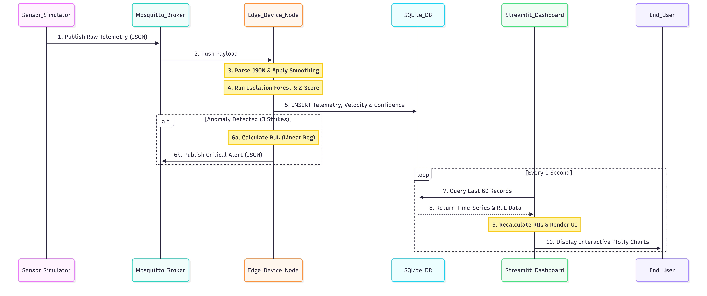
RUL FORECASTING
Linear Regression Engine
Once a fault is latched (3-strike persistence), the system buffers the last 10 seconds of data.
The slope of the regression hyperplane determines the degradation velocity, providing a deterministic countdown to the NEMA/ISO safety limit.

Slide 6
FINITE STATE MACHINE (FSM)
State | Name | Logic & Trigger Condition
State 0 | Initialization | Boots MQTT, trains baselines, applies Poison Filter to SQLite history.
State 1 | Rest/Monitoring | Nominal operation. Consecutive anomaly counter is zero.
State 2 | Drift Identification | Unverified anomaly (Strike 1 or 2). System holds for confirmation.
State 3 | Stage 1 Warning | Latched alarm (Strike 3+). RUL Engine active. Digital Twin alerts.
State 4 | Stage 2 Critical | Hard Limit (e.g. >80°C) breached. Emergency Shutdown (ESD) issued.
State 5 | Repair Validation | Hysteresis logic: Requires 3 consecutive healthy readings to return to State 1.

Slide 7



UML SEQUENCE INTERACTION
1. Perception
2. Intelligence
3. Presentation
Sensor Simulator publishes Raw Telemetry (JSON) to Mosquitto Broker at 1 Hz.
Edge AI Node parses payload, applies Smoothing, runs Hybrid Inference, and logs to SQLite.
Streamlit Dashboard polls SQLite asynchronously, renders Plotly charts and RUL countdown.
Latency Optimized: End-to-end processing < 80ms.

Slide 8
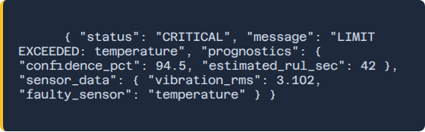
JSON MESSAGING SCHEMA
Diagnostic Payload
Upon fault identification, the system dynamically generates Root-Cause Analysis (RCA) metadata.
•
Status & Message tags.
•
Faulty Sensor ID.
•
Prognostic Confidence markers.

Slide 9






VALIDATION & PERFORMANCE
Unit Testing
Integration
Performance
Verified +1.0°C/sec slope detection and Gaussian noise filtering (< 2% variance).
Validated concurrent SQL read/write and 1 Hz MQTT throughput with zero database lockout.
Avg Latency: 30-80ms (Exceeding NFR-01 target of 100ms).

Slide 10
DEPLOYMENT MANUAL
1. Environment: Run pip install -r requirements.txt to setup ML and MQTT frameworks.
2. Connectivity: Start Mosquitto Broker on Port 1883.
3. Simulation: Launch python cooling_pump_sim.py (1 Hz telemetry).
4. Intelligence: Launch python edge_node.py (Isolation Forest / Z-Score).
5. Dashboard: Launch streamlit run dashboard.py for real-time visualization.
Master Command: python run_all.py

Slide 11
REFERENCES
[1] ISO 20816-1:2017 Mechanical vibration standards.
Questions?
[2] NEMA MG 1-2021: Motors and Generators guidelines.
[3] Liu et al. (2008) "Isolation Forest" IEEE ICDM.
Thank you for your attention.
[4] Si et al. (2011) "Remaining useful life estimation" EJOR.
Industrial Equipment Failure Prediction Using Edge Analytics | MCA
and more…
github.com/smarthsalaria/predictive_maintenance

