Slide 1


SMART INDIA HACKATHON 2026
TITLE PAGE
Problem Statement ID – SIH26064
Problem Statement Title - Low-Cost Deployable Seafloor Metal Detection Sensor for Ocean Resource Exploration
Theme- Robotics and Drones
PS Category- Hardware
Team Name (Registered on portal) - EmbedX

Slide 2
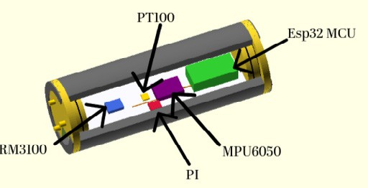
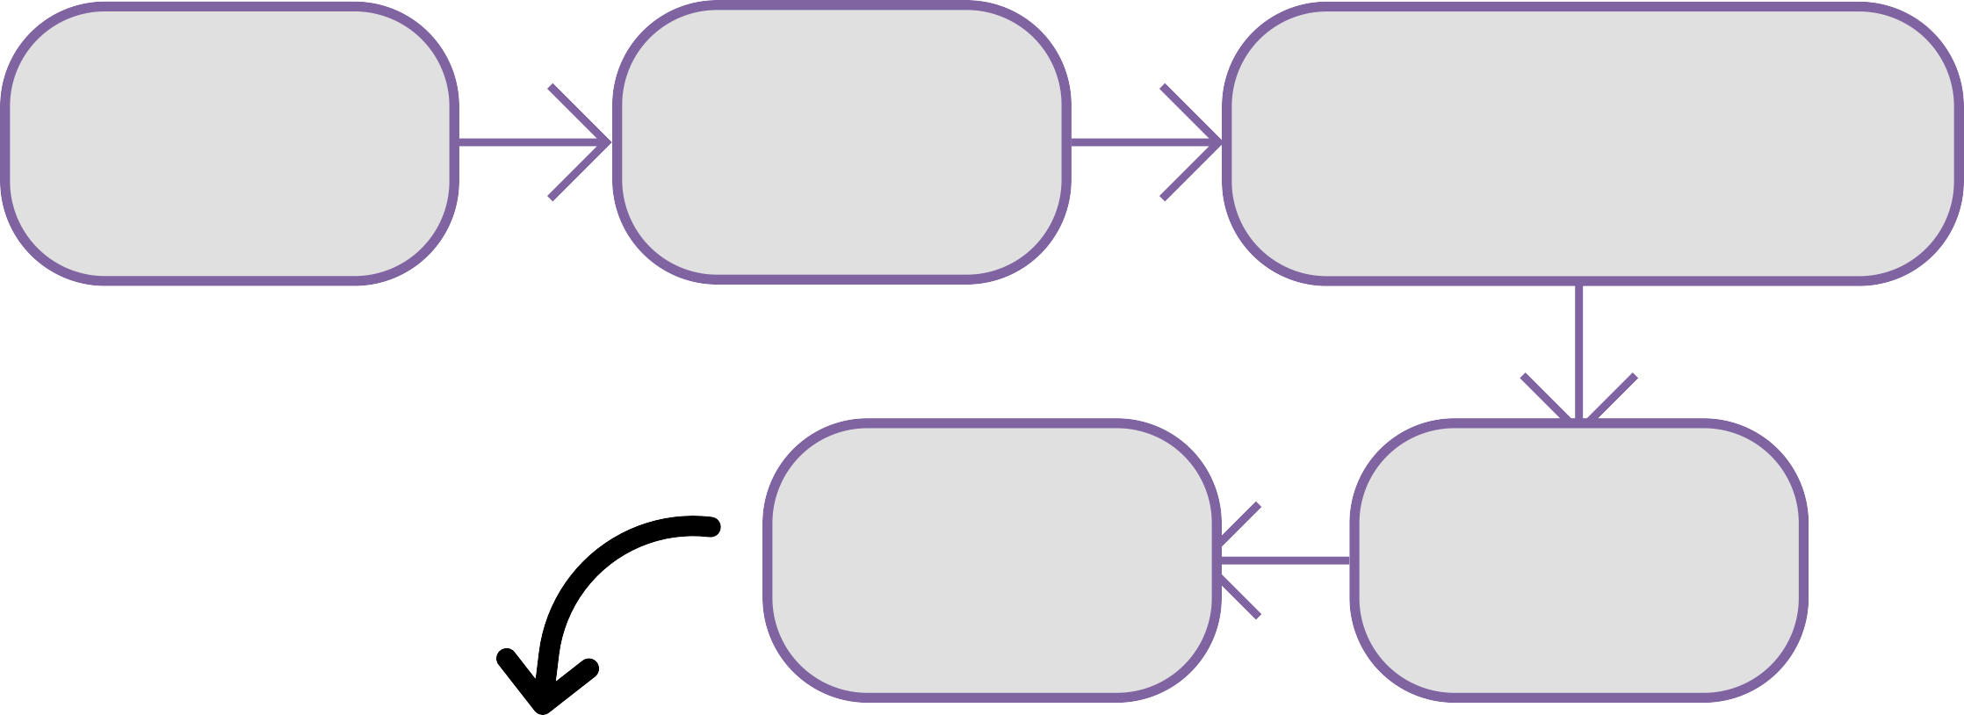
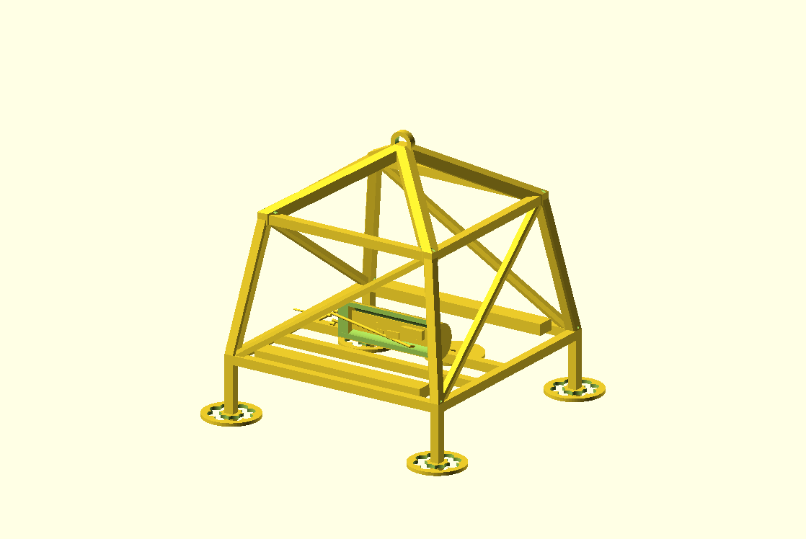

Low-Cost Deployable Seafloor Metal Detection & Localization
EmbedX
Proposed Solution:
A compact deployable package combining PI metal sensing, seawater temperature, magnetic heading and motion/aGitude to detect and prioritize seabed anomalies.
ESP32 synchronizes and logs sensor data for post-recovery analysis and GIS mapping.
Deploy
Surface GPS coordinates are recorded.
Sense
Sensor package collects synchronized measurements
PI Coil s conductive / metallic response PT100 s seawater temperature
RM3100 s magnetic heading MPU6050 s motion & aGitude
Payload carrier and lander
Analyze
Filter s extract features s detect anomaly s combine evidence
ESP32 timestamps and logs all sensor data
LOCALIZE
GPS + driŁ bearing s directional uncertainty sector
MAP
GIS heatmap s
multi-station overlap s candidate region

Slide 3
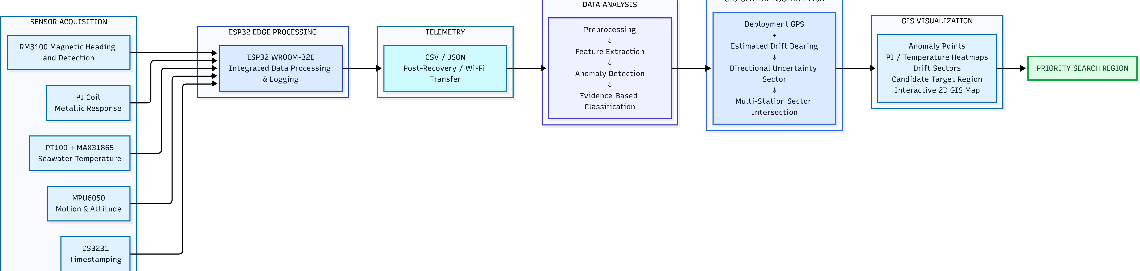

TECHNICAL APPROACH
EmbedX
HOW THE SYSTEM WORKS
Sensor Acquisition: Multi-sensor suite captures magnetic, metallic, temperature, motion and timestamp data.
ESP32 Edge Processing: ESP32 collects, synchronizes and locally logs the raw sensor readings during deployment.
Telemetry: After recovery, logged data is transferred via Wi-Fi in CSV/JSON format for processing.
Data Analysis: Raw signals undergo preprocessing → feature extraction → anomaly detection → evidence-based classification.
Geo-Spatial Localization: Magnetic heading, IMU motion data and current-aligned fins are fused to estimate the probable drift direction and uncertainty.
GIS Visualization: Detected anomalies are mapped with heatmaps and directional uncertainty sectors and overlaid with available seafloor topography.
Priority Search Region: Intersecting information from multiple deployments narrows the probable target area, guiding efficient ROV/field investigation.

Slide 4

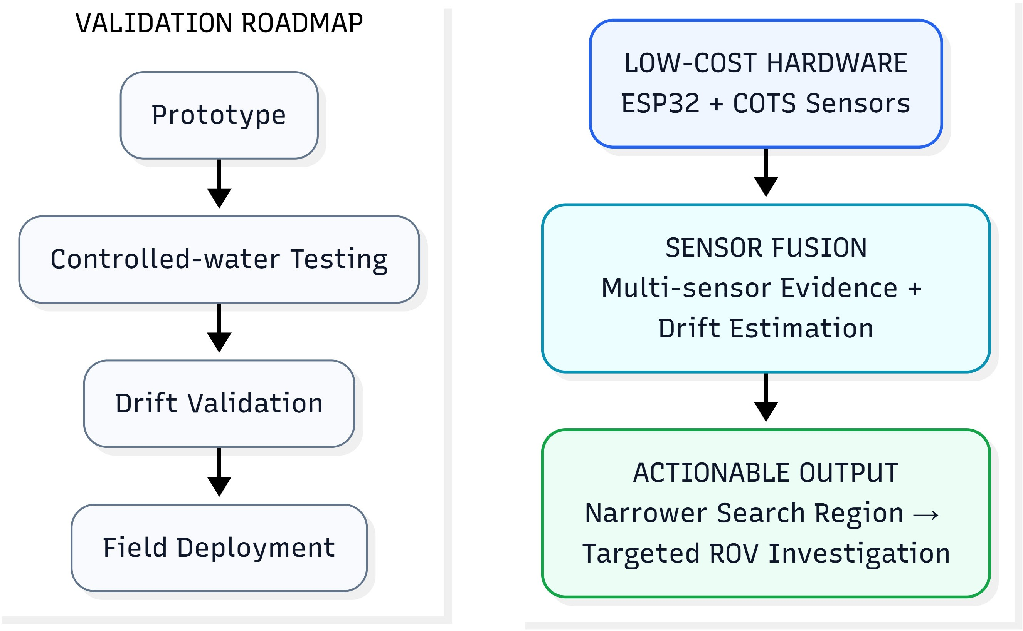
FEASIBILITY AND VIABILITY
EmbedX
TECHNICALLY FEASIBLE
Low-cost COTS sensors: ESP32, MPU6050, RM3100, PT100 and RTC.
Local data logging: Sensor operates underwater without requiring continuous communication.
Post-recovery Wi-Fi transfer: Data can be uploaded after retrieval.
Pressure-resistant torpedo-style housing enables deep-sea deployment.
Modular design: Sensors can be calibrated/replaced independently.
KEY CHALLENGES
Underwater drift: Deployment GPS ≠ actual seabed sensor position.
Magnetic interference: PI coil, battery and magnetometer can interfere with each other.
Accelerometer drift: IMU cannot reliably estimate the full 400 m displacement by double integration.
Deep-sea conditions: Pressure, waterproofing and seawater exposure.
PI coil optimization: Final coil design and detection performance require prototype testing.
MITIGATION STRATEGY
Drift → Estimate probable drift direction using RM3100 + MPU6050 + mechanical fins.
Magnetic interference → Physically separate magnetometer and PI coil + time-multiplex operation.
IMU error → Use IMU for short-term motion, not long-term dead reckoning.
Water/pressure → Sealed pressure-resistant housing + protected seawater interface for PT100.
Uncertainty → Represent location as a directional sector, validated through prototype drift tests.

Slide 5

IMPACT AND BENEFITS
EmbedX
FASTER EXPLORATION
Rapid screening of seabed anomalies
Helps prioritize promising regions before detailed investigation
Reduces time spent investigating low-value anomalies
COST SAVINGS
Low-cost deployable sensor platform
Reduces unnecessary ROV investigations
Enables multiple screening deployments during a survey
DEEP-SEA RESOURCE MAPPING
Identifies magnetic, metallic and thermal anomalies
Combines sensor readings with existing seafloor topography
Produces spatially constrained candidate regions
STRATEGIC BENEFIT
Supports Indian deep-ocean resource exploration
Provides an indigenous, modular sensing approach
Can complement existing MoES/NCPOR survey infrastructure
DETECT
PRIORITIZE
INVESTIGATE

Slide 6
RESEARCH AND REFERENCES
EmbedX
Research:
Drone Flow User Guide
A Low-Cost and High-Precision Underwater Integrated Navigation System
A Multi-Sensor Fusion Underwater Localization Method Based on Unscented Kalman Filter on Manifolds
Hardware References:
ESP32-WROOM-32E Datasheet
RM3100 Datasheet
MPU6050 Datasheet
MAX31865 Datasheet
PT100 Datasheet
PI Detection Reference
Implementation & Documentation:
GitHub Repository

