Slide 1
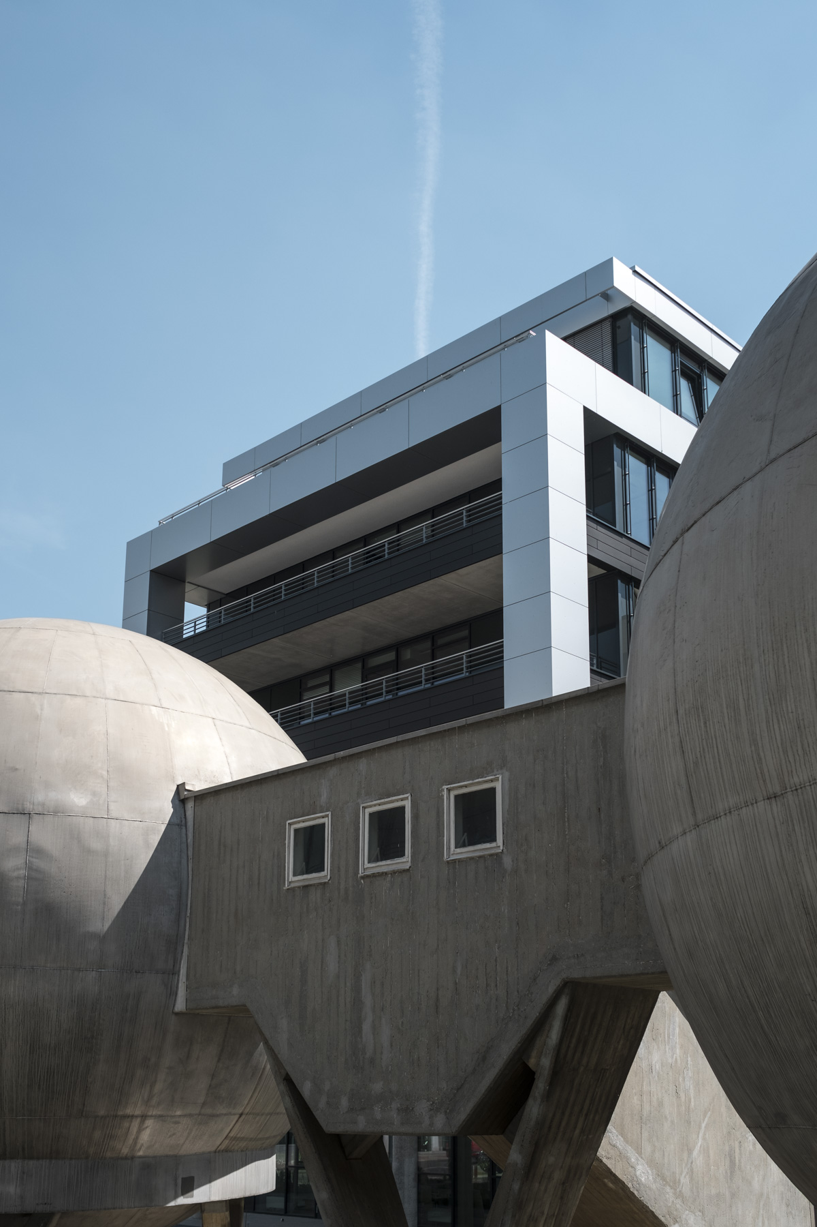

Tutorial:
Simulating a
Micro Grid with Oemof
Martha M. Hoffmann
16.4.2019
RLI
© Reiner Lemoine Institut

Slide 2
Installation Guide on Windows
Install python using Anaconda (Miniconda):
https://docs.conda.io/en/latest/miniconda.html
You now have a terminal named “Anaconda Prompt” in your “Start” menu
Create a new virtual environment
1) open Anaconda Prompt
2) type conda create -n [env_name] python=X.X
3) specifc to Micro Grid Tool:
conda create -n [your_env_name] python=3.5
List environments:
1) type conda env list
Activate your environment:
1) type activate [your env_name]
Install required packages using pip:
1) activate your envrionment, type: activate [your_env_name]
2) pip install package1 package2 package3
3) check if installation was sucessful, type: pip list

Slide 3
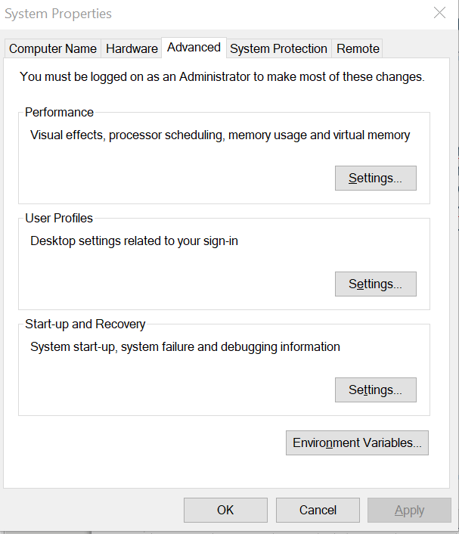
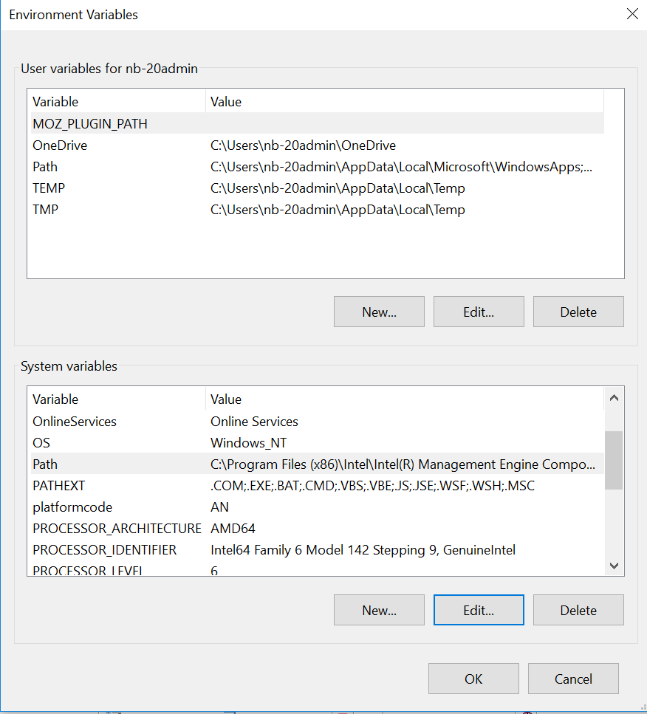
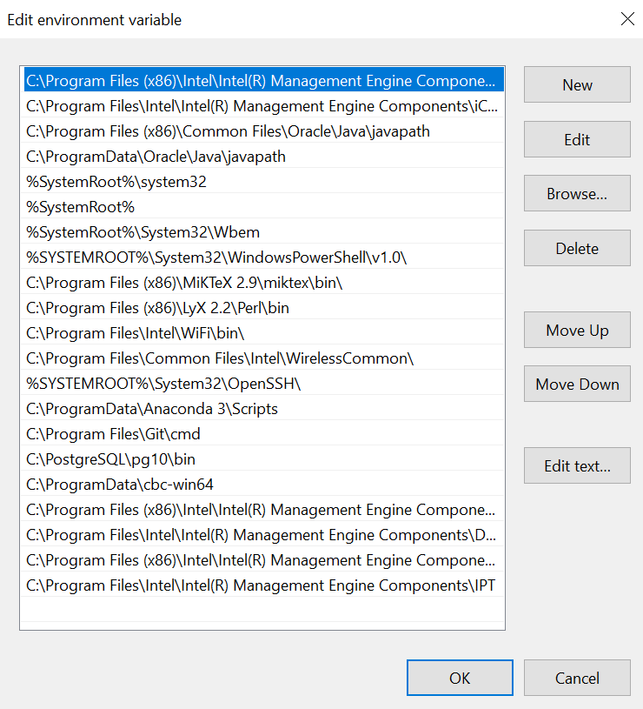
Installation Guide on Windows
Install CBC solver on your machine
1) download CBC-solver .exe here:
64bit: http://ampl.com/dl/open/cbc/cbc-win64.zip
32bit: http://ampl.com/dl/open/cbc/cbc-win32.zip
2) unzip into a chosen path (maybe where you store other programs)
3) add solver path to your system envrionment variables
(local admin rights required):
open “System Propoerties” -->”Advanced”--> “Environment Variables”

Slide 4
Energy system components of MG
Component | Attributes | Oemof object
Demand
Generators
Renewable generation
Storage
Excess
Shortage

Slide 5
Energy system components of MG
Component | Attributes | Oemof object
Demand | Fix timeseries | Sink
Generators
Renewable generation
Storage
Excess
Shortage
demand_sink = solph.Sink(label='demand_el',
inputs={bel: solph.Flow(actual_value=timeseries['demand_el'],
fixed=True,
nominal_value=500)})

Slide 6
Energy system components of MG
Component | Attributes | Oemof object
Demand | Fix timeseries | Sink
Generators | Variable generation | Source or Transformer
Renewable generation
Storage
Excess
Shortage
genset = solph.Transformer(label="transformer_genset",
inputs={bfuel: solph.Flow()},
outputs={bel: solph.Flow(
variable_costs=costs['pp_diesel']['var'],
investment=solph.Investment(
ep_costs=costs['pp_diesel']['epc']))},
conversion_factors={bel: 0.33}))

Slide 7
Energy system components of MG
Component | Attributes | Oemof object
Demand | Fix timeseries | Sink
Generators | Variable generation | Source or Transformer
Renewable generation | Fix timeseries, can be scaled | Source
Storage
Excess
Shortage
wind_plant = solph.Source(label='pp_wind',
outputs={
bel: solph.Flow(nominal_value=None,
fixed=True,
actual_value=timeseries['wind'],
investment=solph.Investment(
ep_costs=costs['pp_wind']['epc']))})

Slide 8
Energy system components of MG
Component | Attributes | Oemof object
Demand | Fix timeseries | Sink
Generators | Variable generation | Source or Transformer
Renewable generation | Fix timeseries, can be scaled | Source
Storage | Variable flows | Generic storage
Excess
Shortage
storage = solph.components.GenericStorage(
label='storage',
inputs={bel: solph.Flow()},
outputs={bel: solph.Flow()},
inflow_conversion_factor=0.95,
outflow_conversion_factor=0.95,
investment=solph.Investment(ep_costs=costs['storage']['epc']))

Slide 9
Energy system components of MG
Component | Attributes | Oemof object
Demand | Fix timeseries | Sink
Generators | Variable generation | Source or Transformer
Renewable generation | Fix timeseries, can be scaled | Source
Storage | Variable flows | Generic storage
Excess | Necessary to balance system | Sink
Shortage
excess_sink = solph.Sink(label='excess',
inputs={bel: solph.Flow()})

Slide 10
Energy system components of MG
Component | Attributes | Oemof object
Demand | Fix timeseries | Sink
Generators | Variable generation | Source or Transformer
Renewable generation | Fix timeseries, can be scaled | Source
Storage | Variable flows | Generic storage
Excess | Necessary to balance system | Sink
Shortage | Possible | Source

Slide 11
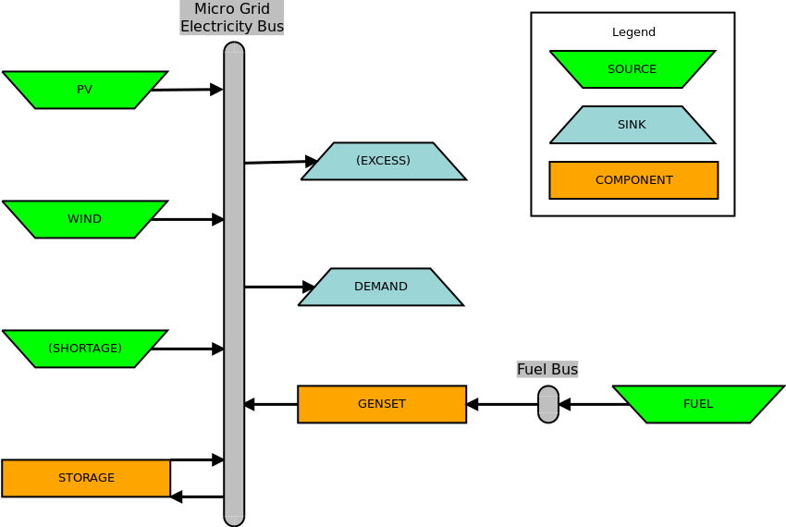
Generalized oemof model

Slide 12
Questions or remarks?
License
Except where otherwise noted, this work and its content (texts and illustrations) are licensed under the Attribution 4.0 International (CC BY 4.0)
See license text for further information.
Tel: +49 (0)30 1208 434 0
E-Mail: info@rl-institut.de
Web: http://www.rl-institut.de
Twitter: @rl_institut
Please quote as: “PRESENTATION TITLE” © Reiner Lemoine Institut | CC BY 4.0

