Slide 1

CS 360
File I/O
io

Slide 2

Reading For Lectures I/O ... Dir2
Subject: The file system
In Unix Programming Environment:
Chapter 2, The File System
  2.1 The basics
  2.2 What's a file
  2.3 Directories
  2.3 Permissions
  2.5 Inodes
  2.6 The hierarchy
  2.7 Devices
Chapter 7, Unix System Calls
  7.1 Low-level I/O
  7.2 Directories
  7.3 Inodes
In Unix Systems Programming:
Chapter 2, The File
  2.1 Access primitives
  2.4 Errno
Chapter 3, The File in Context
  3.1 Multi-user environment
  3.2 Multiple names
  3.3 Obtaining information
Chapter 4, Directories
  4.2 User view
  4.3 Implementation

Slide 3

Agenda
Here we investigate Unix I/O.
We begin with the low level facilities.
Unix Concepts
Unix History
Low Level Unix I/O
Launching Programs
Handling Errors
Lab Assignment

Slide 4

Unix Concepts
How is Unix designed?

Slide 5

Two Building Blocks
1. Files
store
data
- storage areas on disk
2. Processes
manipulate
data
- running programs in memory
% words < gettysburg
name of a file
this file supplies the initial content for a new process

Slide 6
Unix Has a Layered Architecture
users
Kernel:
essential basic services
  only one kernel
  general
Libraries:
useful additional services
  many libraries
  specific
Programs:
executable files
  numerous & specific
Shell:
command line environment
  few & powerful
Graphical User Interfaces
  few
Users: humans
shell
programs
libraries
kernel

Slide 7
Minimalist Philosophy
Build it for programmers
Keep capabilities few
Make them powerful
Compose complex capabilities from simple ones

Slide 8

Programming Practice
Unix
History
Lesson

Slide 9

Unix Evolution
1970’s - Insight & Genesis
  Bell Labs: researchers react to complexity of Multics
  mini computers: PDP-11 provides affordable environment for programmers
1980’s - Completion & Proliferation
  Berkeley: BSD free distribution with many student/faculty additions (esp internet)
  DEC VAX 780: powerful mini is first popular corporate Unix platform w/Virt. Mem
1980’s - Industrialization & Fragmentation
  Sun: first commercial Unix combined with workstations, networking, and graphics
  competitors: HP, IBM, others enter arena and create different Unix flavors
1990’s - Consolidation & Open Source
  standards: various specifications to promote portability (ANSI C, Posix, OSF, ...)
  Linux & GNU: open source version of Unix implemented by internet community
2000’s - Competition & Unknowns
  personal computers: Unix server/workstation niche threatened?
  Internet: current computer packaging threatened?

Slide 10

Unix Innovations
File system
  organization: simple hierarchical structure and access control
  content: simple linear byte streams
Processes
  simplicity: simple model for spawning and coordinating
  uniformity: single model for jobs, concurrency, memory, etc.
Programming
  C language: as efficient and flexible as assembly, but more readable
  OS interface: convenient subroutine interface to all system services
Shell
  pipes: simple model for connecting together programs
  tools: rich set of utilities for common text manipulation tasks
Malleability
  portability: both OS and tools written in C & can be easily ported
  open source: source can be licensed and modified for experiments

Slide 11

Some Unix Terminology
Unix versions
  SVR4 Bell Labs System V - release 4 1990
  4.3BSD Berkeley Standard Distribution - version 4.3 1991
  Minix Andrew Tannenbaum's textbook OS kernel 1987
  Linux Linus Torvalds' open source Unix kernel 1994
  Solaris Sun Unix
  Xenix Microsoft Unix for 80386
Some Unix standards
  POSIX IEEE portable operating system interface specification
  OSF Open Source Foundation Unix API specification
  X/Open descendent of OSF et. al. w/ wide industry support
Other standards
  ANSI C American National Standards Institute "C" specification (also ISO)
Related terminology
  SVID System V Interface Definition
  FSF Free Software Foundation
  GNU FSF Unix project

Slide 12

Some Famous Unix Names
Ken Thompson Unix co-creator at Bell Labs, kernel creator
Dennis Ritchie Unix co-creator at Bell Labs, C creator
Brian Kernighan Unix early developer, C expert & author
Bill Joy Sun co-founder, BSD lead, Vi & Termcap implementor
Richard Stallman FSF founder & EMACS implementor
Linus Torvalds Linux creator
And, of course,
the tools have names too:
  shell
  emacs, vi
  grep, awk, sed
  troff, nroff
  man
  stdio
  ...

Slide 13

Low Level Unix I/O
What does the kernel provide?

Slide 14
Quick Overview: Copying Stdin to Stdout
Usage:
The low level routines "read" and "write" are all you need:
% my-copy < old-file > new-file
main.c
#include <unistd.h>
int main () {
  int n;
  char buffer[512];
  while ((n = read (0, buffer, 512)) > 0) {
    ... process buffer[0..n-1] here, as needed ...
    write (1, buffer, n);
  }
  return 0;
}

Slide 15
File Structure
Regular files are just arrays of bytes!
  an example file:
  on disk:
As you read or write, the system keeps track of your "current position"
  writing: offset of where will write to next
  reading: offset of where will read from next
Much flexibility results:
  can reposition offset to overwrite or re-read bytes
  can move offset to end+1 in order to append without overwriting
Now is a good
time to code.
Exactly 2 lines, 28 characters
example
note: end-of-line = '\n' = 1 byte
bytes:
offset:

Slide 16
Things to Think About
bytes:
offset:
What happens to the current offset when you write N bytes?
When you read N bytes?
What is minimum value of the current offset for a particular file?
Maximum value?
What is the offset of the first character in the first line?
Last line?
Can you read beyond the end of a file?
Write beyond end?
Is there a null at the end of a file?
Can you read and write to the same file within your program?
Can another program write to a file while you are reading it?

Slide 17
Unix File System Model
Unix file
system
=
regular files
+
directory files
+
special files
array of bytes
trees
sequences
Three file types designed to make programming easier
  regular files: simple sequences of bytes with arbitrary file size
  directory files: single hierarchy of files with very deep nesting
  special files: things that look like files but aren't actually on disk
  (terminals, network connections, memory, pipes, ...)
This model has proven to be powerful and flexible
  many physical disks
  multiple disk formats
  networked file system
  graphic user interfaces
When we say "files" without qualification, we usually mean "regular" files. Context will make this clear.

Slide 18
Directory Structure
These are some of the directories that are important to Unix operation:
On our server, we have added some other directories:
/ root ...
  /bin commonly used commands (e.g.: ls, cp)
  /dev device files (e.g.: /dev/tty1)
  /etc system maintenance files (e.g.: /etc/passwd)
  /lib system libraries (e.g.: /lib/libm.a)
  /tmp temporary files
  /usr user files ...
    /usr/include system include files (e.g.: stdio.h)
    /usr/lib more library files (e.g.: CS 360)
    /usr/bin more executable files
    /usr/man manual pages
/ root
  /Network… class login directories
  /cs_Share/cs/class shared information for classes ...
    /cs_Share/cs/class/cs360 the CS 360 class ...
      /cs_Share/cs/class/cs360/bin useful scripts
      /cs_Share/cs/class/cs360/lab the lab directories ...

Slide 19
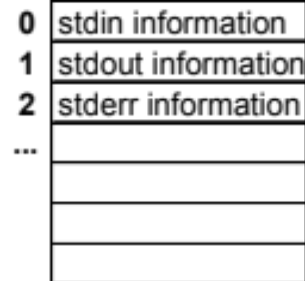
File Descriptors
Open files are manipulated via "file descriptors"
  kernel uses these as indices into a (secret) array
  each entry has information about the state of an open file
contents:
where is file on disk?
open for reading or writing?
what is current offset?
What is in memory:
Process₁
...
Process_{n}
image
image
code
data
stack
avail
heap
context
context
current instruction counter
stack top & frame pointer
heap bottom
scheduling priority
parent process
…
user & group id's
register values
file descriptor array
0: stdin info
1: stdout info
2: ...

Slide 20
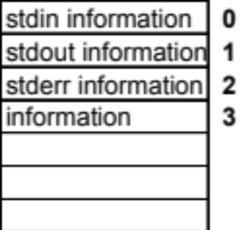

Opening a File
To get a new file descriptor, we "open" a file
  we supply pathname and various options
  kernel returns a new file descriptor (kernel uses lowest number avail)
Example to open "/home/lang/foo" for reading:
#include <fcntl.h>
int fd;
fd = open ("/home/lang/foo", O_RDONLY, 0);
new file descriptor
pathname of file
flags: how file is to be opened
mode: permissions (more on this later)

Slide 21
Opening a File (continued)
Example to open "/home/langd/bar" for writing:
Some useful flag combinations:
  O_RDONLY open for reading
  O_WRONLY | O_CREAT | O_TRUNC if exists, create; otherwise, set size to 0
  O_WRONLY | O_CREAT | O_EXCL fail (return –1) if file exists already
  O_WRONLY | O_CREAT | O_APPEND reset current offset to end-of-file before each write
  O_RDWR open for both reading and writing
#include <fcntl.h>
int fd;
fd = open ("/home/lang/bar", O_WRONLY | O_CREAT, 0644);
new file descriptor
pathname of file
flags: writing, create if doesn't exist
mode: permissions (more later)

Slide 22
Opening Files (continued)
The open can fail
  -1 is returned
Example:
How can read & write opens fail?
#include <fcntl.h>
int fd;
fd = open ("/home/roger/foo", O_RDONLY, 0);
if (fd < 0) {
... handle error
}

Slide 23
Reading From a File
To read bytes from a file:
After the read, "actual" is the number of bytes actually read
  actual == 0 ... there were no more bytes to read
  actual == attempt ... there were at least attempt more bytes
  actual < attempt ... there were less than attempt bytes left
"Current offset" logic:
  read begins from the current offset
  after the read, the offset is incremented by +actual
#include <unistd.h>
char buffer[...];
attempt = ... buffer size ...
actual = read (fd, buffer, attempt);
file descriptor
where to put the bytes
how many to try and read

Slide 24
Writing To a File
To write bytes to a file:
"Current offset" logic:
  write begins at the current offset
  however, if fd is opened with O_APPEND flag, the offset is first set to the offset of the last byte currently in the file + 1 (thus each write "appends" to the file)
  after the write, the current offset is incremented by amount written
  that amount is different from actual only if an error occurred (usually don't check)
#include <unistd.h>
char buffer[...];
actual = ...
write (fd, buffer, actual);
file descriptor
where to get the bytes
how many to write

Slide 25
Changing the Current Offset
You can change the current offset yourself:
Returns:
  returns the new offset or -1 if the fd is not a disk file
How would you:
  reposition to the beginning of a file?
  use the lseek capability to implement a database?
#include <unistd.h>
long i=...
lseek (fd, i, SEEK_SET);
lseek (fd, i, SEEK_CUR);
lseek (fd, i, SEEK_END);
new offset = i
new offset = old offset + i
new offset = size of file + i

Slide 26
Closing a File
It's pretty simple:
Notes:
  when a process terminates, the kernel closes all its open files
  other processes may still have them open, of course
#include <fcntl.h>
close (fd);

Slide 27
Other Operations
Specialized functions provide some other functions
  dup: duplicate a file descriptor
  ioctl: operations particular to file physical type (terminal, disk, ...)
  fcntl: change properties of a file
These functions are rarely used
Next time we will see how to manipulate directories and permissions
  deleting files
  renaming files
  traversing directories
  controlling access

Slide 28
Example: GetChar and PutChar
chario.c
Plan for getchar:
  read 1 char from fd 0
  if successful, return the char
  otherwise, return –1
Plan for putchar:
  write 1 char to fd 1
Notes:
  these are implemented in <stdio.h>; use the versions there
/**
Read one character from stdin.
If successful, return the char; else return -1.
*/
int getchar ()
{
char buffer[1];
int n;
n = read (0, buffer, 1);
if (n == 1) return buffer[0];
else return -1;
}
/**
Write one character to stdout.
*/
void putchar (char c)
{
char buffer[1];
int n;
buffer[0] = c;
write (1, buffer, 1);
}

Slide 29
Example: Quickly Copy Stdin to Stdout
Goal:
  copy stdin to stdout as quickly as possible
Approach:
  experiment with reading/writing different amount of chars at a time
Usage:
Plan:
  convert argv[1] to an integer n
  using <stdlib.h> function atoi
  allocate a buffer of size n
  will read from fd 0 and write to fd 1
  repeat:
    try and read n chars into buffer
    if read any, write them out
    otherwise, quit this loop
  exit with success status
Issues:
  need malloc n+1?
  need return 1 or maybe exit?
buffer-size is how many bytes to read/write
at a time
% fast-copy buffer-size < old-file > new-file
main.c
#include <unistd.h>
#include <stdlib.h>
int main (int argc, char *argv[]) {
  int n = atoi (argv[1]);
  char *buffer = (char *) malloc (n);
  int got; /* # chars actually read */
  while ((got = read (0, buffer, n)) > 0) {
    write (1, buffer, got);
  }
  return 0;
}

Slide 30
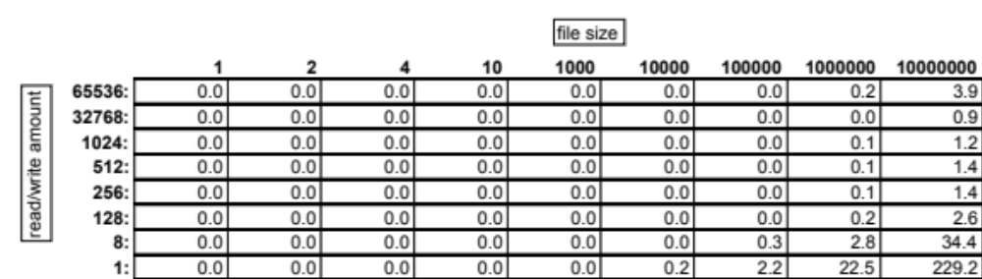
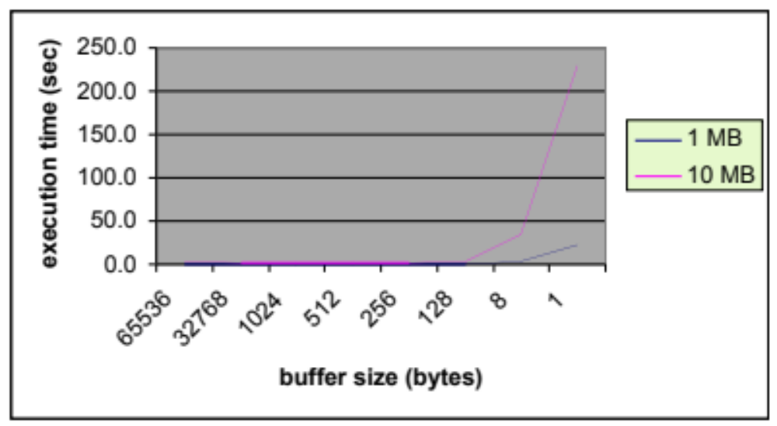
Timing Observations
elapsed time in seconds
user
system
...
....
...
....
...
Why this shape?

Slide 31

Portability Datatypes
As Unix standardization has evolved, with the OS ported to many machine architectures, a set of names have been defined to represent key kinds of program quantities whose representations might differ
  integers can be different sizes
  chars can be different sizes
  file offsets can be different sizes
  ...
You will see many of these names in the text books, e.g.:
  size_t a byte count, usually an unsigned long integer
  ssize_t a byte count or error code, usually a signed long integer
In this class, we will not use these names in our code
  most of them are integers or longs, signed or unsigned
  ANSI C will do conversions as needed if our code just uses integers
  our code will be easier for beginners to understand
  however, this is NOT good portability practice!
There are a lot of include files, note them carefully in the text or slides
  the slides use the minimum, exploiting the fact these include the others

Slide 32
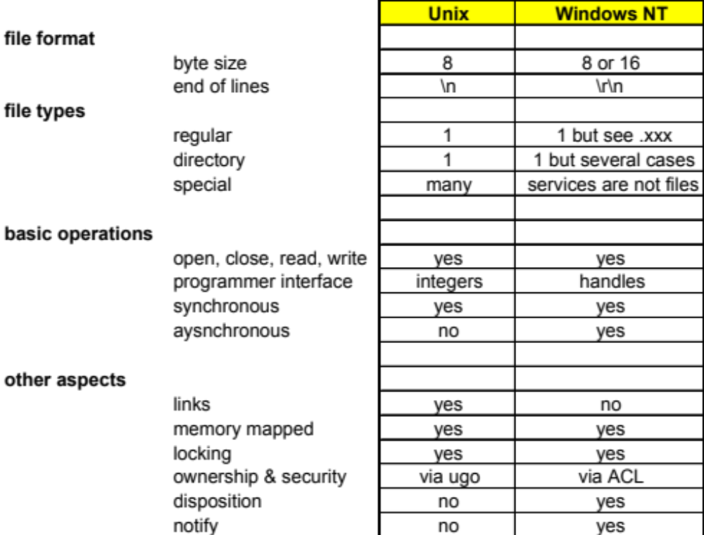
Comparison to Other Operating Systems

Slide 33

Summary
The Unix file system model is simple and powerful
Regular files are arrays of bytes
Low level I/O uses these routines:
  open & close
  read & write
  lseek
You use file descriptors to communicate with the kernel

Slide 34

Launching Programs
Arrays of strings
Introduction to processes
How shell executes programs
Getting command line arguments

Slide 35
Array of Strings
An array of strings is an array of pointers
example code
remarks
char *B[4];
B[0] = "once";
B[1] = "upon";
B[2] = "";
B[3] = 0;
B is an array with 4 elements,
and each element is a string
What is B[0][0]?
What is B[1][2]?
What is *B[2]?
What is *B[3]?

Slide 36
Array of Strings
Such arrays can be
passed as arguments:
2
main (4, B);
char *B[4];
B[0] = "once";
B[1] = "upon";
B[2] = "";
B[3] = 0;
1
int main (int argc, char *argv[])
{
...
}
3
B
4
argc
argv
o
n
c
e
\0
0
What is argv[1][3]?
What is argv[argc]?
u
p
o
n
\0
\0

Slide 37
How Shell Launches Programs
Example command:
Program source:
ls -l -t foo.c bar.c < abc
int main (int argc, char *argv[])
{
...
}
Shell actions:
Create a new process:
  find "ls" file (/bin/ls) and use it to for instructions & initial data
  create an array of command line arguments
  set file descriptors 0, 1, and 2
Run that process:
  first instruction is C startup
  routine from library
  it calls "main" with the
  command line arguments
Wait for process:
  ends with the return
  shell waits (unless pipe or &)
File descriptors:
  0 stdin
  1 stdout
  2 stderr
argc 5
argv[0] "ls"
argv[1] "-l"
argv[2] "-t"
argv[3] "foo.c"
argv[4] "bar.c"

Slide 38
Processing All Command Line Arguments
This logic echoes all command line arguments:
% foo abc def xyz
abc
def
xyz
#include <string.h>
int main (int argc, char *argv [])
{
  int i = 0;
  while (i < argc) {
    write (1, argv[i], strlen (argv[i]));
    write (1, "\n", 1);
    ++i;
  }
  return 0;
}
why two writes?

Slide 39
Getting Selected Command Line Arguments
Assume our program has this interface:
Here is one simple way to begin the program:
Valid cases:
  % bar
  % bar -n xyz
bar [ -n thing ]
#include <stdio.h>
int main (int argc, char* argv [])
{
if (argc == 1) {
... do default processing ...
} else if ((argc == 3) && (strcmp ("-n", argv[1]) == 0)) {
... do processing per value of argv[2] ...
} else {
fprintf (stderr, "usage: %s [ -n thing ]\n", argv[0]);
exit (1);
}
return 0;
}
main.c
immediate exit with status == fail
why?

Slide 40

Handling Errors
Printing values to stderr
Reporting errors

Slide 41
Using "fprintf"
Example:
Operation:
  fprintf writes characters in the output string one at a time
  a % marks a format code, which consumes and prints a data value
    %s data value is a string
    %c data value is a character
    %d data value is an integer to be printed in decimal
    %x data value is an integer to be printed in hex
  the data values are consumed left-to-right, each matching a format code
fprintf (stderr, "This is x=%d and y=%d right now\n", x, y);
destination
output string and format codes
data values that the codes will consume
how send output to stdout?

Slide 42
Detect & Report Errors
You must code defensively
  test for system call failures
  take appropriate action
Usually, the action will be:
  report the error
  stop the process
Two techniques follow ...

Slide 43
1) Use Assert
main.c
Verify a condition is true
using assert macro
If condition is false,
program will abort
#include <assert.h>
int main () {
assert (2 < 1);
}
% cc –o assert assert.c
% assert
Assertion failed at assert.c line 6: 2 < 1
Exiting due to signal SIGABRT
Raised at eip=0000397a
eax=0008ebe0 ebx=00000120 ecx=00000000 edx=0000c710 esi=00000054 edi=0000ecf0
ebp=0008ec8c esp=0008ebdc program=/home/roger/lab/io/assert
cs: sel=00a7 base=88c4d000 limit=0009ffff
ds: sel=00af base=88c4d000 limit=0009ffff
es: sel=00af base=88c4d000 limit=0009ffff
fs: sel=0087 base=0000c710 limit=0000ffff
gs: sel=00bf base=00000000 limit=0010ffff
ss: sel=00af base=88c4d000 limit=0009ffff
... etc ...

Slide 44
2) Use ERRNO
Every system routine tells you about errors this way:
  returns an error value (each routine is different!)
  sets an extern int errno with further information
Your logic is like this:
errno.h
extern int errno;
#define EPERM 1 /* Not owner */
#define ENOENT 2 /* No such file or directory */
#define ESRCH 3 /* No such process */
#define EINTR 4 /* Interrupted system call */
#define EIO 5 /* I/O error */
#define ENXIO 6 /* No such device or address */
#define E2BIG 7 /* Arg list too long */
... etc ...
string.h
extern char *strerror (int errno);
fd = open (fname, RD_ONLY, 0);
if ( fd < 0) {
  fprintf (stderr, "%s: Can't open %s for reading -- %s\n",
  argv[0], fname, strerror (errno));
  exit (1);
}
% myprogram
myprogram: Can't open /home/xyz for reading -- No such file or directory (ENOENT)

Slide 45

Lab Assignment

Slide 46
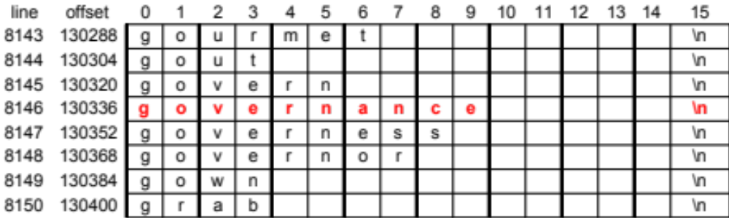
Help Users Spell Correctly
% ok governence
no
% ok governance
yes
Search online dictionary.
Print "yes" or "no" if argv[1] found or not found
Report error if no argument supplied.
Details:
  The online dictionary is /cs_Share/class/cs360/lib/webster
  Format is 1 word/line
  Lines are in ascending sorted order
  Each line is 16 characters long
  Use binary search (how?)
Files to submit:
  ok.c (complete program)
how test?

Slide 47
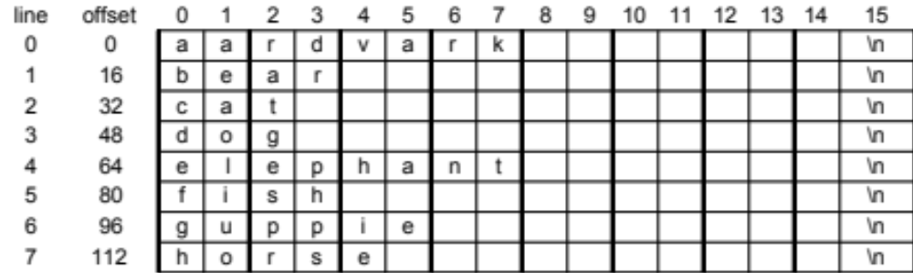
Example Operation
Assume the online dictionary has this content:
(this file at /cs_Share/class/cs360/lab/io/tiny)
% ok dog
# word wanted="dog "
# search range: bottom=0, top=8
# middle=4, word have="elephant "
# test: want < have
# search range: bottom=0, top=4
# middle=2, word have="cat "
# test: want > have
# search range: bottom=3, top=4
# middle=3, word have="dog "
# test: want = have
yes
Here is a sample run of my version with debugging turned on:

Slide 48
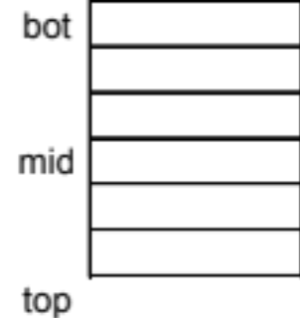
"OK" Program Design
Plan:
  Use binary search via lseek and read
Variables:
  want: the word we are testing
  have: word read from the dictionary
  bot & top: line numbers
  that define the search range
Logic for main routine:
  exit if command line not correct
  set word = argv[1], set fd by opening dictionary; exit if can't open the dictionary
  call ok (fd, word) to check the word; print "yes" or "no" per returned value
Logic for subroutine: int ok (int fd, char *word)
  prepare 'want' and 'have' variables per above format
  set bot to 0 and top to last line number + 1 (use lseek)
  repeat:
    if search range empty (bot >= top), return 0
    set mid = (bot+top)/2; read that line into 'have' (don't read newline)
    compare 'want' vs. 'have' (using strcmp)
    if they are equal, return 1
    if 'want' smaller than 'have', set top = mid; otherwise, set bot = mid+1
both are padded with blanks and terminated
with a \0 like this (note there is NO newline):
lines remaining to be searched are those with line numbers n such that bot <= n < top

