Slide 1
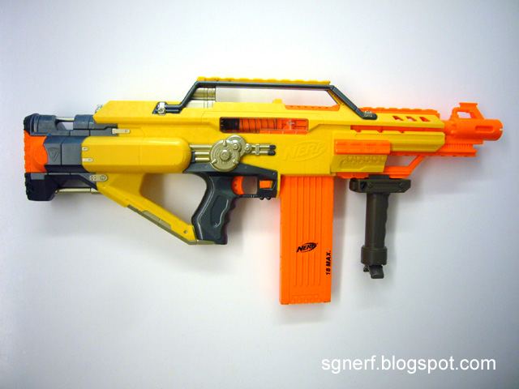
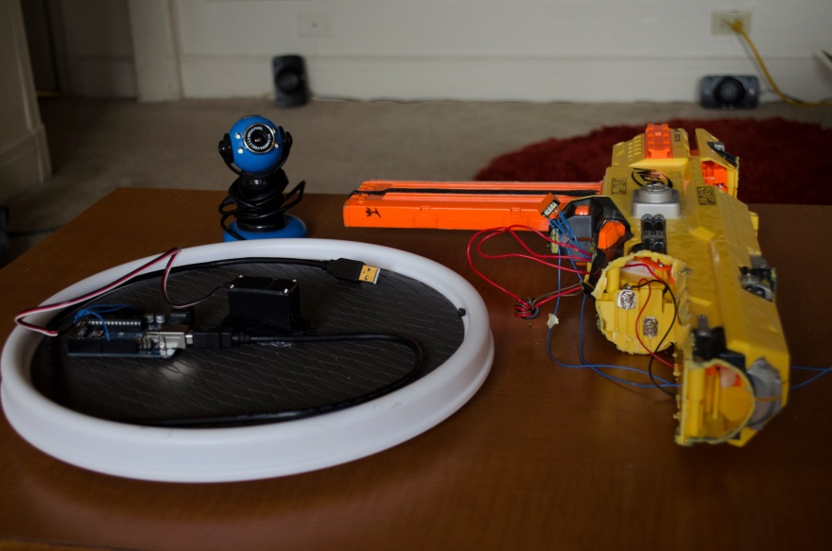
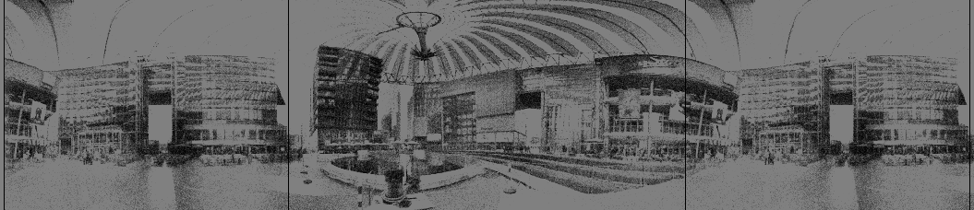
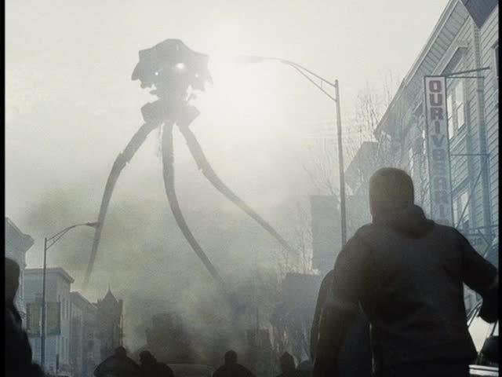
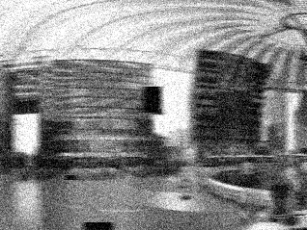
NERF Stampede
Add Turntable & Camera…
Localization & Tracking
World Domination!
>80% Test Accuracy
- With blur
- And occlusion
- No Priors!
16-385 Computer Vision, Scott Martin

