Slide 1
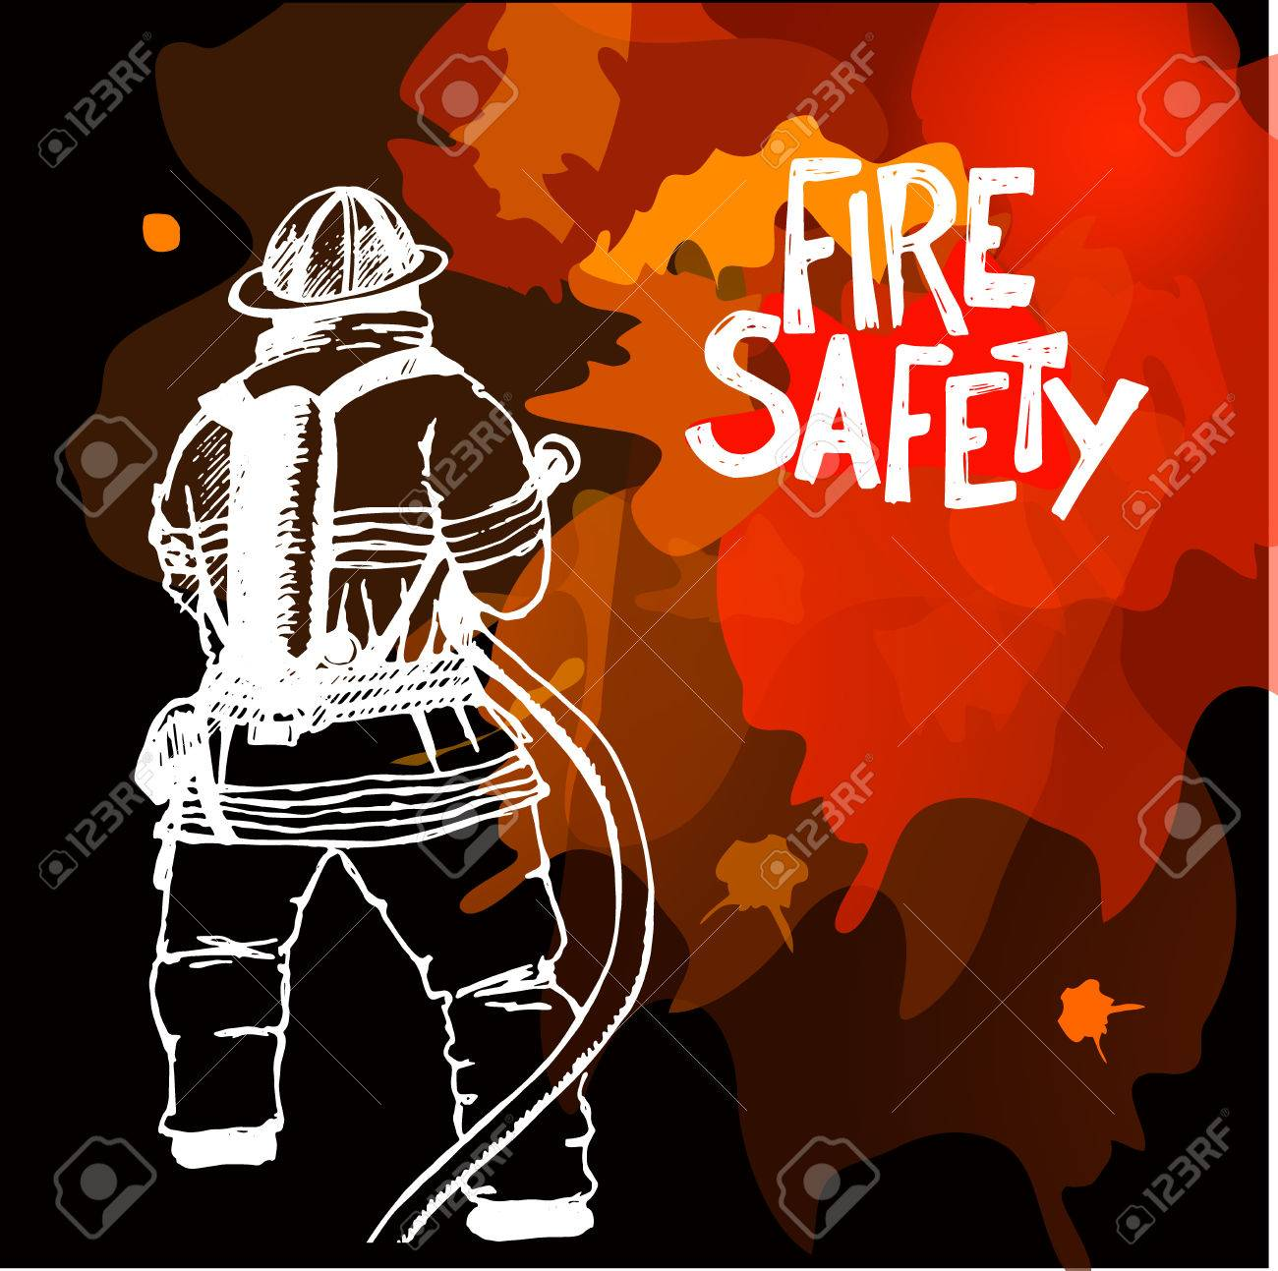
BlazeAware

Slide 2
About :
Project name : BlazeAware
Synonym : Educating for Effective Fire Prevention.
Project title : Safe Zone ( Real-time video analytics for industrial safety ).
Type : Created as a website for fire safety consultation

Slide 3
Existing problem :
Lack of Education and Awareness :
Many individuals, especially in residential settings, lack proper education and awareness about fire safety measures.
This can lead to unsafe practices, such as improper use of appliances, ignoring fire alarms, or not knowing how to respond in case of a fire emergency.
Inadequate Maintenance:
Even when fire safety systems are in place, they might not be properly maintained. Faulty wiring, malfunctioning smoke detectors, or blocked fire exits can render these systems ineffective when they're needed most.

Slide 4
Other problems :
Lack of Regular Drills and Training:
Without regular fire drills and training sessions, occupants might not know how to respond in the event of a fire. This includes knowing evacuation routes, assembly points, and using fire extinguishers.
Urban Planning and Infrastructure:
Poor urban planning that places residential areas too close to industrial zones or lacks proper infrastructure for emergency services can hinder effective fire prevention and response.
Highly Flammable Materials:
In industrial settings, the use, storage, and handling of highly flammable materials without proper safety measures can increase the risk of fire incidents.

Slide 5
Aim :
Education and Public Awareness:
Fire Safety Campaigns:
Develop comprehensive and ongoing public awareness campaigns to educate people about fire safety practices, the importance of regular fire drills, and the proper use of fire safety equipment.
School and Community Programs:
Incorporate fire safety education into school curricula and community workshops to ensure that people of all ages are knowledgeable about fire risks and safety measures.

Slide 6
Solution :
Consultation and Expert Guidance:
Fire Safety Consultants:
Employ fire safety consultants who can assess different settings, identify vulnerabilities, and recommend tailored solutions to improve fire prevention and response.
Industry-Specific Training:
Provide specialized fire safety training for industries that handle flammable materials or have unique fire risks, ensuring employees are equipped to handle emergencies.

Slide 7
Services :
2
Notification
1
Analytics Page
Registration details are sent to the owner via mail .
Analytics page consists of services and about the frame work
3
Offers
Contains special offers and free certification
4
Free consultance
5
courses
Registration is available for free consultants
Registration is available for course details are send via mail

Slide 8
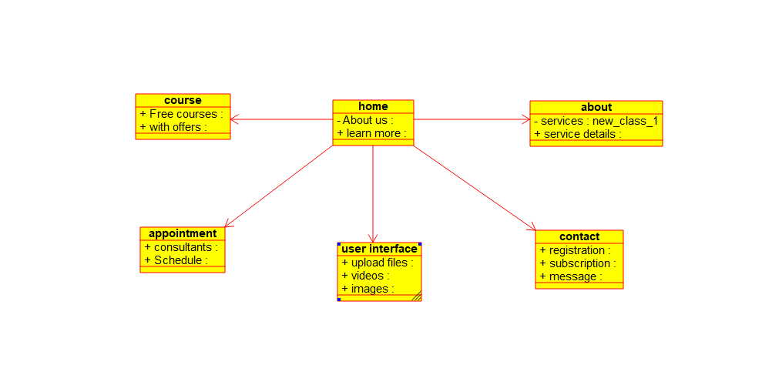
Class diagram :
BlazeAware

Slide 9
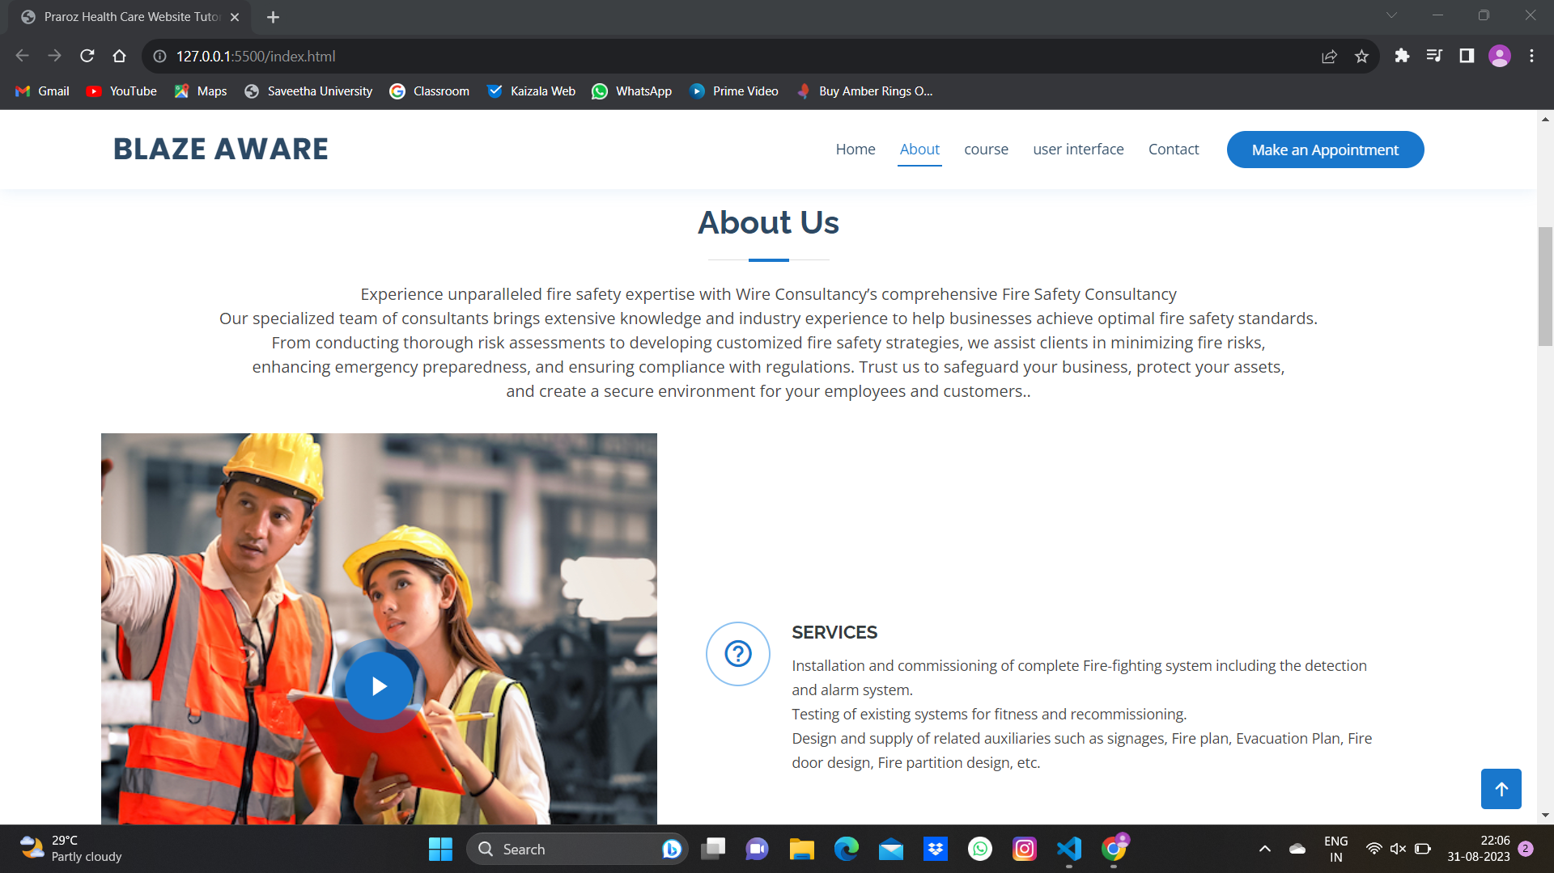

Slide 10
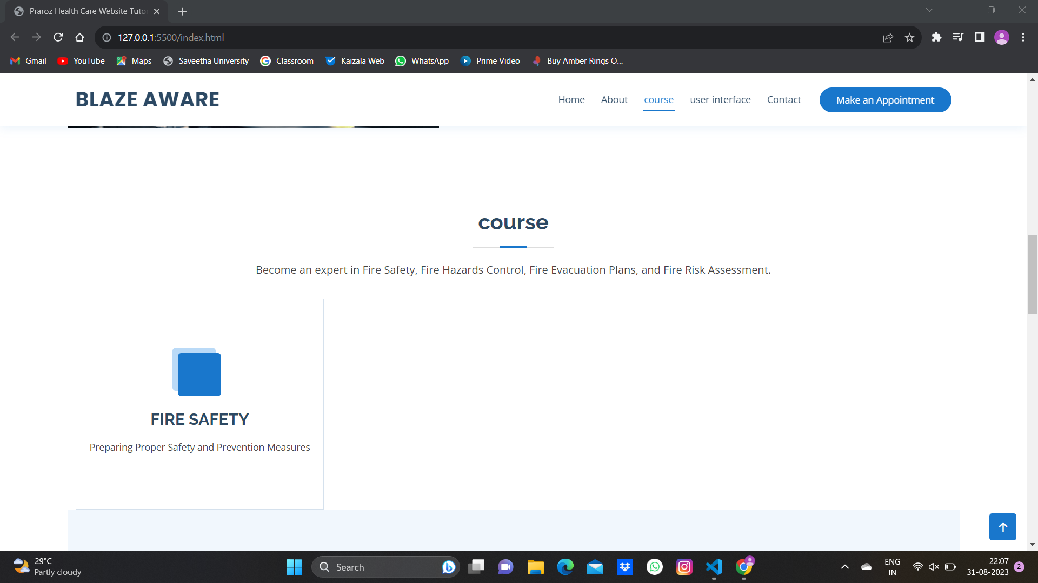

Slide 11
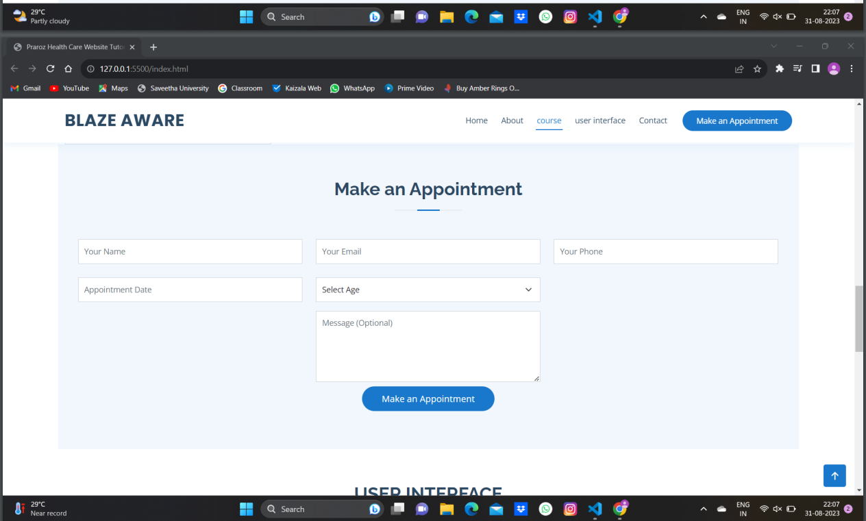

Slide 12
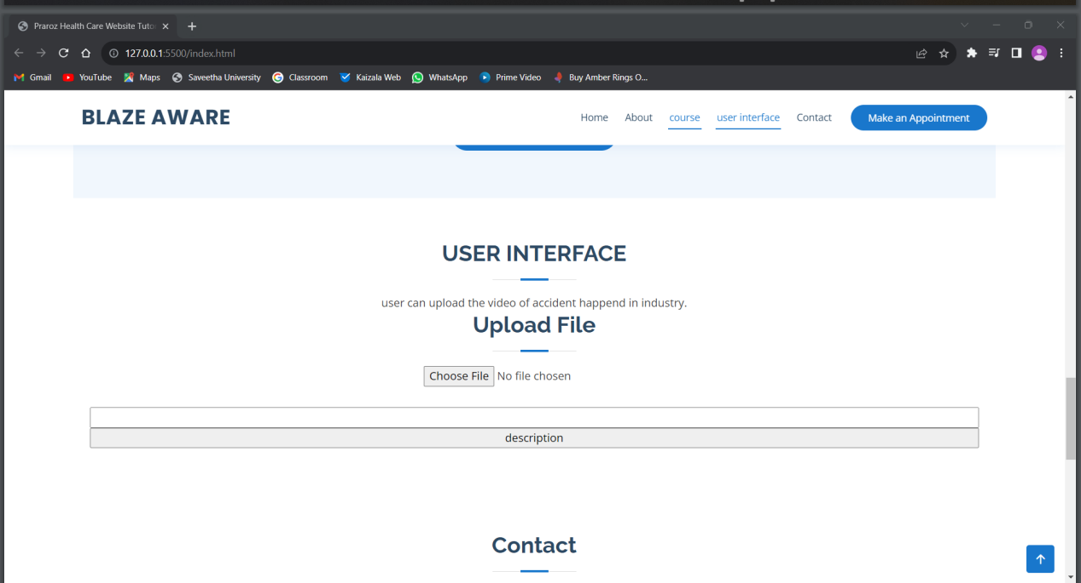

Slide 13
Thank You

