Slide 1
IBM Hack Challenge 2021 (IPL Super Predictor)
Team Name : DARK
By: Kunta Kshiraj
(19H61A05L9)

Slide 2
INTRODUCTION
OVERVIEW
Since the dawn of the IPL in 2008, it has attracted viewers all around the globe. High level of uncertainty and last moment nail biters has drawn the fans to watch the matches in large numbers. Within a short period, IPL has become the highest revenue generating league of cricket. With all this, the amount of data being generated in terms of matches revenue scores etc has also become huge. Analyzing such vast amounts of data would give great insights in forecasting match results ,top scores and wicket takers etc.

Slide 3
PURPOSE
The objective of this solution is to create a dashboard that visualizes the following capabilities and also forecasts the future results.
1.To find the team that won the most number of matches in the entire IPL.
2. To find the team that lost the most number of matches in the entire IPL.
3. Does winning a toss increase the chances of victory.
4. To find the player with the most player of the match awards.
5. To find the city that hosted the maximum number of IPL matches.
6. To find the most winning team for each season.
7. To find the on-field umpire with the maximum number of IPL matches.
8. To find the biggest victories in IPL while defending a total and while chasing a total. 9. Which team won the most matches while batting first.
10. Which team won the most matches while batting second.
11. List of teams which have won matches by most runs cumulatively

Slide 4
LITEARTURE SURVEY
EXISTING PROBLEM-Existing approaches to solve the problem.
IPL Data Analysis is all about the analyzing the data that is al- ready present in data set using data science, machine learning and python. This is an application design for the purpose of analyzing the data by fetching the attribute from the data set and predicting the future of the match and as well as of the players. This will help in the selection of the IPL team that the team should perform good and win the match. Prediction is
done for anything like which player will play well in tomorrow's match,which team will win toss and even match etc. The prediction can be done with the help of the analysis on that data set collected and by displaying proper data that is useful for the future prediction.

Slide 5
PROPOSED SOLUTION
The solution is to create a dashboard that visualizes capabilities and also forecasts the future results.
Using the following tools we have developed the solution :
IBM Cloud, IBM Cognos Analytics, IBM Watson Studio.

Slide 6
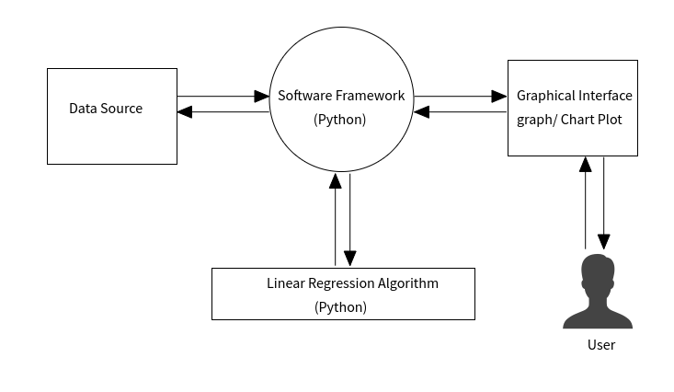
THEORITICAL ANALYSIS
Block Diagram

Slide 7
HARDWARE AND SOFTWARE REQUIREMENTS
1)IBM Cloud
2)IBM Cognos Analytics
3)IBM Watson Studio.

Slide 8
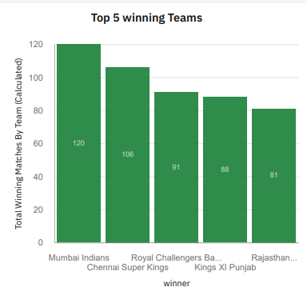
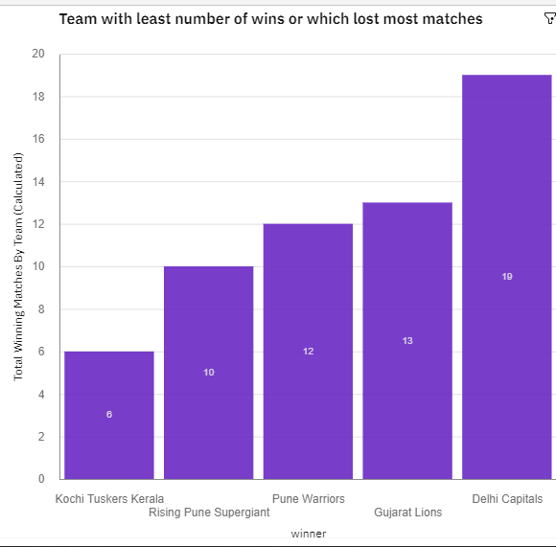
RESULT

Slide 9
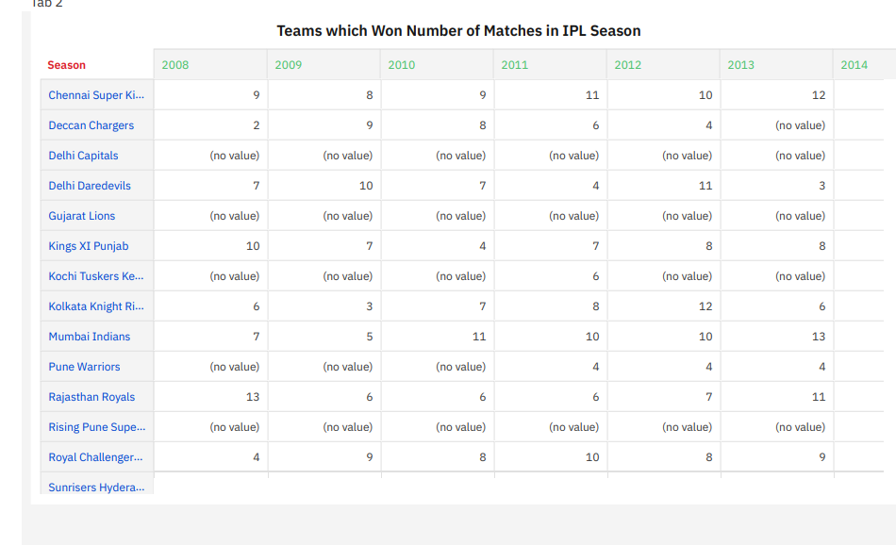

Slide 10
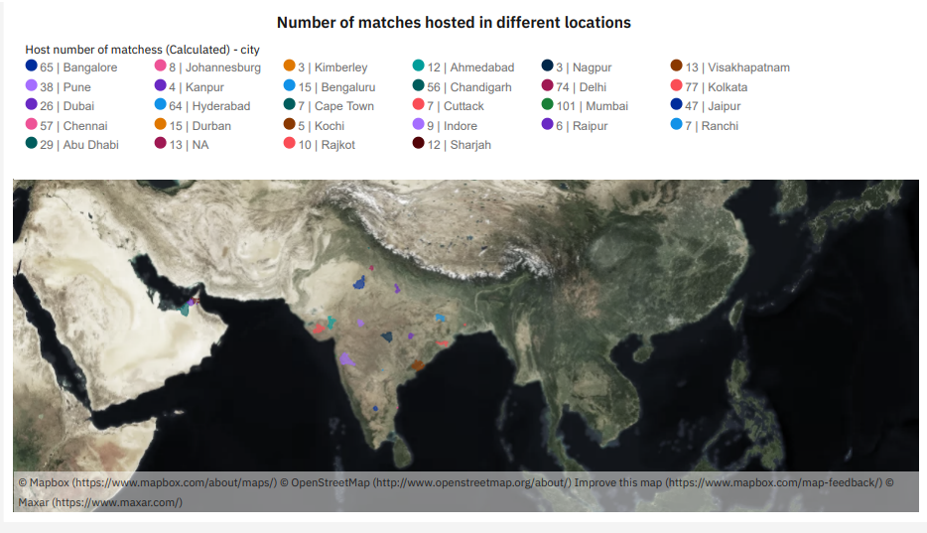

Slide 11
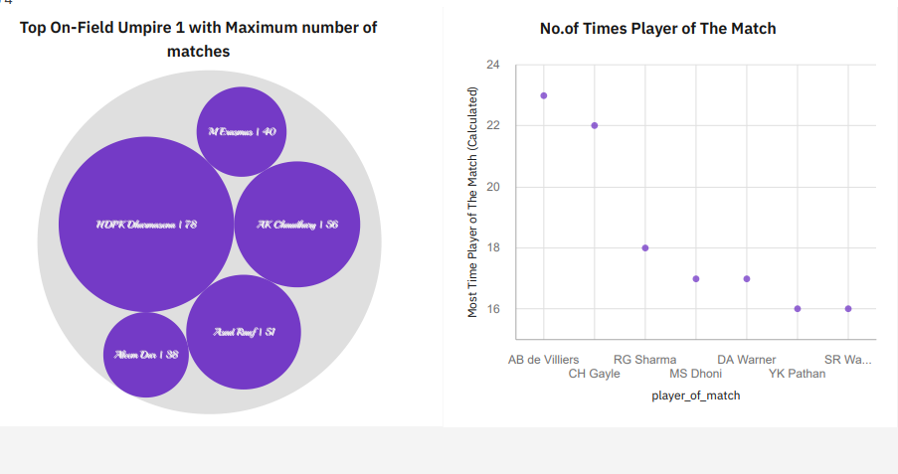

Slide 12
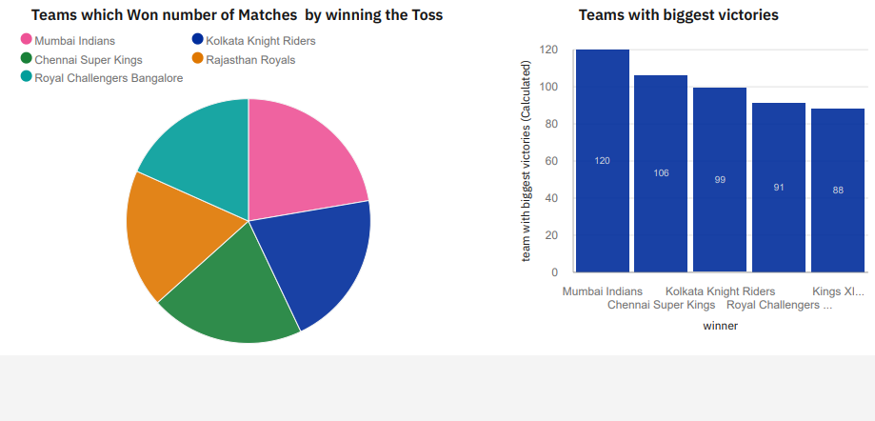

Slide 13
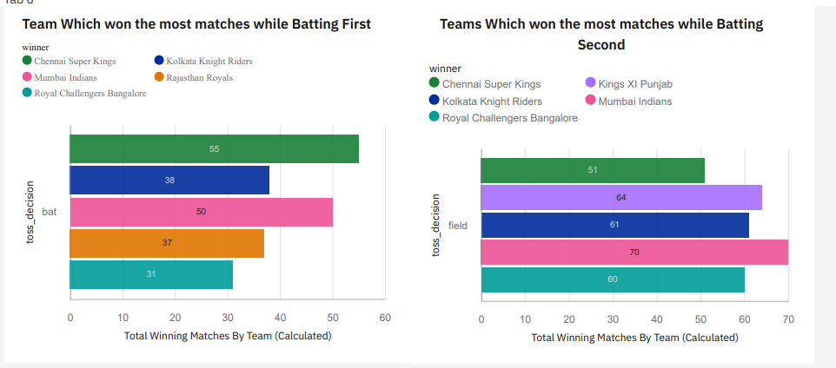

Slide 14
.ADVANTAGES OF THE PROPOSED SOLUTION
To provide the statistical analysis of players based on different characteristics . To predict the performance of a team depending on individual player statistics. To successfully predict the outcome of IPL matches.
APPLICATION The main objective of sports prediction is to improve team performance and enhance
the chances of winning the game. The value of a win takes on different forms like trickles down to the fans filling the stadium seats, television contracts, fan store merchandise, parking, concessions, sponsorships, enrollment and retention.

Slide 15
CONCLUSION
This work aims at understanding the dataset of past 12 years history of the IPL data. It helps to understand machine learning algorithms working principal and their implementation. It creates the Model and Training dataset and helps to predict with the help of the model created. The model classifies the data and compares the results. It takes into consideration the measures accuracy, error rate, precision, recall, sensitivity and specificity. This work focuses on exploring IPL data and presenting its insights as graphical representation and comparative analysis. By making use of this, Indian Premier League and the fan followers can take decisions on the team’s performance and predict the trophy winners that will lead to success in future.

Slide 16
FUTURE SCOPE
The implementation tools Anaconda navigator,Jupyter,Random Forest is observed to be the best accurate classifier with 89.15% to predict the best player performance. This knowledge will be used in future to predict the winning teams for the next series IPL matches. Hence using this prediction, the best team can be formed.
BIBLIOGRAPHY
IBM
SmartInternz
www.google.com
www.wikipedia.com

