Slide 1
EDUCATION
THE SUPER POWER

Slide 2
INDIAN SYSTEM
Education is the process of facilitating learning, or the acquisition of knowledge, skills, values, morals, beliefs, and habits. Educational methods include teaching, training, storytelling, discussion ,research .
IMPORTANCE :Having education in an area helps people think, feel, and behave in a way that contributes to their success, and improves not only their personal satisfaction but also their community. In addition, education develops human personality, thoughts, dealing with others and prepares people for life experiences.

Slide 3
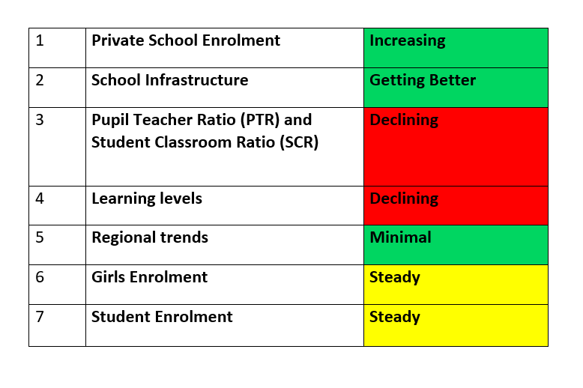
IN TELANGANA

Slide 4
FACTS
Indian Education system – 10+ 2+ 3+ 2 = 17 years .
Learning process of 100% Financial Literacy is absent .
As per the population almost one student out of 1000 is getting government or private jobs
No practical approach which actually takes place in industrial sector .

Slide 5
FACTS
Lack of suitable jobs for the students
All proffessions are not given equal importance
After attenaing the age of 23 if they are not getting the jobs whole family suffers a lot

Slide 6
FACTS
The salary received by them is very low which leads to a bad lifestyle .
Almost upto 30 years they are dependent on their family members
Finally only after 17 years of education they can either choose for job, profession or Business .

Slide 7
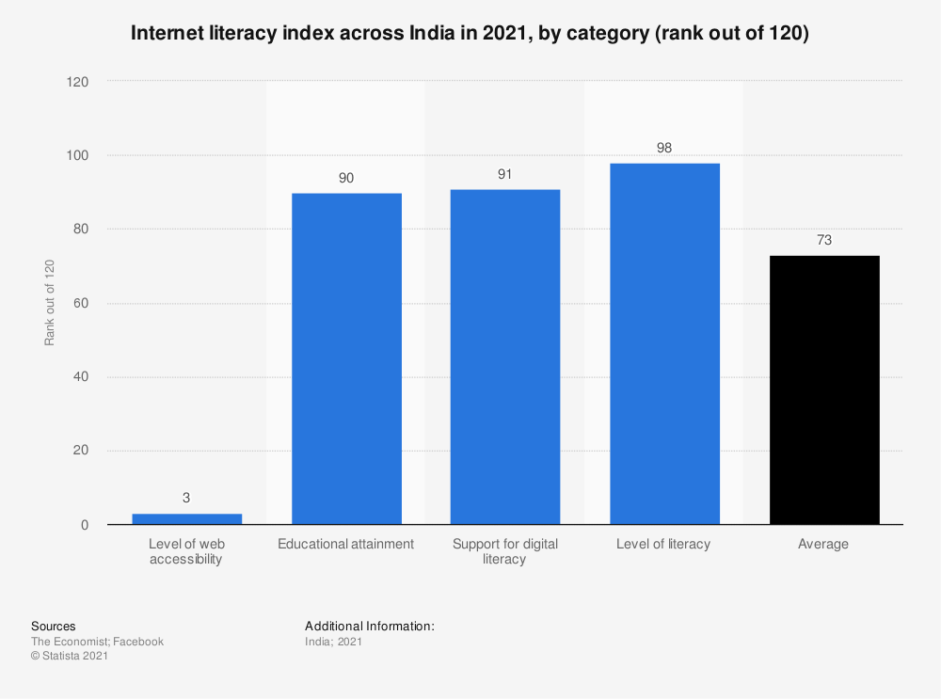

Slide 8
SOLUTION
When the students complete there Five standard they have to given the choice of subjects which they are going to study further
By this methodology they will aware about subject knowledge at a very young age
Practical execution in which ever stream they are going to pursue
By achieving the above goals .They can also opt for Jobs by 19 years itself
Not only studies we must encourage them to choose sports as a career and also make them professionals in the particular category
Giving importance to all the sectors can make every individual life better when it comes to Salary
Along with the Technology students should also increase there skills , their daily activities , practical approach in life and also there mental health .
By these above methods once easily access for better education , employments , business and most importantly settle in life by the age 25 .

