Slide 1



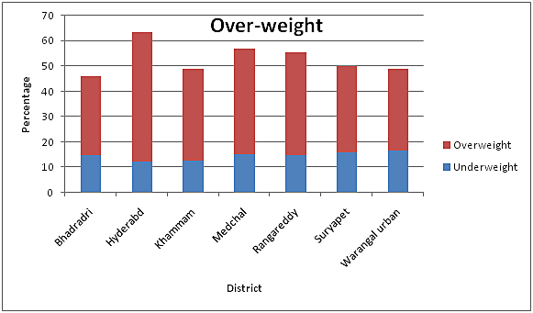
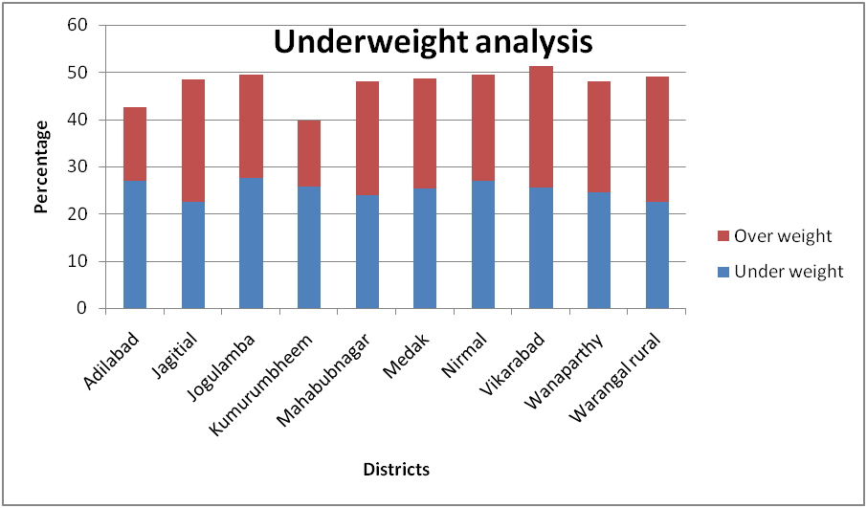
GOOD HEALTH AND WELL BEING
INTRODUCTION
METHODS USED TO ANALYZE
FOCUS
I am Shravani from ‘JS’ team, individual participant. My project is about good health, focusing on nutritional status of women.
I have analyzed this using an Excel application. I have gone through the statistical data for three categories under the nutritional status of women. I gathered information about the nutritional balance, Body mass index. I have gone through the official websites of the Telangana portal, which describes its schemes.
Brief in review
My work is based on the factors that are affecting women nutrition. Its analysis using data sets provided by National Family Health Survey (NFHS-5). These are also provided by the organizing team. I used these data sets to analyse the problem statement. Theory deals with a comparative study of Body mass index values among districts of Telangana.
DATA ANALYSIS
Data prompts
CHANCE
CHOICE
CHANGE
I have selected this prompt “Nutritional status” provided by organizing team. I have chosen this because, nutritional status affects many other indicators like hyper-tension, fertility. proper diet has to be taken for maintaining healthy body weight. I am keen towards finding a way to make aware among women.
INSIGHTS
aringSharing is c
The above comparative analysis gives us a conclusion that districts having higher underweight percentages have a low overweight percentage. and districts that are having a lower under-weight percentage are showing a high overweight percentage. By observing the schemes provided by the Government of Telangana Arogya Lakshmi and Rice distribution, there is no dominance of economic factors playing a vital role.
RECOMMENDED POLICIES
There is a lack of awareness among the people regarding nutritional values. This stage among the women has to be vanish. Studies show that people suffering from being underweight have more risk than people having over-weight. Lack of nutrition leads to Anemia, fertility issues. The recommended policies are:
☆ There should be an awareness program either virtually or in-person by the organizing teams to deliver the importance of nutritional health.
☆ "Today's children are tomorrow's citizens" having said it, our main focus should be on women having 15-25 years.
☆ The information will be shared by the people to elders, In some cases, women above 30 years also join the program.
☆ Different social media platforms can be utilized to share super nutritional tips through posts, pictures, and reels too. The audience gets more attracted too with reels.
☆ Proper guidance is necessary to maintain this.
The Market survey can be done by circulating Google forms to the students from engineering colleges, intermediate, pharmacy, degree, and all other streams to know the level of students who are aware and not aware of BMI, effects of less nutritional food.
CONCLUSION
All the women should be aware of their health because this decrease in good food leads to other internal problems in women.
“Proper diet helps to maintain healthy weight”

