Slide 1
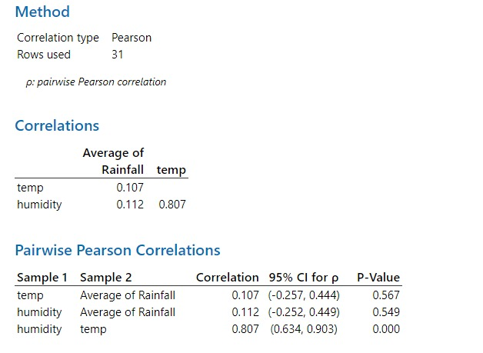
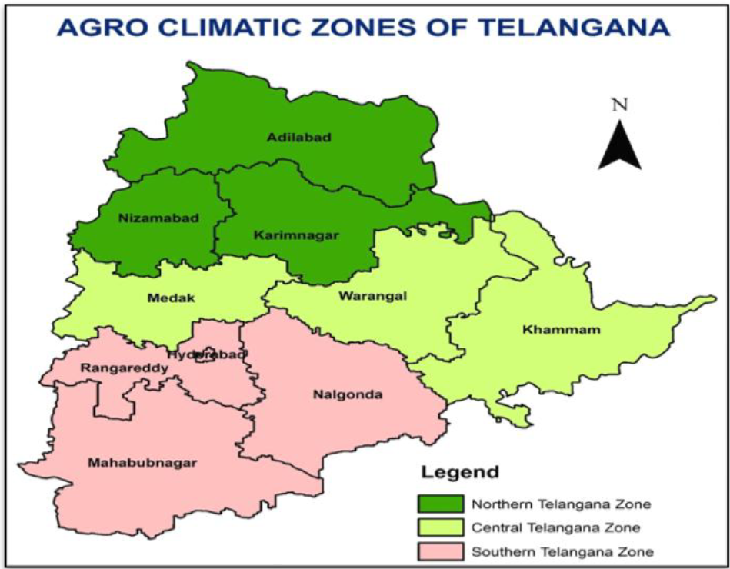
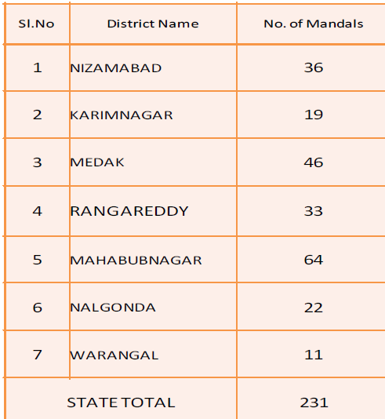
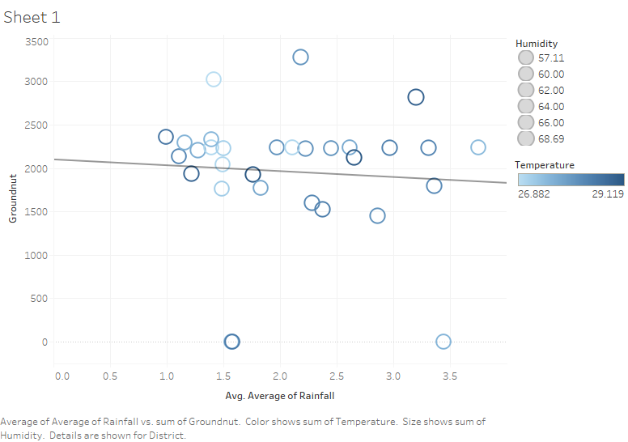
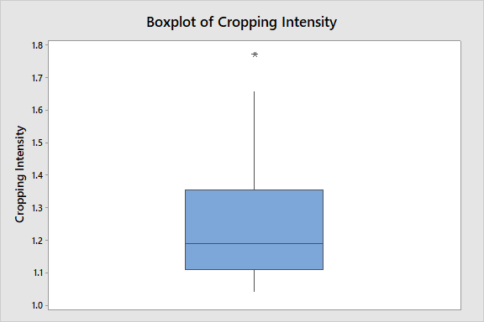
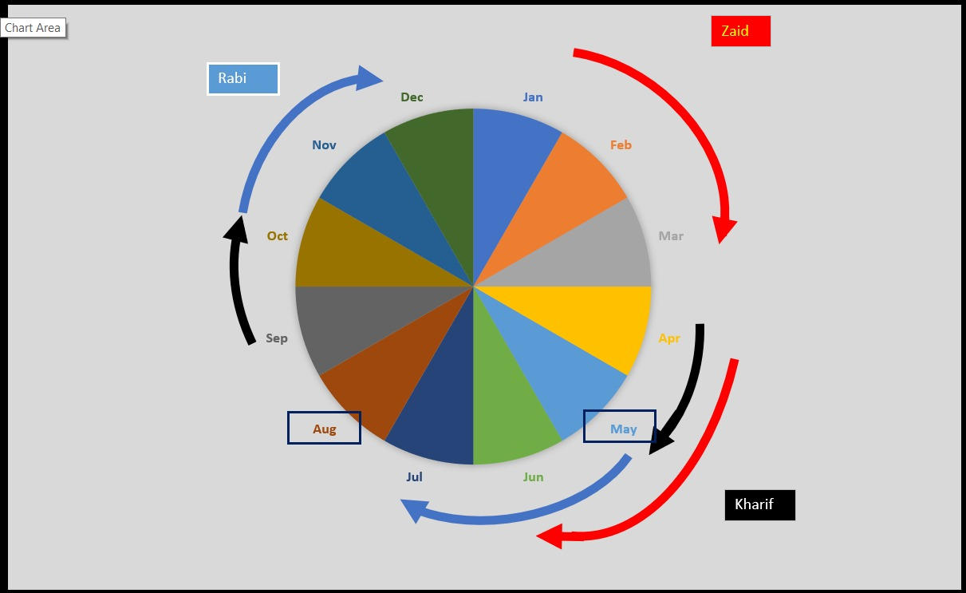
SDG-2: Zero Hunger| Precision Farming for improving yield State- Telangana
Introduction- Based on rainfall, soil type, cropping pattern, etc. Telangana is divided into Northern, Central, and Southern Telangana Zone. Out of 55.54 lakh of land holdings 86% constitute of small and marginal land holding farmers. The average land holding of the state is 1.12 acre with Adilabad and Mahbubnagar having farm power availability as less than 2Kw/ha.
Analysis
The corelation analysis between rainfall, humidity and temperature shows strong corelation between rainfall and humidity.
Insights
Erratic rainfall are major cause of rainfall, majorly due to south-west monsoon rains and districts on west are mostly drought affected regions.
Farm-mechanisation is Adilabad and Mahbubnagar is least.
Most of the farmers are small- and marginal so we need to focus on improving soil-health and irrigation facilities.
Fig. 3 Minitab Output for Corelation
Fig. 4 Box-plot (Minitab)
The box-plot for cropping intensity shows presence of outlier in data.
The fig 5 show months of May, June, July as most engaged months for cropping.
Fig.1. Agro-Climatic Zones
Table.2 District wise drought affected Mandal
The rainfall is the state is erratic with 80% of rainfall being of South-West monsoon. Pre-dominant crops in Central Zone includes cotton, rice, maize, green gram, mango, sugarcane and chilies with Red type of Soils (54%). Northern Zone is dominated with red soil (45%), black soil (24%) and calcareous soil. The southern zone is also dominated with red soil, colluvial and calcareous soils.
Fig. 6 Correlation bet Groundnut & Avg. Rainfall
References:
Agro-climatic zone of Telangana. https://pjtsau.edu.in/research.html
Agriculture at a Glance 2015-16.(2015) https://des.telangana.gov.in/publications/Agricultural_at_glance_2015-16.pdf
Agriculture in Telangana (2015). https://www.niti.gov.in/writereaddata/files/Telangana_Presentation_0.pdf
Methodology: Background Study→ Data Wrangling → Variables Identification → Data Analysis (Correlational and Multiple Linear Regression) → Insights & Recommendation.
Fig. 5 Season (Black-Rabi; Red-Zaid; Blue- Kharif)

