Slide 1
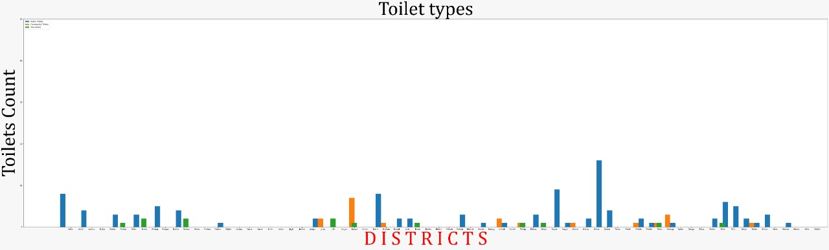
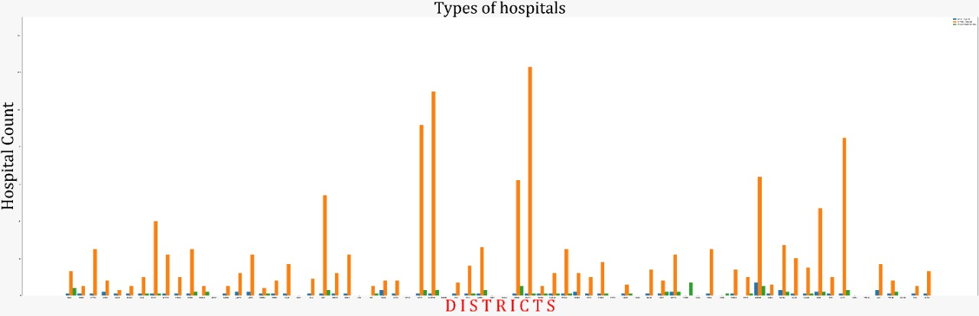
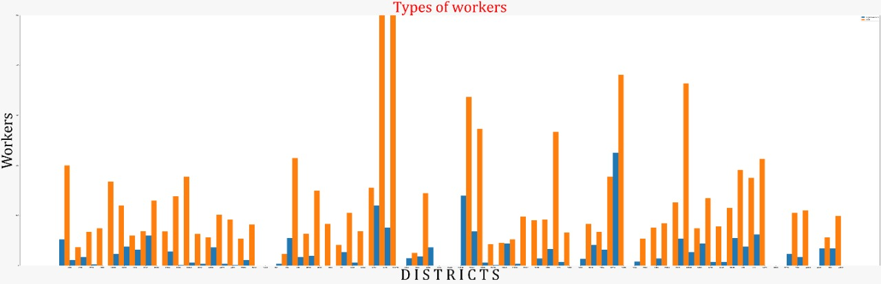
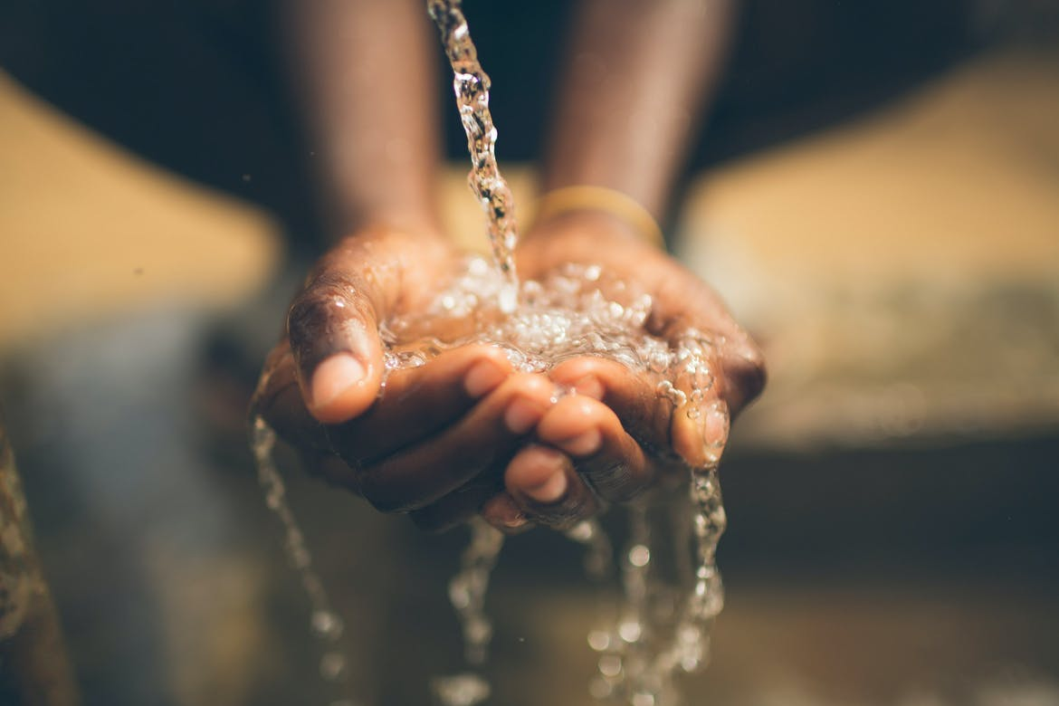
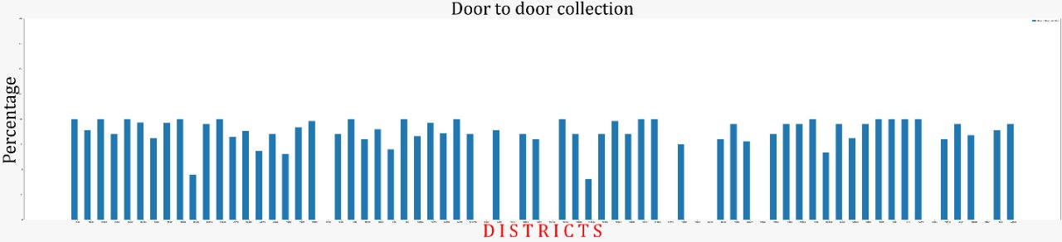
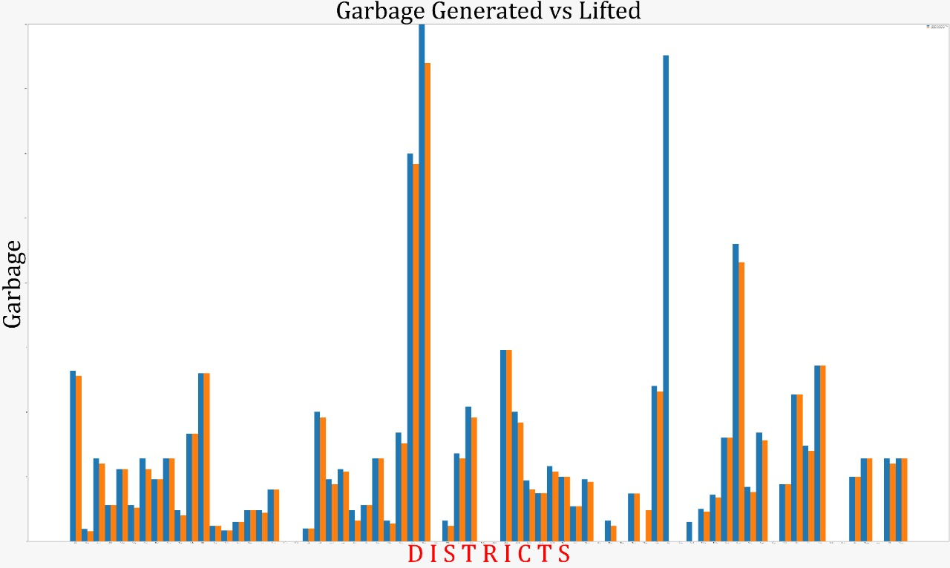
CLEAN WATER AND SANITATION
Results
Introduction
This is team “TERRIFIC” from Institute of Aeronautical Engineering college.Team members are Bhimesh(head ),Praneetha, Madhuri.We are working on the social causes in our locality and we are very excited to participate in this program.
PROMPT
To Perform visualizations on the following attributes from the belowmentioned dataset; toilet types i.e Public, Community, She. Vehicle typesi.e tractor, autos, tricycles, rickshaws, pushcarts. Worker types regular,outsources. Hospital types private, government, urban health centers and garbage generation and or lifted per day.
We found that there are many districts without the basic needs.The number of prvate hospitals is more than the governments.And there is less garbage lifting in the state which leads to the bad smell and diseases.We had the less public toilets which is very basic need.We found these in problems our analysis.
Conclusions
In our state there is lack of basic needs in every place we should fond the best ways to solve these issues.Mainly public toilets,toilet is the basic need for every human being so we provie the minimum toilets in all the departments.There are less workers in some places so government should try to give those jobs to the unemloyees.Garbage cleaning will play a major role in our helath and cleaniness so it should be cleaned regularly.There are more private hospitals in the state poor people cannot efford to those hospitals and government should construct new hospitals for poor people.
METHODLOGY
We referred many datsets from the google and also different sites for relevant information and to solve the issues we faced in this work.We used python programming language for visualizing the data.It became very helpful by using the python.

