Slide 1
Challenge Title : Data for Social Good – Hackathon
Project ID | : | SPS_PRO_2614
Project Title | : | SDG 6 Clean water and Sanitation
Duration | : | Days
Team | : | Sunrisers

Slide 2
Visualizations on Clean Water and Sanitation in Urban Local Bodies, Telangana
Presented by Rahul Sai J and Sumanath Beku
B V Raju Institute Of Technology , Narsapur
Medak , Telangana

Slide 3
Challenge Name: Clean Water and Sanitation
The state of Telangana , with over 43,273 miles in area, and population size of 35.19 million,
there is a need to ensure that human development is not impacting the natural ecosystem of the state.

Slide 4
Visualizations on following attributes:
Toilet types
Vehicle types
Worker types
Hospital types
Garbage Generation and Lifted per day.

Slide 5
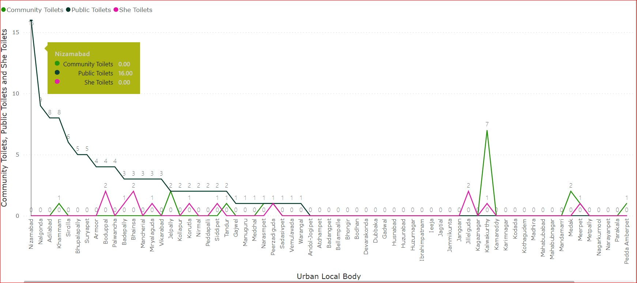
(A) Toilet Types
The visualization we have done depicts types of Toilets present in 72 selected ULBs (Urban Local Bodies) across the State Of Telangana.
The Town of ﻿﻿Kalwakurthy accounted for 35.00% of Community Toilets with 7 Community Toilets.﻿﻿ ﻿﻿ ﻿Nizamabad has only Public Toilets which accounts to 16 and it is also the only town in the data set with most number of Public Toilets.
There are only a few of ULBs with She Toilets . Among them Boduppal, Bhainsa, Jillelguda have 2 She Toilets each.
Across all 72 ULBs, Community Toilets ranged from 0 to 7, Public Toilets ranged from 0 to 16, and She Toilets ranged from 0 to 2.﻿﻿ ﻿﻿

Slide 6
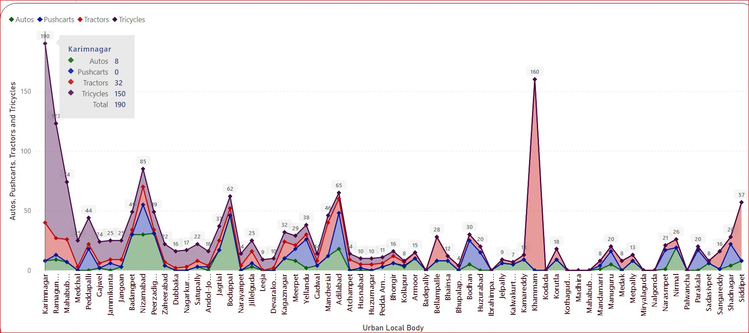
(b) Vehicle Types
The visualization we have done depicts various types of Vehicles used for Garbage Collection in 72 selected ULBs (Urban Local Bodies) across the State Of Telangana.
The town of Karimnagar has the most number of vehicles used i.e 190 followed by Khammam with 160 vehicles and Ramagundam 123 vehicles.
﻿Across all 72 Urban Local Body, Autos ranged from 0 to 46, Pushcarts ranged from 0 to 30, and Tractors ranged from 0 to 160.
From the visualization, it is evident that the most commonly used vehicle for Garbage Collection is Tricycles. So Measures must be taken to introduce other types of efficient vehicles for a better and easy collection and transportation of Garbage.

Slide 7
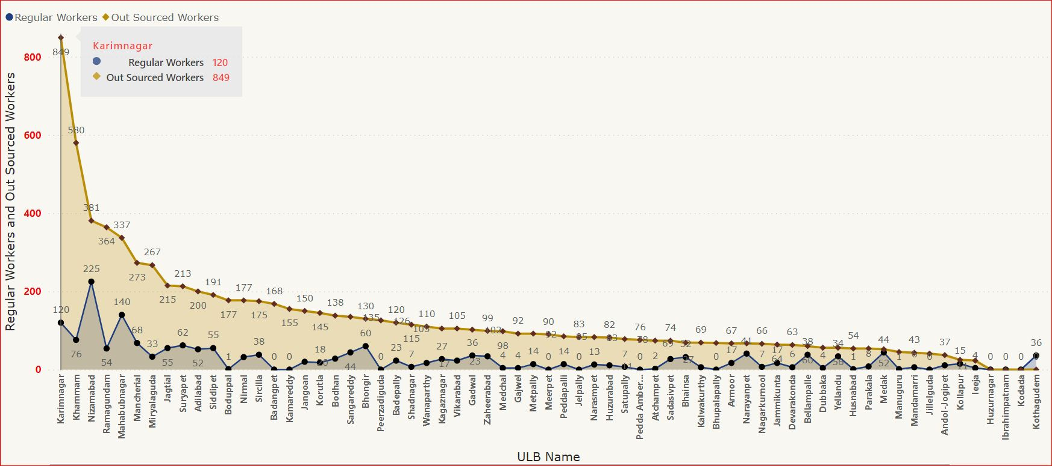
(C). Worker Types
The visualization we have done depicts 2 types of Workers (Regular and Out Sourced) involved in Sanitation in 72 selected ULBs (Urban Local Bodies) across the State Of Telangana.
Out Sourced Workers and Regular Workers diverged the most for the ULB Karimnagar , when Out Sourced Workers were 729 higher than Regular Workers.
The ULB Nizamabad had the highest number of Regular Workers with 225 followed by Mahabubnagar with 140.
It can be concluded from the visualization that there is a huge difference between the number of Regular and Out Sourced Workers. So appropriate measures should be taken to minimize the discrepancy.

Slide 8
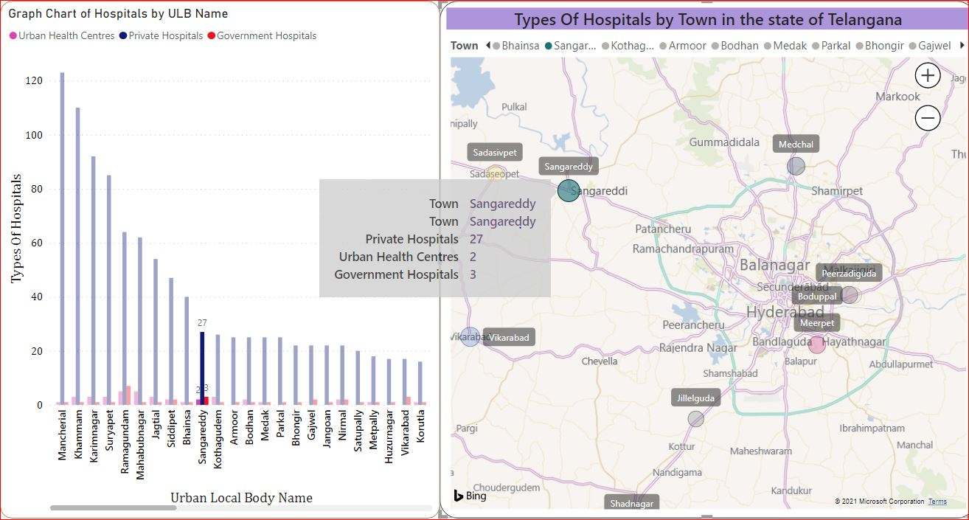
(D). Hospital Types
The visualization we have done depicts various types of Hospitals in 72 selected ULBs (Urban Local Bodies) across the State Of Telangana.
﻿ ﻿﻿Urban Health Centres and Private Hospitals are negatively correlated with each other.﻿﻿ ﻿﻿﻿﻿Mancherial has more number of Hospitals where Private being the maximum with value 123. This trend is followed by Khammam, Karimnagar, Suryapet.
In almost all the ULBs, Private Hospitals have dominated in the Health sector, so more number of Government Hospitals and Urban Health Centres should be established so that people can get Free Health Care and Services.

Slide 9
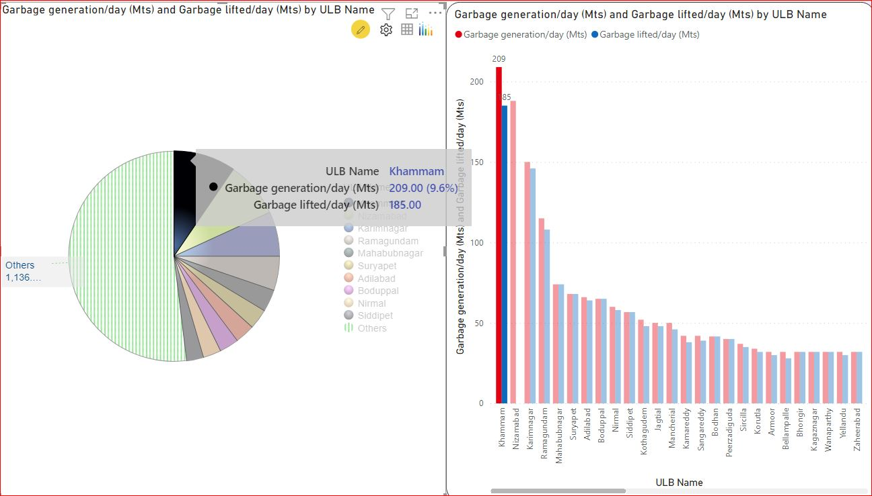
(E). Garbage Generation and Lifted per day
The visualization we have done depicts Garbage Generation per day and Garbage lifted per day in 72 selected ULBs (Urban Local Bodies) across the State Of Telangana.
Garbage generation/day (Mts) and Total Garbage lifted/day (Mts) are positively correlated with each other.﻿﻿ ﻿﻿ ﻿﻿Khammam accounted for 9.55% of Garbage generation/day (Mts).﻿﻿ ﻿﻿ ﻿﻿
The Garbage lifted per Day is not as same as Garbage generation per Day for few ULBs, this means that collection of Garbage is not up to the mark for few ULBs.
So, appropriate measures must be taken so that no Garbage is uncollected.

