Slide 1

DATA FOR SOCIAL GOOD - HACKATON
TEAM : THE VARIANTS

Slide 2

TEAM: The Variants TEAM MEMBERS: G Hemanth sai G Sri Krishna Kireeti T Sai gopi Ch Sai charan
Gokaraju Rangaraju Institute of Engineering & Technology

Slide 3
SDC 3 : GOOD HEALTH AND WELL BEING
Tobacco use and alcohol consumption among Adults(age 15 years and above)

Slide 4
INTRODUCTION:
Alcohol and tobacco use is becoming more common every day in our society. Tobacco can forever damage a person’s internal organs, while alcohol can cause major damage to a person’s body as well as the people surrounding him/her. Although the public knows about the negafive eﬀects of these products, people sfill confinue to use the substances without thinking twice.
Smoking is a greater cause of death and disability than any single disease. It is responsible for about 3.5 million deaths worldwide every year - or about 7% of all deaths. Women who smoke increase fatality risk by nearly 12 fimes. Lung cancer is diﬃcult to treat - long-term survival rates are poor.
Smoking also increases the risk of oral, uterine, liver, kidney, bladder, stomach, and cervical cancers, and leukemia. Another health problem associated with tobacco is emphysema, which, when combined with
chronic bronchifis, produces chronic obstrucfive pulmonary disease.
Alcohol is highly toxic to almost every organ in the body but when alcohol is taken in allowed limits amounts it is detoxiﬁed by the liver and therefore does litle or no harm to the body. Alcohol can cause cancer, liver disease, heart atacks, and brain damage, to menfion a few. Alcohol and tobacco use does not only aﬀect youth especially students' health-wise it also aﬀects their academic performance, but it also aﬀects them ﬁnancially, psychologically, physically, and ulfimately students may suﬀer some legal consequences.
In this study we look at; level of consumpfion of alcohol and tobacco in diﬀerent areas of Telangana state; shown the rafio of alcohol and tobacco intake by males and females above 15 years at diﬀerent regions and ﬁnally the areas where GOVT should take measures to control the alcoholic dependence of people.
PROMPT:
Analysis of Tobacco Use and Alcohol Consumpfion among Adults in Telangana (age 15 years and
above).
Dataset:
We’ve used NFHS.xlsm dataset.

Slide 5
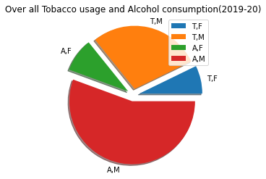
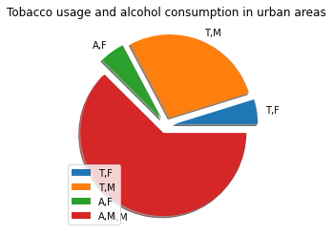
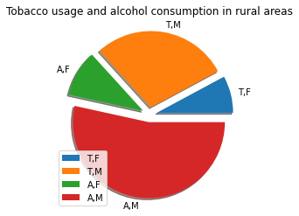
1. Pie chart representation of Percentage of Tobacco usage and alcohol consumption by males and females form 2019-20 in Telangana.
 | T,F = Tobacco consumpfion percentage of females T,M = Tobacco consumpfion percentage among males A,F = Alcohol consumpfion among females A.M = Alcohol consumpfion among males

Slide 6
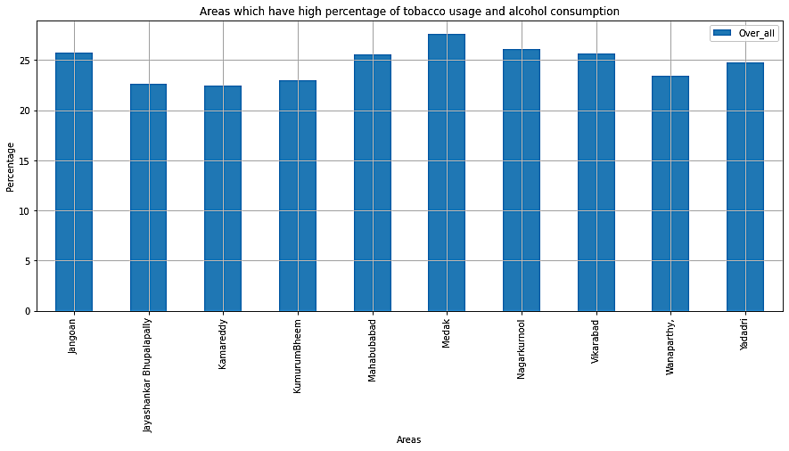
Based on analysis, these are the top ten areas where overall consumption of both tobacco and alcohol is high.
Medak : 27.6,
Nagarkurnool : 26.075
Jangoan : 25.775
Vikarabad : 25.625
Mahabubabad : 25.549
Yadadri : 24.775
Wanaparthy : 23.45
KumurumBheem : 22.975 Jayashankar Bhupalapally : 22.6 Kamareddy : 22.45

Slide 7
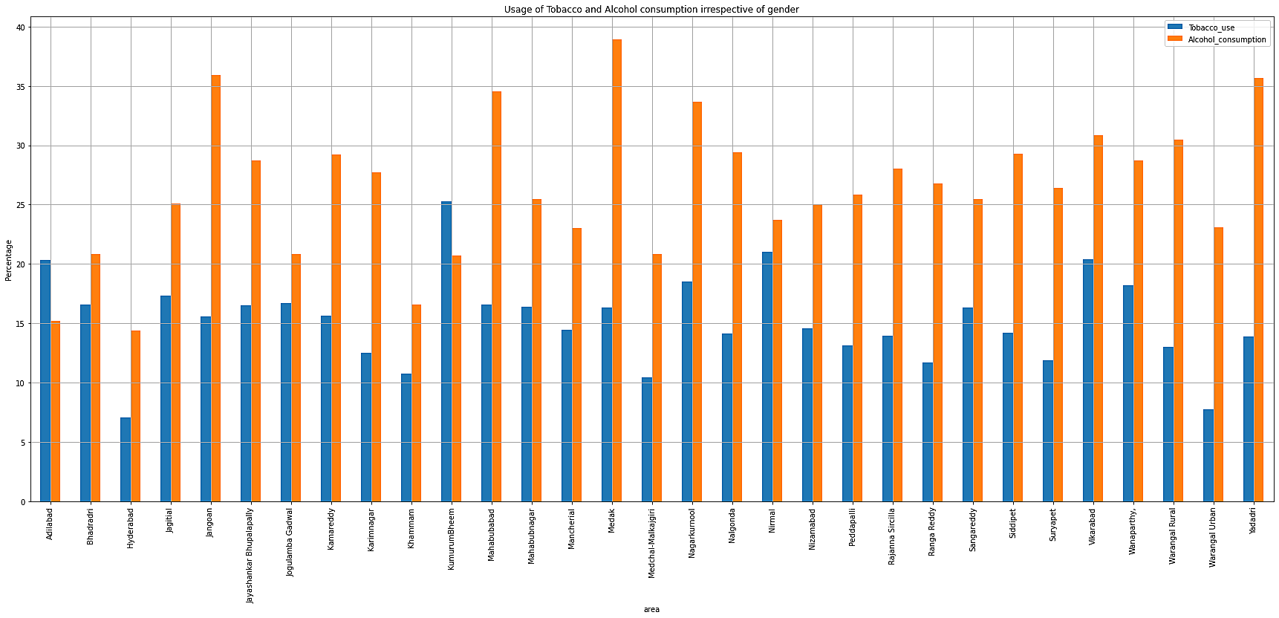
3. Usage of Tobacco and Alcohol consumption irrespective of gender:

Slide 8
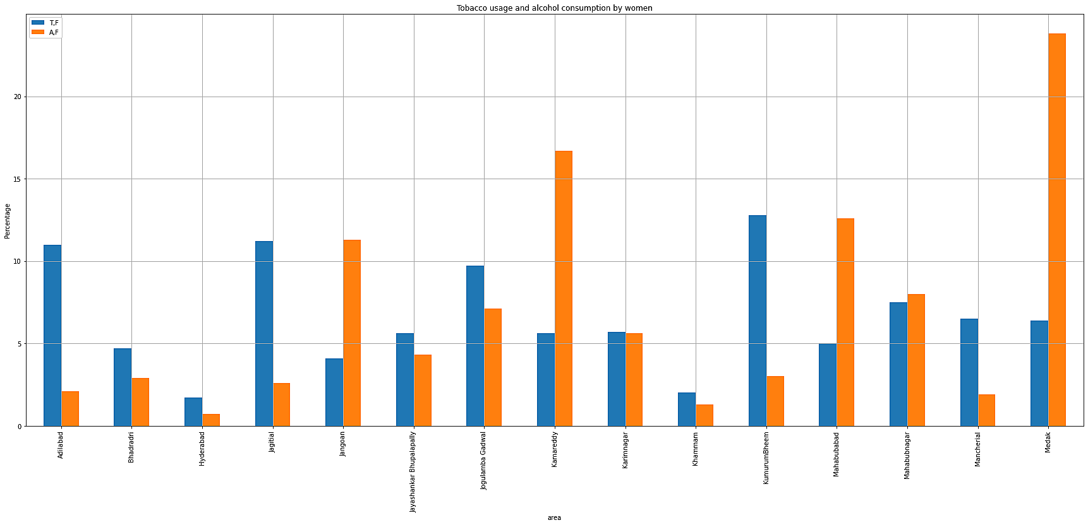
4.Tobacco usage and alcohol consumption by women

Slide 9
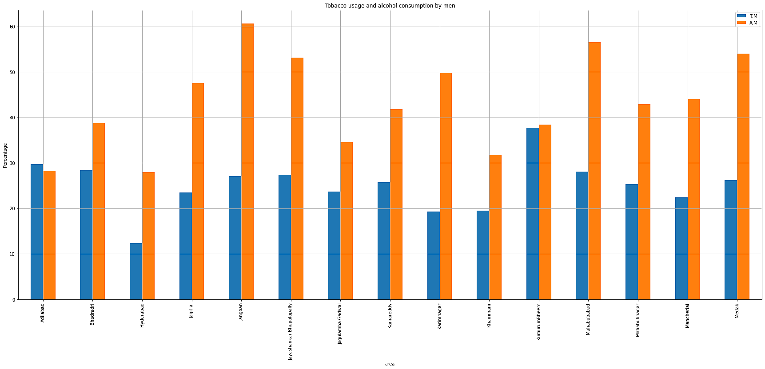
5.Tobacco usage and alcohol consumption by men

Slide 10
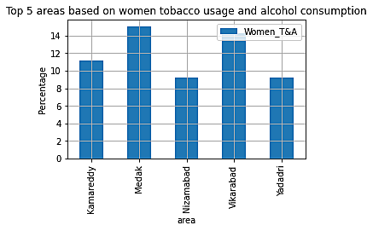
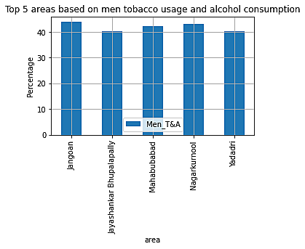
6. Men and Women among both tobacco usage & alcohol consumption:
Top 5 areas where Women’s Tobacco and Alcohol consumpfion percentage is high.
Top 5 areas where Men’s Tobacco and Alcohol consumpfion percentage is high.
Based on the analysis, there are so many areas where GOVT should take measures and control the alcoholic dependence and tobacco usage among people.

Slide 11
CONCLUSION:
This analysis gives a better data visualization on the percentage of Tobacco and Alcohol consumption. Based on our analysis, the ﬁrst ﬁnding is that; In the places like Medak, Nagarkurnool, Kamareddy, etc., there is less control among people. GOVT should monitor and control the sales and quality of Tobacco and alcohol. People at those places should be educated about the harms and diﬃculties they will face by consuming them. Secondly, men are more addicted to them and women percentage is also considerable. This will also aﬀect our future generations and ﬁnally the overall consumption rate is observed visually through the pie charts and bar graphs.
REFERENCES:
1. https://docs.google.com/spreadsheets/d/1DeLYgfnVYtPrNa1nomVzjXHJeFlcz923/edit?u sp=sharing&ouid=105336180941317630214&rtpof=true&sd=true
2. https://matplotlib.org/stable/contents.html

Slide 12
