Slide 1


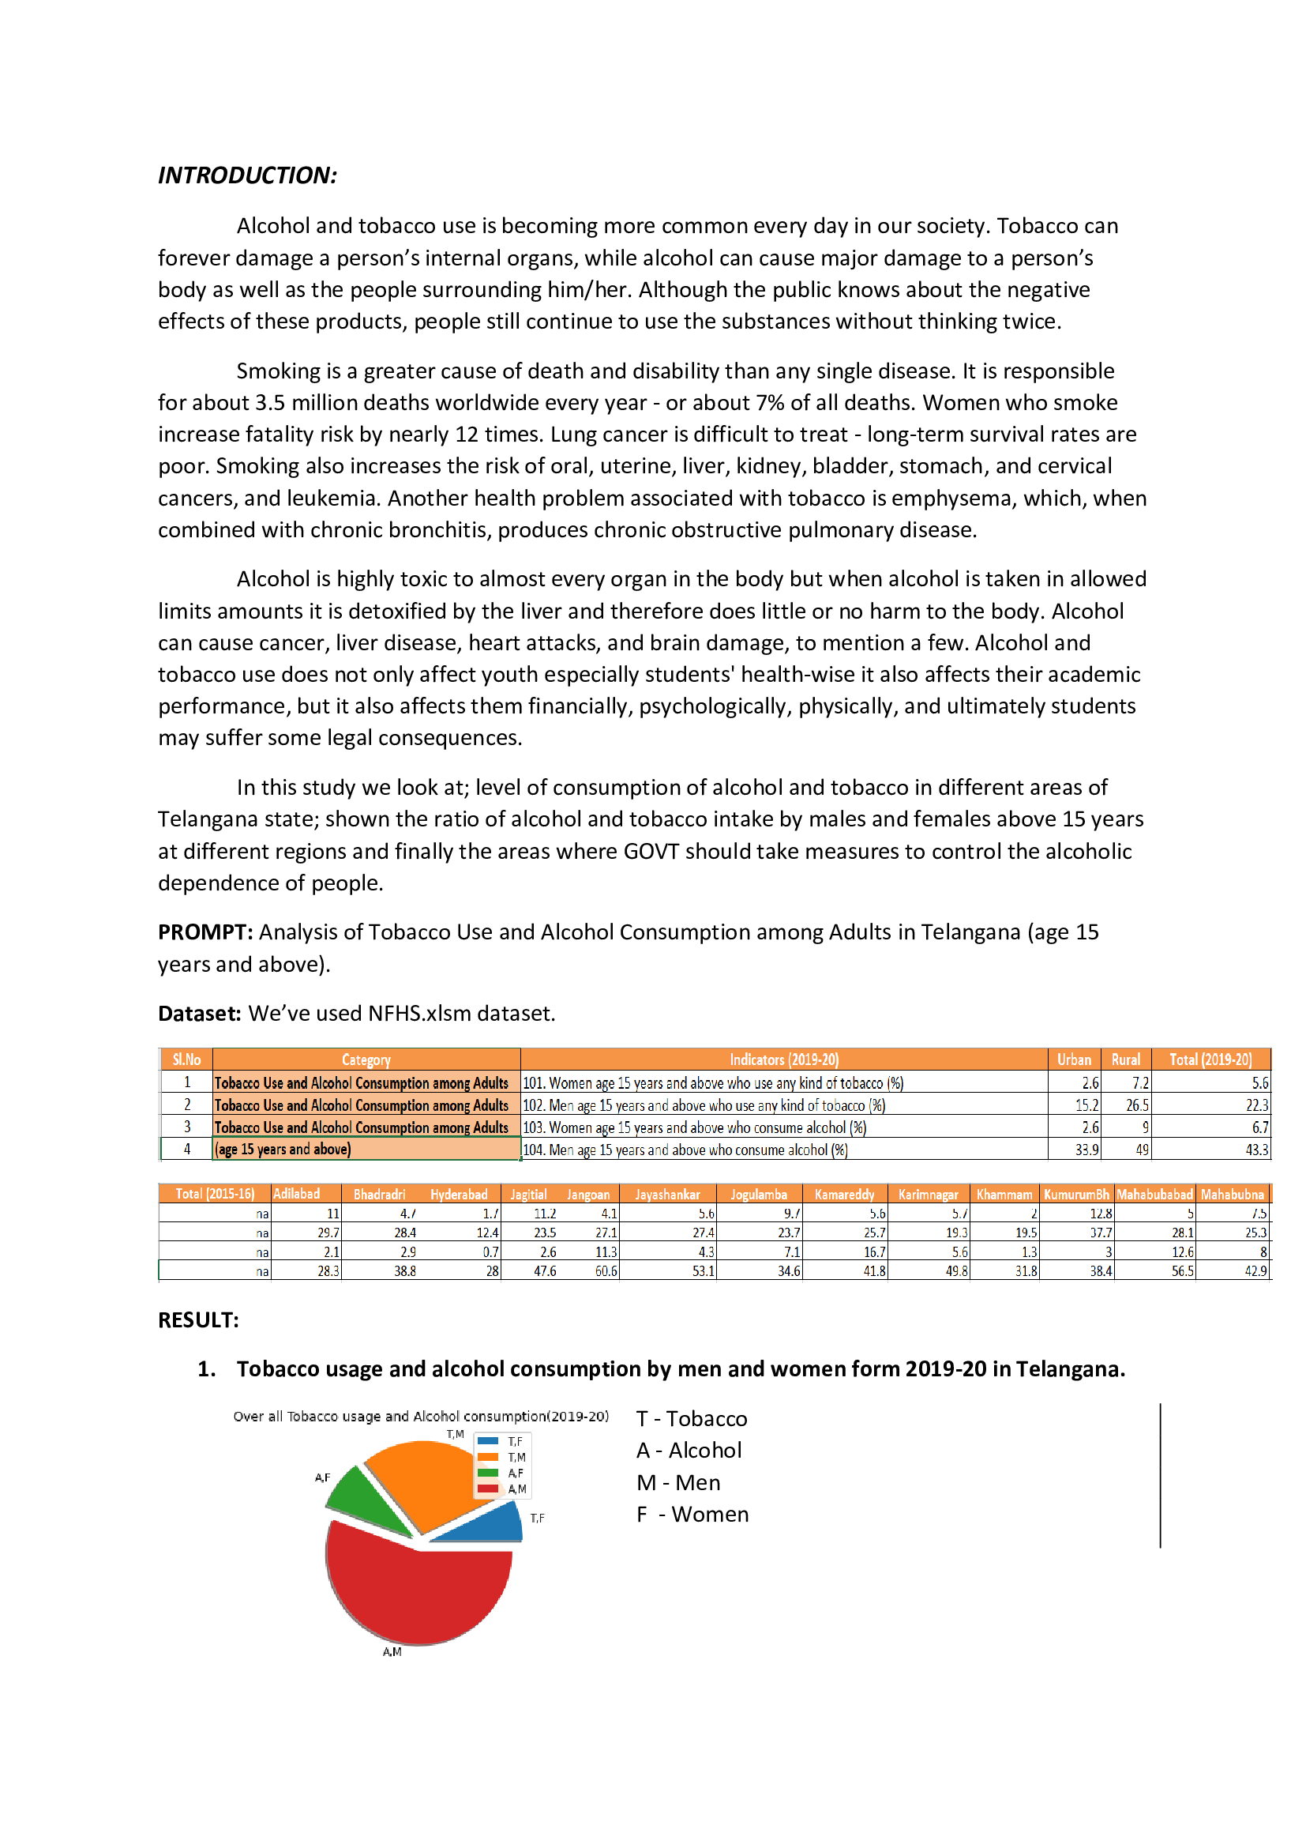
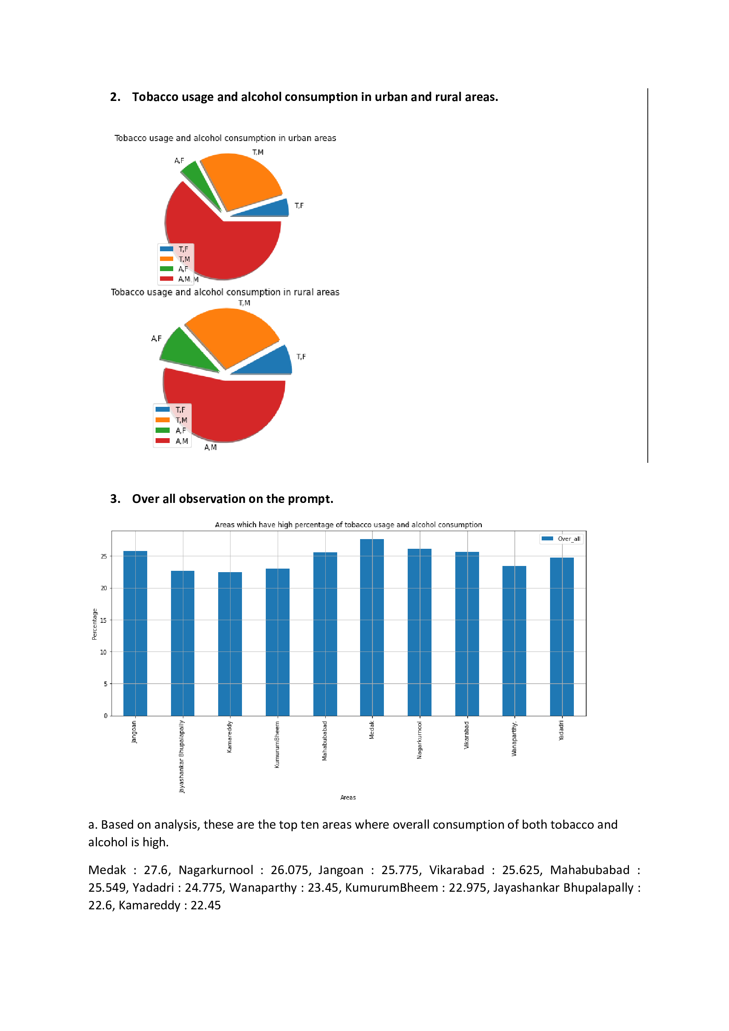
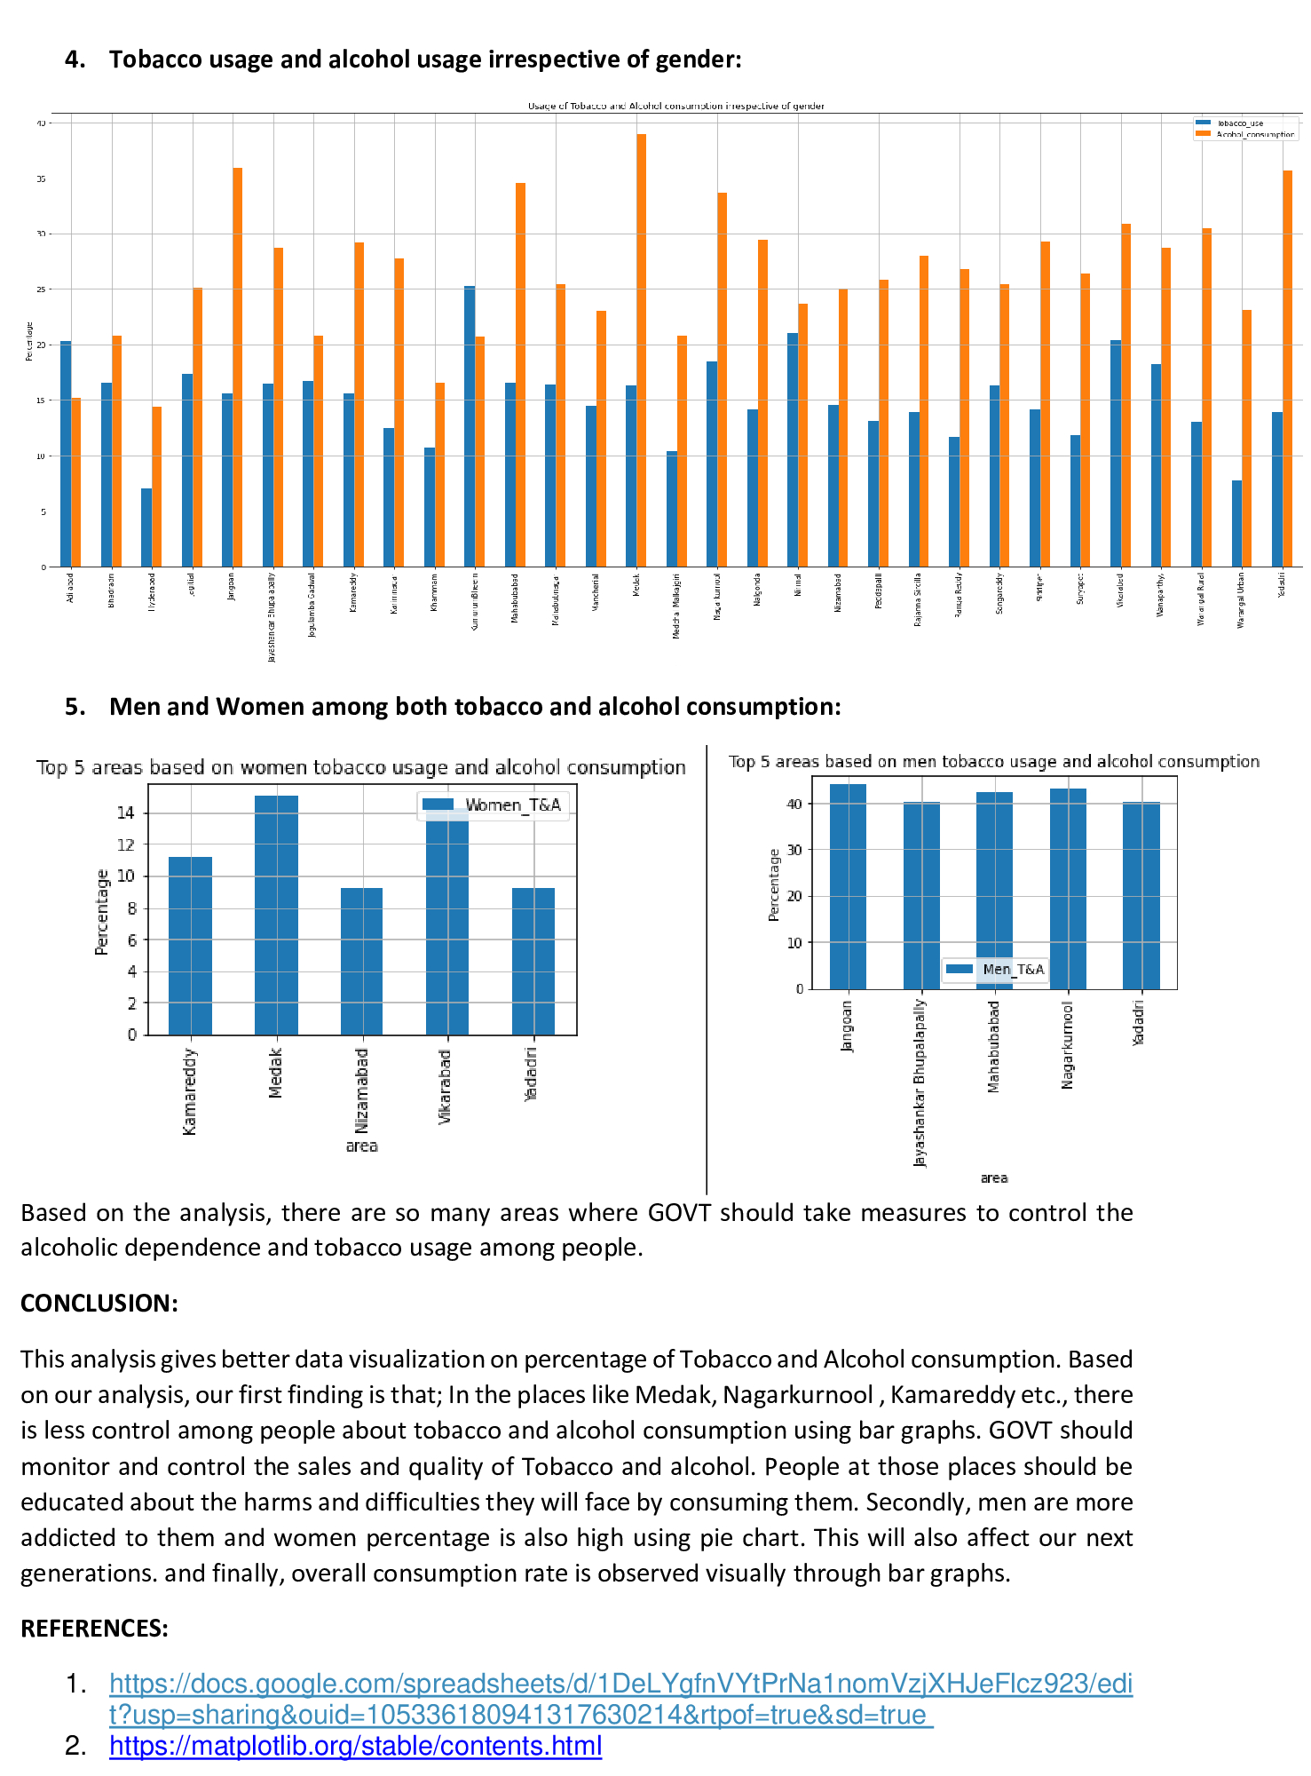
ANALYSIS OF TOBACCO USE AND ALCOHOL CONSUMPTION AMONG ADULTS IN TELANGANA (AGE 15 YEARS AND ABOVE)
Completed by : G Hemanth sai, G Sri Krishna kireeti, Ch Sai charan, T Sai gopi Team: The Variants
GOKARAJU RANGARAJU INSTITUTE OF ENGINEERING AND TECHNOLOGY

