Slide 1


Pyrofalcons
To Manage Rush

Slide 2
Existing Problem :
Cafeteria is one of the stress burster places where everyone comes to spend their time peacefully and to have healthy relationships with their colleagues. .
But due to the unforeseeable rush created in the cafeteria can lead to displeasing experience for people who visit the cafeteria .
These situations may arise stress for the people who run the cafeteria as they have to maintain time management for the customers pleasant service .
The owner has to face loss, food wastage or shortage etc if they are not aware about the rush in advance .

Slide 3
Solution :
To manage the rush , we are going to estimate the present day rush based on previous data using Computer Vision, Linear Regression and Object Detection .
For predicting the customer Rush of each day , the details related to the analytics page till the end of the previous day will be sent to the owner of the Cafeteria via mail.
Notification through mail can be done to the owner on the same day when the Estimated Customer limit of a current day exceeds, which helps them to plan for the next day.

Slide 4
Solution :
The mode of Software Operation can be done in both Automatic and Semi-Automatic (Scheduled Time, Holidays).
The Graphical representation of the rush is also specified for quick identification and to reduce the analysis time.
The Analytical page includes the estimation of customer rush by day wise, week wise and in terms of month .

Slide 5
Services :
1
Analytics Page
Live stream
This shows the live stream of the cafeteria
The Analytics page consist of graphical representation and Past recordings
Graphical Representation
4
The predicted Rush is represented in graphical manner to get a clear idea about the rush
Past Recordings
2
Notifications
Any particular rush of past can also be viewed using the past recordings
The Analytics page details are sent to the owner via mail . And if the predicted rush exceeds an alert mail is sent to the owner .
3
5

Slide 6
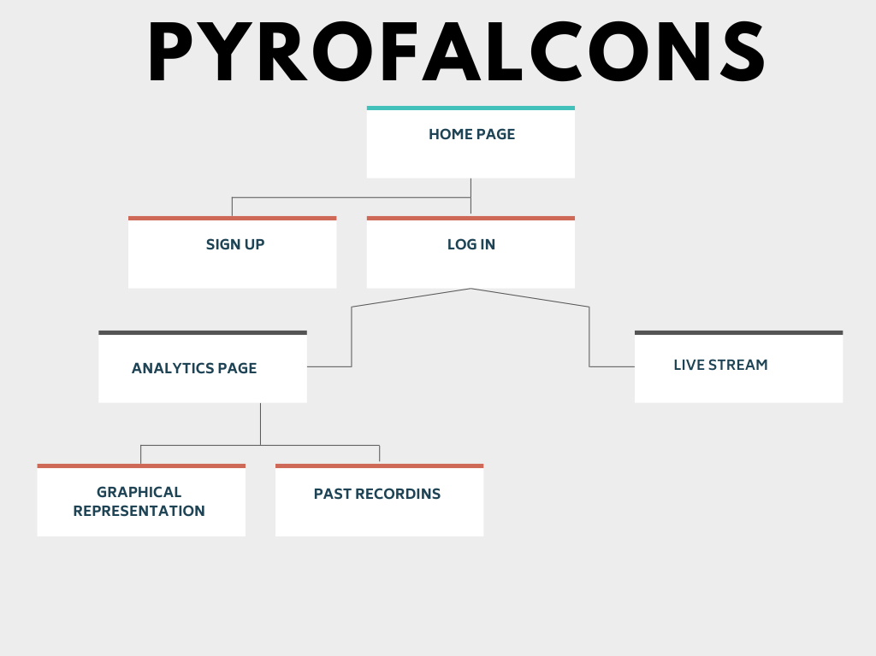
FLOW CHART

Slide 7
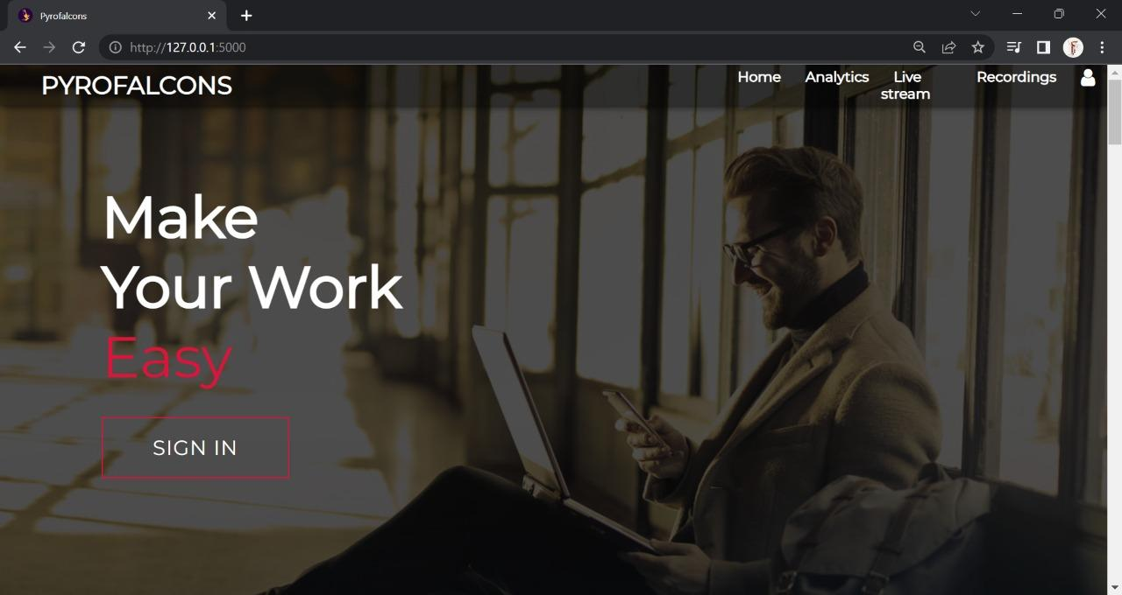
HOME PAGE

Slide 8
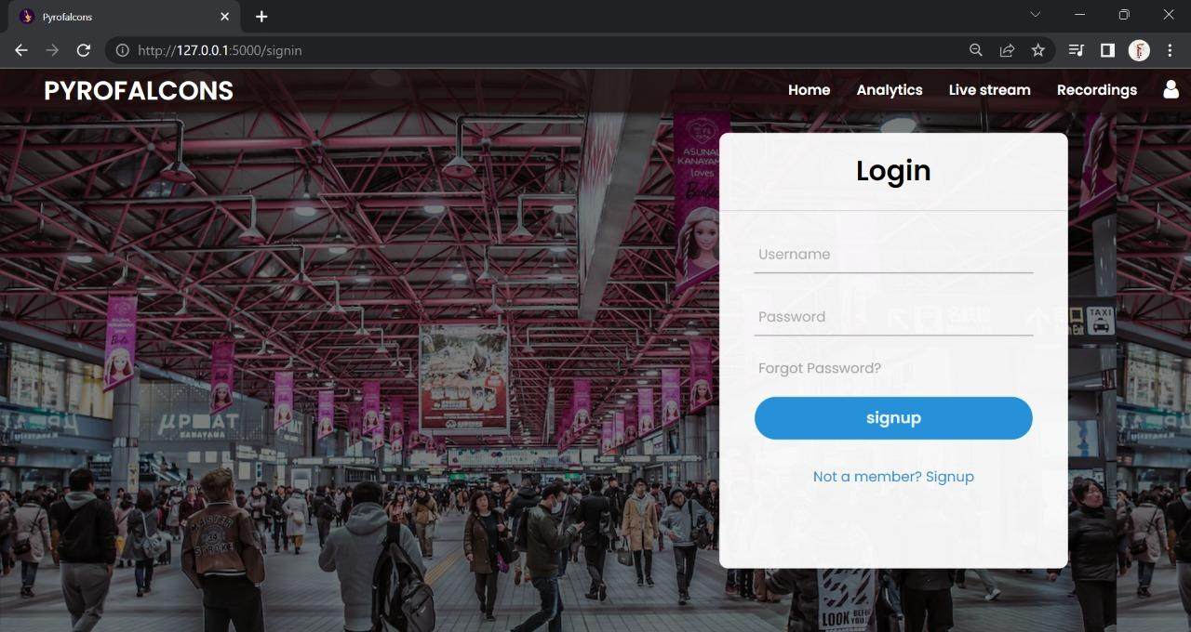
LOGIN PAGE

Slide 9
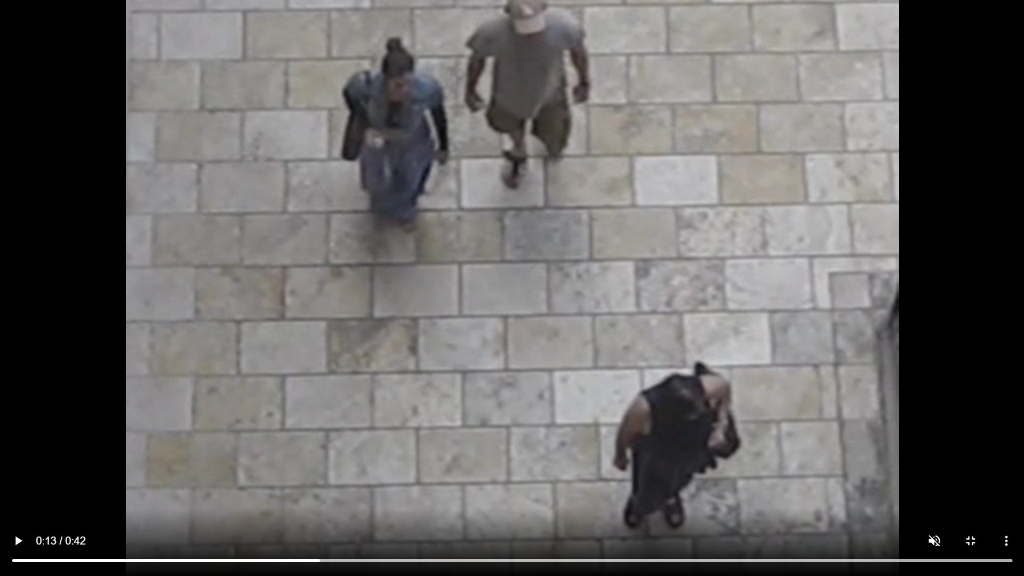
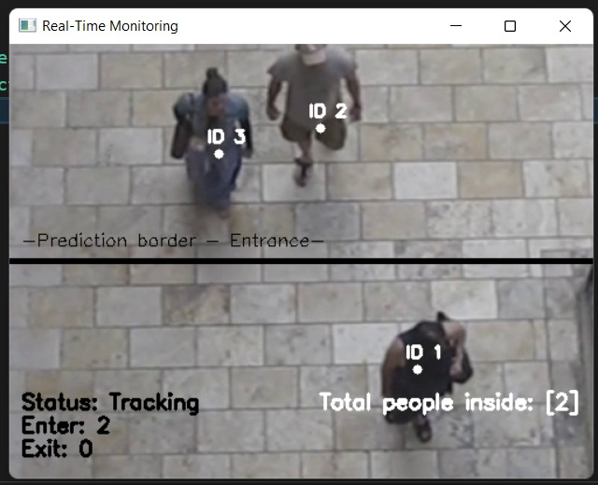
BEFORE DETECTING AFTER DETECTING

Slide 10
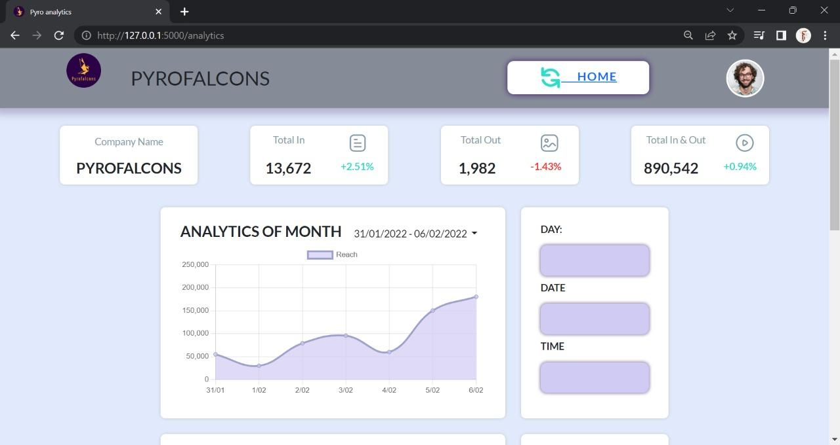
ANALYTICS PAGE

Slide 11
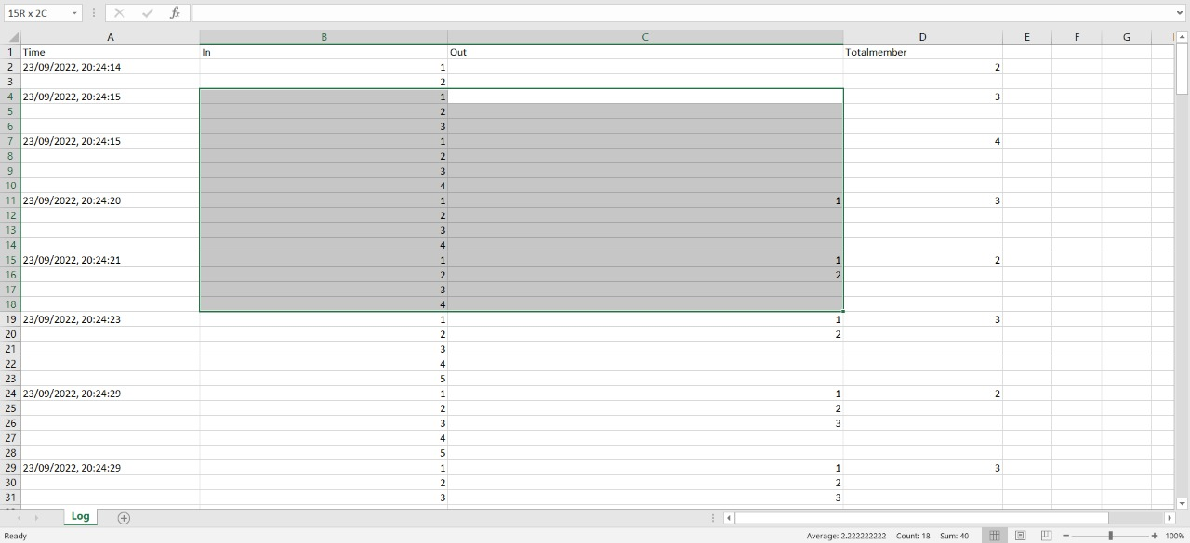
Log File

Slide 12
THANK YOU

