Slide 1

Ai enabled candidate resume screening application
PREPARED BY:
M.SRINIVAS
L.SANDEEP
M.AKHILA
K.JYOSHNA
M.AMULYA

Slide 2

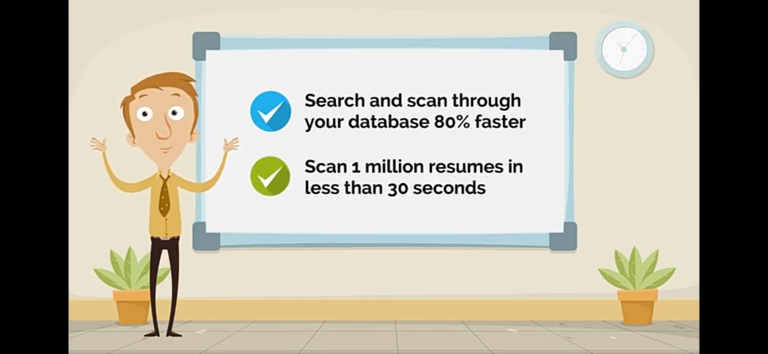
Why companies use AI resume screening tools?
As is the case with a lot of repetitive, time-consuming work, it can literally pay to find ways to become more efficient, and HR tasks are no exception. ... That's the main idea behind automatically pre-screening resumes based on certain criteria.

Slide 3
BLOCK DIAGRAM
Location of Resumes
Web Application
Tech support
Stack Developer
Lead Developer
Select Domain
Give Skill Set Requirement
Oracle
Java
Python
Final Status
Name, Experience, Email-id, Phone no. etc
SELECTED
REJECTED

Slide 4
STEPS FOR DOING RESUME SCREENING
1. Installing Python IDE. Here the priority is Anaconda.
2.Importing the required libraries for the model to run.
3.Downloading the dataset and feeding it to the model.
4.Data pre-processing – if there any null values.
5.Converting the strings into the binary format by using Label Encoding
and One Hot Encoding.
6.Dividing the model into Train and Test data.
7.Fitting the model (train dataset).
8.Predicting the Case Status.

Slide 5
INSTALLING REQUIRED IDE(integrated development environment ) with python packages
First we need to install Anaconda/ PyCharm IDE is Ideal to complete this project
We need to install the following packages:
1.Numpy: This package is used to perform numerical computations.
This package is pre-installed in anaconda.
2.Pandas: Pandas is one of the most widely used python libraries in data science.
It provides high-performance, easy to use structures, and data analysis tools.
This package is pre-installed in anaconda.
3.Matplotlib: Matplotlib is a comprehensive library for creating static, animated,
and interactive visualizations in Python. This package is pre-installed in anaconda.
4.Scikit-learn: This is a machine learning library for the Python programming
language. This package is pre-installed in anaconda.
5.Flask: Flask is a lightweight WSGI web application framework.
6.Tensorflow.
7.Keras.
8.Pyresparser.

Slide 6
Data Collection and Preprocessing
1.ML depends heavily on data, without data, it is impossible for an “AI” to learn. It is the
most crucial aspect that makes algorithmtraining possible. In Machine Learning projects,
we need a training data set. It is the actual data set used to train the model for
performing various actions.
2.Data pre-processing is a process of cleaning the raw data i.e. the data is collected in the
real world and is converted to a clean data set.In other words, whenever the data is
gathered from different sources it is collected in a raw format and this data isn’t feasible
for the analysis.
3.Therefore, certain steps are executed to convert the data into a small clean data set, this
part of the process is called as data pre-processing Follow the following steps to process
your Data
4.Import the Libraries
5.mporting the dataset
6.Taking care of Missing Data
7.Label encoding
8.One Hot Encoding
9.Feature Scaling
10.Splitting Data into Train and Test

Slide 7
MODEL BUILDING
There are several Machine learning algorithms to be used depending on the data
you are going to process such as images, sound, text, and numerical values.
The algorithms that you can choose according to the objective that you might
have it may be Classification algorithms are Regression algorithms. As the
dataset which we are using is a Regression dataset so you can use the following
algorithms
Linear Regression.
Logistic Regression.

Slide 8
TRAINING AND SAVING THE MODEL
1.Once after splitting the data into train and test, the data should be fed
to an algorithm to build a model.
2.The machine learning algorithms used for this model here is Linear
Regression. The Random Forest Classifier is a set of decision trees from
a randomly selected subset of the training set. It aggregates the votes
from different decision trees to decide the final class of the test object.
3.After building the model we have to save the model
4.Pickle in Python is primarily used in serializing and deserializing a Python
object structure. In other words, it's the process of converting a Python
object into a byte stream to store it in a file/database, maintain program
state across sessions or transport data over the network. wb indicates the
write method and rd indicates the read method.

Slide 9
BUILDING FLASK WITH WEB PAGES
Let us build flask file ’PAE_Flask.ipynb’ which is a web framework written in python for
server-side scripting. Let’s see step by step procedure for building the backend application.
1.You can also run this on spyder, given as app.py
2.App starts running when “__name__” constructor is called in main.
3.Render_template is used to return html file.
4.“GET” method is used to take input from the user.
5.“POST” method is used to display the output to the user.
6.A webpage is created as “form.html” for predictin

Slide 10
TRAINING OF MODEL IN IBM CLOUD
For training the model in IBM cloud you need to create an account
in IBM
After Registration , Login into your IBM account
There includes two steps in training :
1. Train the Machine learning model to IBM
2. Integrate Flask with IBM with scoring end point

Slide 11
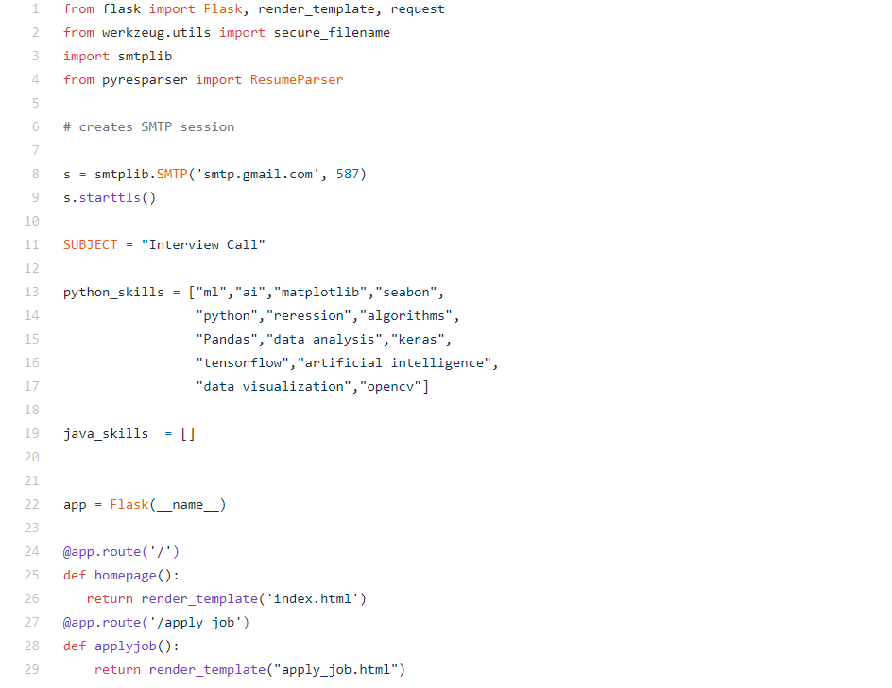

Slide 12
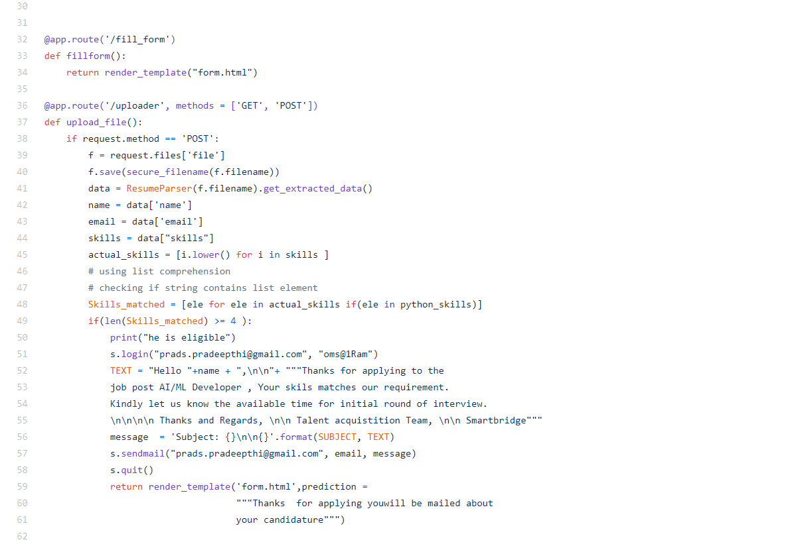

Slide 13
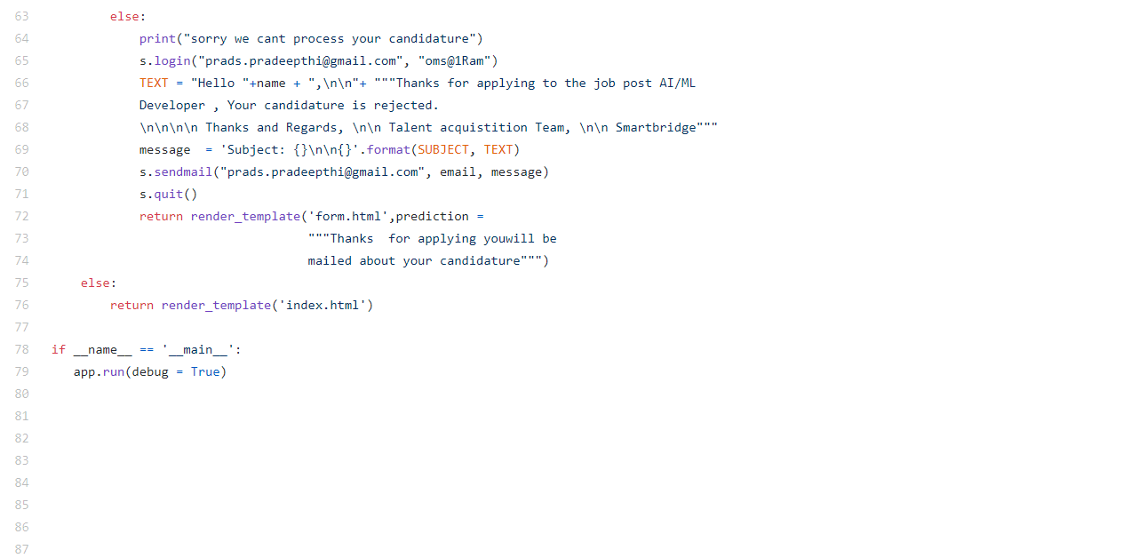

Slide 14
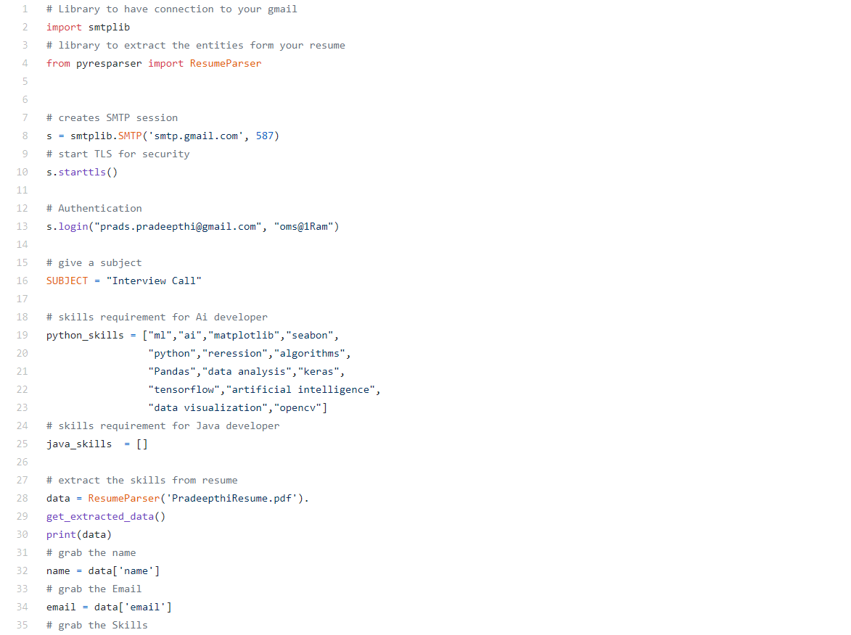

Slide 15
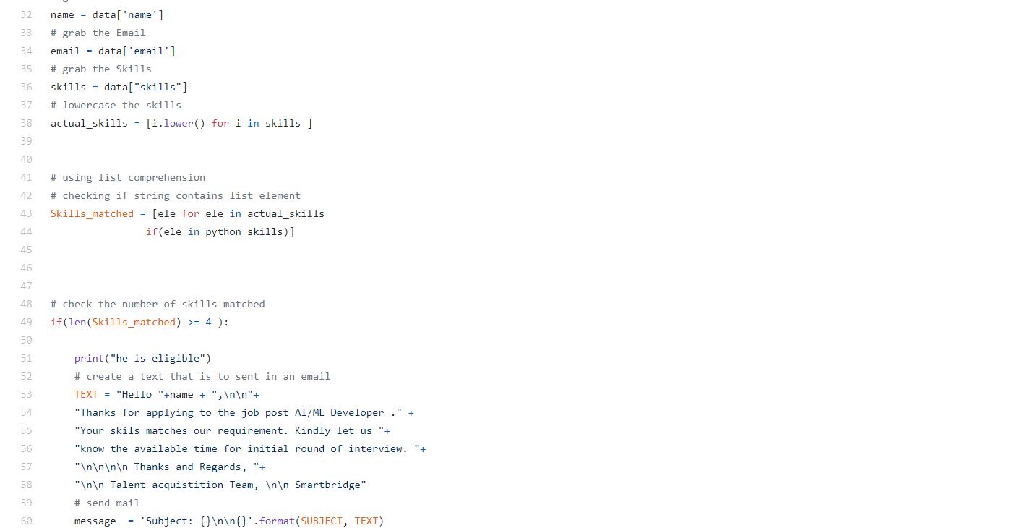

Slide 16
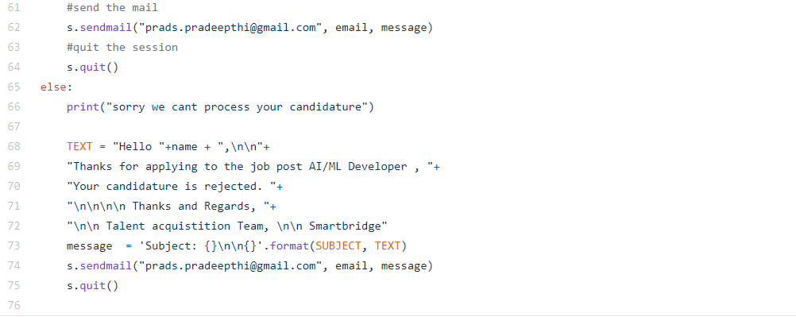

Slide 17
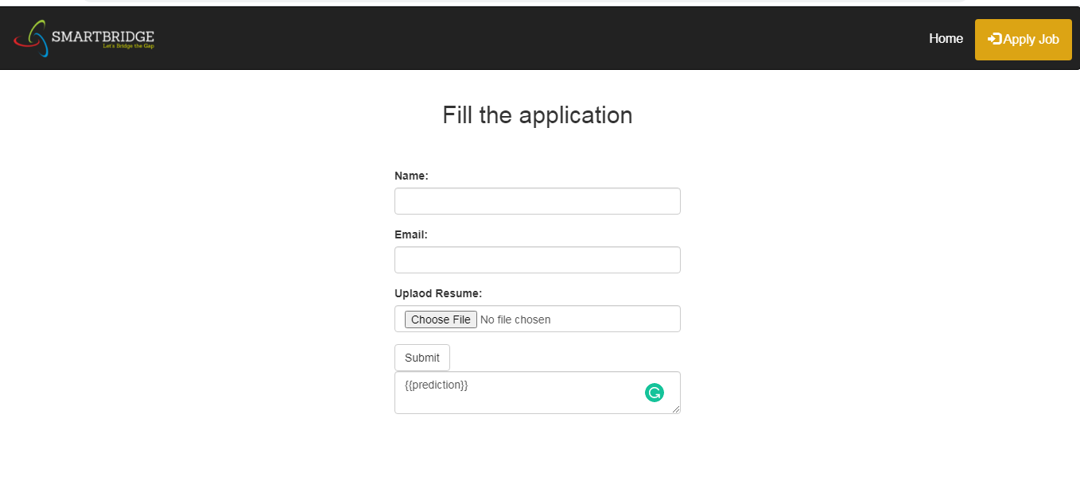
Input form

Slide 18
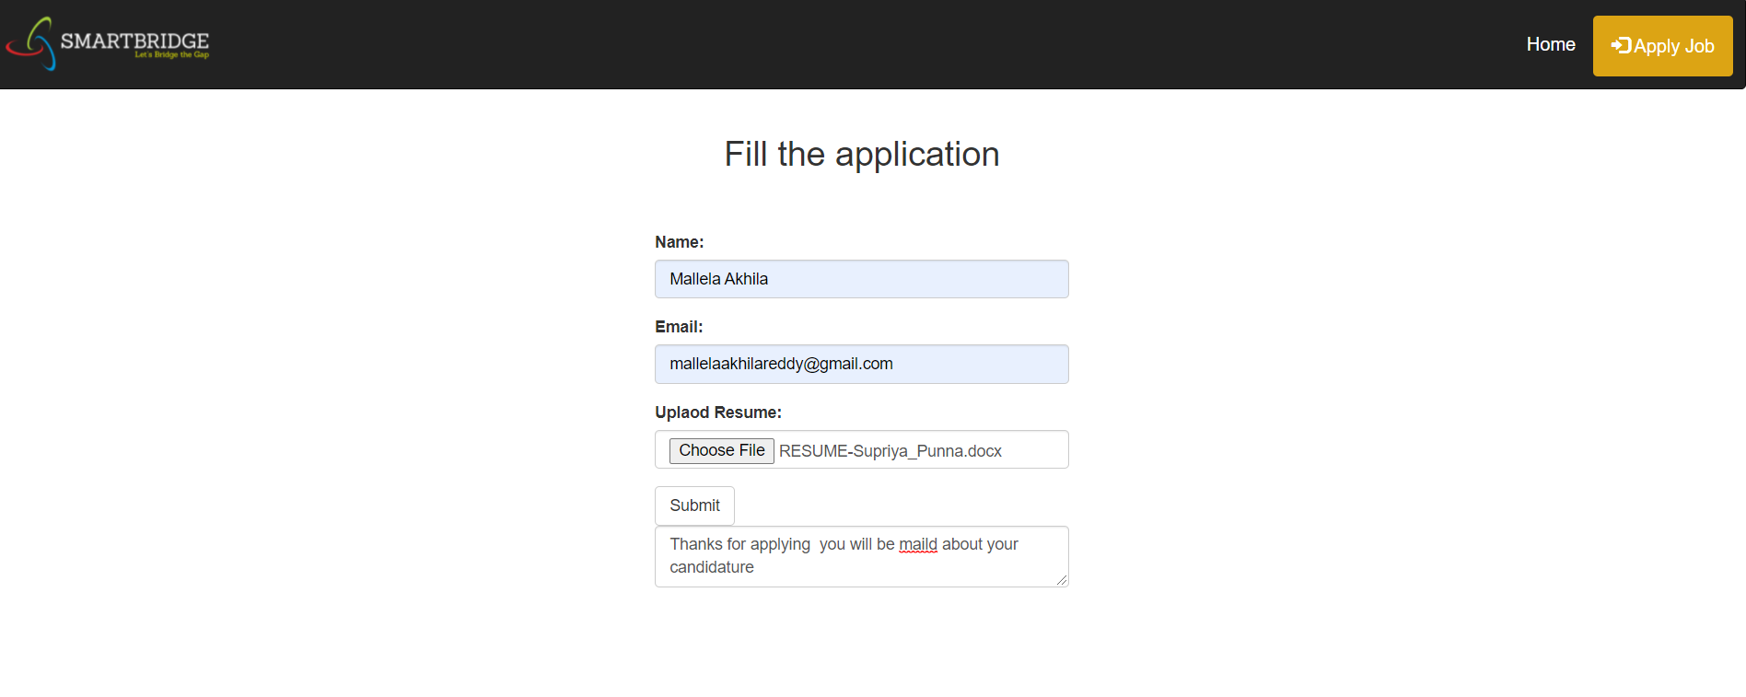
EXPECTED OUTPUT
FORM

Slide 19
Using AI in recruitment – Pros vs Cons
Pro: Efficient and time-effective hiring
Pro: Providing recruiters with an improved quality of candidates
Pro: Improved and quicker experience for the candidates
Con: Not immune from human biases
Con: Issues of accuracy can happen
Con: Lack of human judgement
Conclusion: Highly useful but prepare for the flaws

Slide 20

Thank you

