Slide 1

Sentiment Analysis Of Customer Feedback On Restaurants Using IBM Cloud
ECE Team -13
TEAM MEMBERS:-
G. SHIRISHA – 19R11A04B1
G.NITISH KUMAR-19R11A04B2
K.W.SAMUEL – 19R11A04B4
K.UDAYSRI – 19R11A04C0
M.ADHITHYA – 19R11A04C2

Slide 2

CONTENTS
INTRODUCTION
LITERATURE SURVEY
THEORITICAL ANALYSIS
EXPERIMENTAL INVESTIGATIONS
FLOWCHART
RESULT
CONCLUSION

Slide 3
INTRODUCTION
Most of the customers will follow and choose the best restaurants on the basis of reviews and ratings. So reviews Play a Crucial Role in any model or system. The approach to this problem is based on review text content analysis and uses the principles of natural language process (the NLP method) and Machine learning. After applying the above method we can classify whether it is a positive review or negative review and can also visualize the total no of positive reviews and negative reviews.
A. Social Media
Make sure that we all using some sort of social media and having a page on facebook makes our venue rateable and courages from a people to tag more people when they all having their rating food. People will post on some sorts.
B. Google
Now a days it has become a number one position and second position is a food online reviews. Food sites focus more on reviews.
C. Yelp
Yelp ranks has a second 45.18 percent followed by some many people and by trip advisor. The popularity is getting more on third party review sites like google, facebook, yelp, and trip advisor is driven by customers’ genuine desire to engage with their businesses.

Slide 4
LITERATURE SURVEY
C. D. Manning, M. Surdeanu, J. Bauer, J. R. Finkel, S. Bethard, and D. McClosky has proposed “Stanford corenlp natural language processing toolkit” the proposed work describe the design and use of the Stanford Core NLP toolkit, an extensible pipeline that provides core natural language analysis. This tool kit is quite widely used, both in the research NLP community and also among commercial and government users of open source NLP technology. The method suggest that it follows from a simple, approachable and easy design, which can be straightforward interfaces, the inclusion of robust and in the good quality analysis components, and not to requiring use of a large amount of associated baggage. The approached method defines the design and development of stanford Core NLP, and gives the common core natural language processing steps, from the tokenization.

Slide 5
HARDWARE AND SOFTWARE DESIGNING:
In order to develop this project we need to install the following software/packages:
Anaconda Navigator :
Anaconda Navigator is a free and open-source distribution of the Python and R programming languages for data science and machine learning related applications. It can be installed on Windows, Linux, and macOS.Conda is an open-source, cross-platform, package management system. Anaconda comes with so very nice tools like JupyterLab, Jupyter Notebook,
QtConsole, Spyder, Glueviz, Orange, Rstudio, Visual Studio Code. For this project, we will be using Jupyter notebook and Spyder

Slide 6
To build Deep learning models you must require the following packages
Tensor flow: TensorFlow is an end-to-end open-source platform for machine learning. It has a comprehensive, flexible ecosystem of tools, libraries, and community resources that lets researchers push the state-of-the-art in ML and developers can easily build and deploy ML-powered applications.
Keras: Keras leverages various optimization techniques to make high-level neural network API easier and more performant. It supports the following features:
Consistent, simple, and extensible API.
Minimal structure - easy to achieve the result without any frills.
It supports multiple platforms and backends.
It is a user-friendly framework that runs on both CPU and GPU.
Highly scalability of computation.
Flask: Web framework used for building Web applications

Slide 7
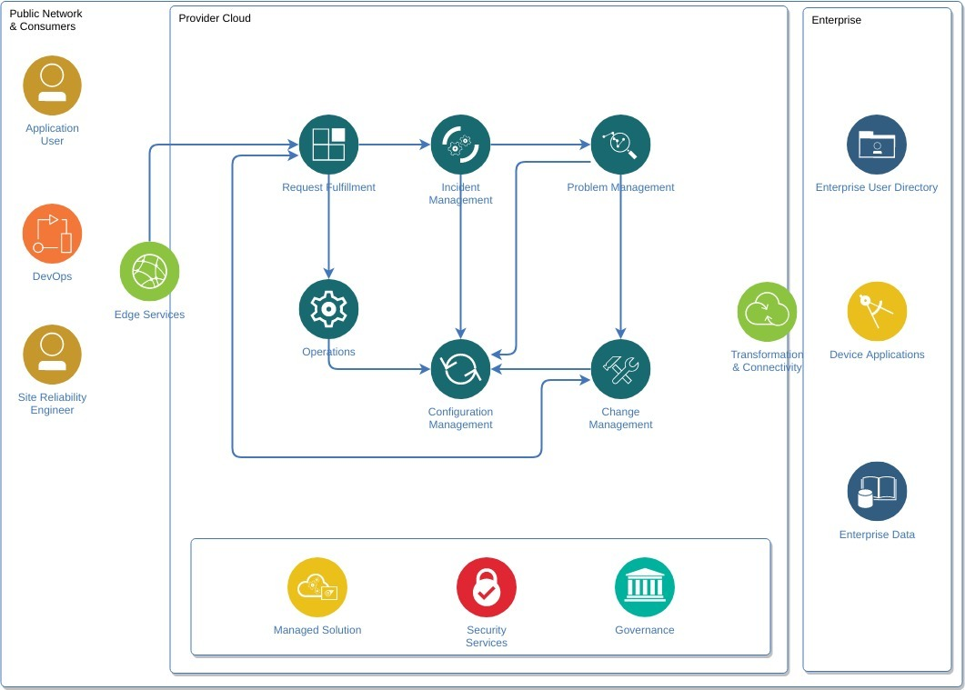
THEORITICAL ANALYSIS:

Slide 8
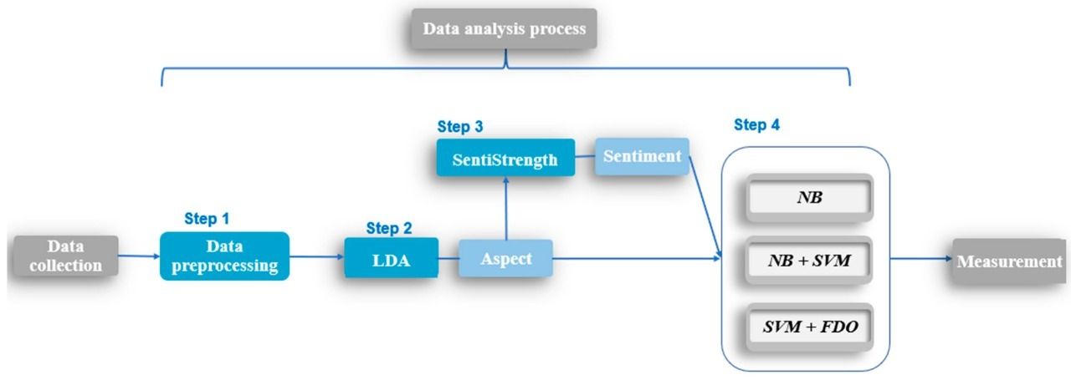
BLOCK DIAGRAM

Slide 9
EXPERIMENTAL INVESTIGATIONS:
While working on the solution we have investigated the following topics
Supervised and unsupervised learning
Regression Classification and Clustering
Artificial Neural Networks
Natural Language Processing
Flask app
LSTM and GRU

Slide 10
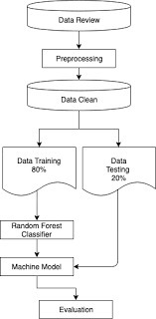
FLOW CHART:

Slide 11
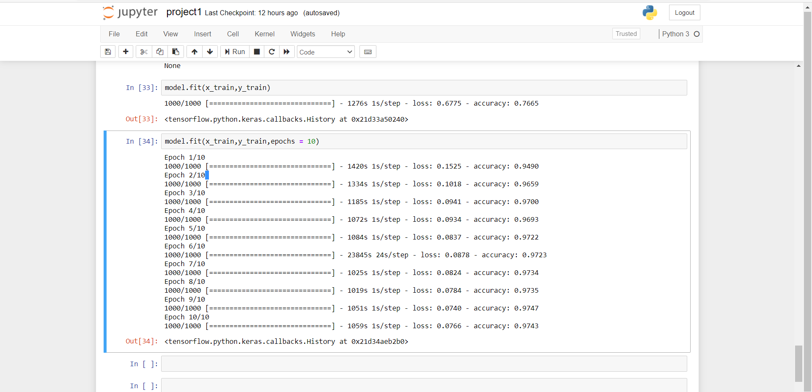
RESULT:
Result after model building:

Slide 12
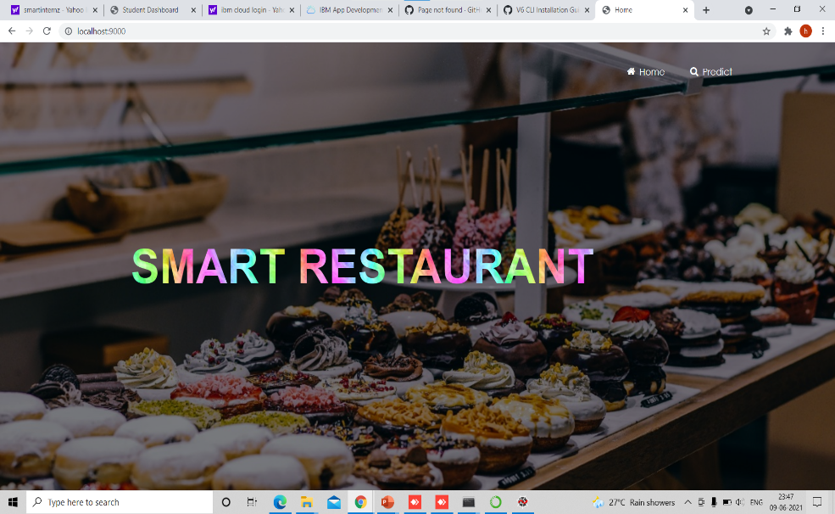
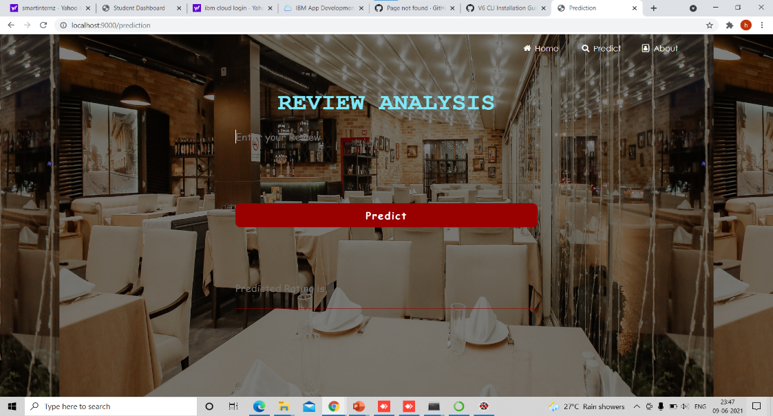
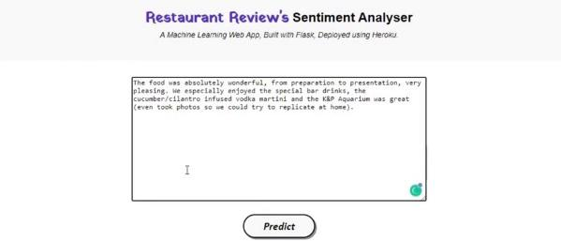
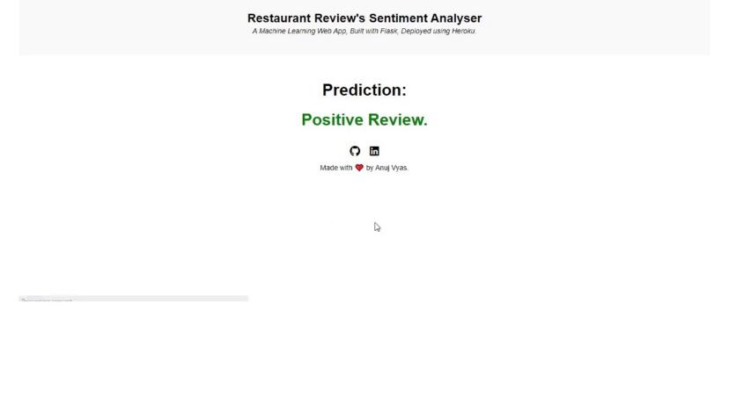

Result after web application:

Slide 13
CONCLUSION:
We have built an machine learning model that is integrated to the model we built.
A UI is provided for the uses where he has to enter the values for predictions. The enter values are given to the saved model and prediction is showcased on the UI.
The built application is integrated with 3 html pages
1.home
2.prediction
3.Project Data

Slide 14

THANK YOU

