Slide 1

Financial Risk Prediction using IBM Auto AI
PROJECT TITLE

Slide 2
TEAM : IT – 04
* Soundarya - 19R11A1218
* Nishanth - 19R11A1219
* Prasoona - 19R11A1220
* Govtham - 19R11A1221
* Mounika - 19R11A1222

Slide 3

INTRODUCTION:
* The goal of the project is creating predictions that can be used in different scenarios. It focuses on predicting fraudulent transactions, which can reduce loss and risk by building a web application.
* Using IBM AutoAI, we automate all of the tasks involved in building predictive models for different requirements. We create a model from a data set that includes the gender, married, dependents, education, self-employed, applicant income, com-applicant income, loan amount, loan term, credit history, housing, and locality.

Slide 4
OBJECTIVES OF THE PROJECT:
In this project we will learn:
* How to Work with Watson Studio
* How to Create a project in Watson Studio
* How to Use Auto Ai experiment to create a model
* How to Deploy the ML model as a webserver
* How to Integrating Model and Node-RED Service
* How to Build an Application using Node-RED which takes inputs from the user and showcases the prediction on UI

Slide 5
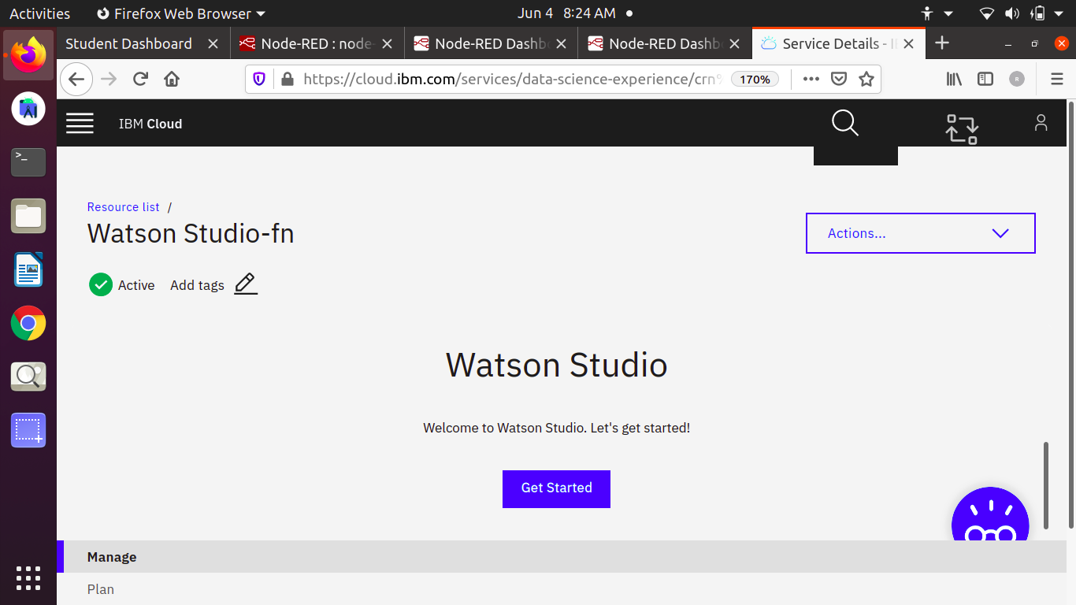

Slide 6
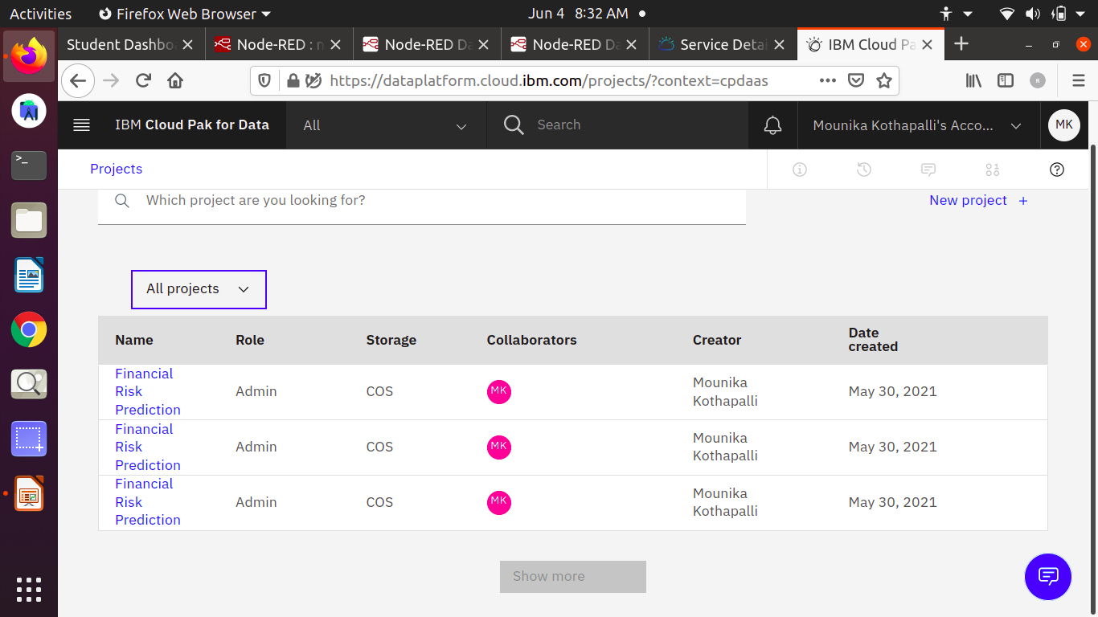

Slide 7
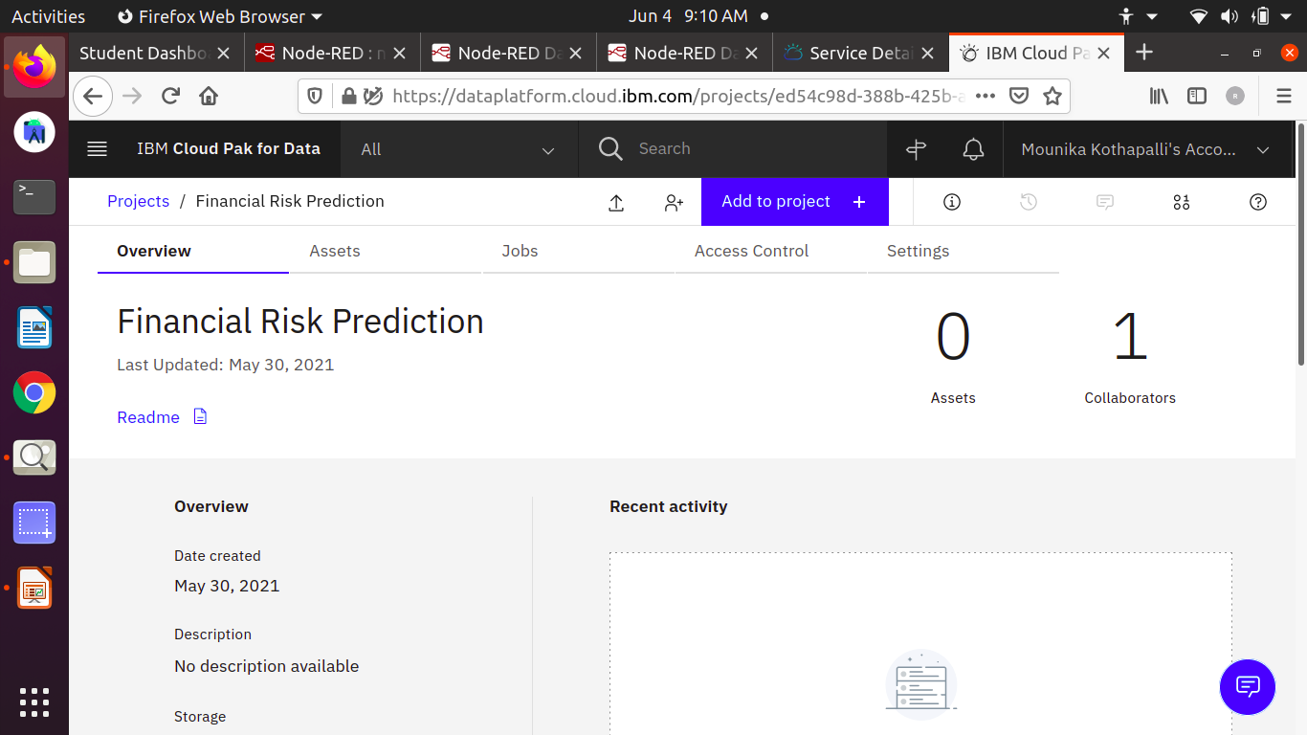

Slide 8
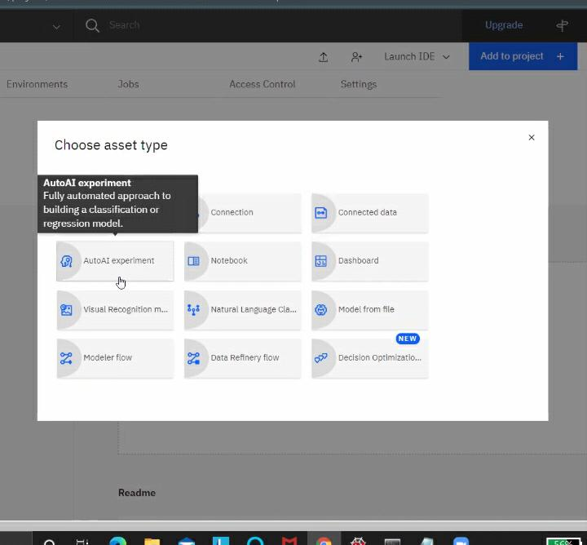

Slide 9
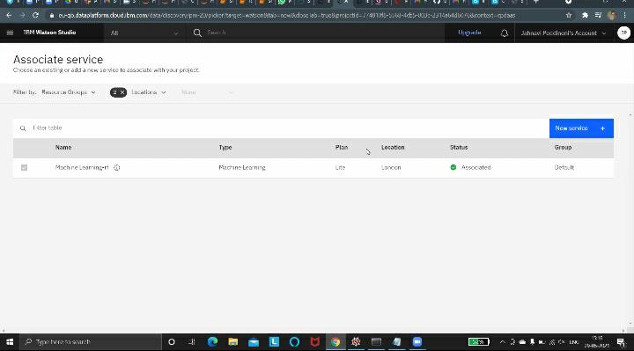

Slide 10
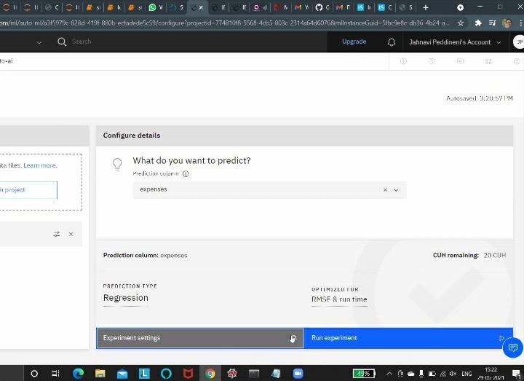
Fraud_Risk
Fraud_Risk

Slide 11
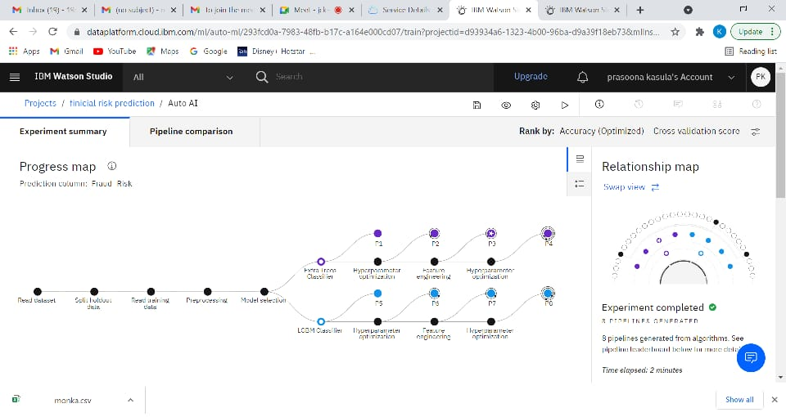

Slide 12
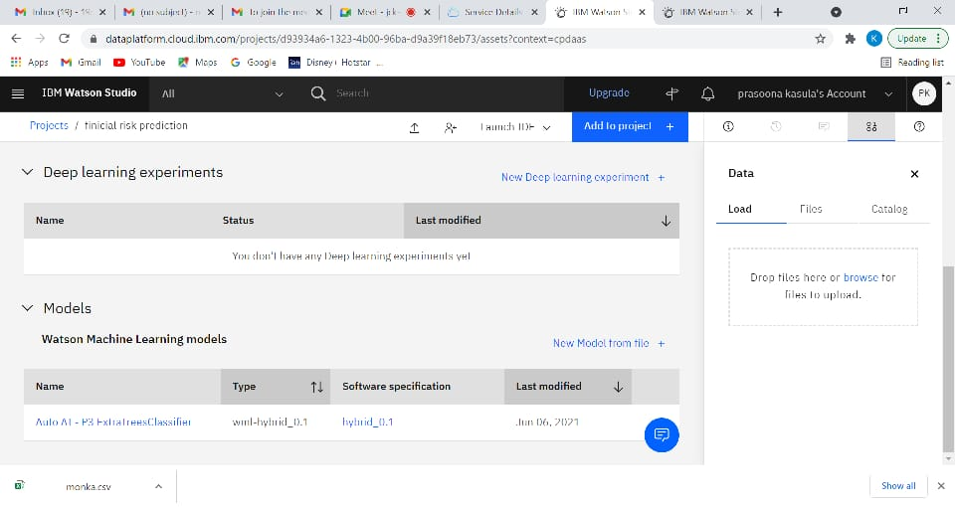

Slide 13
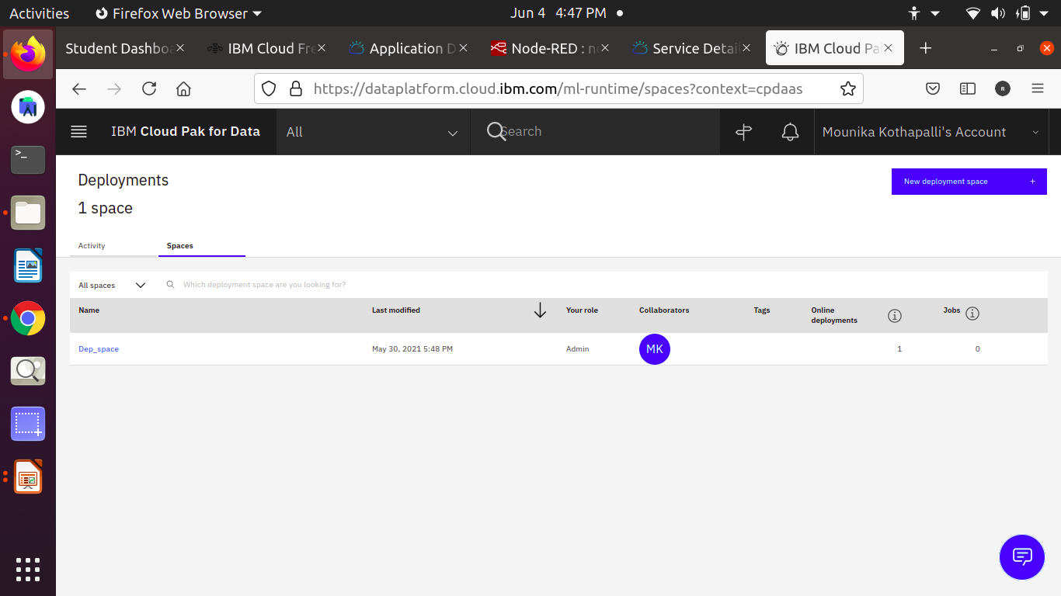

Slide 14
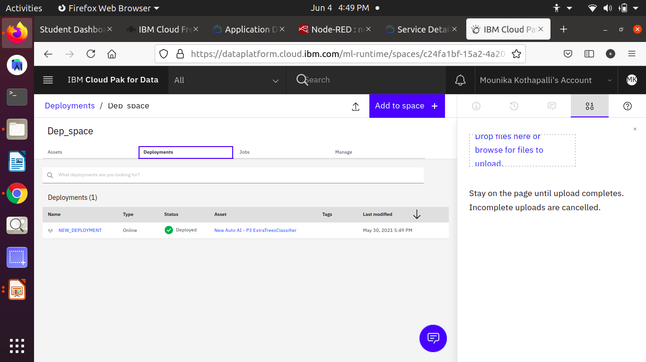

Slide 15
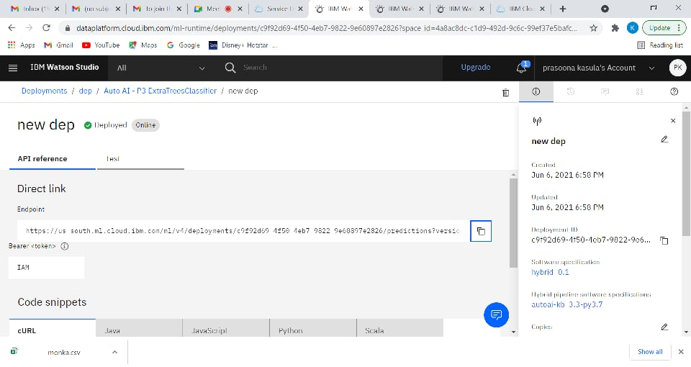

Slide 16
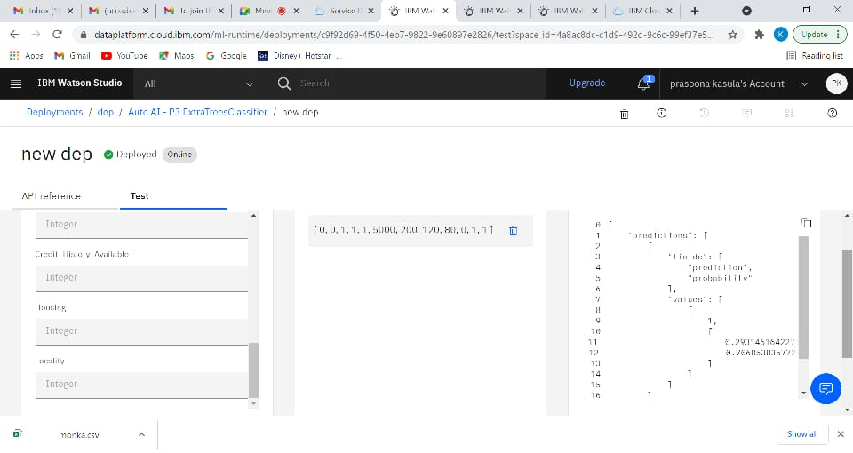

Slide 17
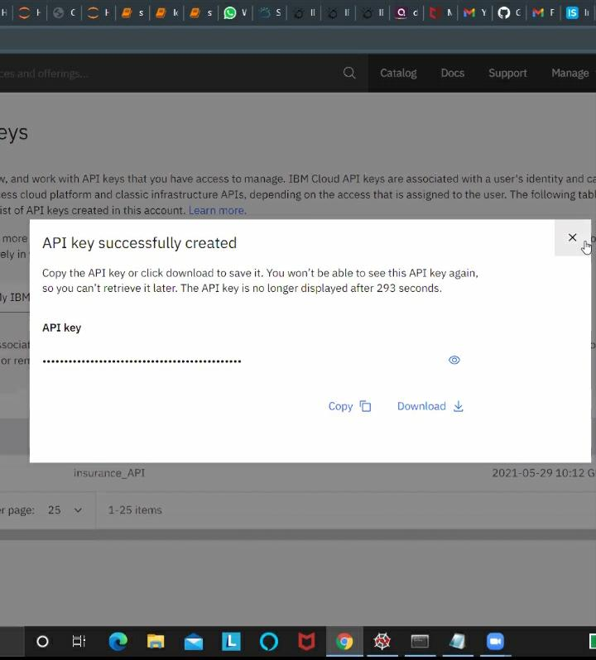

Slide 18
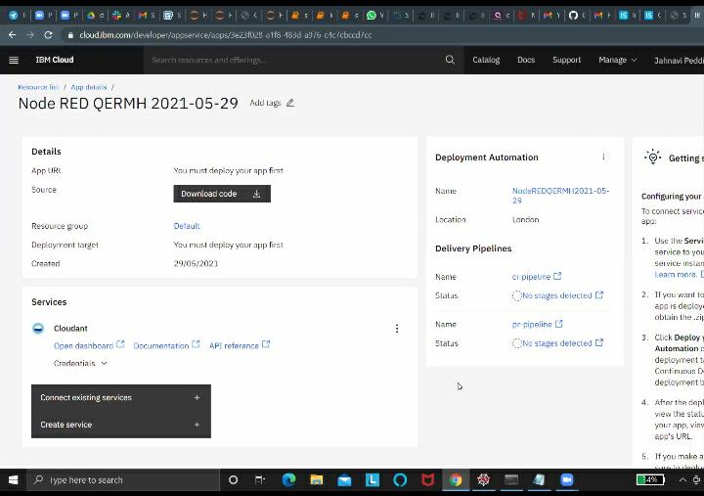

Slide 19
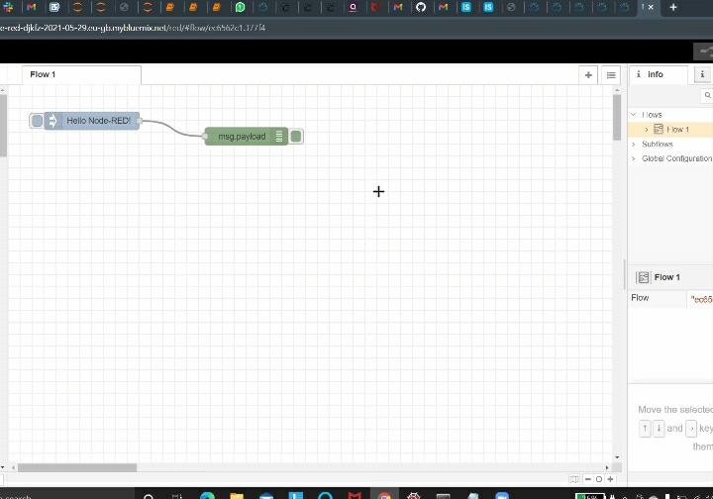

Slide 20
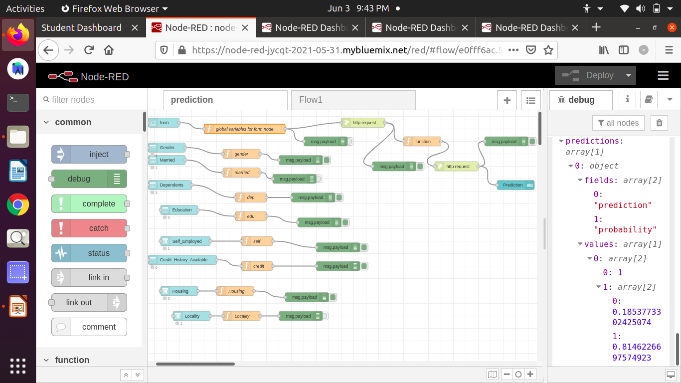

Slide 21
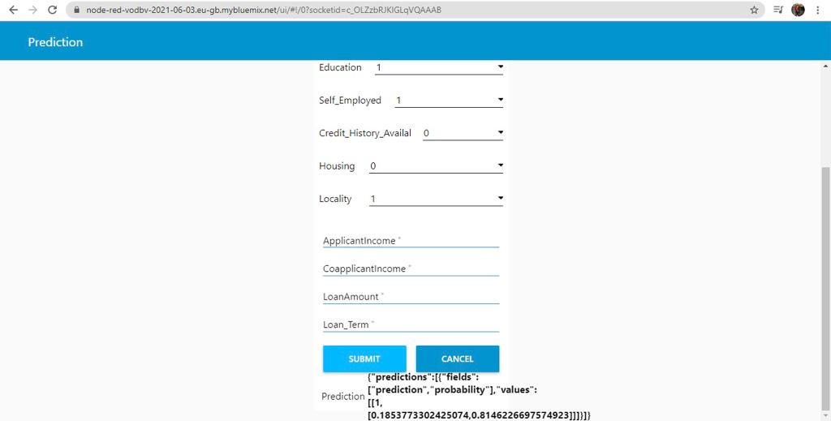

Slide 22

]]

