Slide 1


PROJECT TITLE
Financial Risk Prediction Using IBM Auto AI

Slide 2
TEAM : IT – 04
* Soundarya - 19R11A1218
* Nishanth - 19R11A1219
* Prasoona - 19R11A1220
* Govtham - 19R11A1221
* Mounika - 19R11A1222

Slide 3

INTRODUCTION
This project discusses building a system for creating predictions that can be used in different scenarios. It focuses on predicting fraudulent transactions, which can reduce monetary loss and risk mitigation by building a web application.
Using IBM AutoAI, we automate all of the tasks involved in building predictive models for different requirements. You create a model from a data set that includes the gender, married, dependents, education, self-employed, applicant income, co-applicant income, loan amount, loan term, credit history, housing, and locality.

Slide 4
OBJECTIVES OF THE PROJECT:
In this project we will learn:
* How to Work with Watson Studio
* How to Create a project in Watson Studio
* How to Use Auto Ai experiment to create a model
* How to Deploy the ML model as a webserver
* How to Integrating Model and Node-RED Service
* How to Build an Application using Node-RED which takes inputs from the user and showcases the prediction on UI

Slide 5
We need to create the Necessary IBM services. The following are the services that you have to create.
* Watson studio
* Node-RED
* Cloud Object Storage service (COS)
* Machine Learning service (ML)
* COS and ML services will e created while creating a Watson Studio Project

Slide 6
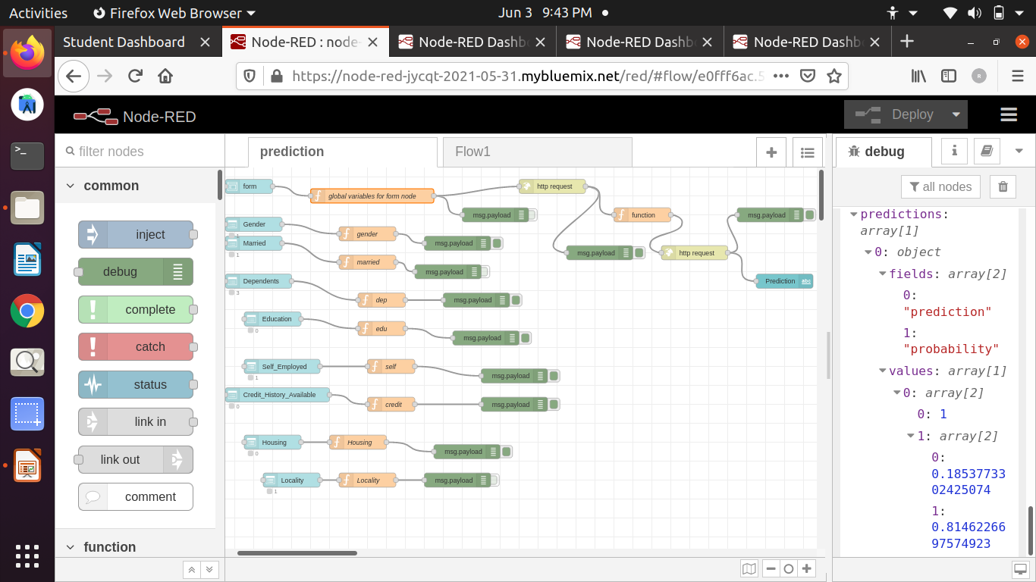
We are Building an Application using Node-RED which takes inputs from the user and
showcases the predicUI.

Slide 7
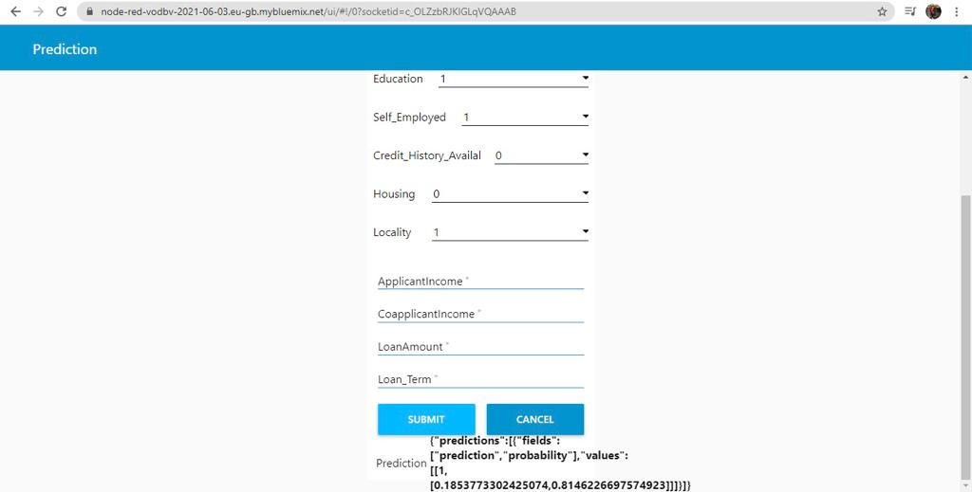
The Financial Risk Prediction is show cased on Ui as follows

Slide 8
THANK YOU

