Slide 1

PREDICTIVE MAINTAINCE OF AIRLINES
USING IBM WATSON STUDIO
PROJECT BY:
G EESHWAR 19R11A0509
G JHANSI LAKSHMI 19R11A0510
G DINESH 19R11A0511
G SREEMANT 19R11A0512
G BHANU PRAKASH 19R11A0513

Slide 2
INTRO
The airport is currently carrying scale increased year by year, the traditional method of airport resource allocation has been unable to adapt to the requirements of the operation of the airport. Dynamic allocation and scheduling of airport terminal passenger service resources are one of the most effective ways to improve passenger service levels and operational efficiency within the terminal, while the relatively accurate passenger traffic forecasting is the prerequisite for dynamic allocation and scheduling.

Slide 3
PROJECT FLOW
DATA
COLLECTION
DATA
PREPROCESSING
MODEL BUILDING
APPLICATION
BUILDING
TRAIN MODEL
IN IBM

Slide 4
DATA COLLECTION
Collect the dataset or create the dataset
Artificial Intelligence is a data hunger technology, it depends heavily on data, without data, it is impossible for a machine to learn. It is the most crucial aspect that makes algorithm training possible.

Slide 5
DATA PREPROCESSING
In this milestone, we will be pre-processing the dataset that is collected.
Import the Libraries
Importing the dataset
Checking for null values
Split into train and test sets
Normalize the train test data.

Slide 6
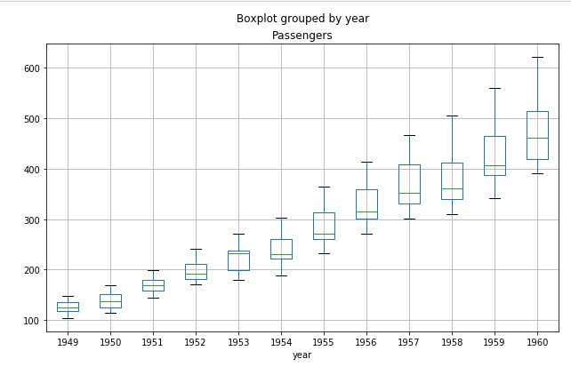
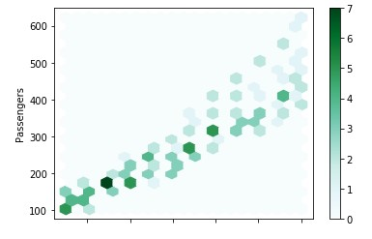
DATA VISUALIZATION
Data visualization is the technique to present the data in a pictorial or graphical format. It enables stakeholders and decision makers to analyze data visually.

Slide 7
Feature Scaling
Feature scaling is a method used to normalize the range of independent variables or features of data. It is common to scale data prior to fitting a machine learning model. If there are inputs variables that have very large values relative to the other input variables. At that time there is a need to normalize the data. There are many different scaling techniques there, like, Standard scaler, MinMax scaler, and Robust scaler etc.
Robust Scaler : Here using Robust Scaler normalizing the inputs or independent variables are normalized and stored in other variable called data_training.

Slide 8
MODEL BUILDING
Model building involves the following sequence of steps :
Import the model building Libraries
Initializing the model
Adding LSTM Layer
Adding Output Layer
Configure the Learning Process
Training and testing the model
Optimize the Model
Save the Model

Slide 9
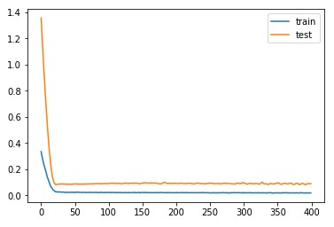
TRAIN AND TESTING OF MODEL
When you are building a model and you want to train it, you obviously have a dataset. But after training, we have to test the model with test data. For this, you require a dataset which is different from the training set which was used earlier. In such cases, the solution is to split the dataset into two sets, one for training and the other for testing.
In this 90% data considering as training and 10% data is testing and assigning it to a variable train and test.
Training begins by calling the fit() method.

Slide 10
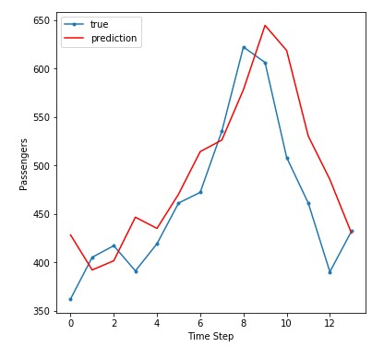
Evaluating The Model Performance
The model is to be saved for future purpose. This saved model can be integrated with an android application or web application in order to get prediction.
Evaluation of the model can be done by different techniques like, here evaluated the model using RMSE.

Slide 11
Application Building
HTML page
Flask application is build using spyder IDLE.
a web application using the basics of “HTML, CSS, Bootstrap, flask framework and python”
Python code
Importing Libraries Routing to the HTML Page
Showcasing prediction on UI Main Function is used to run the application in localhost.

Slide 12

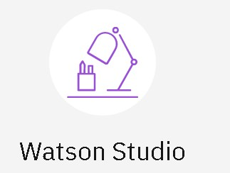
Train The Model On IBM
Register For IBM Cloud
Create Watson studio service
Create Machine Learning service
Train The ML Model On IBM
Integrate Flask With Scoring End Point

Slide 13
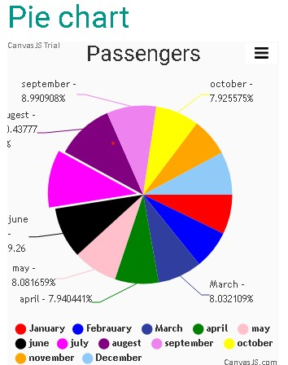
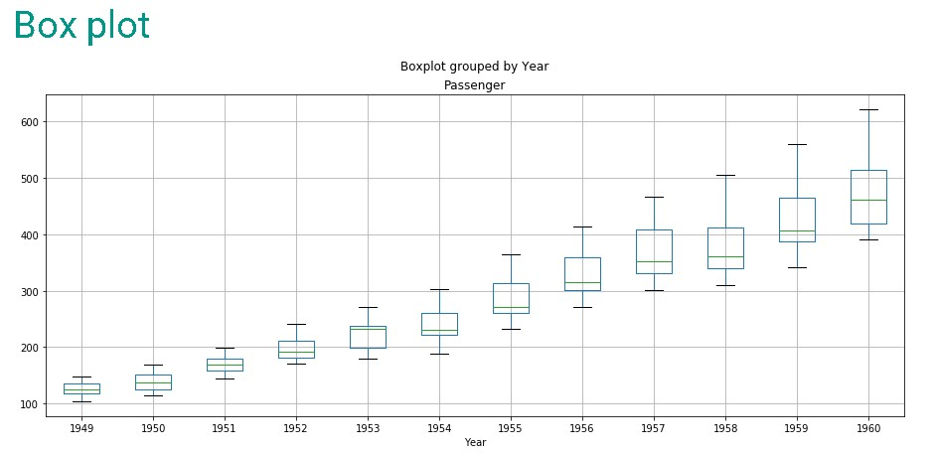
OUTPUT

Slide 14
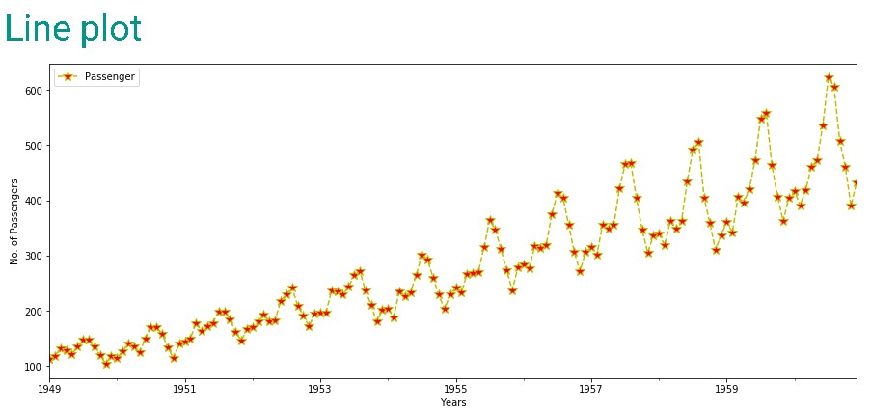
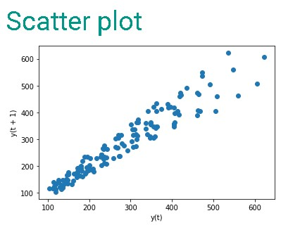
OUTPUT

