Slide 1
Univariate Time Series Analysis For Weather Prediction Using Prophet Library
Team Members: (CSE-05)
T. Manvitha
T. Lakshmi Prasanna
V. Likitha
N. Kirthana
V. Nithin

Slide 2
The aim of our project is to create an application for forecasting the weather by using Facebook Prophet Library.

Slide 3
INTRODUCTION:
Time series analysis is the use of statistical methods to analyze time series data and extract meaningful statistics and characteristics about the data. Time series analysis helps identify trends, cycles, and seasonal variances to aid in the forecasting of a future event. Factors relevant to time series analysis include stationarity, seasonality and autocorrelation. Time series forecasting uses information regarding historical values and associated patterns to predict future activity.
There are many models present for the predictive analysis of time series like Machine learning ARIMA (Auto-Regressive Integrated Moving Average model), Auto-Regressive model, Exponential Smoothing, LSTM (Long Short Term Memory), etc. These models require the data to be fed and with certain tweaking and fine-tuning they help us to make predictions. But, Facebook Prophet library is a third party library that could perform all the fine-tuning part within and we just need to feed the model .

Slide 4
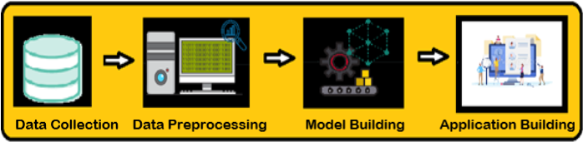
To accomplish the application, we have to complete the tasks listed below :
Data Collection
Data Preprocessing
Model Building
Application Building

Slide 5
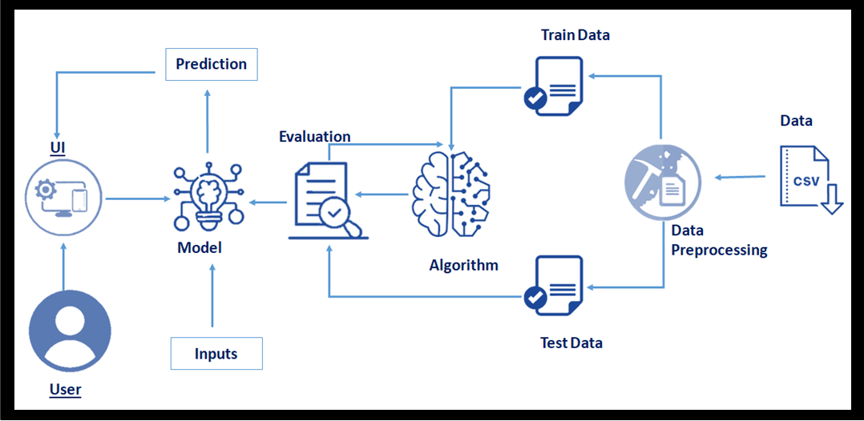
Technical Architecture

Slide 6

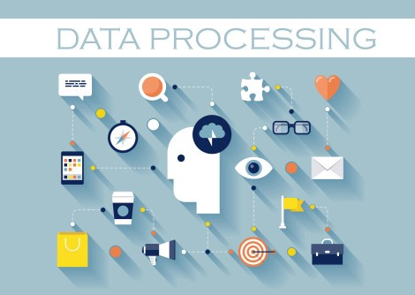
Data Collection : Collect the dataset or create the dataset Data Preprocessing : Importing the required libraries Importing the dataset Analyse the data Resampling the dataset Pre processing the data Taking care of Missing Data Prophet Library naming convention Data visualization

Slide 7
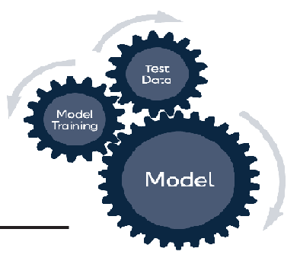

Model Building : Model fitting: Making Future Predictions Obtaining the Forecasts Plotting the Forecasts Plotting the Forecast Components Cross Validation Model Evaluation Saving the model Application Building : Create an HTML file Build Python code

Slide 8
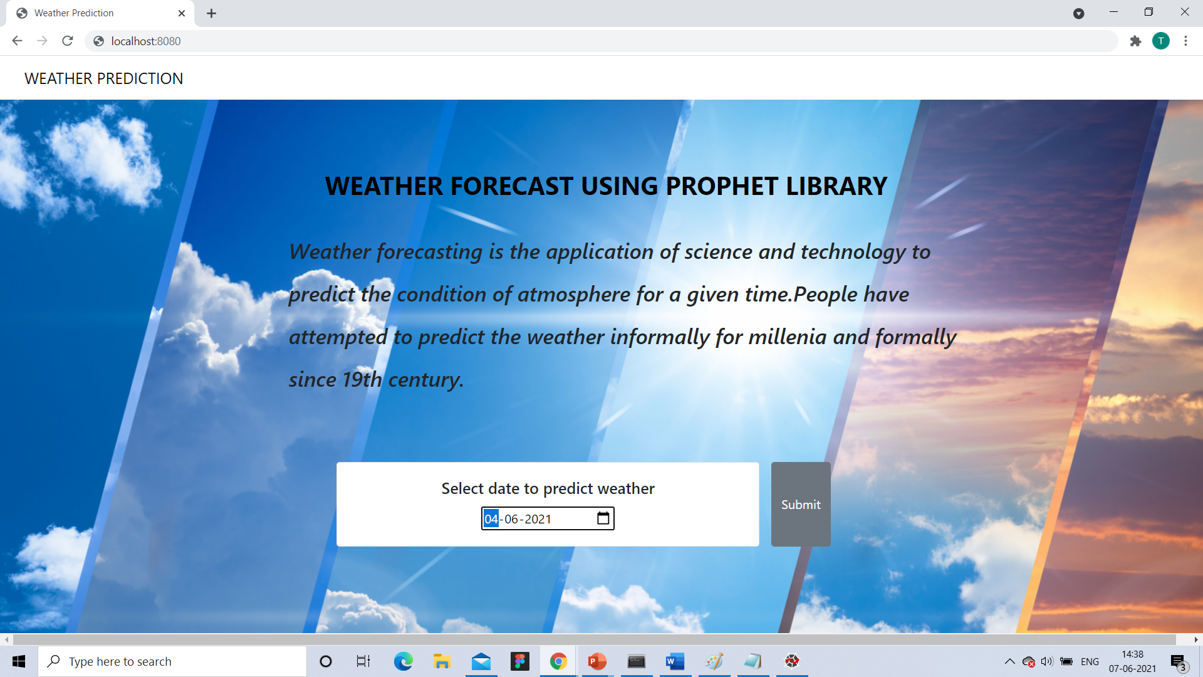
WEBPAGE AND OUTPUT :

Slide 9
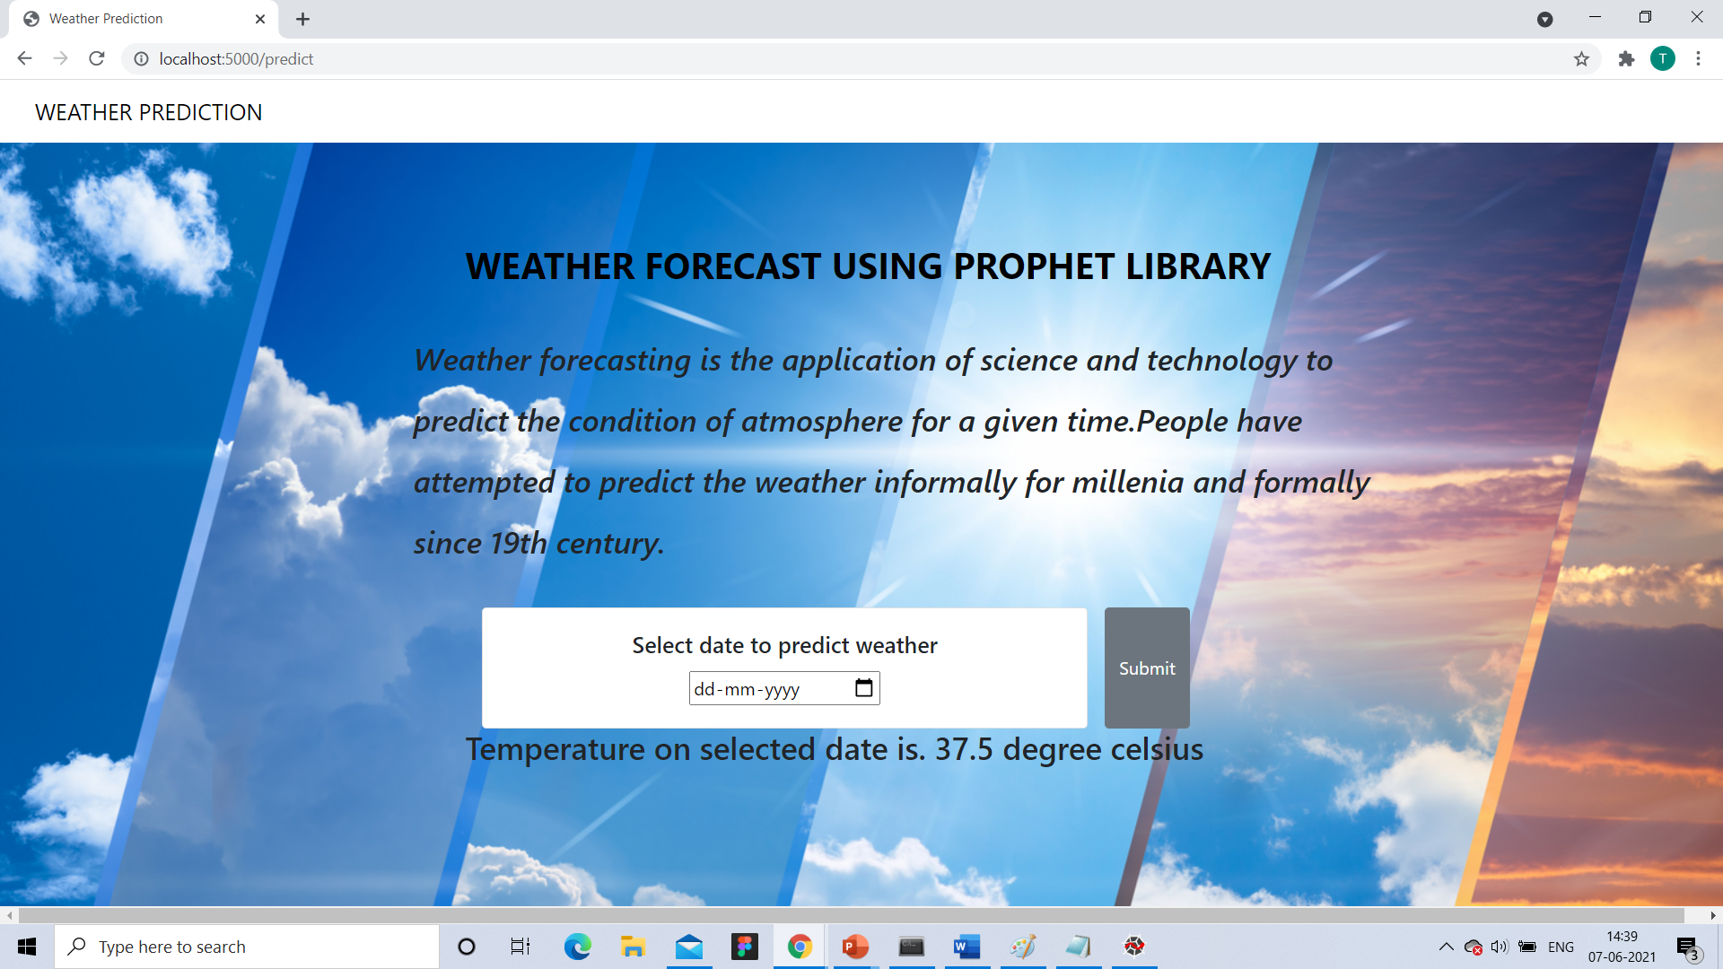
The predicted temperature of the given data is shown as output.

Slide 10
THANK YOU!!

