Slide 1
Predicting compressive strength of concrete
Cse Team – 08
Team Members
19R11A0570
19R11A0568
19R11A0571
19R11A0572
19R11A0567

Slide 2
About Project
Concrete is a material used in construction that has great versatility and which is used across the globe. Concrete has several advantages, including good compressive strength, durability, workability and low cost
The traditional way to know the strength of concrete will take about 28 days which is very time consuming.
It is important to wait 28 days to ensure the quality control of the process,although it is very long
This project aims to build a Machine Learning model to predict the compressive strength of concrete to greatly speed up prediction with high accuracy
A web application is build where the user can enter the required parameters and see the predicted results on Web Application.

Slide 3
Project Flow
Data collection
Data Pre-processing
Model Building
Application Building

Slide 4
Data Collection
Collect the dataset or create the data set
ML depends heavily on data, without data, it is impossible for a machine to learn.
The data set used to train the model for performing various actions.
In this Project we create a dataset which contains all the things we add in kg(m^3)
They are – Age, Fine Aggregate, Coarse Aggregate, Superplasticizer, Water, Fly Ash, Blast Furnace slag, Cement

Slide 5
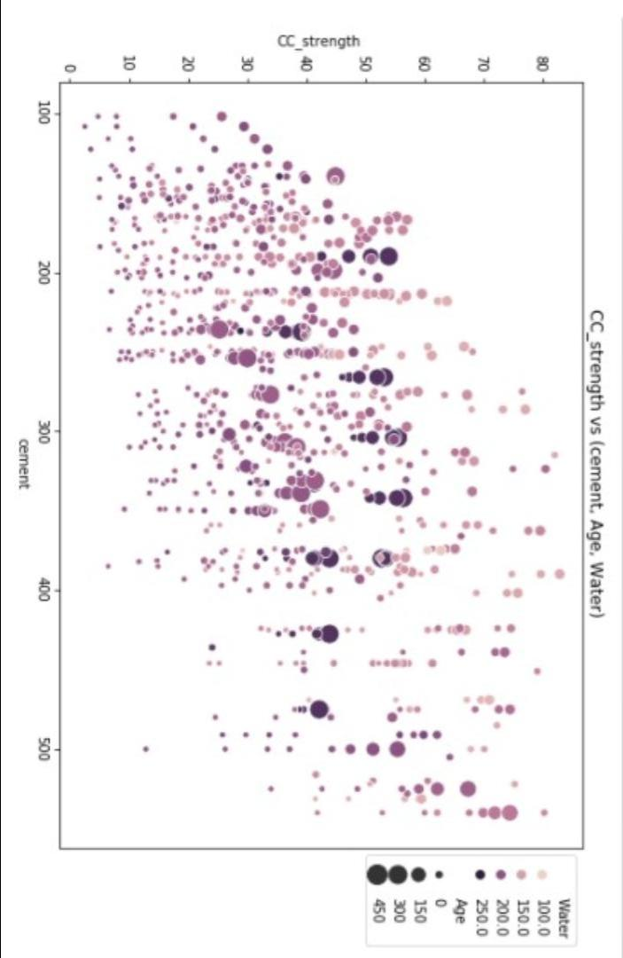
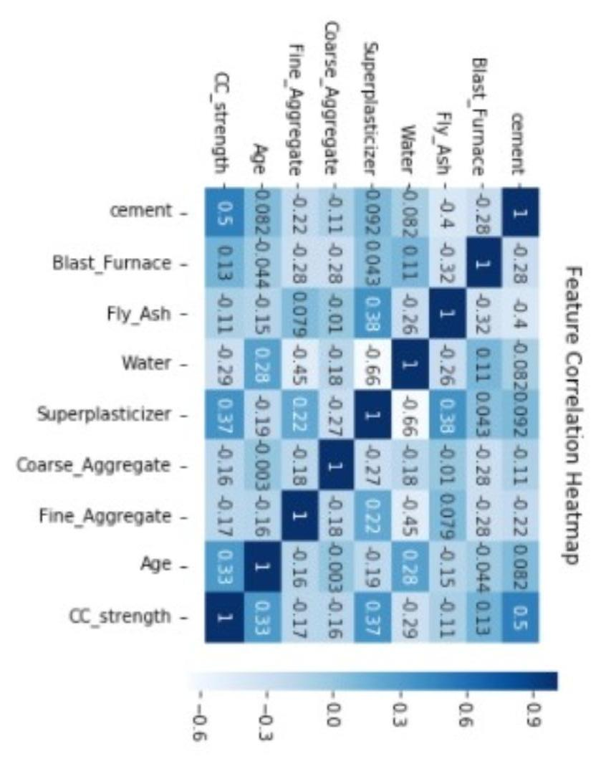
Data Pre-processing
We have to import all the necessary libraries
We should link and read the data set
We have to process the data and should handle the missing data
Label encoding and data visualization should be done as shown
Should split the dataset into Dependent and Independent variable
At last splitting data into train and test

Slide 6
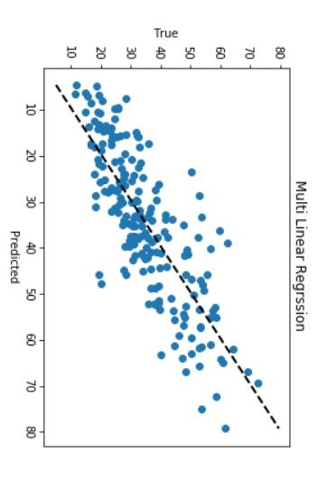
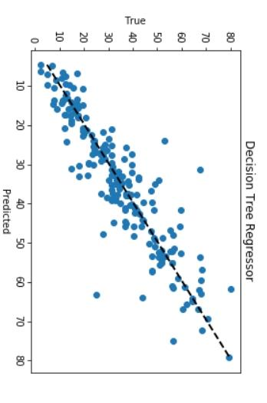
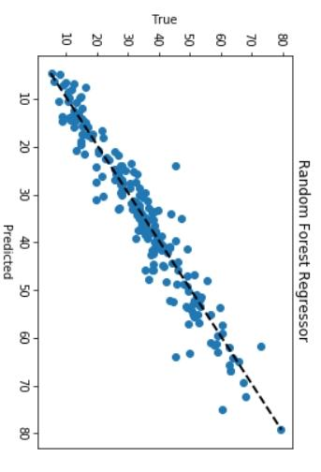
Model Building
Here we have to tarin and test the model
Gradient boosting trains many models in a gradual, additive and sequential manner.
Model evaluation is done
At last we have to save the model

Slide 7
Application Building
We should create an Html file
Build an python code
Run the app
We should also train the model on IBM
For this we should 1st register IBM Cloud
Train the ML model on IBM

Slide 8

Home Page

Slide 9

Page where you enter values to check strength

Slide 10

Output

Slide 11
Thank you

