Slide 1
Predictive Maintenance Of Generators
Gudlavalleru Engineering College
Presented by,
T Uamesh
T Omasree
S Naga Phani
T Priyanka

Slide 2
Contents
Introduction
Existing Problem
Tools used
Working
Advantages
Disadvantages
Conclusion
Applications
Reference

Slide 3
Introduction
Predictive maintenance (PDM) relies on condition-monitoring equipment to assess the performance of assets in real-time. By combining condition-based diagnostics with predictive formulas and with a little help from the Internet of Things (IoT), PDM creates an accurate tool for collecting and analyzing asset data.

Slide 4
EXISTING PROBLEMS:
Detect emerging issues, simplify root cause analysis, reduce warranty risk. Use machine learning to identify issues for improved quality, reduced financial impact. Machine Equipment Failure. Service Pack Optimization. IOT Data Analytics. Manufacturing Analytics.

Slide 5
HARDWARE/SOFTWARE DESIGNING
In this we have used python code
Nodered platform to store data
Mit APP inventor to create mobile application

Slide 6
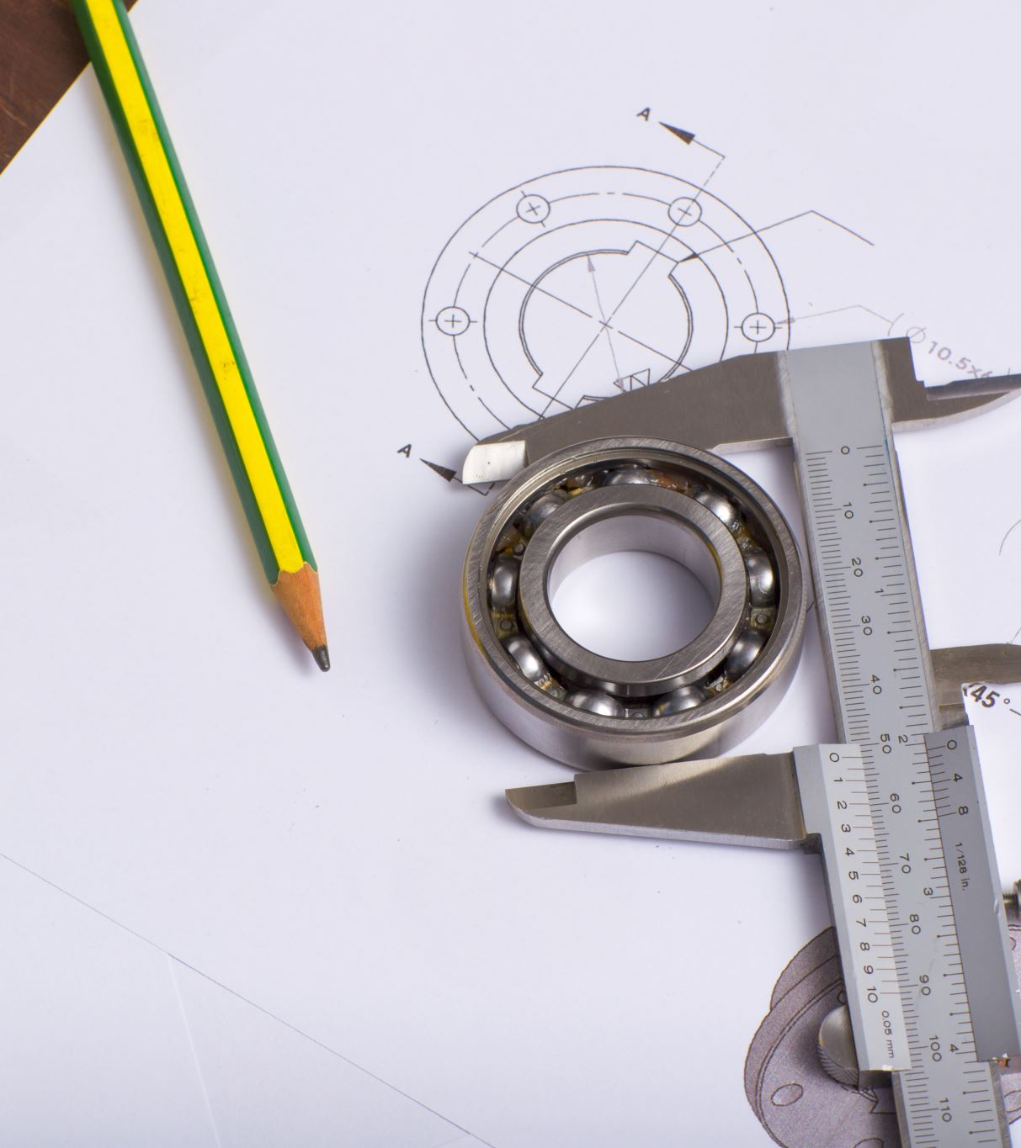
Working

Slide 7
Advantages
Reduction in maintenance costs
Reduction in machine failures
Reduced downtime for repairs
Reduced stock of spare parts
Increased service life of parts
Increased production
Improved operator safety.
Less risk factor- Because the equipment and your building are being regularly checked, they are at less risk to breaking down without notice. Therefore, creating a safer working environment for employees.
Follows a schedule- By following a schedule, you are able to keep to a budget while maintaining your building. Also, you will be able to keep track of all your equipment and pin point times when you will need to replace your equipment.

Slide 8
Disadvantages
Data can be misinterpreted, leading to false maintenance requests,
It's costly to establish a complete IoT system with sensors, transmission costs and analysis,
Predictive analysis may not take contextual information into account, such as equipment age or weather.
More money upfront- When initially starting a preventative maintenance plan, it will cost you more to regularly maintain equipment and the building, than it would be if you waited for things to simply break down.
Over maintenance- Because there is a regular plan, sometimes items may not need to be checked as often as planned. If this is the case, you can change your maintenance plan to checking the specific equipment or areas less often, while still maintaining a schedule.

Slide 9
Applications
Monitoring generators
1
Alerting system
2

Slide 10
Conclusion:
Generators should be maintained and serviced regularly, for this IoT will keep on tracking the crucial parameters while the generator is working.
All the monitored parameters are stored in the node red on which we implement machine learning algorithms to predict the failures.
The data is visualized in the Web App

Slide 11

References
https://github.com/gnaneshwarbandari/IOT/blob/main/ibm_code.py
https://flows.nodered.org/node/node-red-dashboard

Slide 12
Thank you

