Slide 1

COVID'19 Analysis Using IBM Cognos Dashboard
Internship Project
This Photo by Unknown author is licensed under CC BY-SA.

Slide 2

OUR TEAM
NAMES ROLL NUMBERS
DEEKSHITA 18481A1201
VARA PRASAD 18481A1235
SARANYA 18481A1248
GOWSIYA BEGUM 19485A1202
This Photo by Unknown author is licensed under CC BY.

Slide 3

OVERVIEW
Introduction
Solution Requirements
Project Objectives
Project Flow
Working With The Dataset
Data Visualization Charts
Creating The Dashboard
Export The Analytics

Slide 4

Introduction
Coronaviruses are a large family of viruses which may cause illness in animals or humans. In humans, several coronaviruses are known to cause respiratory infections ranging from the common cold to more severe diseases such as Middle East Respiratory Syndrome (MERS) and Severe Acute Respiratory Syndrome (SARS). The most recently discovered coronavirus causes coronavirus disease COVID-19 - World Health Organization.
The number of new cases are increasing day by day around the world. This dataset has information from the states and union territories of India at daily level.
As per this project we will be analyzing some important visualizations, creating a dashboard and by going through these we will get most of the insights of COVID 19 in India.
This Photo by Unknown author is licensed under CC BY-NC.

Slide 5
Solution Requirements
IBM
Cognos
Analytics

Slide 6

Project Objectives
By the end of this project, you will:
Know fundamental concepts and can work on IBM Cognos Analytics.
Gain a broad understanding of plotting different graphs.
Able to create meaningful dashboards
This Photo by Unknown author is licensed under CC BY.

Slide 7
Project Flow
Users create multiple analysis graphs/charts.
Using the analyzed chart creation of Dashboard is done.
Saving and Visualizing the final dashboard in the IBM Cognos Analytics.

Slide 8

Working With The Dataset
Understand The Dataset
Loading The Dataset
This Photo by Unknown author is licensed under CC BY.

Slide 9

Data Visualization Charts
Using the COVID 19 India dataset, we plan to create various graphs and charts to highlight the insights and visualizations.
Confirmed for State/UnionTerritory regions
Percentage Of Confirmed Cases Of Top 10 Affected States
Top 10 State Wise No Of Confirmed Case
Statistics Of Chosen State(Selective State)
Monthly Analysis

Slide 10
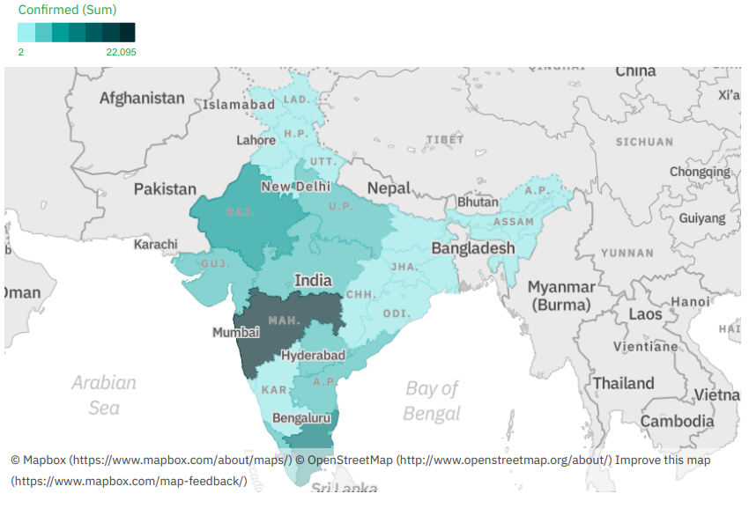
Confirmed for State/UnionTerritory regions

Slide 11
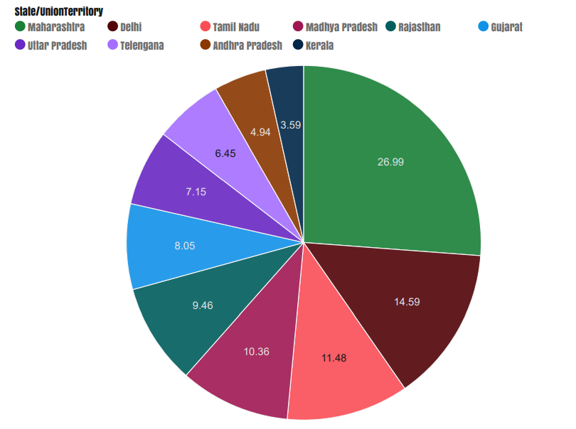
Percentage Of Confirmed Cases Of Top 10 Affected States

Slide 12
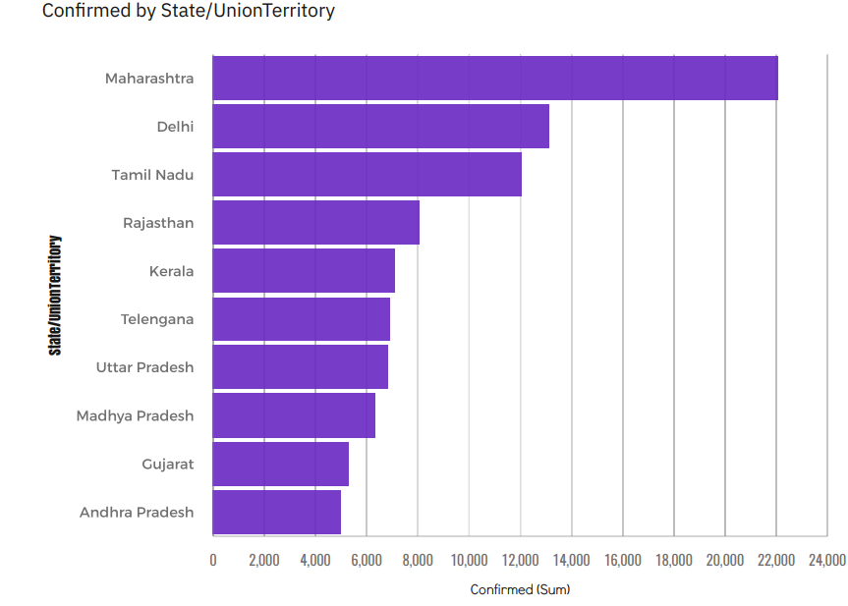
Top 10 State Wise No Of Confirmed Case

Slide 13
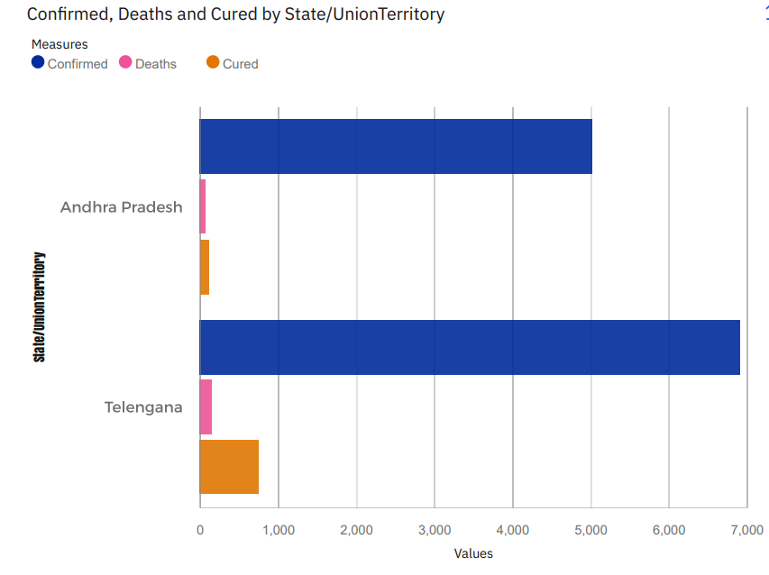
Statistics Of Chosen State(Selective State)

Slide 14
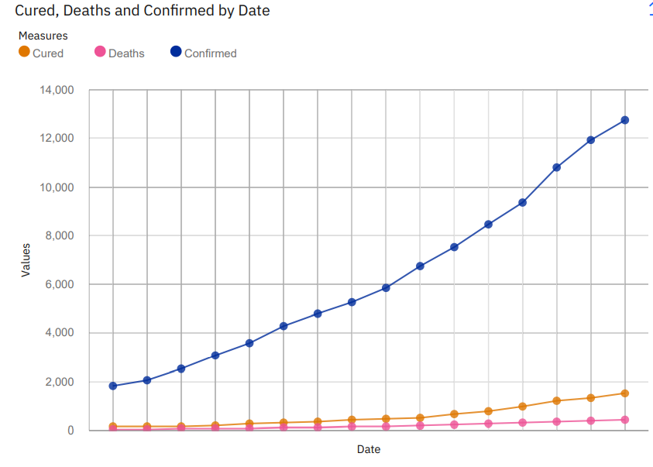
Monthly Analysis

Slide 15

Creating The Dashboard
Once you’ve created views on different tabs in Cognos analytics, you can pull them into a dashboard.

Slide 16


